Slide 1

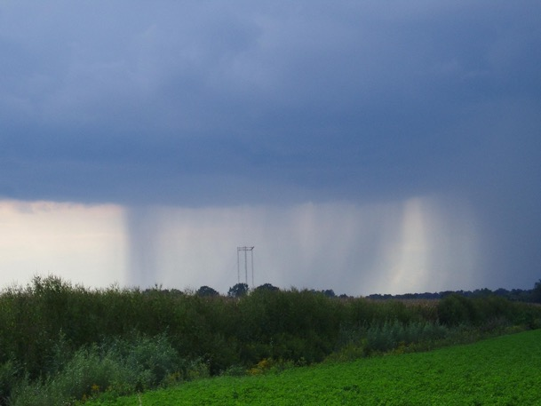
Protocol Training Slides
Precipitation (Rain)

Slide 2
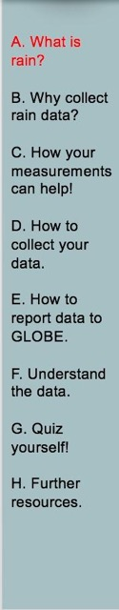
Overview and Learning Objectives
Overview
This module:
Describes the different types of precipitation
Provides step-by-step protocol instructions for collecting rainfall
Learning Objectives
After completing this module, you will be able to:
List the different types of precipitation
Describe how, where, and when to collect each type
Measure the amount of rain that has collected in your rain gauge in metric units
Measure the pH of the rain (optional)
Prepare the rain gauge to collect more rain
Upload data to GLOBE
Visualize data using the GLOBE Visualization System and formulate your own questions about weather
Estimated time to complete this module: 1 hour

Slide 3
Overview and Learning Objectives
Materials for Precipitation (Rainfall) Measurement
Integrated 1-Day Data Sheet OR instructions for using GLOBE Observer to record data can be found in the Data Entry section
Installed rain gauge
Materials for Precipitation pH (Optional)
Integrated 1-Day Data Sheet OR instructions for using GLOBE Observer to record data can be found in the Data Entry section
3 clean 100-mL beakers or cups
Finely ground “table” salt (crystals less than 0.5 mm in diameter)
Covered sample jar containing at least 30 mL of rain
Salt card consisting of 4-mm and 5-mm circles drawn on a card or piece of paper
Protective gloves
Stirring rod or spoon
Pen or pencil
pH paper or pH meter
  If using pH meter: pH buffers 4, 7, and 10
Distilled water for cleaning the rain gauge

Slide 4
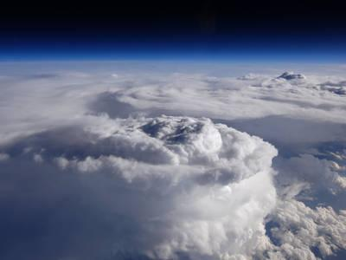
The Atmosphere
Extremely thin sheet of air extending about 300 miles from Earth’s surface to edge of space.
Its composition has changed over time.
The water in the atmosphere plays an essential role in determining the weather.
Temperature and precipitation in a given region vary over time when studying climate change.
When we study the history of Earth’s climate, we notice that temperature and precipitation in any given region vary over time and that the composition of the atmosphere has changed.
Storm Cell. Image: NASA

Slide 5
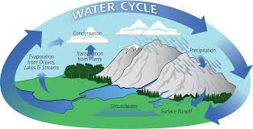
The Hydrologic Cycle
Water evaporates from the oceans and land into the atmosphere, falls back to the surface as precipitation, and returns to the sea on the surface in rivers and streams, and underground.
Through this process, energy and chemicals are transported from place to place shaping our climate, giving us storms, and putting salt in our oceans and seas.
Image: NASA GPM

Slide 6
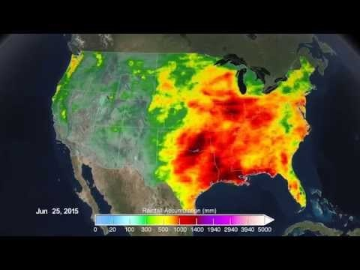
Rainfall across America, 2015
Video, Rainfall across America, 2015 (https://www.youtube.com/watch?v=7UT8B3Ix-HU&feature=youtu.be)

Slide 7
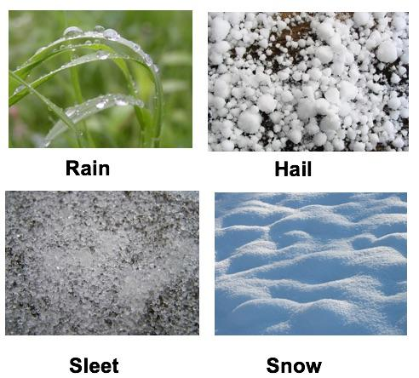
Precipitation Types
Aerosols
Air Temperature
Albedo
Barometric Pressure
Clouds
Precipitation
Relative Humidity
Surface Ozone
Surface Temperature
Water Vapor
Wind
Image: Wikipedia Commons

Slide 8
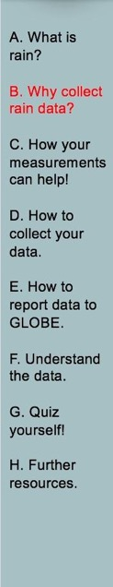
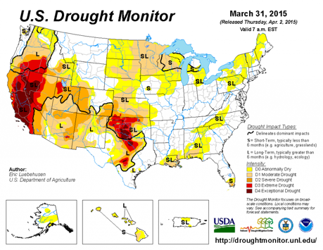
The importance of recording rainfall 1
Water is essential to life on Earth.
Precipitation varies greatly from place to place.
Measuring and mapping precipitation helps us understand weather, climate and ecological systems.
Precipitation affects our daily life.
Source: National Drought Mitigation Center, University of Nebraska

Slide 9
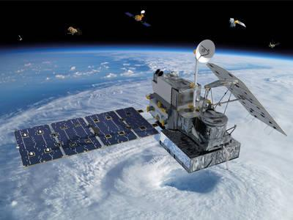
The importance of recording rainfall 2
Earth based measurements of precipitation assist the Global Precipitation Measurement program by providing in situ data.
GPM aids in understanding water-borne diseases, weather forecasting, and freshwater availability.
Knowing how much precipitation falls and where it falls helps to understand weather and climate.
Global Precipitation Measurement Core Observatory
Image: NASA
Your observations are valuable contributions to the scientific community and may be used by educators, students, researchers, and the general public to increase environmental awareness and STEM literacy, as well as advance Earth system science.

Slide 10
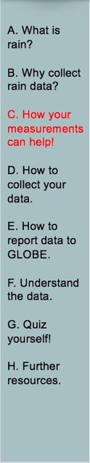
YOUR measurements can help NASA scientists understand and predict:
The seasonal variation in precipitation
Wet or dry years for our location
The pH of rainfall and how it varies

Slide 11
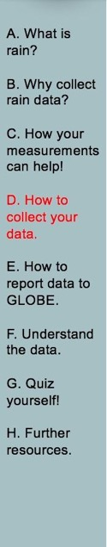
What I Need to Collect Rain Data
Instruments | Large Capacity Metric Rain Gauge, Post for the Rain Gauge (0.6 m with angled top in open area; 1.5 m with angled top in developed area.)
Data Sheet | Liquid Precipitation Data Sheet or Atmosphere All Protocols Data Sheet
When | Preferably within one hour of local solar noon; OK at other times
Where | A good observation site (See Documenting your atmosphere study site)
Other | Log book for data collection; Computer with internet connection to enter data

Slide 12
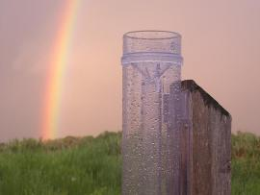
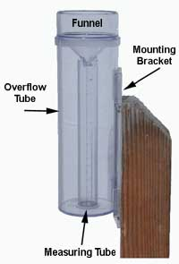
Setting Up a Rain Gauge
In open areas, make sure the distance between the gauge and any obstructions is equal to twice the height of the obstruction. In developed areas, put it as far from obstacles as they are high.
Place the gauge in natural earth or short grass that is unpaved with concrete or asphalt. Avoid placing the gauge near artificial heat sources like air conditioning units or sources of water, like sprinklers.
Make sure the gauge top is 10 cm higher than the top of the mounting post. The recommended height for the gauge is typically between 2 and 5 feet above ground level.
Installed Rain Gauge

Slide 13
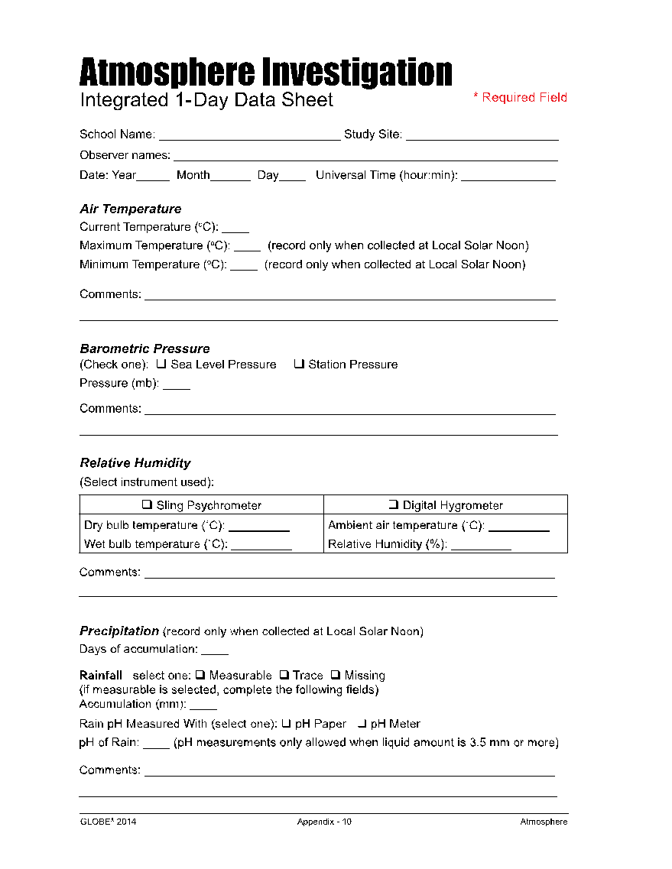
Data Sheet
Enter the data on the Integrated 1-Day Data Sheet
Be sure to fill out the top: School Name, Study Site, Observer Names, Date and Time (local or UTC)
Atmosphere Investigation Integrated 1-Day Data Sheet

Slide 14
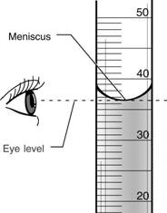
Collecting Data-Reading the Meniscus
Reminder: Use metric units when reporting and recording observations.
Take latitude and longitude coordinates with your GPS of your site the first time you enter data. Refer to GPS protocol.
Read the level of water in the rain gauge by reading the bottom of meniscus, ensuring your eyes are level with the water.
Record the rainfall amount to the nearest 0.1 of a millimeter.
  If no water in gauge, report 0.0 mm.
  If less than 0.5 mm, record “T” for trace.
  If you spill any water before measuring the rain, record “M” for missing as the amount. If you have spilled only a little, record the amount not spilled as metadata.)
An observation of “zero” is just as important as an observation of precipitation.
Check the rain gauge daily even if it did not rain in case debris gets into the gauge.
Reading the Rain Gauge

Slide 15
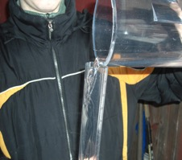
Collecting Data-Water in Overflow Tube-1
Remove the measuring tube from the overflow tube.
Read the level of water in the measuring tube holding it so that your eyes are level with the meniscus.
Record the amount to the nearest 0.1 millimeter.
Pour the water from the measuring tube out (into a covered container if measuring pH).
Pour water from the overflow tube into the measuring tube.
Repeat steps 2) through 5) until the overflow tube is empty.
Picture by Kevin Czajkowski

Slide 16
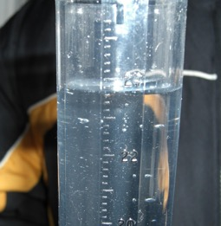
Collecting Data-Water in Overflow Tube-2
Add your measurements and record the sum as the rainfall amount.
Record the number of days rain has accumulated in the gauge. (The number of days since the rain gauge was last checked and emptied.)
Perform the Optional Precipitation pH Lab Guide (depending on which type of pH measuring device and salt you are using).
Dry the rain gauge and remount it on the post.
You are now ready to enter your data on the GLOBE website.
Picture by Kevin Czajkowski

Slide 17
What I need to Collect pH Data
Materials | Finely ground “table” salt, salt card with 4mm and 5mm circles, stirring rod or spoon, pH paper or meter, 3 clean 100 ml beakers or cups, covered sample jar with at least 30ml of rain or melted snow, latex gloves, distilled water in wash bottle.
Data Sheet | Liquid Precipitation Data Sheet Atmosphere All Protocols Data Sheet.
When | After observing snow or rain.
Where | A good observation site (See Documenting your atmosphere study site).
Other | Log book for data collection; computer with internet connection to enter data.

Slide 18
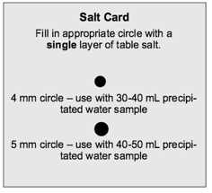
Testing Precipitation for pH
Most precipitation has low conductivity and pH paper does not perform well for low conductivity samples. Adding salt crystals to the rainwater will increase the conductivity to an appropriate level. You can use either large salt crystals (0.5 mm to 2.0 mm in diameter) or finely ground table salt (with crystals less than 0.5 mm in diameter).
Pour a 50 mL (or less, if you do not have a 50 mL sample jar) sample of rain from your sample jar into a clean beaker. You must have at least 30 mL of sample to measure pH.
Put on protective gloves.
Sprinkle salt onto the appropriate circle on your salt card. If your rain or snow sample is 40-50 ml, use the 5 mm circle on the salt circle. If your rain or melted snow sample is 30-40 ml, use the 4mm circle.

Slide 19
pH Testing, Continued.
4) Fill the appropriate circle with a single layer of salt. Remove any excess salt from the salt card.
5) Pour the salt covering the circle on your salt card into the beaker.
6) Stir the beaker’s contents thoroughly with the stirring rod or spoon until the salt is dissolved.

Slide 20
pH Testing, Continued.
Follow the instructions that came with the pH paper to measure the pH of the sample. Record the pH value on your Data Sheet.
If you have at least 30 ml of rain or snow left in your sample jar, then repeat steps 1-7. Otherwise, repeat step 7. Continue until you have collected a total of 3 pH measurements.
Calculate the average of the 3 pH measurements and record on your Data Sheet.
Check to make sure that each measurement is within 1.0 pH unit of the average. If they are not, then repeat the measurements. If your measurements are still not within 1.0 pH unit of the average, test your pH meter with a standard or calibrate your pH meter.
Discard used pH paper in a waste container and rinse the beakers and sample jar.

Slide 21
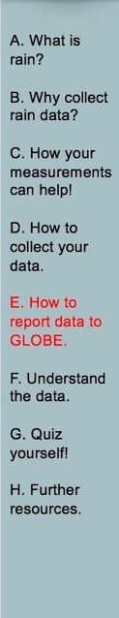

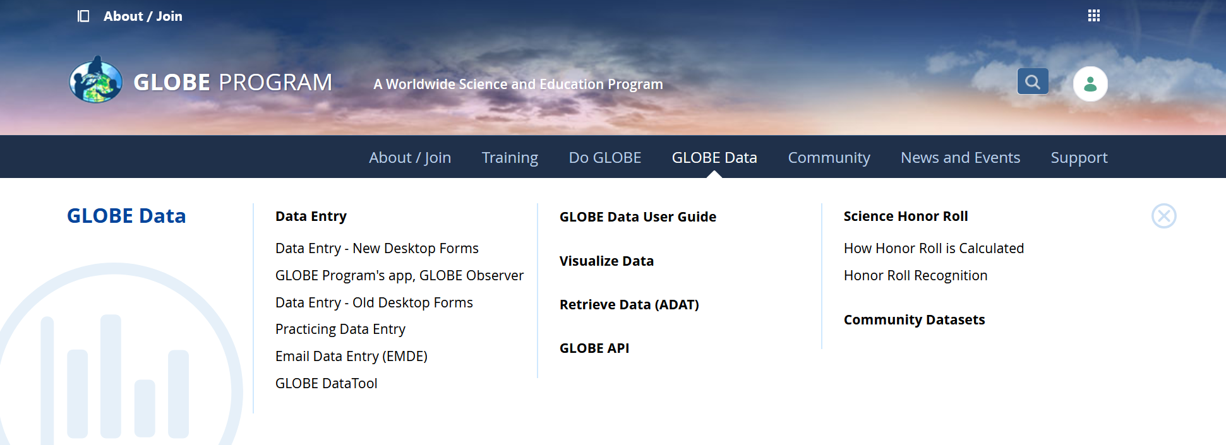
Entering Precipitation Data in the GLOBE Observer Data Entry System
Two Options for Uploading Data:
These methods all allow users to submit environmental data – collected at defined sites, according to protocol, and using approved instrumentation – for entry into the official GLOBE science database.
Download the GLOBE Observer mobile app from the App Store.
Data Entry: Visit globe.gov, click on the “GLOBE Data” tab, then underneath “Data Entry” click on “Data Entry – New Desktop Forms”.
Note 1: You will need a GLOBE teacher, trainer, or scientist account to submit GLOBE data.
Note 2: It may take some time after you enter your data for it to appear in the GLOBE data visualization system.

Slide 22

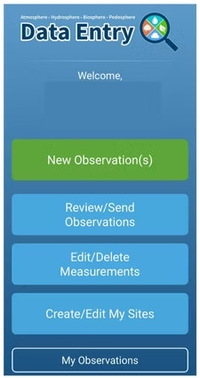
Entering Precipitation Data – Step 1&2
The steps below will walk you through entering your Atmosphere Study Site Information in the GLOBE Observer App, which you can access using your GLOBE or GLOBE Observer login.
2. Click "Create/Edit My Sites"
1. Click “Data Entry”

Slide 23
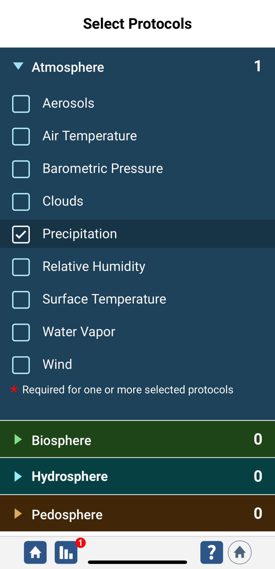
Entering Precipitation Data – Step 3
3. Click on the arrow next to "Atmosphere" and select “Precipitation“. The other necessary protocols will be automatically selected.

Slide 24
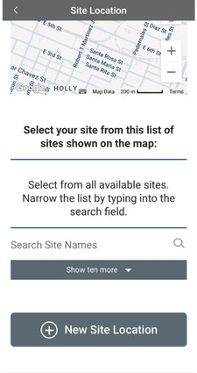
Entering Precipitation Data – Step 4
4. At the bottom of the screen, click “Continue”. When prompted, enter site location details (latitude, longitude, and elevation). Choose an existing site or identify a new site by clicking “+ New Site Location”

Slide 25
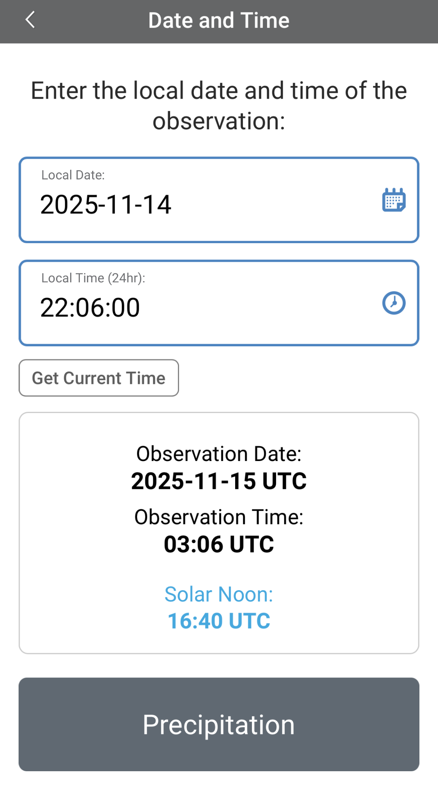
Entering Precipitation Data – Step 5
5. Check to see if the “Date and Time” are correct, if it is not, click
“Get Current Time” to update it. Then click “Precipitation” to move on

Slide 26
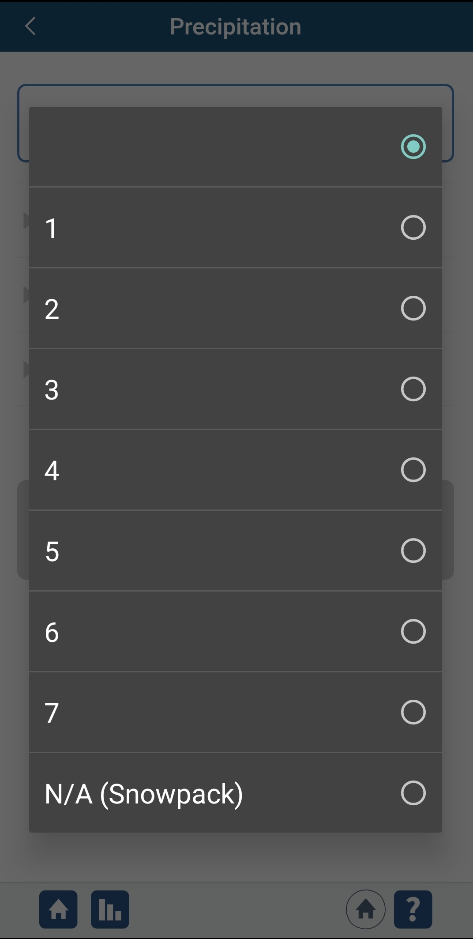
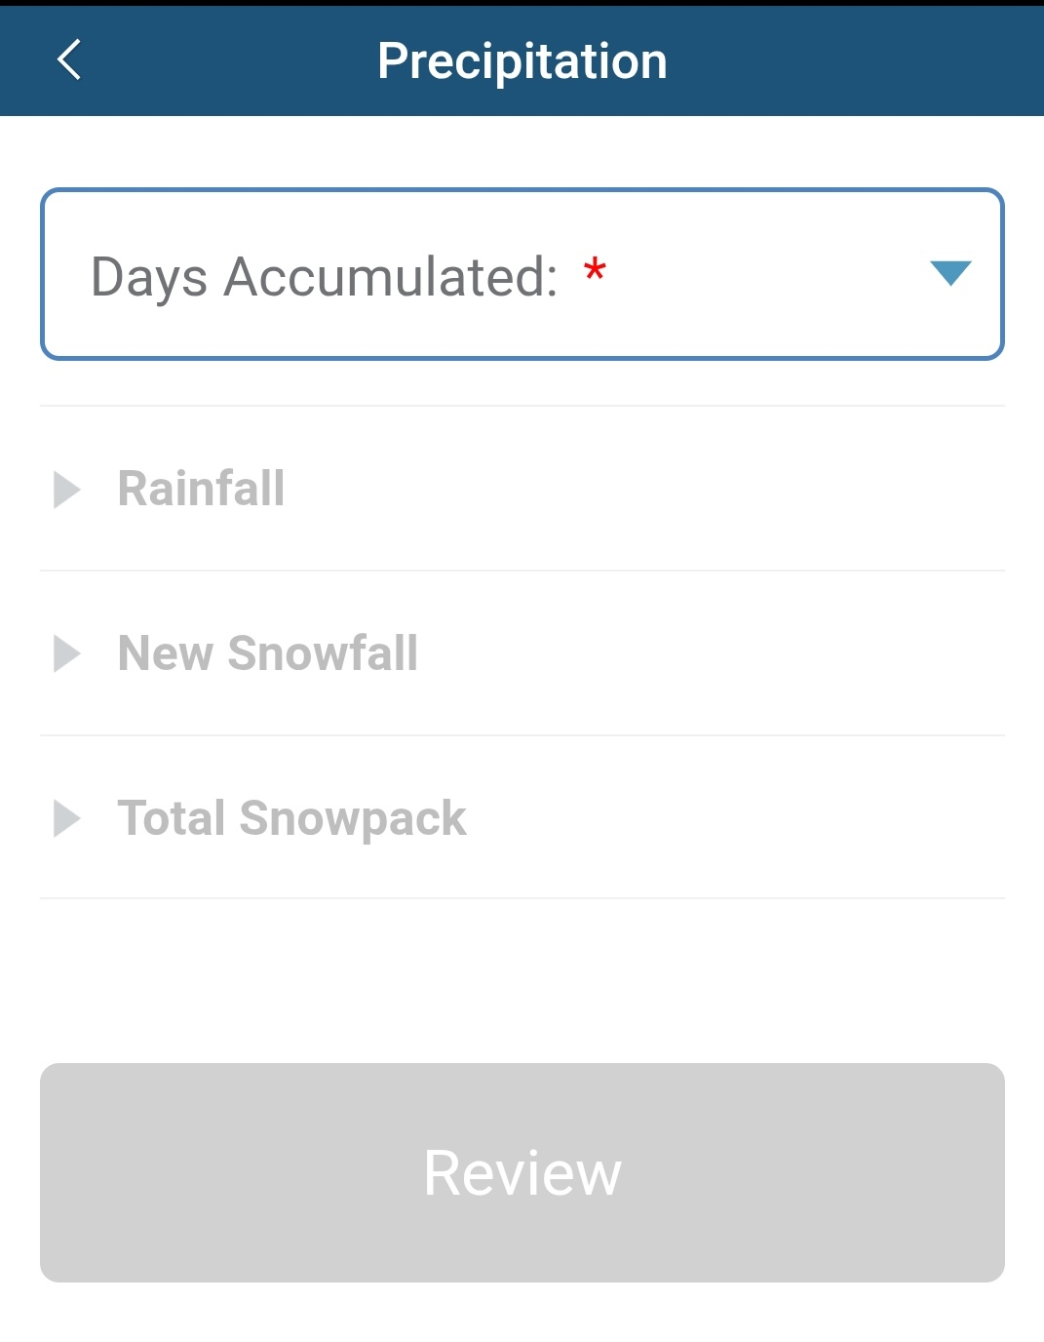
Entering Precipitation Data – Step 6
6. Select the number of days of rainfall accumulation.

Slide 27
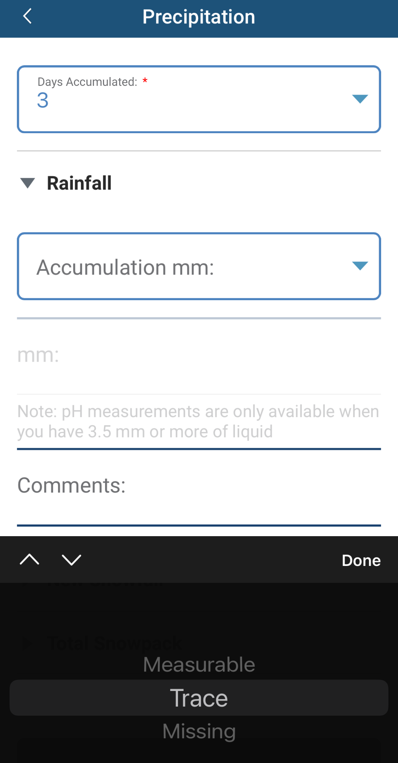
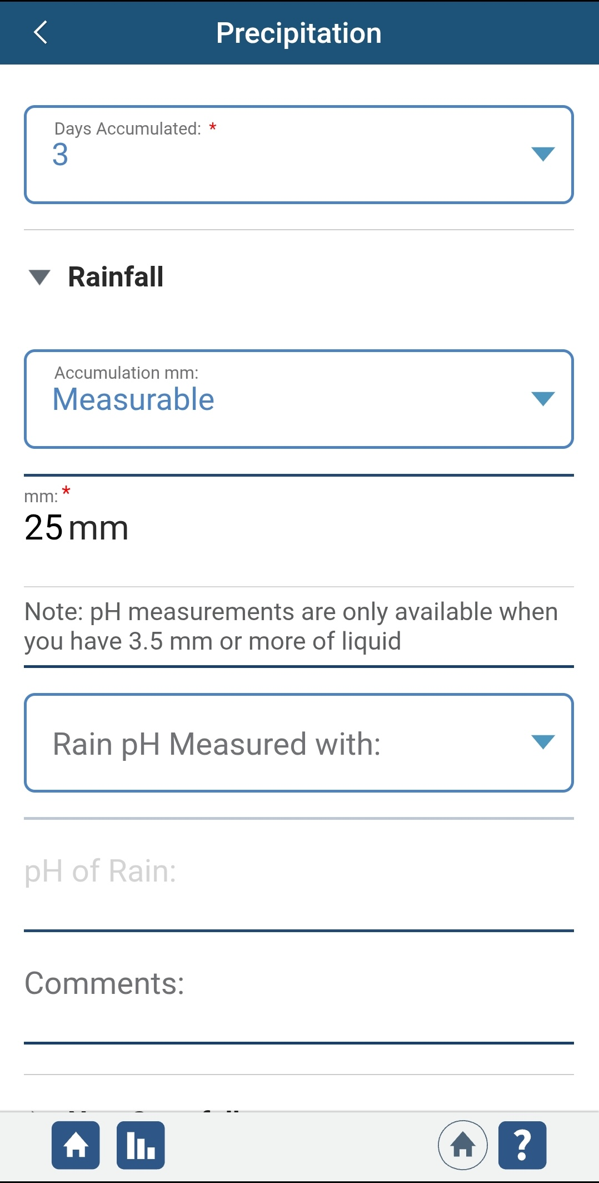
Entering Precipitation Data – Step 7
7. Enter the accumulation (measurable, trace, or missing) and if measurable, the amount of rainfall in millimeters. If pH is measured, select pH paper or pH meter and enter the measured pH. Document site conditions, timing, and any other information about the site or precipitation measurement clearly using the “Comments” section.

Slide 28
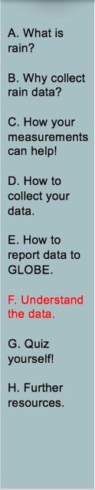
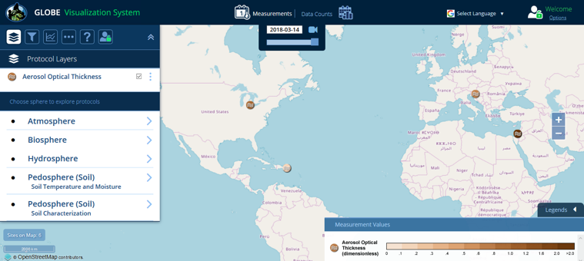
Visualize and Retrieve Data
GLOBE provides the ability to view and interact with data measured across the world. Select our visualization tool to map, graph, filter and export data that have been measured across GLOBE protocols since 1995.
These step-by-step tutorials on using the visualization system will assist you in finding and analyzing data: PDF version PowerPoint version
http://vis.globe.gov/GLOBE/

Slide 29
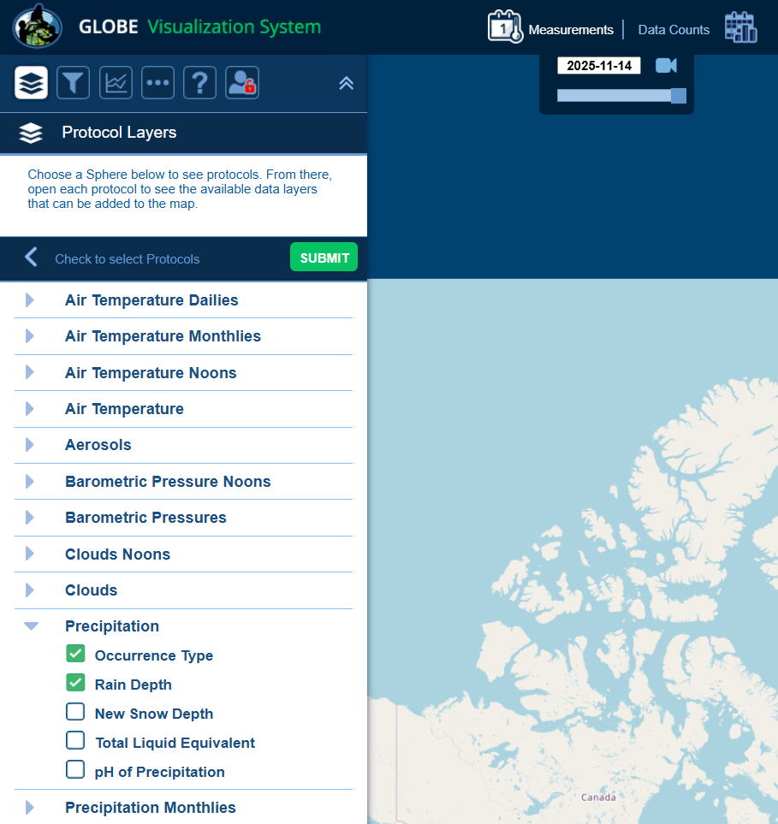
Visualize and Retrieve Data – 2
Select the date for which you need data, add the protocol layers, and you can see where data is available.

Slide 30
Questions for YOU to Investigate
When does your area get precipitation? Why?
What would happen if you got only half the average amount of precipitation in a given year? How would the effects vary if the lack of precipitation occurred in the summer or winter?
Is the amount of precipitation you get at your school the same or different from the amount measured at the nearest GLOBE schools? What causes these differences or similarities?
Does precipitation pH vary from storm to storm?
How do the amount and timing of precipitation relate to budburst and other phenological measurements?
How do the amount and timing of precipitation in your area relate to land cover?
How does the pH of precipitation relate to the pH of nearby water bodies?

Slide 31
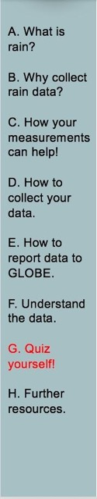
What Have You Learned?
Name the four types of precipitation.
Why is it important to collect rain and/or snow data?
Where should you place your rain gauge?
Describe the procedure in collecting rain data.
What unit of measure should precipitation be reported to the GLOBE website in?
What if the rainfall fills the inner tube and water spills over into the outer tube?

Slide 32
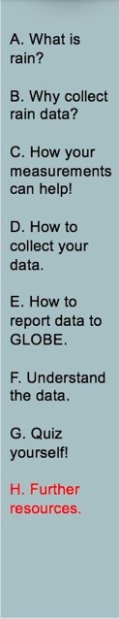
Frequently Asked Questions-page 1 of 3
Why do we have to check the rain gauge every day, even if we know it hasn’t rained?
The problem with containers like a rain gauge is that they tend to collect more than just rain. Leaves, dirt, and other debris can quickly spoil the rain gauge as a scientific instrument. This debris can block the funnel, causing rainwater to flow out of the gauge. Even if the debris isn’t large enough to block the funnel, it may become mixed in with the rainwater and affect the level of precipitation you read or the pH reading. Therefore, it is important that you check the gauge daily to make sure it is free of dust and debris.
2. What is solar noon, and how do we figure out when it is in our area?
Local solar noon is a term used by scientists to indicate the time of day when the sun has reached its highest point in the sky in your particular location. The easiest way to determine local solar noon is to find the exact times of sunrise and sunset in your area, calculate the total number of hours of daylight between those times, divide the number of daylight hours by two, and add that number to the time of sunrise. See the examples in Solar Noon in the section on Measurement Logistics.

Slide 33
Frequently Asked Questions-page 2 of 3
3. Can we leave the overflow tube of our rain gauge out as a snow catcher? Unfortunately, this won’t work. Snow blows around too much to get an accurate measure of its depth using a rain gauge. Plus, we need to get several measurements of snow depth and average them to get a more accurate measure of the depth of snow in a region. However, on days when the temperature will be both above and below freezing, leave the overflow tube out to catch both rain and snow. The snow on these days is usually wet and heavy and doesn’t blow as much and melts before local solar noon. You can measure the water in the overflow tube to get the rain equivalent of the snow plus any rainfall.

Slide 34
Frequently Asked Questions-page 3 of 3
4. What should we do if we are likely to get both rain and snow during certain times of year?
There are many places where transition times (from Autumn to Winter, and then from Winter to Spring) mean temperature can fluctuate above and below freezing over relatively short times. Once there is a chance that overnight temperatures will be below freezing, bring the funnel top and measuring tube of the rain gauge indoors. Leave the overflow tube in place at your Atmosphere Study Site. The narrow measuring tube is much more likely to crack if ice forms in it after a rainfall than the larger overflow tube. The overflow tube will be able to catch any rain or snow that falls.
In some cases, you may get a snowfall that melts before your usual measurement time. If this happens, you can’t report a new snow depth, but you can report as metadata that there was snow on the ground but it melted before a measurement was made.
Bring the measuring tube outside with you and use it to measure the amount of rain plus melted snow present in your overflow tube. If the water in your overflow tube all fell as rain, report it as rain. If the water in your overflow tube is all from snow which has melted, report it as the water equivalent of new snow, and report the new snow depth as “M” for missing and the snowpack depth on the ground as whatever value you measure (including 0.0 in many cases). If the water in your overflow tube is a mix of rain and melted snow or you don’t know which it is, report it as rain and include in your comments that the sample included may have included melted snow.

Slide 35
Further Resources
  GLOBE Learning Activities
  My NASA Data activities Weather and Climate
  Information on purchasing GLOBE supplies
  NASA Wavelength- NASA’s Digital Library of Earth and Space Education Resources
  Questions about this module? Contact GLOBE: help@nasaglobe.org

Slide 36

Please provide us with feedback about this module. This is a community project and we welcome your comments, suggestions and edits!
Comment here: eTraining Feedback
Credits
Slide Developers:
Kevin Czajkowski
Janet Struble
Mikell Lynne Hedley
Sara Mierzwiak
Photos unless otherwise identified:
Kevin Czajkowski
Sponsored By the Following Organizations:
Version 1/1/26. If you edit and modify this slide set for use for educational purposes, please note “modified by (and your name and date) “ on this page. Thank you.
Modified by GLOBE Implementation Office – Science, Training, Education, and Public Engagement

