Slide 1

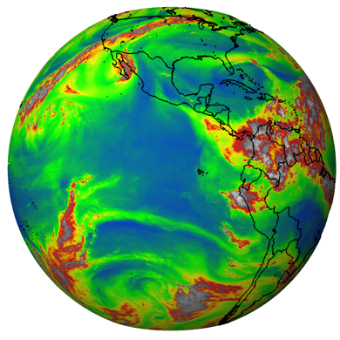
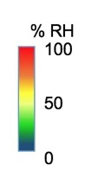
Protocol Training Slides:
Relative Humidity
Relative humidity found in our atmosphere,
as observed by satellites of the GOES project.
The gray and white regions are clouds. Image: NOAA

Slide 2
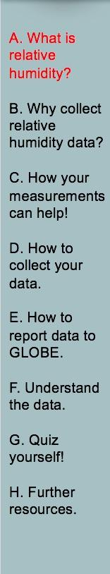
Overview and Learning Objectives
Overview
This module:
Describes relative humidity
Provides step-by-step protocol instructions for collecting relative humidity
Learning Objectives
After completing this module, you will be able to:
List some reasons to collect relative humidity
Describe how, where, and when to collect relative humidity
Upload data to the GLOBE website
Visualize data using the GLOBE Visualization Site and formulate your own questions about weather
Estimated time needed to complete this module: 1.5 hours

Slide 3
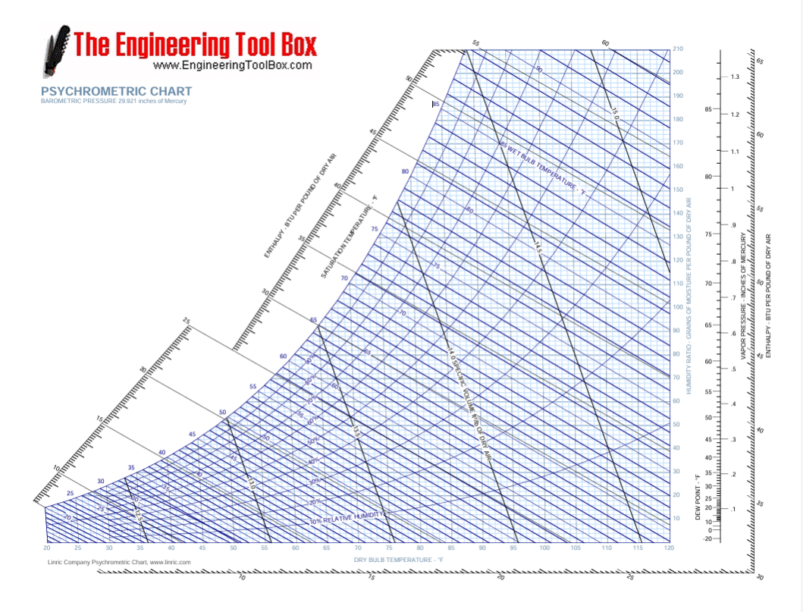
Overview and Learning Objectives
Materials
Atmosphere Investigation Data Sheet OR instructions for using GLOBE Observer to record data can be found in the Data Entry section
Digital hygrometer or sling psychrometer (with chart - see example)
Calibrated thermometer
Watch or timer

Slide 4

The Atmosphere
Extremely thin blanket of air extending about 300 miles from Earth’s surface to edge of space
Contains water vapor, an important part of hydrologic cycle
Image: NASA
Link to the GLOBE Atmosphere Protocols

Slide 5
Relative Humidity
Measures the amount of water vapor in the atmosphere (humidity) relative to the maximum amount of water vapor that the atmosphere could hold at the same temperature
Affects the heating and cooling of air
Warm air can hold more water vapor and the saturation point of the air is higher than for cold air
Water vapor has the strongest impact as a greenhouse gas
Specific humidity refers to the actual amount of water vapor in the air
Aerosols
Air Temperature
Albedo
Barometric Pressure
Clouds
Precipitation
Relative Humidity
Surface Ozone
Surface Temperature
Water Vapor
Wind

Slide 6
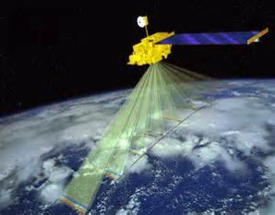
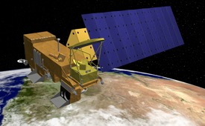
Measuring Relative Humidity
MODIS (or Moderate Resolution Imaging Spectroradiometer)
Key instrument on the Terra and Aqua Satellites
Views the entire Earth’s surface every 1 or 2 days
Helps in understanding the global dynamics and processes of the lower atmosphere over land and water
Check out the MODIS Image of the Day
NASA’s Terra satellite
NASA’s Aqua satellite

Slide 7
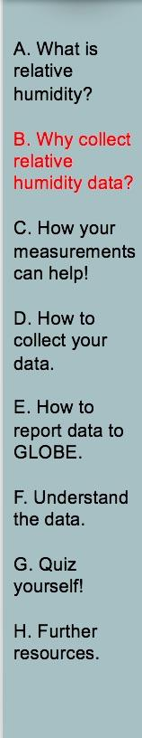
Recording Relative Humidity (RH) is important for many reasons:
Taking RH measurements helps us understand how quickly water will move from the surface of the Earth to the atmosphere and then back to Earth.
RH measurements are important in classifying an area as arid (dry), or humid (moist).
RH influences when clouds will form and when precipitation will fall.
The amount of water in the atmosphere is one of the determining factors in the weather and climate in an area.
RH affects the heating and cooling of the air.
Because of its high heat capacity, water vapor can greatly change the rate that air masses change temperature.

Slide 8
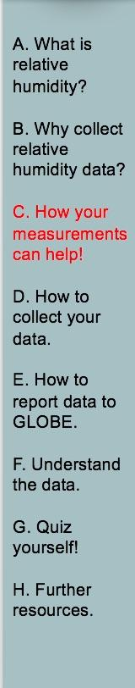
Why It Matters
Your observations are valuable contributions to the scientific community and may be used by educators, students, researchers, and the general public to increase environmental awareness and STEM literacy, as well as advance Earth system science.

Slide 9
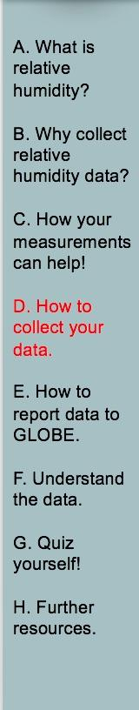
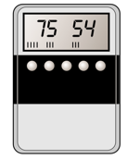
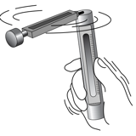
What I Need to Collect RH Data
Instruments | Digital Hygrometer or Sling Psychrometer (with chart), Calibrated Thermometer, Watch or Timer
Data Sheet | Relative Humidity Data Sheet or Atmosphere All Protocols Data Sheet
When | Preferably within one hour of local solar noon; OK at other times
Where | A good observation site (See Documenting your atmosphere study site) at your Instrument Shelter
Other | Log book for data collection; Computer with internet connection to enter data
Digital Hygrometer
Sling Psychrometer

Slide 10
Which Instrument do I Use?
You can use either a Digital Hygrometer or a Sling Psychrometer
If the students have only a short period of time to take the measurements and are taking measurements in temperatures below freezing, use the digital hygrometer.
If you have the time, the students will probably enjoy using the sling psychrometer.
It is important to note that either instrument will give data that is equally useful to scientists, teachers and student researchers. It is the choice of the teacher and students to choose the instrument they want to use.
Digital Hygrometer
Sling Psychrometer

Slide 11
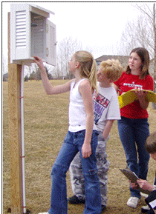
Instrument Shelter
Your hygrometer is placed in the instrument shelter for 30 minutes before you plan to take a measurement. If you don’t have a instrument shelter, place the hygrometer in a shaded area with airflow.
Your shelter should be located in an open area without obstructions such as trees and other buildings, and within walking distance.
Your instrument shelter should be clean both inside and out.
Installed Instrument Shelter

Slide 12
Collecting Data: Hygrometer
Preferably within an hour of local solar noon, open the instrument shelter and place the hygrometer in the instrument shelter.
After 30 minutes, record the time and date on your Atmosphere data sheet in both local or Coordinated Universal Time (UTC) time. Note: GLOBE website data entry only accepts either local or UTC time.
Read the relative humidity to the nearest 1% and note the instrument used.
Read the current temperature (if your reading is not being taken at the same time as the daily reading of maximum, minimum, and current temperature).
Return the hygrometer to the classroom, and store it in a dry place.

Slide 13
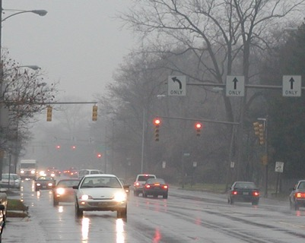
When Not to Collect Data: Hygrometer
If there is fog or it is raining or snowing, the relative humidity is at 100%; record 100% on your data sheet and put “condensation occurring” in comments.

Slide 14
Collecting Data: Sling Psychrometer- 1
Stand far enough away from other people and the instrument shelter so you will not hit them with the psychrometer. Stand in the shade if possible with your back to the sun. If there is no shade near the shelter, move to a shady spot nearby, but not too close to trees or buildings.
Keep the sling psychrometer as far away as possible from your body to prevent body heat from changing the temperature readings. This is very important in cold weather. Do not touch or breathe on the temperature-sensing parts of the thermometer as this, too, may affect the reading. If possible, face into the wind to minimize the impact on the measurement from your body heat.
Open the sling psychrometer case by pulling out the slider, which contains the two thermometers.
Wait 3 minutes to allow the thermometer to read the current air temperature and then read the current dry bulb temperature to 0.5 ̊ C using the thermometer with no wick attached. Make sure your eyes are level with the instrument.
Record the dry bulb temperature.

Slide 15
Collecting Data: Sling Psychrometer- 2
Check to be sure that there is still distilled water in the reservoir, and that the wick is wet. If it is dry, add distilled water to the reservoir.
Sling the psychrometer for 3 minutes.
Let the psychrometer stop whirling on its own! Do not stop it with your hand or other object.
Read the wet bulb temperature to 0.5 ̊ C (from the thermometer with the wick attached).
Record the wet bulb temperature.
Determine the relative humidity using a psychrometric chart or the sliding scale found on the cases of some psychrometers. You may also leave this blank as GLOBE can calculate relative humidity from your wet and dry bulb temperatures.
When you are done with the instrument, close it up and return it to the shelter properly.

Slide 16
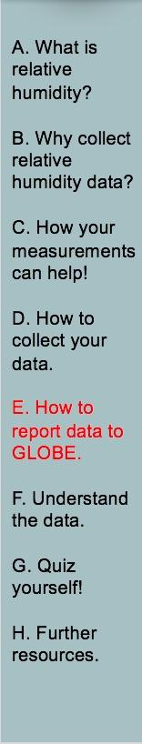

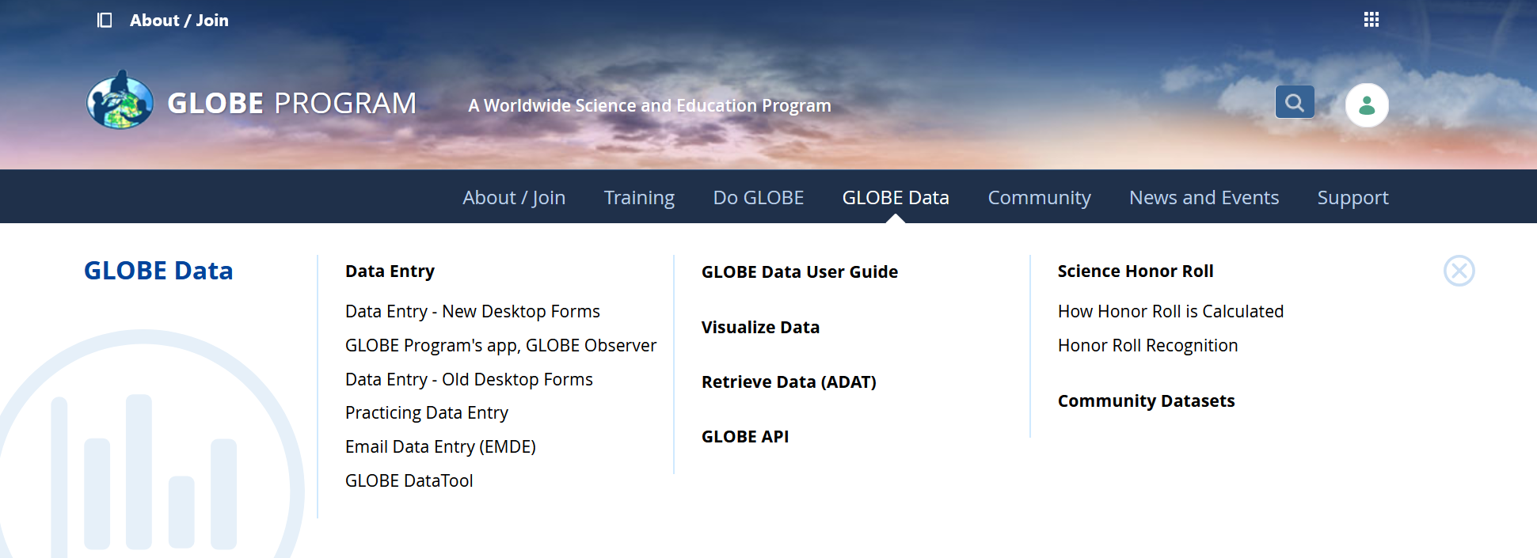
Entering Relative Humidity Data in the GLOBE Observer Data Entry System
Two Options for Uploading Data:
These methods all allow users to submit environmental data – collected at defined sites, according to protocol, and using approved instrumentation – for entry into the official GLOBE science database.
Download the GLOBE Observer mobile app from the App Store.
Data Entry: Visit globe.gov, click on the “GLOBE Data” tab, then underneath “Data Entry” click on “Data Entry – New Desktop Forms”.
Note 1: You will need a GLOBE teacher, trainer, or scientist account to submit GLOBE data.
Note 2: It may take some time after you enter your data for it to appear in the GLOBE data visualization system.

Slide 17

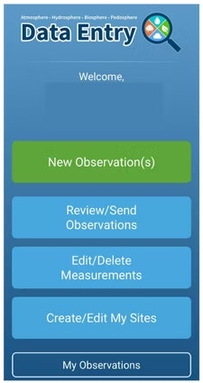
Entering Relative Humidity Data – Step 1&2
The steps below will walk you through entering your Atmosphere Study Site Information in the GLOBE Observer App, which you can access using your GLOBE or GLOBE Observer login.
2. Click "Create/Edit My Sites"
1. Click “Data Entry”

Slide 18
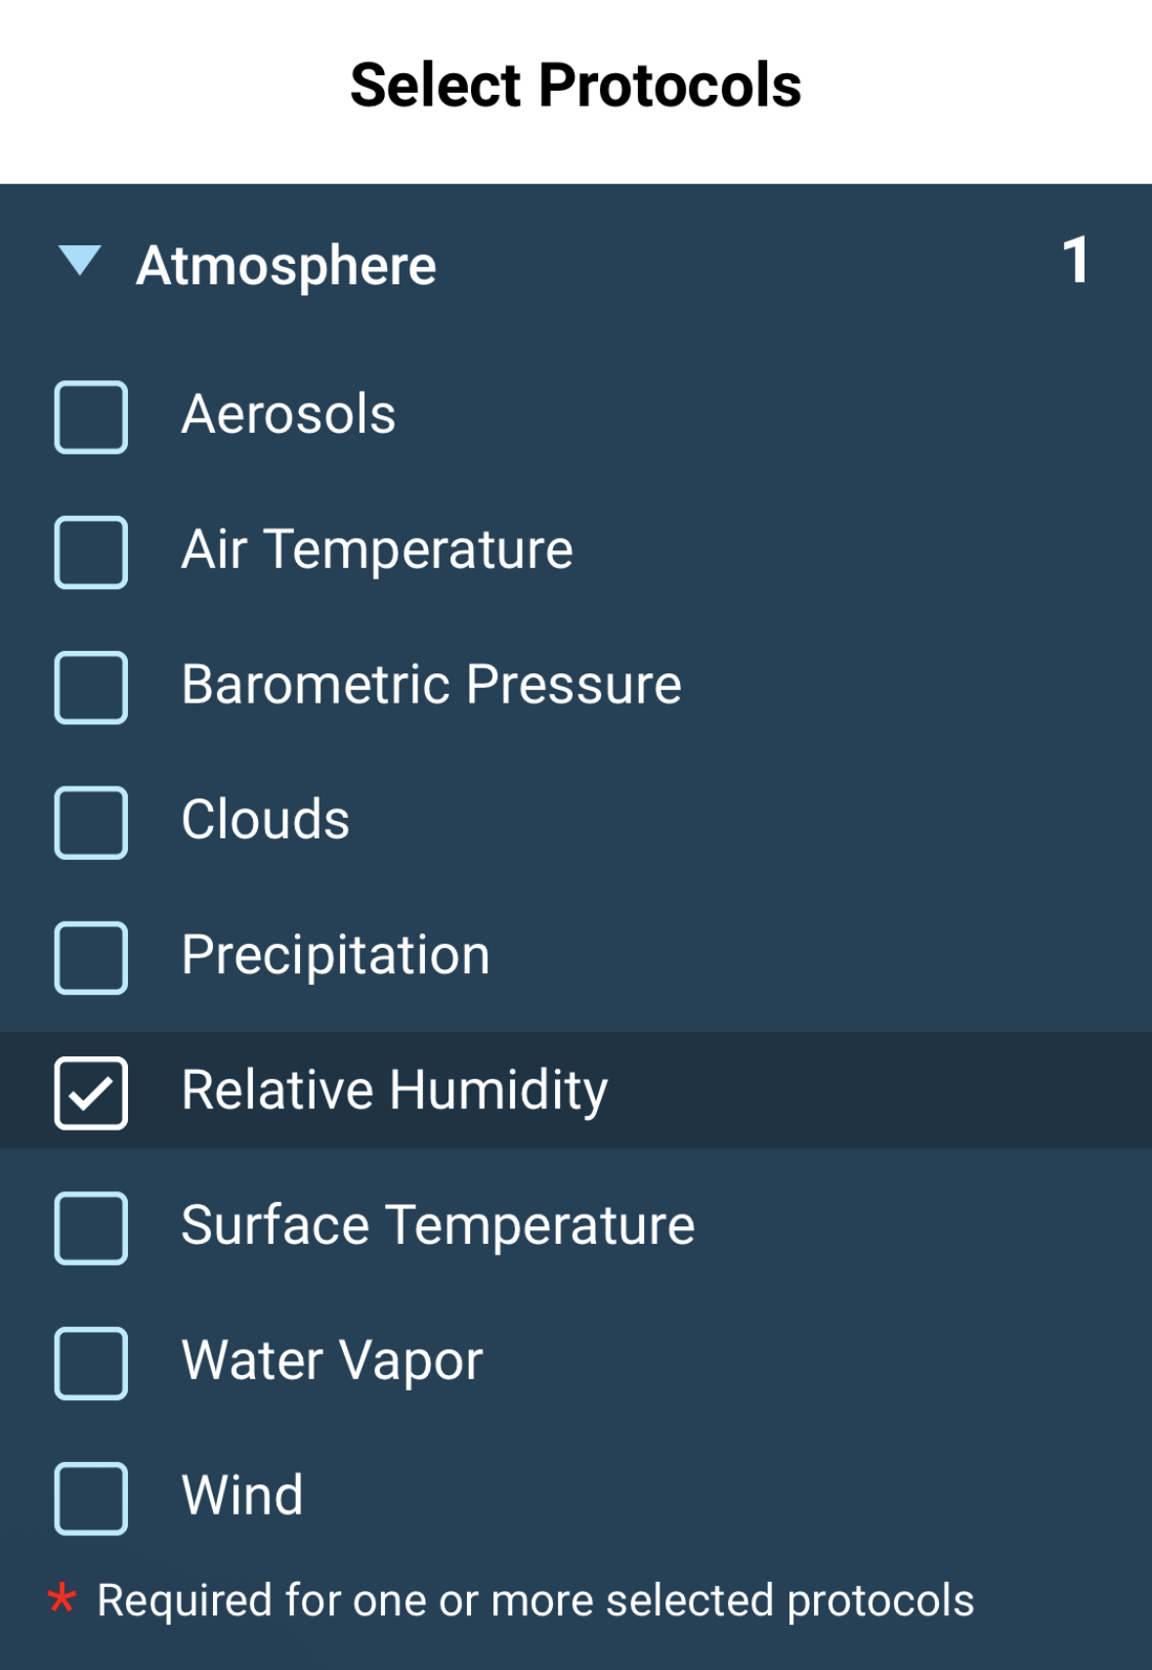
Entering Relative Humidity Data – Step 3
3. Click on the arrow next to "Atmosphere" and select “Relative Humidity"

Slide 19
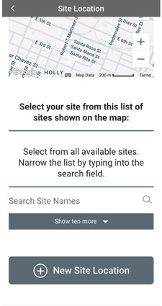
Entering Relative Humidity Data – Step 4
4. At the bottom of the screen, click “Continue”. When prompted, enter site location details (latitude, longitude, and elevation). Choose an existing site or identify a new site by clicking “+ New Site Location”

Slide 20
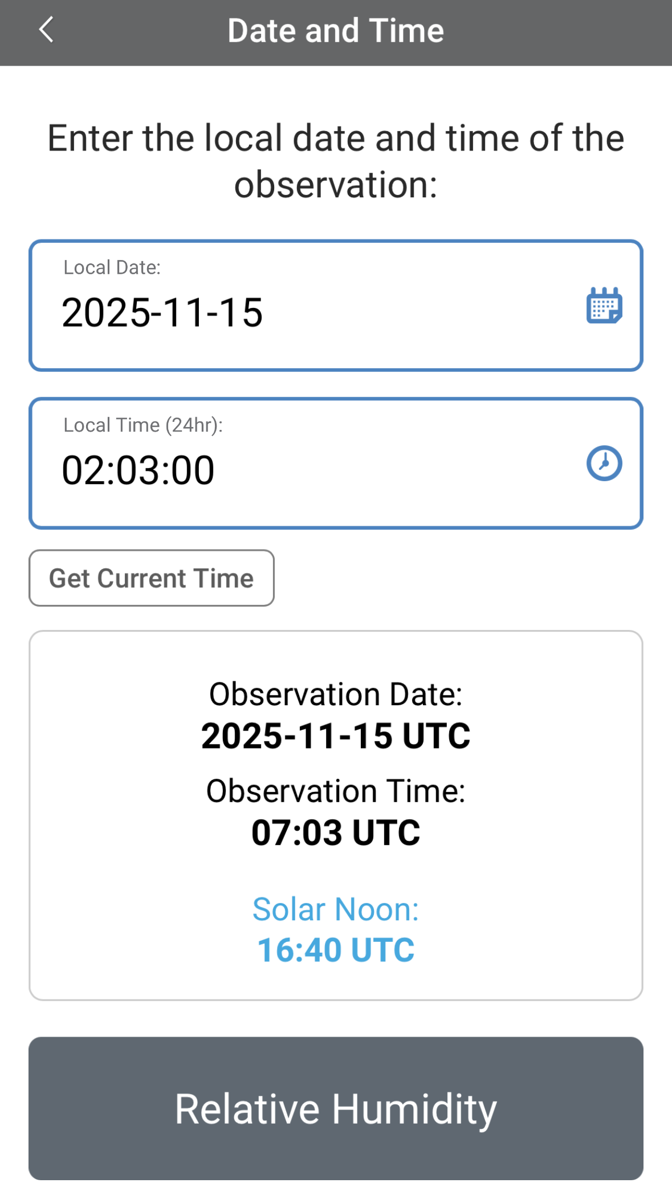
Entering Relative Humidity Data – Step 5
5. Check to see if the “Date and Time” are correct, if it is not, click “Get Current Time” to update it. Then click “Relative Humidity” to move on

Slide 21
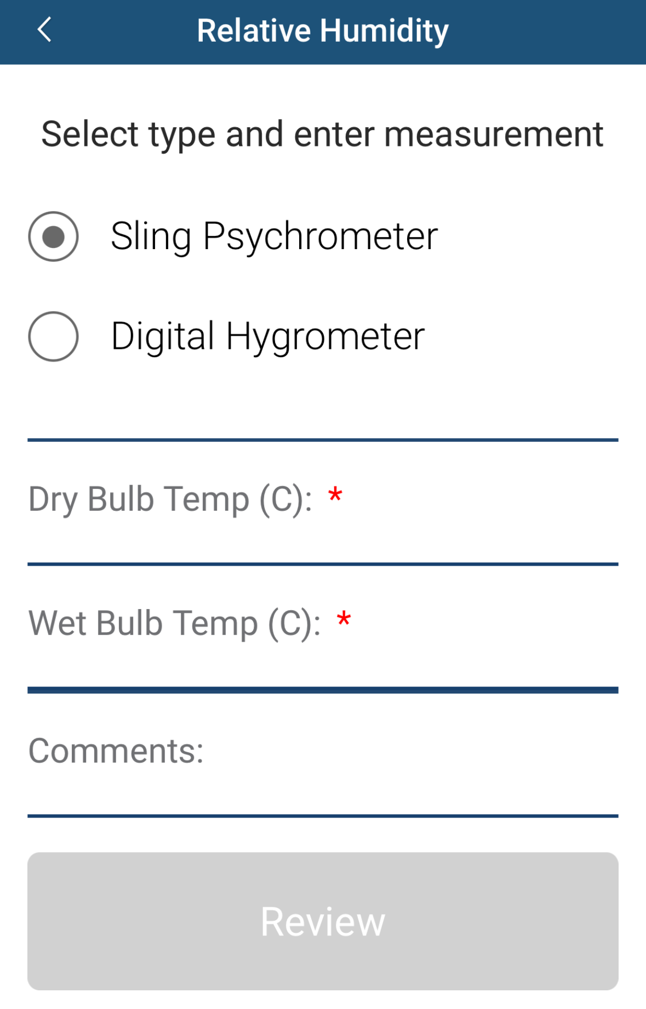
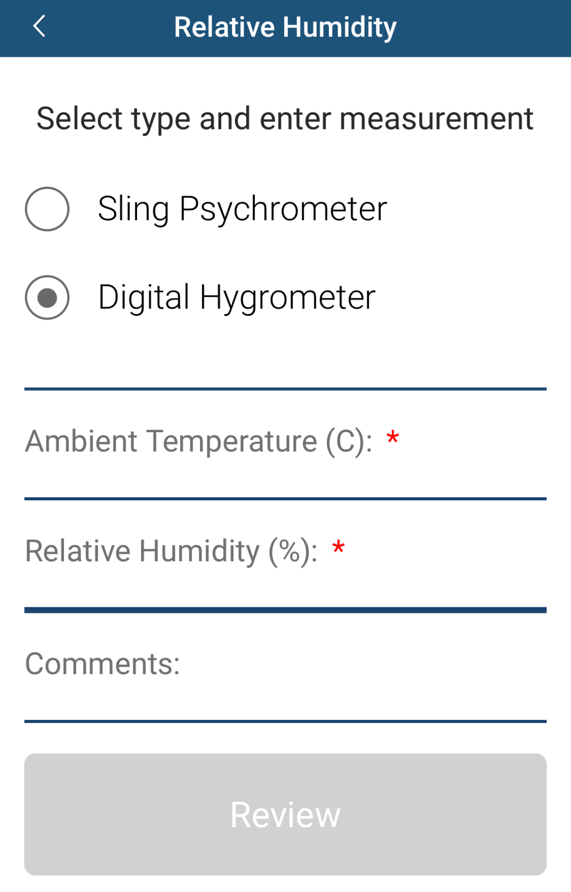
Entering Relative Humidity Data – Step 6
6. Select the type of instrument used to measure relative humidity—Sling Psychrometer or Digital Hygrometer, then enter your data. If using a Sling Psychrometer, enter the dry bulb temperature (°C) and wet bulb temperature (°C). If using a Digital Hygrometer, enter the ambient temperature (°C) and relative humidity (%). Document site conditions, timing, and any other information about the site or relative humidity measurement clearly using the “Comments” section

Slide 22
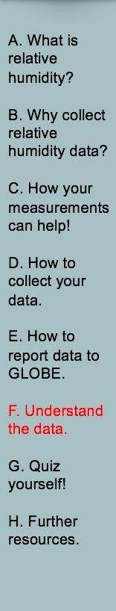
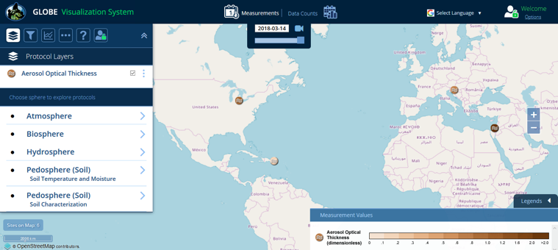
Visualize and Retrieve Data – Step 1
GLOBE provides the ability to view and interact with data measured across the world. Select our visualization tool to map, graph, filter and export data that have been measured across GLOBE protocols since 1995.
These step-by-step tutorials on using the visualization system will assist you in finding and analyzing data: PDF version PowerPoint version
http://vis.globe.gov/GLOBE/

Slide 23
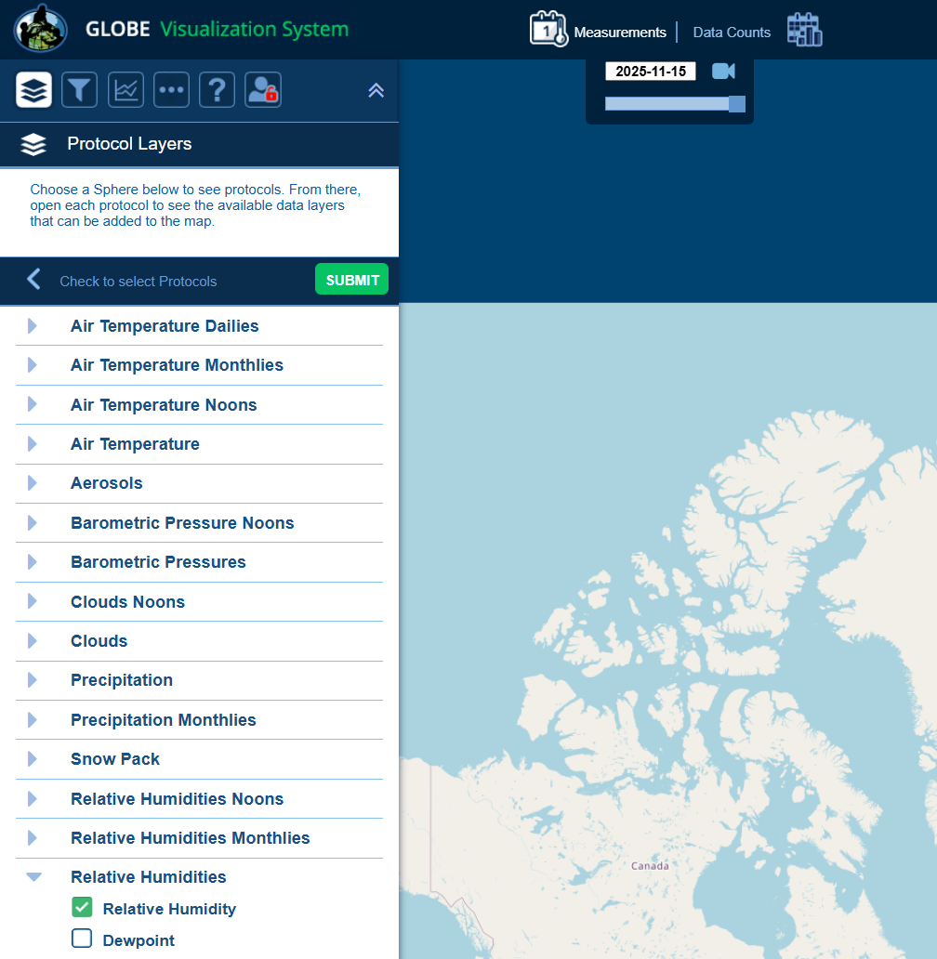
Visualize and Retrieve Data – Step 2
Select the date for which you need data, add the protocol layers, and you can see where data is available.

Slide 24
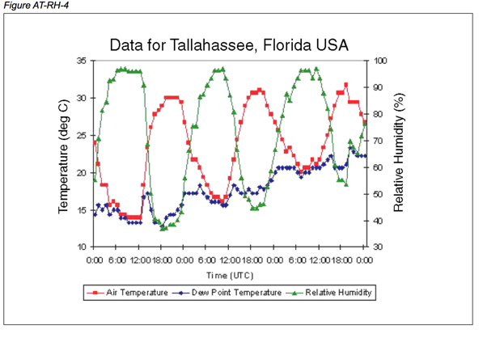
Understanding the Data
This graphic from the GLOBE database shows the relationship between air temperature and relative humidity for Tallahassee, FL. Note that as air temperature goes up throughout the day, relative humidity goes down and the opposite occurs in the evening.

Slide 25
Questions for YOU to Investigate
How are your relative humidity observations related to air temperature?
Can you find other GLOBE sites at your latitude which are closer to or further from large bodies of water? Do you see any systematic differences in relative humidity between your location and the others?
Does relative humidity affect any non-atmosphere parts of your local environment? How?
At what time of day will relative humidity normally be at a maximum? minimum?
Are your relative humidity and phenology measurements related?

Slide 26
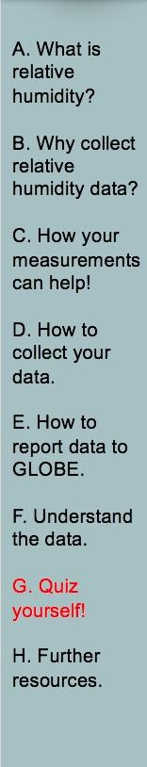
What have you learned?
What is relative humidity?
Why is it important to collect relative humidity data?
What instruments can you use to collect relative humidity?
Where should you place your instrument?
When should you take your measurements?
What data sheet will you use?
Describe the procedure in collecting relative humidity.
How do you enter data on the GLOBE website?
What are some questions you could use to investigate relative humidity in the visualization part of GLOBE?
What data layer would you need to add?

Slide 27
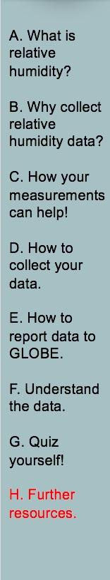
Frequently Asked Questions (FAQs) 1
1. Why do you have two different methods of measuring relative humidity?
Two methods are used to try to provide an incentive for the teacher and student to make a determination about how much time is desired taking the observations. One is more complex (and fun) than the other. Observations from either method are equally valuable to the GLOBE program and scientists, in general.
2. Why do we need to take the hygrometer inside each day, and bring
it out to the weather shelter 30 minutes before we make our local solar noon observations?
The sensitive electronics inside the hygrometer cannot be exposed to condensation for long periods of time, so it is best to avoid all situations when condensation may be expected. If fog or persistent rainfall is occurring at the time of observation, it is best not to take the hygrometer outside; rather, the observer should report a relative humidity of 100%, but also should make a comment in the metadata that the observation was inferred based on visible condensation in the air (rain or fog).

Slide 28
Frequently Asked Questions (FAQs) 2
3. I see the definitions for wet-bulb and dry-bulb temperature; what is the dew point temperature?
The dew point temperature is the temperature to which air must be cooled to achieve saturation (relative humidity = 100%) given its current water content. Dew point is a measure of the actual water vapor content. On calm clear days followed by calm clear nights, the temperature will fall rapidly towards the dew point. Unless dew forms, if the air temperature reaches the dew point temperature, fog may form. Once dew or fog forms, the dew point temperature will fall, because there is less water vapor in the air.
4. Why can’t we use the sling psychrometer below freezing?
The relationship between evaporation rate and temperature is more complicated below freezing than above freezing, so the sling psychrometer will not be as practical. More expensive models that have greater ranges are available, but are beyond the reach of the expected school budgets for instruments. We recommend the use of a hygrometer for locations that have frequent temperatures below freezing.

Slide 29
Frequently Asked Questions (FAQs) 3
5. How accurate are these relative humidity readings, compared to those that might be taken with more expensive instruments?
The hygrometer will report relative humidity with an accuracy range of 2-4%, within the desired 5% figure. The sling psychrometer reports temperature to within an accuracy of approximately 0.5 ̊ C; provided the calibration on the thermometers is maintained, this also ensures accuracy better than 5% over the most common range of values of relative humidity, between 20-95%.
6. The reservoir on the left side of the instrument (holding the wick) is either broken or cracked (nearly broken); is there a way to still use it?
Yes. The plastic reservoir end cap that holds the wick inside can become weak. The instrument is still useable; however some simple repairs or precautionary effort must be done. Taping a piece of cardboard on the end will usually hold the wick inside and not affect the readings.
7. Is there a special way that we should store our sling psychrometer?
In order to prevent the liquid separating in the thermometers, it is suggested that you store the sling psychrometer in a jar or other receptacle so that the thermometers are resting with the lower temperatures at the bottom.

Slide 30
Further Resources
  Video: How to use a sling psychrometer
  Sling Psychrometer Chart
  GLOBE Learning Activities
  My NASA Data
  NASA Wavelength NASA’s Digital Library of K-16 Earth and Space Education Resources
  For information on purchasing GLOBE supplies go to:
  Equipment suppliers

Slide 31

We want your Feedback!
Please provide us with feedback about this module. This is a community project and we welcome your comments, suggestions and edits!
Comment here: eTraining Feedback
Questions about module? Contact GLOBE: help@nasaglobe.org
Credits
Power point Developers:
Kevin Czajkowski
Janet Struble
Mikell Lynne Hedley
Sara Mierzwiak
Photos unless otherwise identified:
Kevin Czajkowski
Funding Provided by NASA
Version 1/1/26 If you edit and modify this slide set for use for educational purposes, please note “modified by (and your name and date)“ on this page. Thank you.
Modified by GLOBE Implementation Office – Science, Training, Education, and Public Engagement

