Slide 1
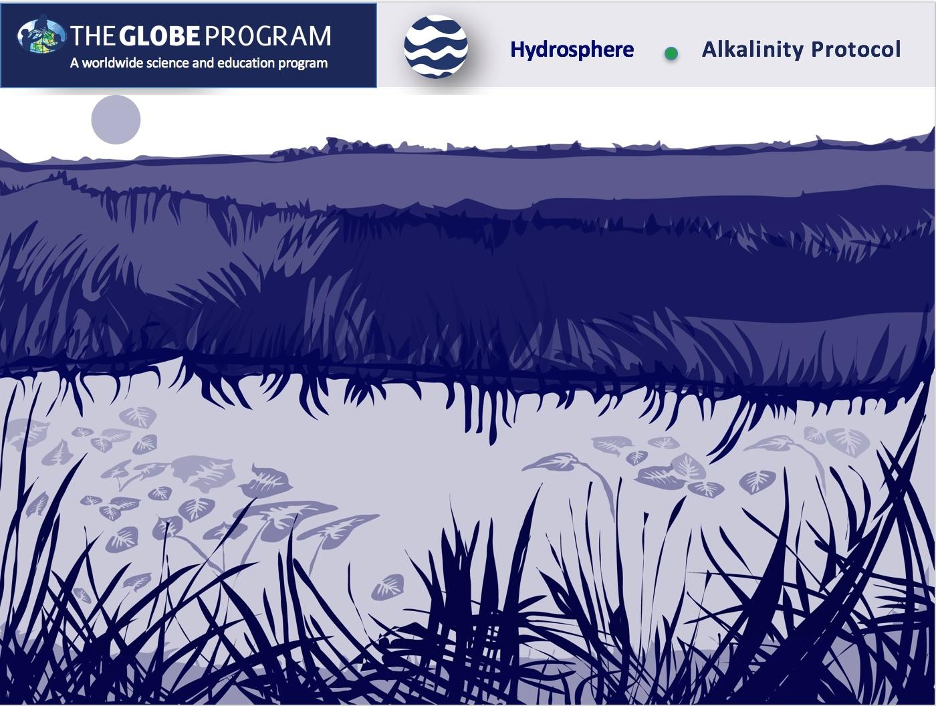


Slide 2
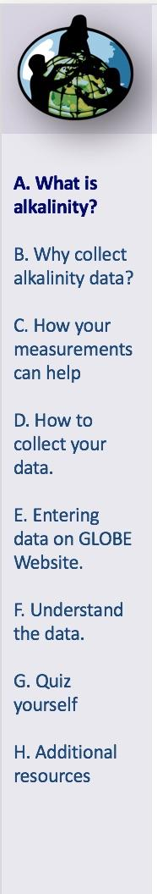
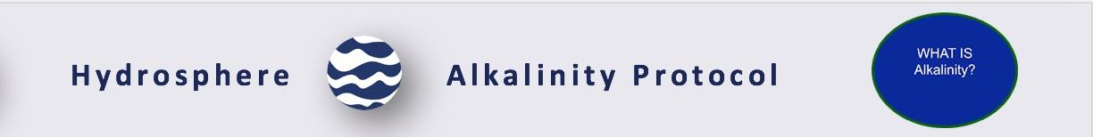
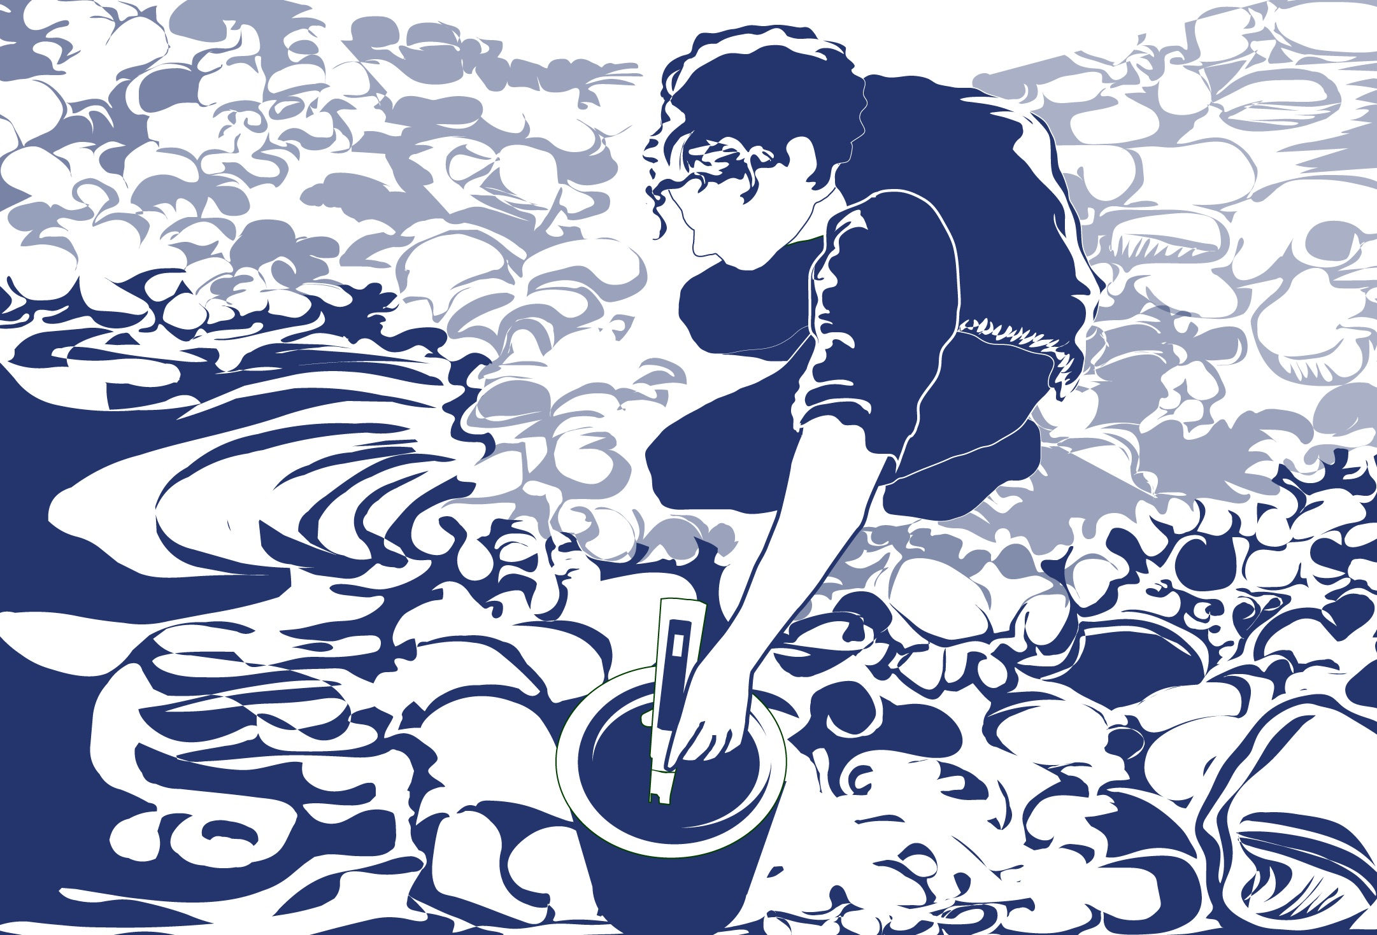
Overview
This module:
Reviews the selection of a GLOBE hydrology site
Reviews the water sampling technique used in GLOBE hydrology protocols
Provides a step by step introduction of the protocol method
Learning Objectives
After completing this module, you will be able to:
Define water alkalinity and explain how environmental variables affect the alkalinity of a water body
Describe the importance of instrument calibration and quality control procedures in the the collection of accurate data
Conduct alkalinity measurements using a test kit
Upload data to the GLOBE portal
Visualize data using GLOBE’s Visualization System
Estimated time to complete this module: 1.5 hours

Slide 3
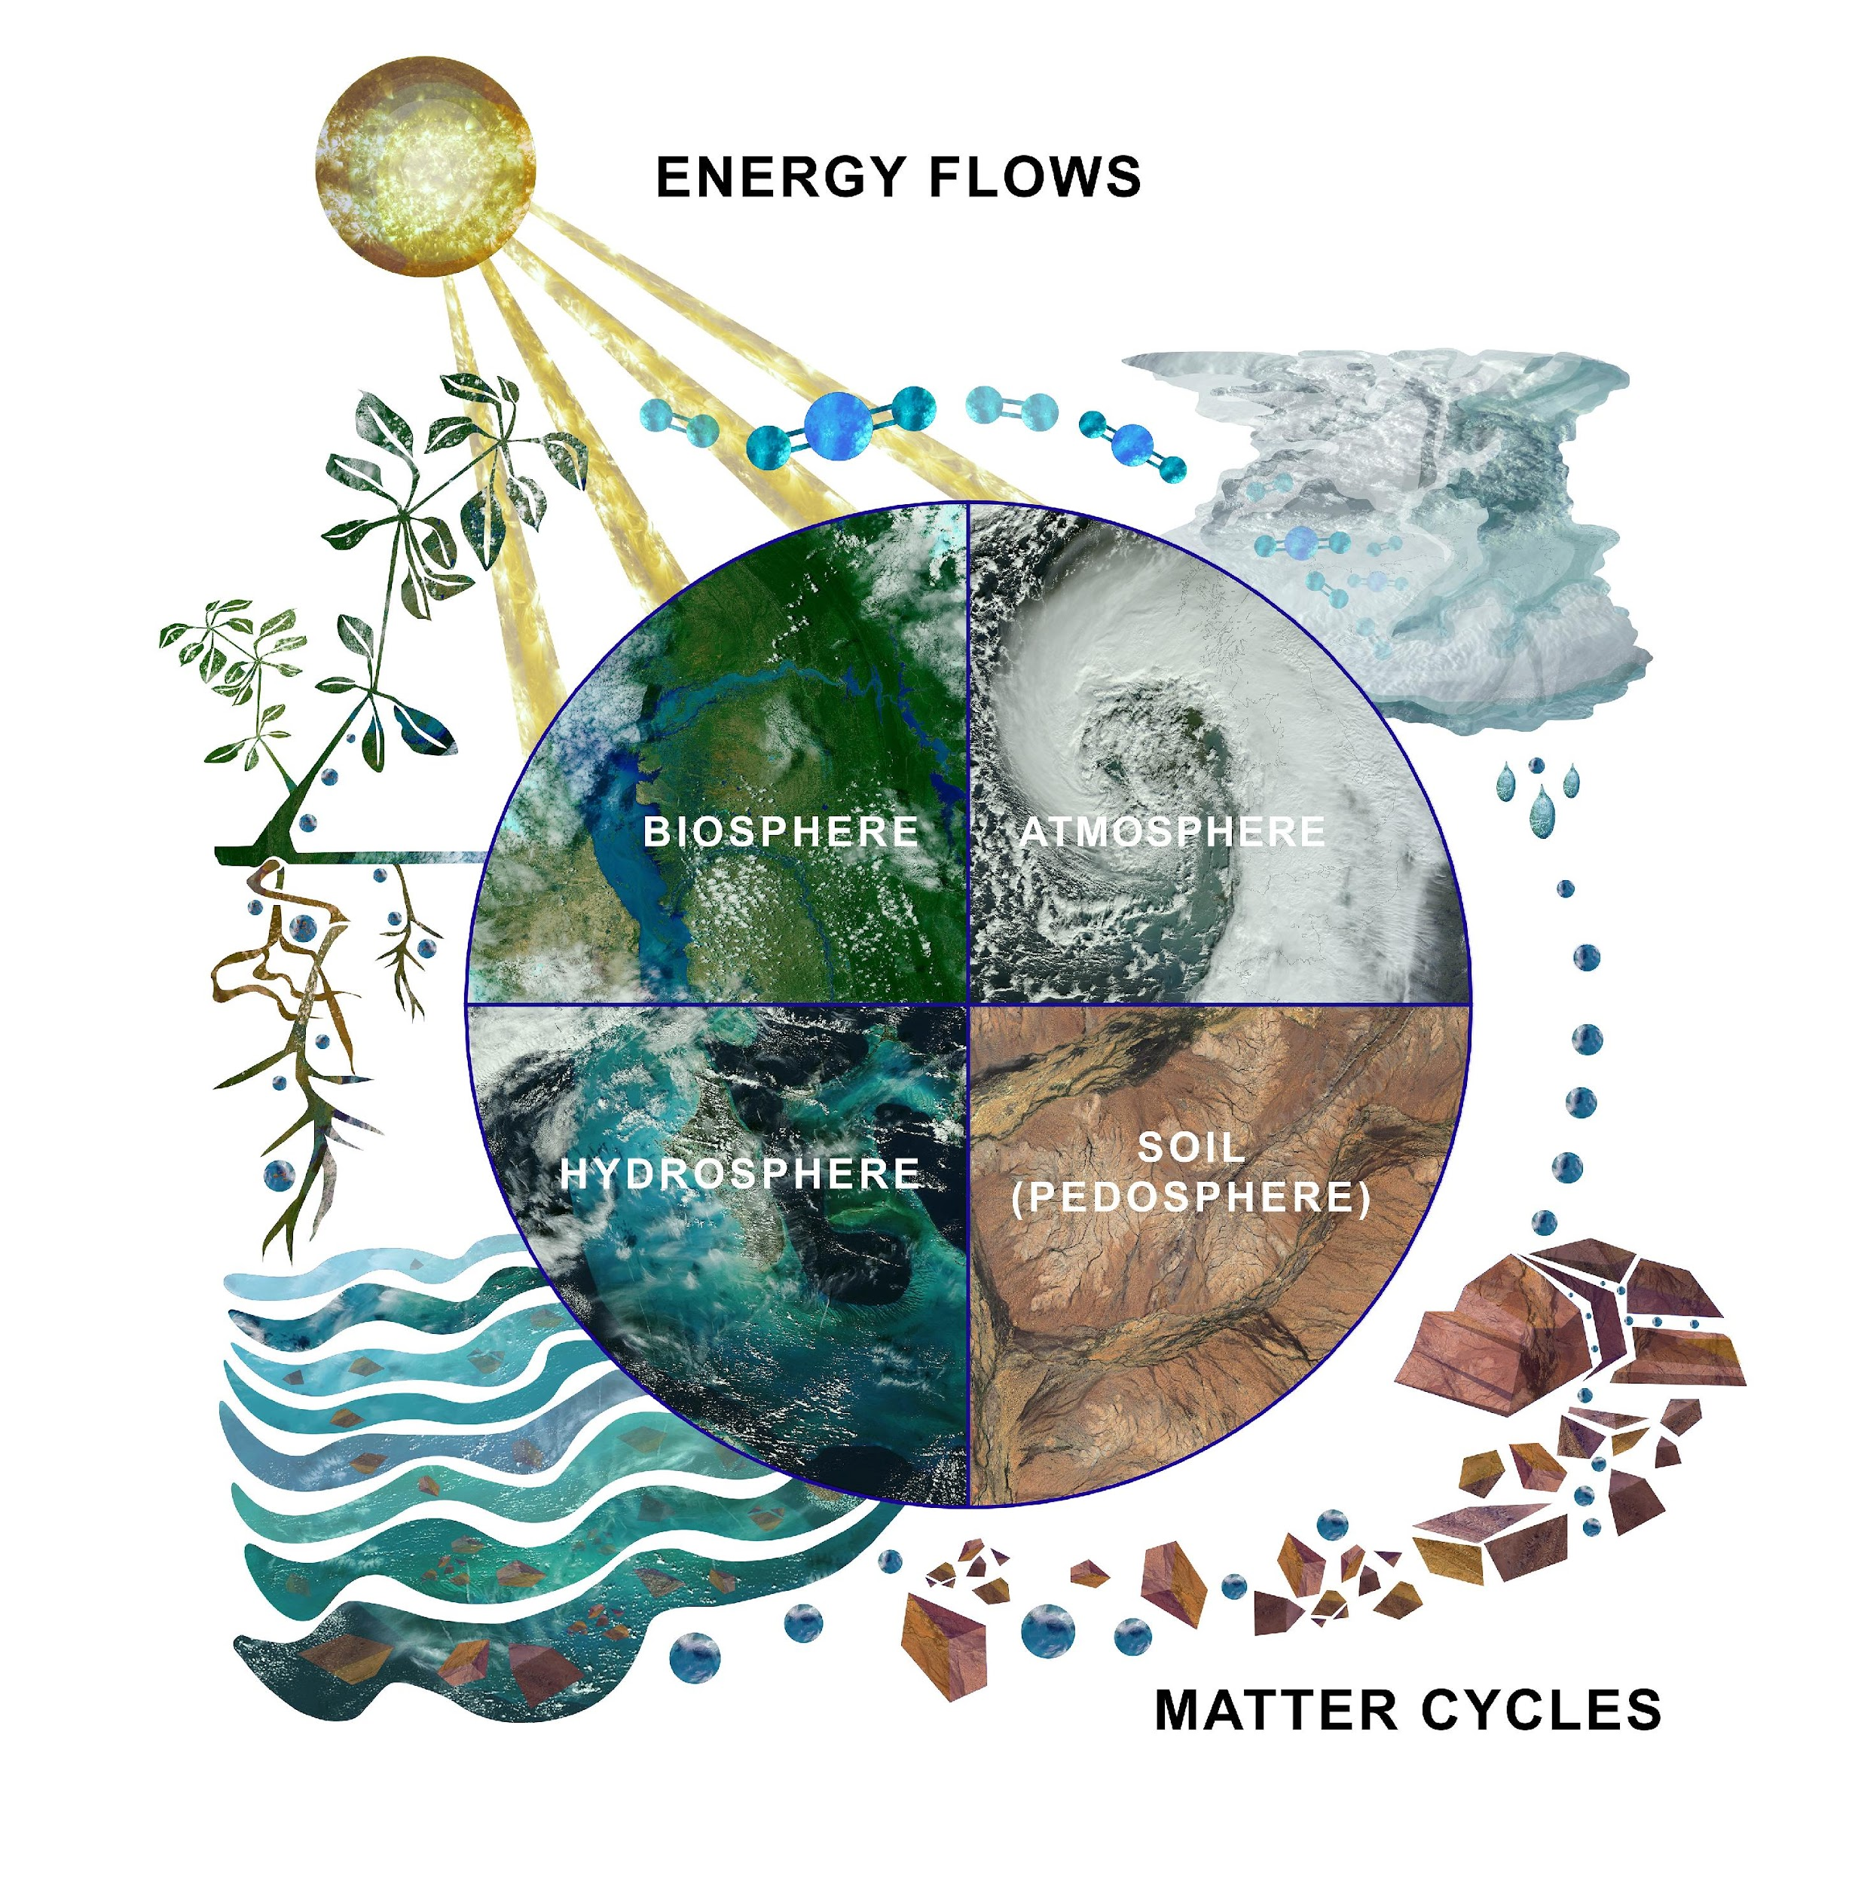
The Hydrosphere
The hydrosphere is the part of the Earth system that includes water, ice and water vapor. Water participates in many important natural chemical reactions and is a good solvent. Changing any part of the Earth system, such as the amount or type of vegetation in a region or from natural land cover to an impervious one, can affect the rest of the system. Rain and snow capture aerosols from the air. Acidic water slowly dissolves rocks, placing dissolved solids in water.
Dissolved or suspended impurities determine water's chemical composition. Current measurement programs in many areas of the world cover only a few water bodies a few times during the year. GLOBE Hydrosphere protocols will allow you to collect valuable data to help fill these gaps and improve our understanding of Earth's natural waters.
The Earth System: Energy flows and matter cycles.

Slide 4
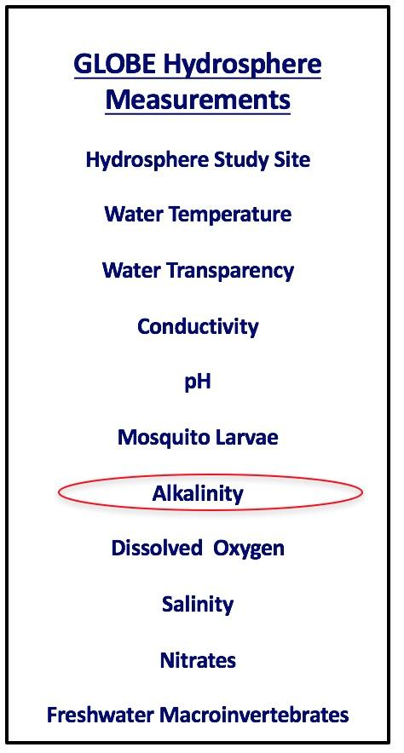
Alkalinity Protocol
Alkalinity and pH are properties of water that are related, but different. Alkalinity is the measure of the pH buffering capacity of the water. pH, on the other hand, is the acidity of water.
Alkalinity is expressed as the amount of calcium carbonate (CaCO3) in your water, although other substances can contribute to alkalinity as well. The units of alkalinity are either part per million (ppm) or mg/L. These units are equivalent, as 1 ppm = 1 mg/L.
Alkalinity comes from dissolved rocks, particularly limestone (CaCO3), and soils. It is added to the water naturally as water comes in contact with rocks and soil. Water dissolves the CaCO3, carrying it into streams and lakes. Those water bodies that have high alkalinity are well buffered and resist changes in pH even when acid is added to the water.

Slide 5
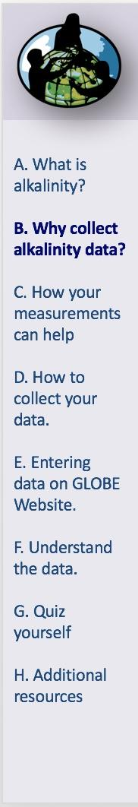
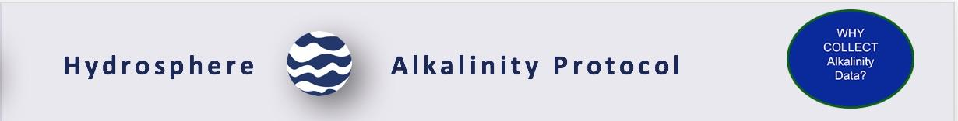
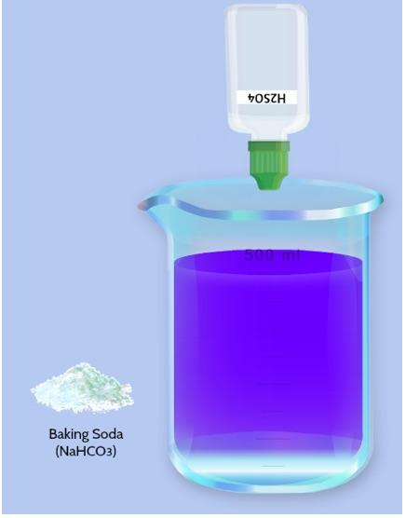
Why Collect Water Alkalinity Data?
pH is a very important water quality parameter. Many plants and animals have very specific pH requirements and are harmed by sudden pH changes or extreme pH values. What happens to the pH of your water if acid is added? The answer depends on how much alkalinity is in the water and how much acid is added.
Let us say your water has a high alkalinity. When acid is added to the water, the alkalinity neutralizes the acid. Some of the alkalinity will be used up, so that alkalinity will go down. If more acid is added, the alkalinity will continue to decrease. Eventually, when the alkalinity is low enough, adding acid will cause the pH to decrease.

Slide 6
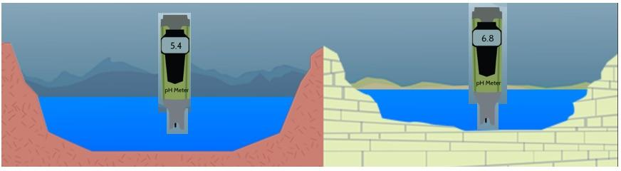
Buffering
When water has high alkalinity, we say that it is well buffered. It resists a decrease in pH when acidic water, such as rain or snowmelt, enters it. Alkalinity comes from dissolved rocks, particularly limestone (CaCO3), and soils. It is added to the water naturally as water comes in contact with rocks and soil. Water dissolves the CaCO3, carrying it into streams and lakes. Lakes and streams in areas rich in limestone bedrock will tend to have a higher alkalinity than those in regions with non-carbonate bedrock.
Buffering solutions resist changes. The lake on the right is surrounded by limestone which weather to produce carbonate and bicarbonate ions. These raise the water’s alkalinity. The lake on the left is formed in igneous rock, which does not produce carbonates when weathered. The lake on the right is resistant to change when acid is added, whereas the lake on the left will change more readily.

Slide 7

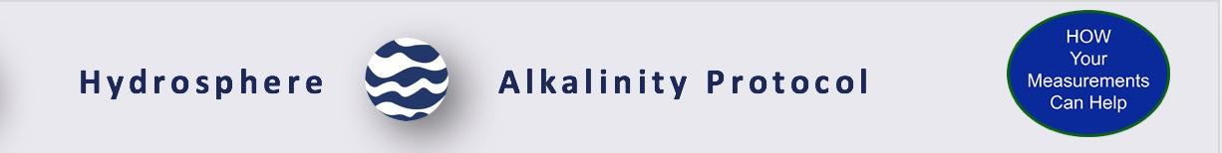
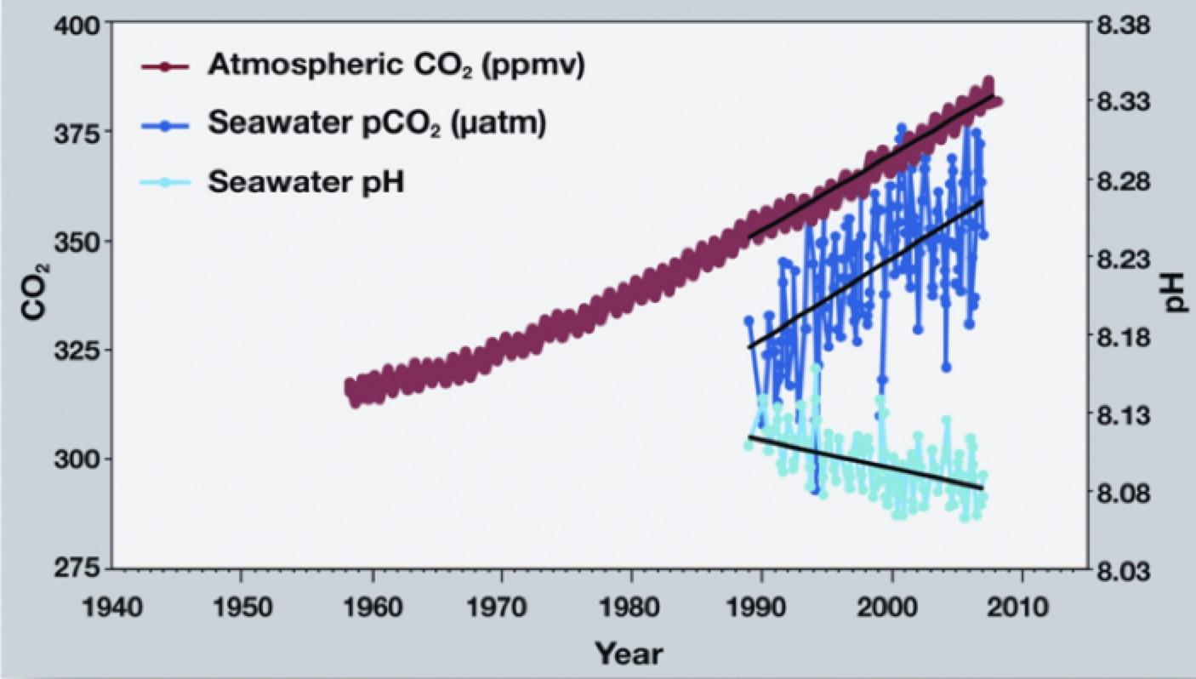
Example: Ocean Acidification-1
The measurement of pH, total alkalinity and dissolved inorganic carbon are important for monitoring ocean acidification. Ocean acidification (OA) is the decrease in ocean pH as a result of an increase in carbon dioxide (CO₂) absorption by seawater. OA is a prominent concern in today’s world. CO₂ is pumped into the atmosphere from everyday human activities, such as emissions from vehicles and industrial pollution. Each year approximately 25% of the CO₂ pumped into the atmosphere is absorbed by the ocean. Although plants can use CO₂ for photosynthesis, the increase also has negative implications. As the amount of CO₂ absorbed by the ocean increases, the pH is expected to continue decreasing.
http://www.pmel.noaa.gov/co2/story/OA+Observations+and+Data

Slide 8
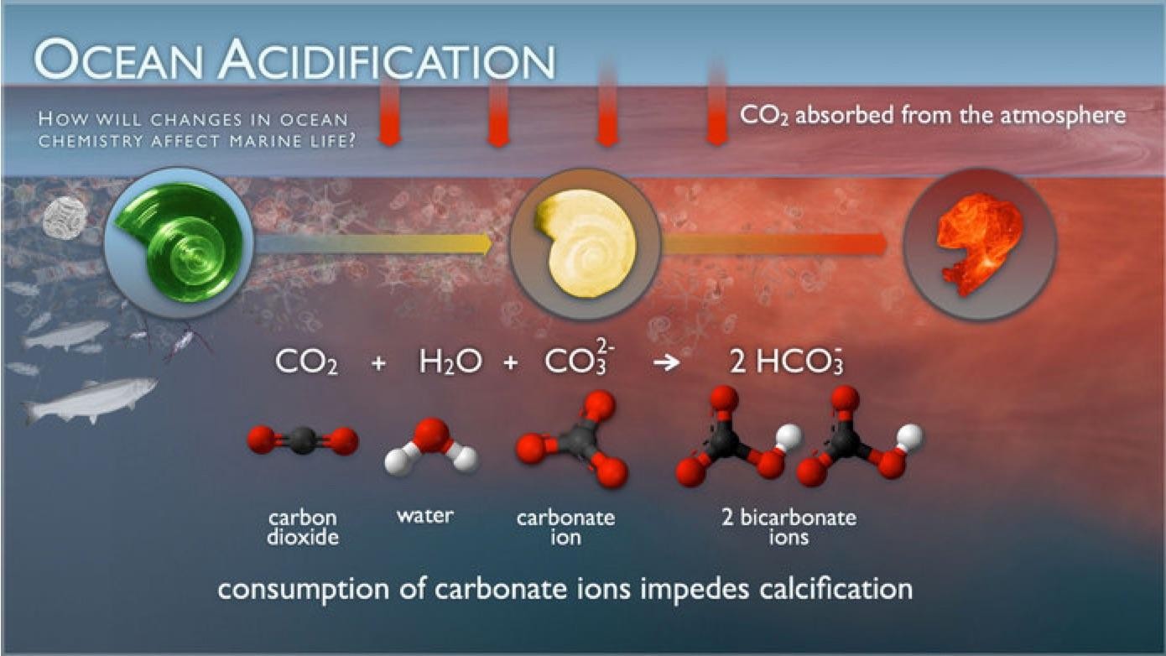
Example: Ocean Acidification-2
The pH of the ocean directly affects organisms that form calcium carbonate shells or structures, like corals, oysters, clams and sea urchins. When the ocean water is more acidic, it causes the calcium carbonate to dissolve and makes it more difficult for the organisms to make their calcium carbonate skeletons. Read more here from NASA’s Earth Observatory.
http://www.pmel.noaa.gov/co2/story/What+is+Ocean+Acidification%3F

Slide 9

Let’s do a quick review before moving onto data collection! Question 1
Alkalinity is expressed as the amount of ____ in your sample
Acid
Calcium carbonate
Sodium chloride
Base

Slide 10
Let’s do a quick review before moving onto data collection! Answer to Question 1
Alkalinity is expressed as the amount of ____ in your sample
Acid
Calcium carbonate- correct ☺
Sodium chloride
Base

Slide 11
Let’s do a quick review before moving onto data collection! Question 2
True or false: 1 ppm= 1 mg/L
True
False

Slide 12
Let’s do a quick review before moving onto data collection! Answer to Question 2
True or false: 1 ppm= 1 mg/L
True – correct ☺
False

Slide 13
Let’s do a quick review before moving onto data collection! Question 3
When a water body has high alkalinity
It has a low pH
It is well buffered

Slide 14
Let’s do a quick review before moving onto data collection! Answer to Question 3
When a water body has high alkalinity
It has a low pH
It is well buffered – correct ☺
Now we will explore how to collect alkalinity data in the following slides

Slide 15

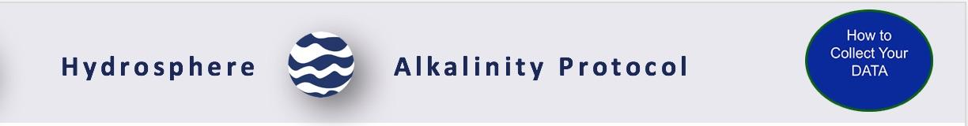
Alkalinity Protocol at a Glance
When | Weekly, if possible. Quality Control Procedure: twice a year
Where | Hydrosphere Study Site
Time Needed | 15 minutes, Quality Control Procedure 20 minutes
Prerequisites | Described Hydrosphere Study Site Make your Baking Soda
Key Instrument | Commercial Alkalinity Test Kit
Skill Level | Middle and Secondary
References | Alkalinity Protocol Field Guide Making the Baking Soda Alkalinity Standard Guide Hydrosphere Investigation Quality Control Data Sheet Quality Control Procedure for Alkalinity Lab Guide

Slide 16
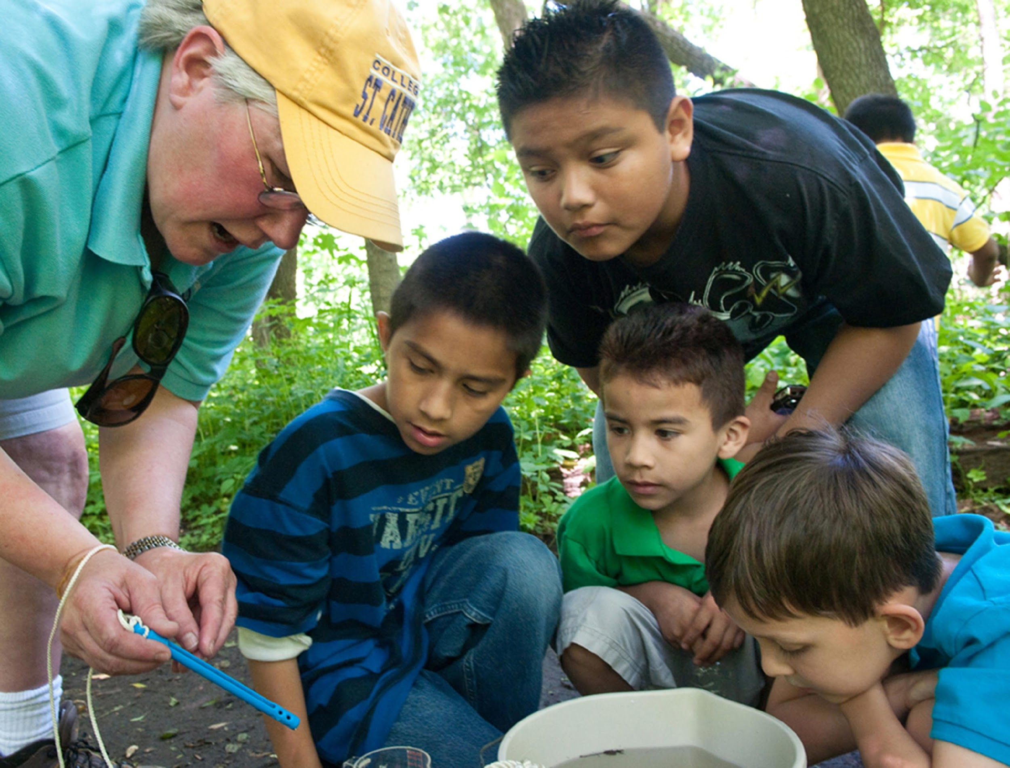
Simultaneous or Prior Investigations Required
The Water Alkalinity Protocol will allow you to determine the buffering capability to changes in the pH of your water body. This protocol is conducted at your GLOBE Study Site. You will need to define your GLOBE Study Site where you will conduct your Hydrosphere Investigation prior to beginning this protocol. The Hydrosphere Investigation Data Sheet is used to record all the hydrosphere measurements, including alkalinity. You will also want to map your Hydrosphere Site at some point. Since there is a close connection between alkalinity and pH, it would be helpful to collect pH data along with alkalinity. Additionally, atmospheric measurements of temperature and precipitation are helpful in interpreting the data.
Alkalinity Data Sheet OR Find your
documents here:
GLOBE Study Site Definition Sheet
Hydrosphere All Protocols Data Sheet
Mapping your Hydrosphere Study Site Field Guide

Slide 17
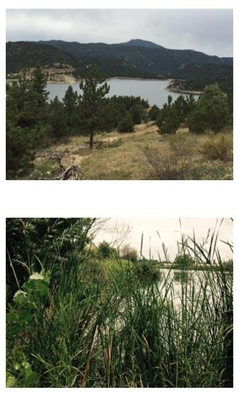
How to Collect Your Data
Site Selection: Hydrosphere Study Site
All your hydrosphere measurements are taken at the same Hydrosphere Study Site. This may be any surface water site that can be safely visited and monitored regularly, although natural waters are preferred. Sites may include (in order of preference):
1. Stream or river
2. Lake, reservoir, bay or ocean
3. Pond
4. An irrigation ditch or other water
body, if natural body is not available

Slide 18
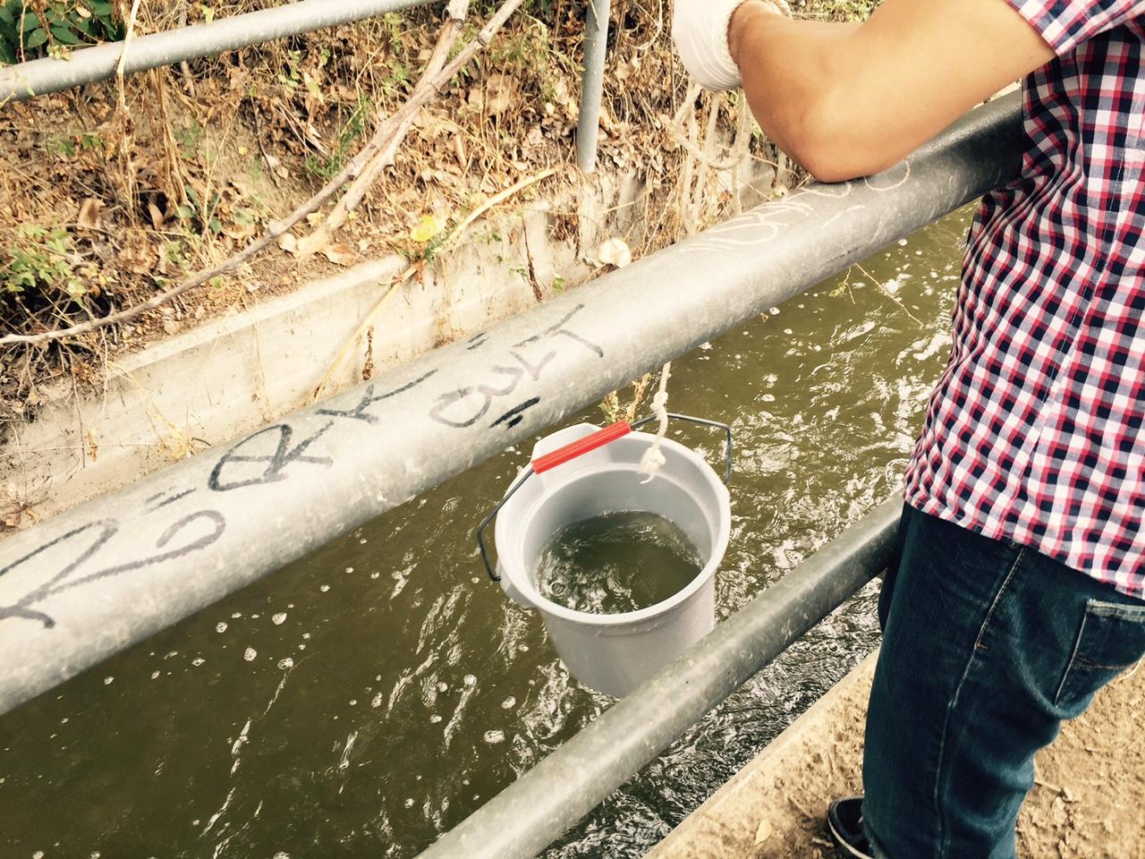
Site Selection: Hydrosphere Study Site
Select a specific site where the hydrosphere measurements (water temperature, dissolved oxygen, nitrate, pH, alkalinity, turbidity, and either conductivity or salinity) will be taken. If the selected study site is a moving body of water (i.e. stream or river), locate your sampling site at a riffle area as opposed to still water or rapids. This will provide a more representative measurement of the water in the stream or river.
If the selected study site is a still body of water i.e. a lake or reservoir), find a sampling site near the outlet area or along the middle of the water body. Avoid inlet areas. A bridge or a pier are good choices. If your water body is brackish or salty, you will need to know the times of high and low tide at a location as close as possible to your study site.

Slide 19

Sources for Equipment You Need for the Water Alkalinity Protocol
The following resources summarize the measurements associated with each protocol, associated skill level, scientific specifications for the instruments, and how to access the equipment you need (purchase, build, or download).
Where to find specifications for instrument used in GLOBE investigations
Where to find scientific instruments used in GLOBE investigations

Slide 20
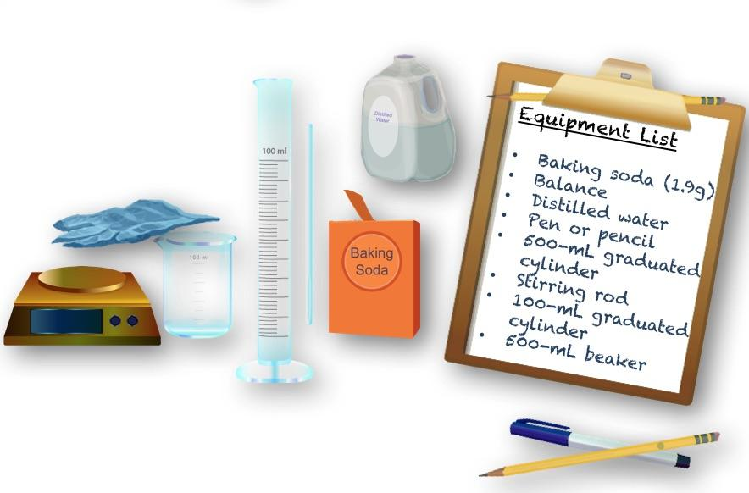
Quality Control Procedure: Create Baking Soda Alkalinity Standard 1
Assemble Equipment
Distilled Water
Digital Scale or Balance
500 ml Graduated Cylinder
Stirring Rod
100 ml Graduated Cylinder
500 ml Beaker
Gloves
Safety Glasses
Assemble Documents
Making the Baking Soda Alkalinity Standard

Slide 21
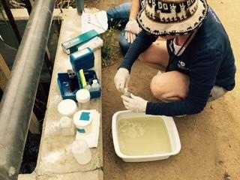

Water Alkalinity Protocol: Quality Control Overview
Alkalinity kits are based on the technique of adding a pH sensitive color indicator to the sample and then adding an acid titrant solution drop by drop until a color change is observed. To ensure accurate readings:
The alkalinity kit should be kept in a dry place away from direct heat.
All chemicals should be kept tightly capped.
Chemicals in the kits should last a year if they are not contaminated, and are stored in a dry area away from extreme heat.
The alkalinity standard should be kept refrigerated after opening and discarded after one year.
Store the titrator with the plunger removed to avoid the rubber end sticking in the tube.
Perform the Quality Control Procedure every 6 months.
Be sure to pay close attention to your quality control procedure. Without the quality control steps your alkalinity data will not be meaningful or comparable to data collected by others!

Slide 22
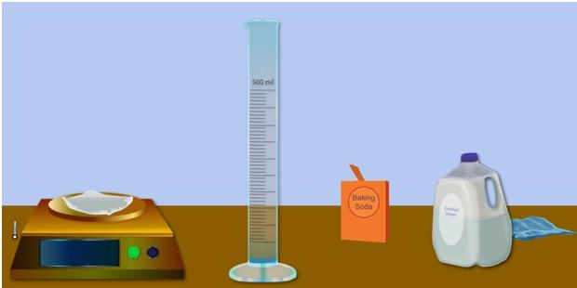
Quality Control Procedure: Create Baking Soda Alkalinity Standard 2
Weigh out 1.9 g of baking soda into 500-mL graduated cylinder.
Pour distilled water into the same beaker up to the 500-mL mark.
Pour solution into beaker and stir until completely dissolved.
Rinse the 500-mL graduated cylinder with distilled water.
Using the 100-mL graduated cylinder measure 15-mL of the solution and pour into clean 500-mL graduated cylinder.
Add distilled water to the solution in the graduated cylinder to the 500-mL mark.
This is your standard solution and the approximate alkalinity should be 84 mg/L.

Slide 23
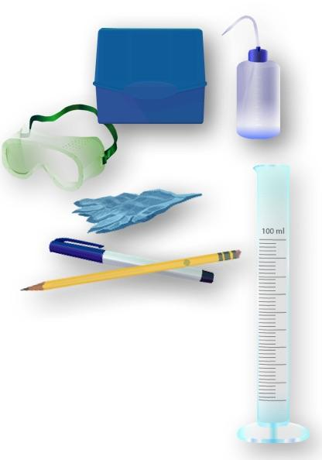
Quality Control Procedure for Alkalinity-1
Assemble Equipment
Alkalinity test kit
Alkalinity standard, purchased or made
Distilled water in wash bottle
Goggles
Pen or Pencil
Protective gloves
100-ml graduated cylinder
Assemble Documents
Hydrosphere Investigation Quality Control Data Sheet
Quality Control Procedure for Alkalinity
Time: 15 minutes
Frequency: Conduct quality control procedure twice a year

Slide 24
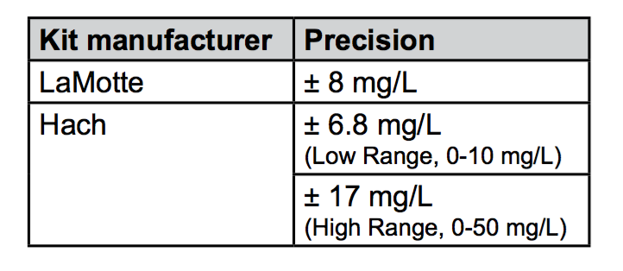
Quality Control Procedure for Alkalinity-2
Check the accuracy of the alkalinity kit with this procedure
Put on the gloves and goggles.
Fill in the top of the Hydrosphere Investigation Data Sheet. Make note of the standard being used along with kit manufacturer and model number.
Measure the alkalinity of your standard according to your kit’s directions.
Record the results on the data sheet.
Compare the results with the value of your standard. If using the baking soda standard results, it should be 84 mg/L + 10 mg/L. Otherwise check the range for your kit.
If the measured value is not within the expected range, repeat procedure with a fresh standard sample.
If the value is still not within range, discuss possible problems with a master trainer.
Maximum Acceptable Differences for Common Alkalinity Test Kits

Slide 25
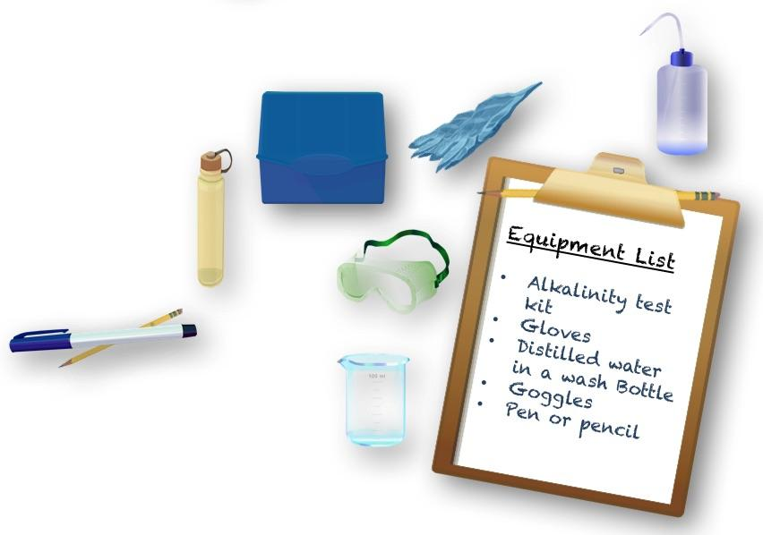
How to Collect your Data: Alkalinity Water Protocol-1
Assemble Equipment
Alkalinity Data Sheet OR Assemble Necessary
Documents:
Hydrosphere Investigation Data Sheet OR Hydrosphere All Protocols Data Sheet
Alkalinity Water Protocol

Slide 26
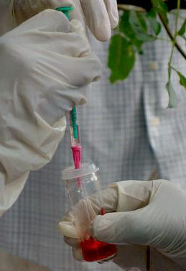
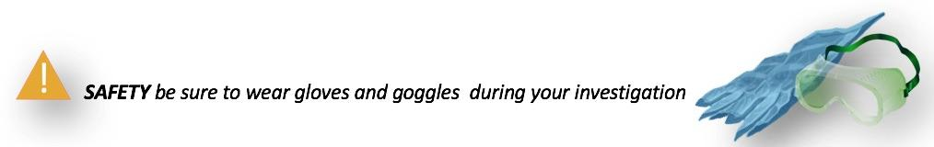
How to Collect your Data: Alkalinity Water Protocol-2
Fill in the top part of the Hydrosphere Investigation Data Sheet.
Put on protective gloves and goggles.
Follow the measurement instructions according to the alkalinity kit.
Record the measurement on Hydrosphere Investigation Data Sheet.
Repeat measurement twice using fresh water samples and record on data sheet as observers 2 and 3.
Calculate the average.
Each individual measurement should be within acceptable range specified by test kit. If one measurement is not in range, discard and find the average of the other two. If two or more are out of range repeat protocol from step 3.

Slide 27
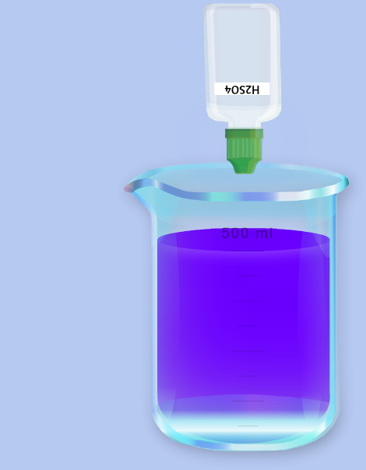
Technique Tips for Using Alkalinity Test Kits
Measure carefully. Read the volume of the sample in the sample bottle at eye level. Read at the bottom of the meniscus.
If using a titrator, make sure that the titrator is being read correctly. Most kits include instructions for the proper use of titrators.
If the alkalinity kit uses drops, hold the dropper bottle vertically so that all of the drops are the same size.
During the Quality Control Procedure and actual water testing, be sure to note the color change that gives the correct alkalinity. In many kits, it is an intermediate color change that gives the correct alkalinity and not the final color. For kits with an intermediate color (such as a LaMotte kit), if you are not sure when the intermediate color change occurs, read the titrator or write down the number of drops when you think it might be first occurring. For kits with only one color change during titration, add one more drop to see if the color changes further. If it does not, use the previous number you wrote down.

Slide 28
Let’s do a quick review- Question 4
How often should you perform the quality control procedure?
Every 6 months
Once a calendar year
Never, as long as you have made your own baking soda alkalinity standard and can vouch for its quality

Slide 29
Let’s do a quick review- Answer to Question 4
How often should you perform the quality control procedure?
Every 6 months- correct! ☺
Once a calendar year
Never, as long as you have made your own baking soda alkalinity standard and can vouch for its quality

Slide 30
Let’s do a quick review -Question 5
Each measurement you make should be within the acceptable range of the test kit. If one of your three measurements is not in the range, you
Repeat the protocol from the beginning
Discard one of the measurements and average the other two
Average all three measurements and make a note in the metadata

Slide 31
Let’s do a quick review - Answer to Question 5
Each measurement you make should be within the acceptable range of the test kit. If one of your three measurements is not in the range, you
Repeat the protocol from the beginning
Discard one of the measurements and average the other two- correct! ☺
Average all three measurements and make a note in the metadata

Slide 32
Let’s do a quick review - Question 6
When measuring, read the volume of the sample at eye level. Then:
Record the measurement at the top of the meniscus
Average the value between the top and the bottom of the meniscus
Record the measurement at the bottom of the meniscus

Slide 33
Let’s do a quick review - Answer to Question 6
When measuring, read the volume of the sample at eye level. Then:
Record the measurement at the top of the meniscus
Average the value between the top and the bottom of the meniscus
Record the measurement at the bottom of the meniscus- correct! ☺
In the next few slides, we will review how to report data to GLOBE and visualize data using the GLOBE Visualization System.

Slide 34

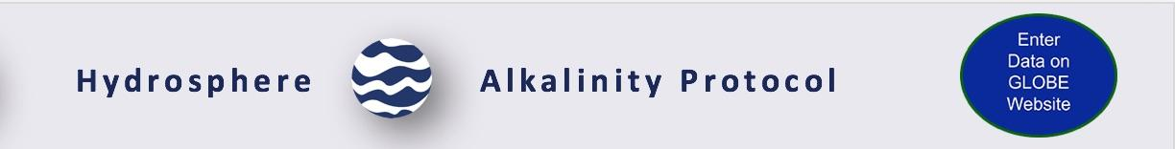
Hydrosphere Site Creation
If this is your first time making hydrosphere observations at this location, you will need to create a new Hydrosphere study site before entering data.
To do this, please review the Introduction to Hydrosphere training.

Slide 35

Submit Your Data to GLOBE
1.Desktop Data Entry: Log environmental data directly on the GLOBE website.
2.GLOBE Observer App: The app allows users to enter data directly from an iOS or Android device for any GLOBE protocol.

Slide 36
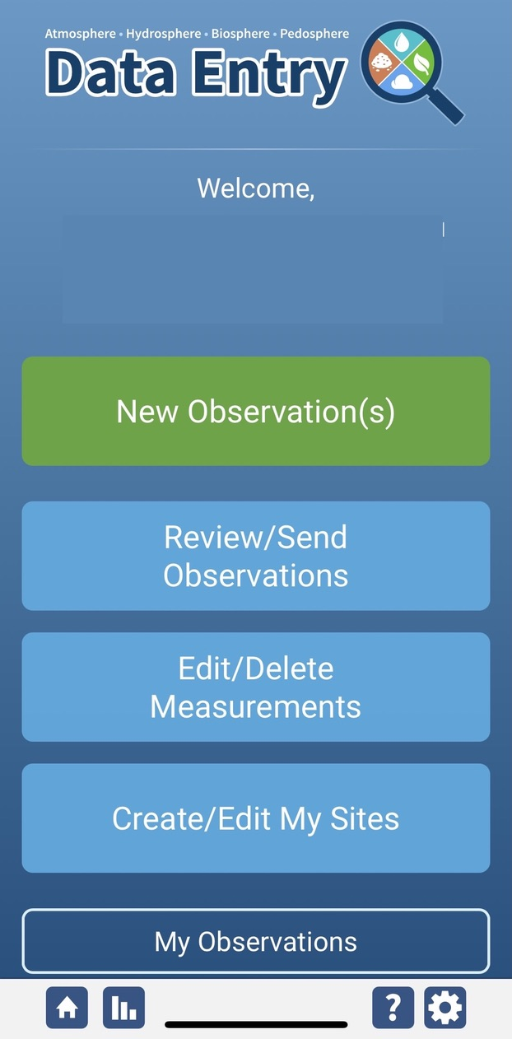
Alkalinity Protocol Data Entry
To enter data, first return to GLOBE Observer main page by clicking the home button in the bottom left.
Select “Data Entry”.
Next, click “New Observation(s)”

Slide 37
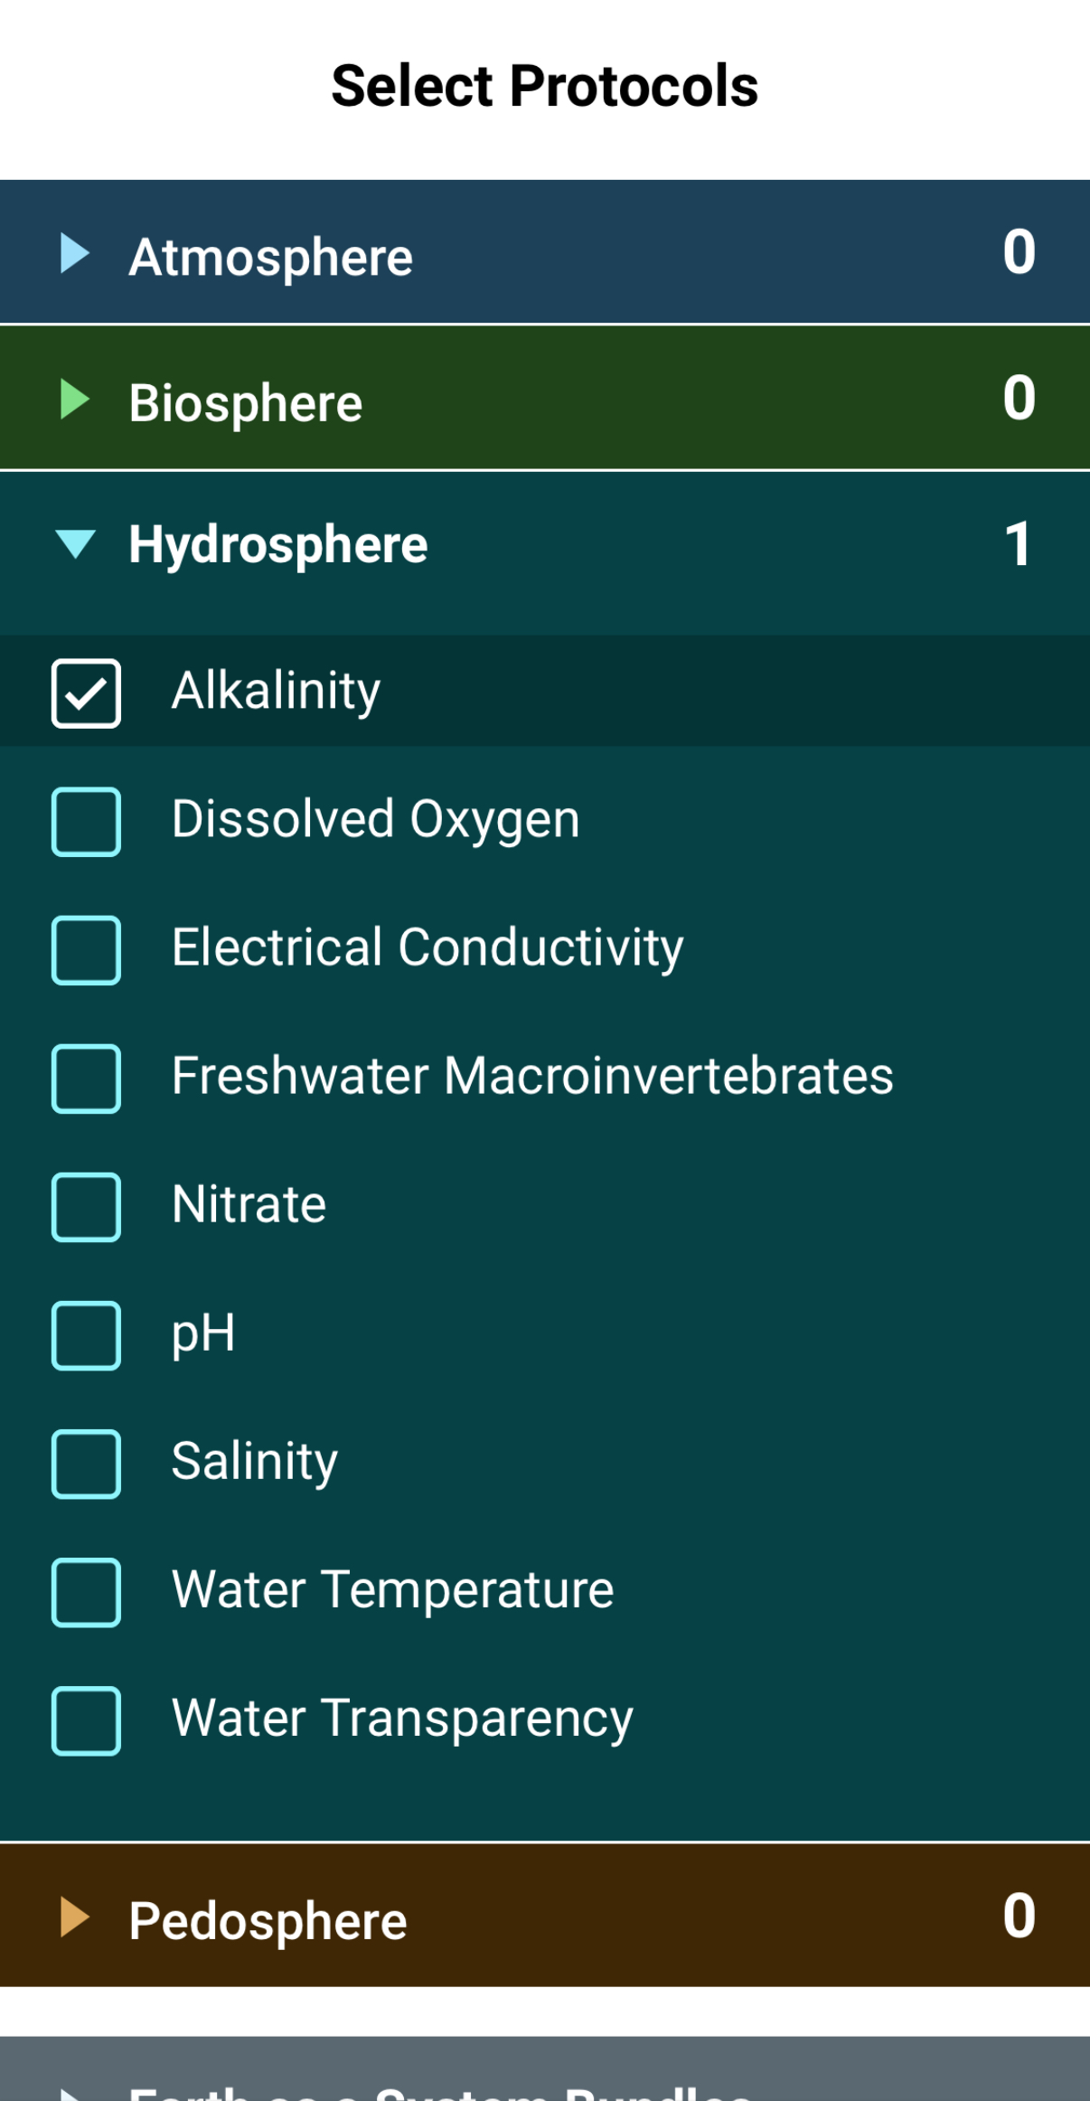
Alkalinity Protocol Data Entry
Select Alkalinity from the list of Hydrosphere protocols and click Continue at the bottom of the screen.

Slide 38
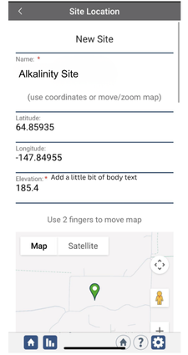
Alkalinity Protocol Site Information
If you have not already created a Hydrosphere site, create one now.
Click “New Site” at the bottom of the site location screen and choose a name for your new site.

Slide 39
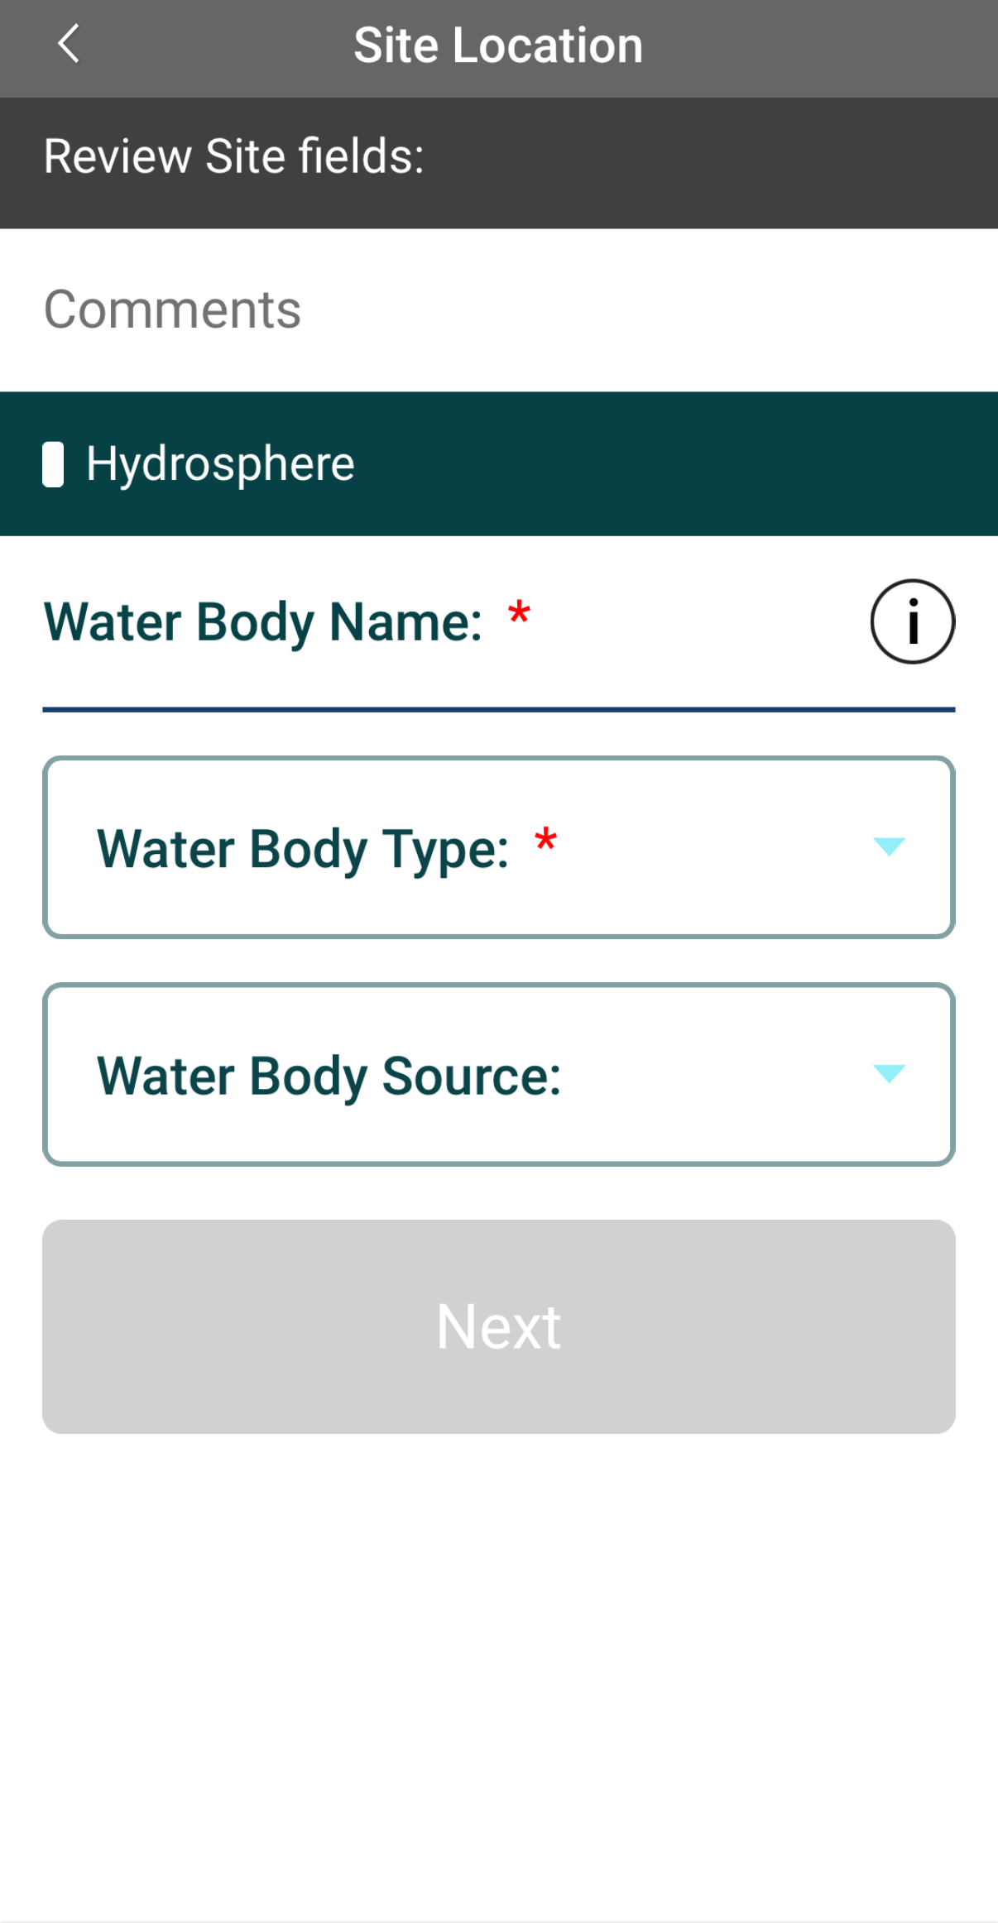
Alkalinity Protocol Site Information
Enter the Water Body Name.
Select the Water Body Type and Water Body Source from the dropdown list of options.

Slide 40
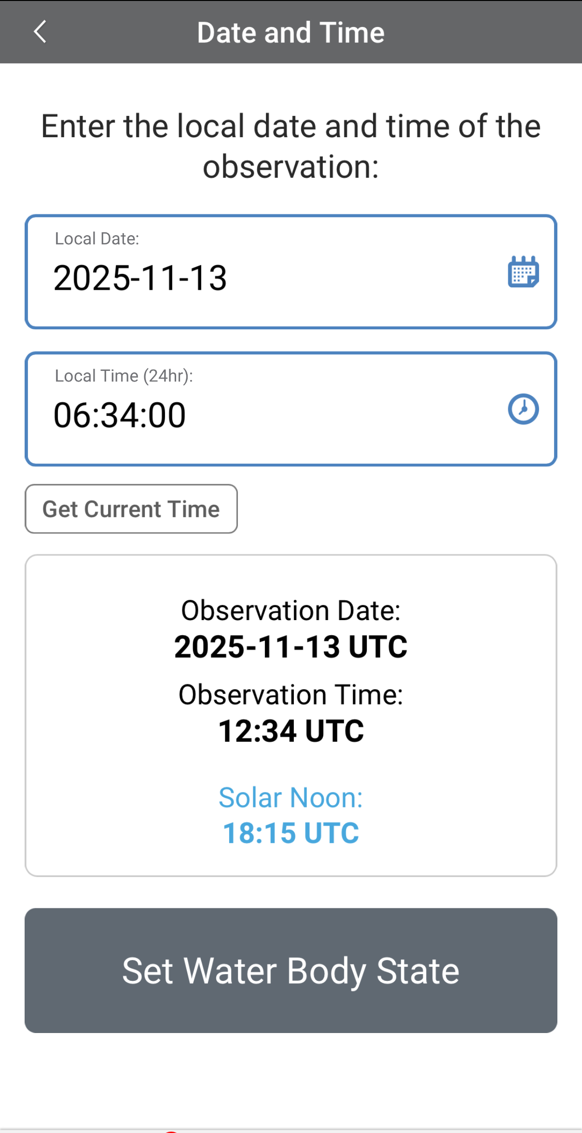
Entering Measurement Data
Enter the date and time you took the measurements.
Once you enter the date, select Set Water Body State to enter your data.

Slide 41
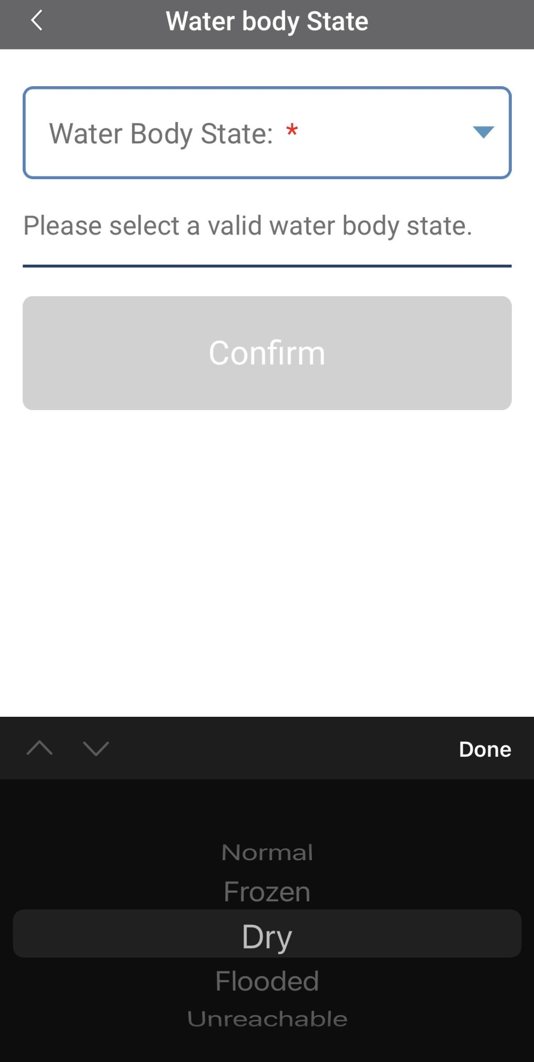
Enter the Water Body State
Select the Water Body State from the dropdown list of options.

Slide 42
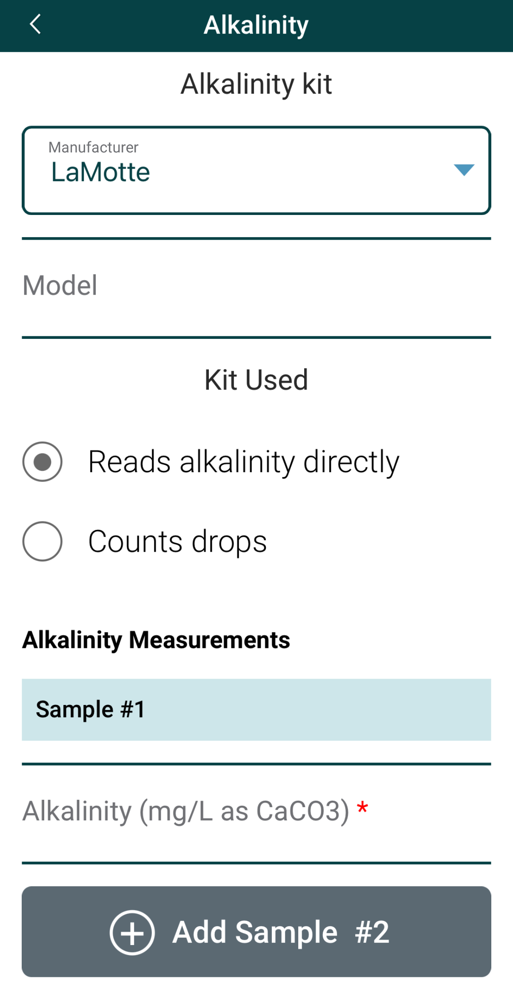
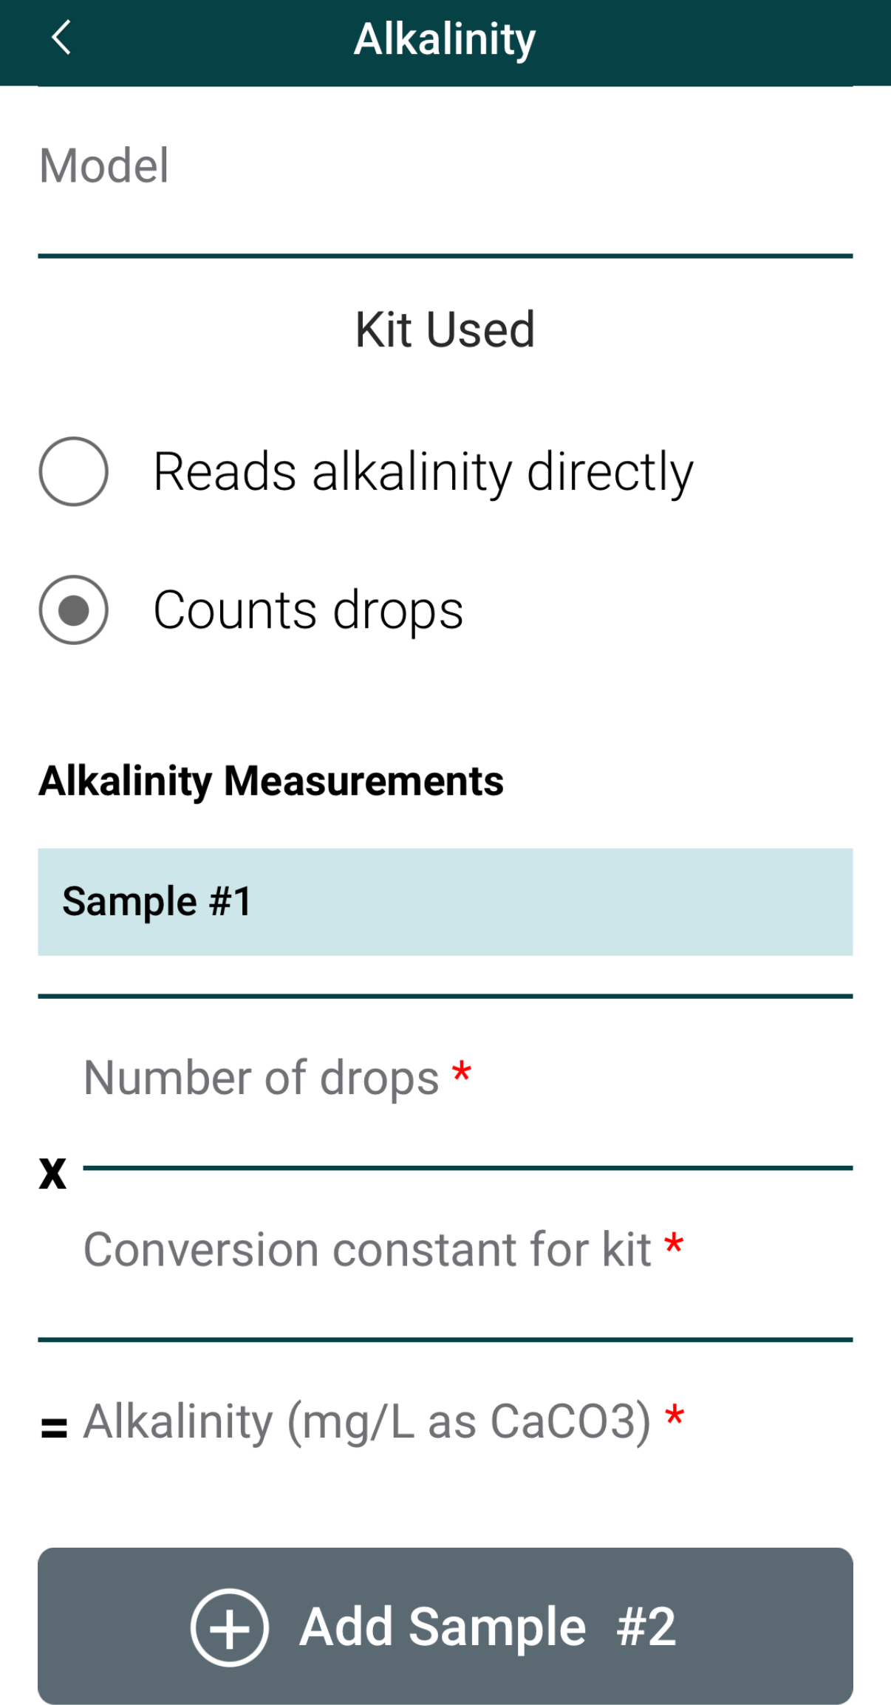
Enter Alkalinity Measurement Data
Select the Manufacturer for the type of alkalinity kit used.
Select the method of obtaining the measurement.
Enter the alkalinity measurement data, either read directly from the kit or by counting the number of drops and using the conversion constant for the kit.

Slide 43
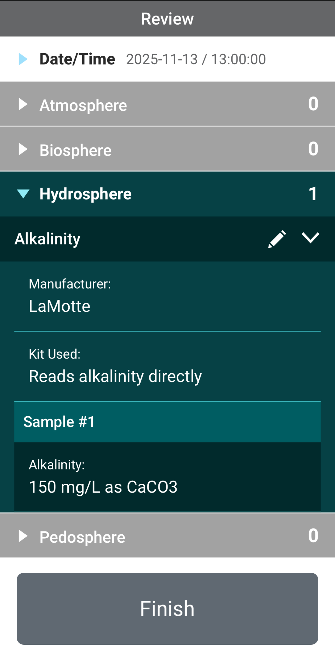
Review Data Entry and Send Data
Review the data you entered and check for errors.
When complete, select Finish to complete the send the observation to GLOBE.

Slide 44
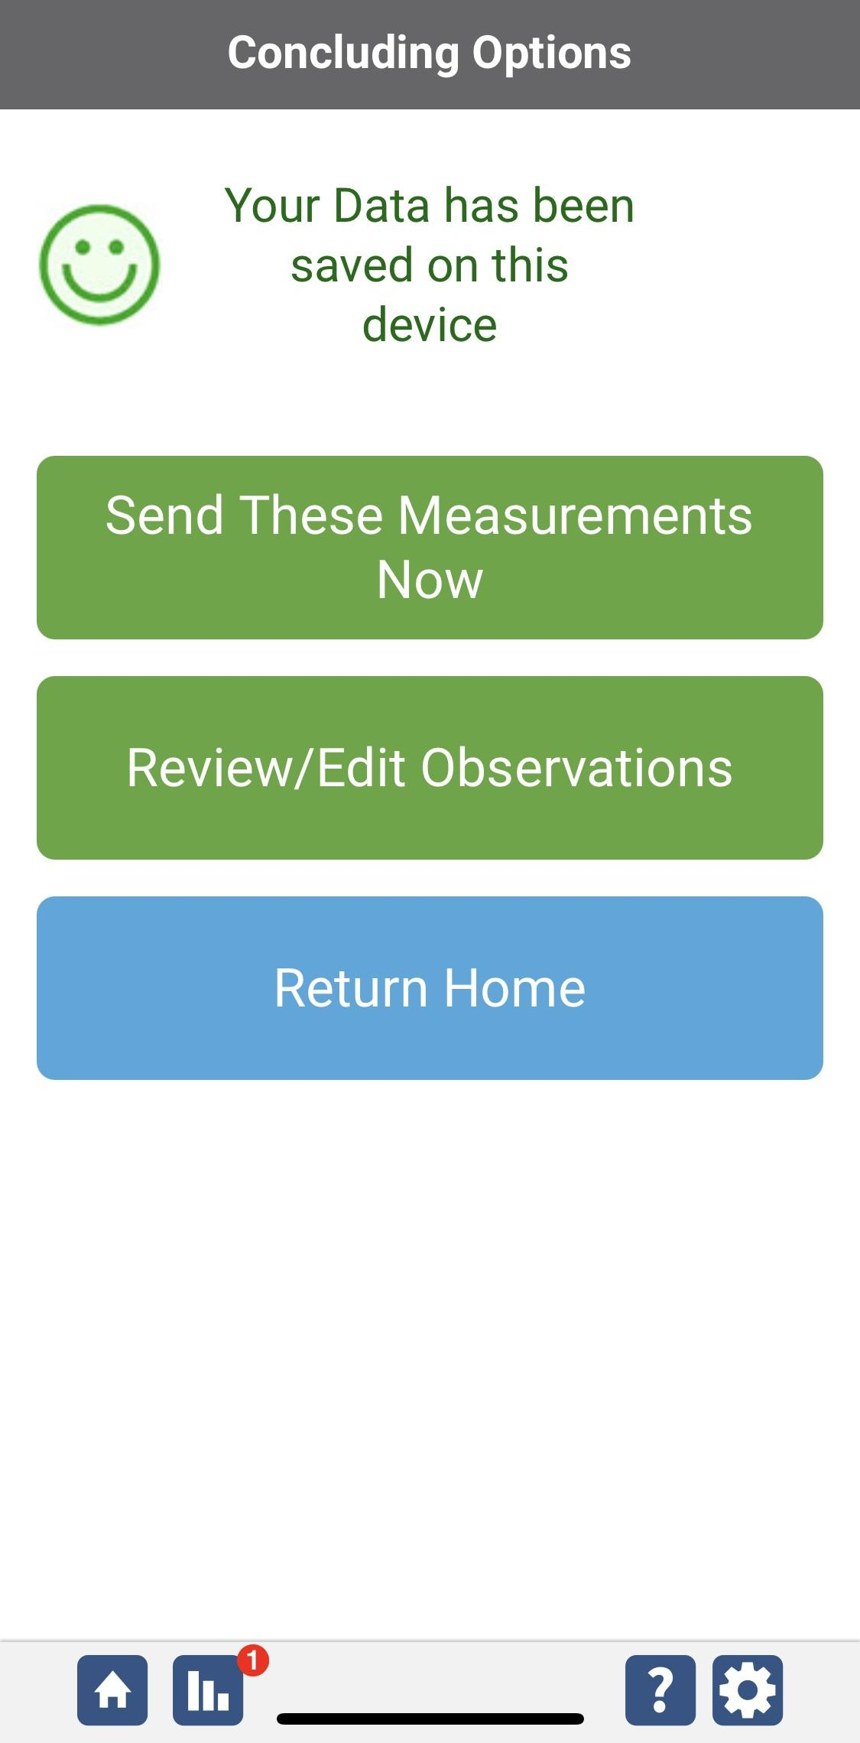
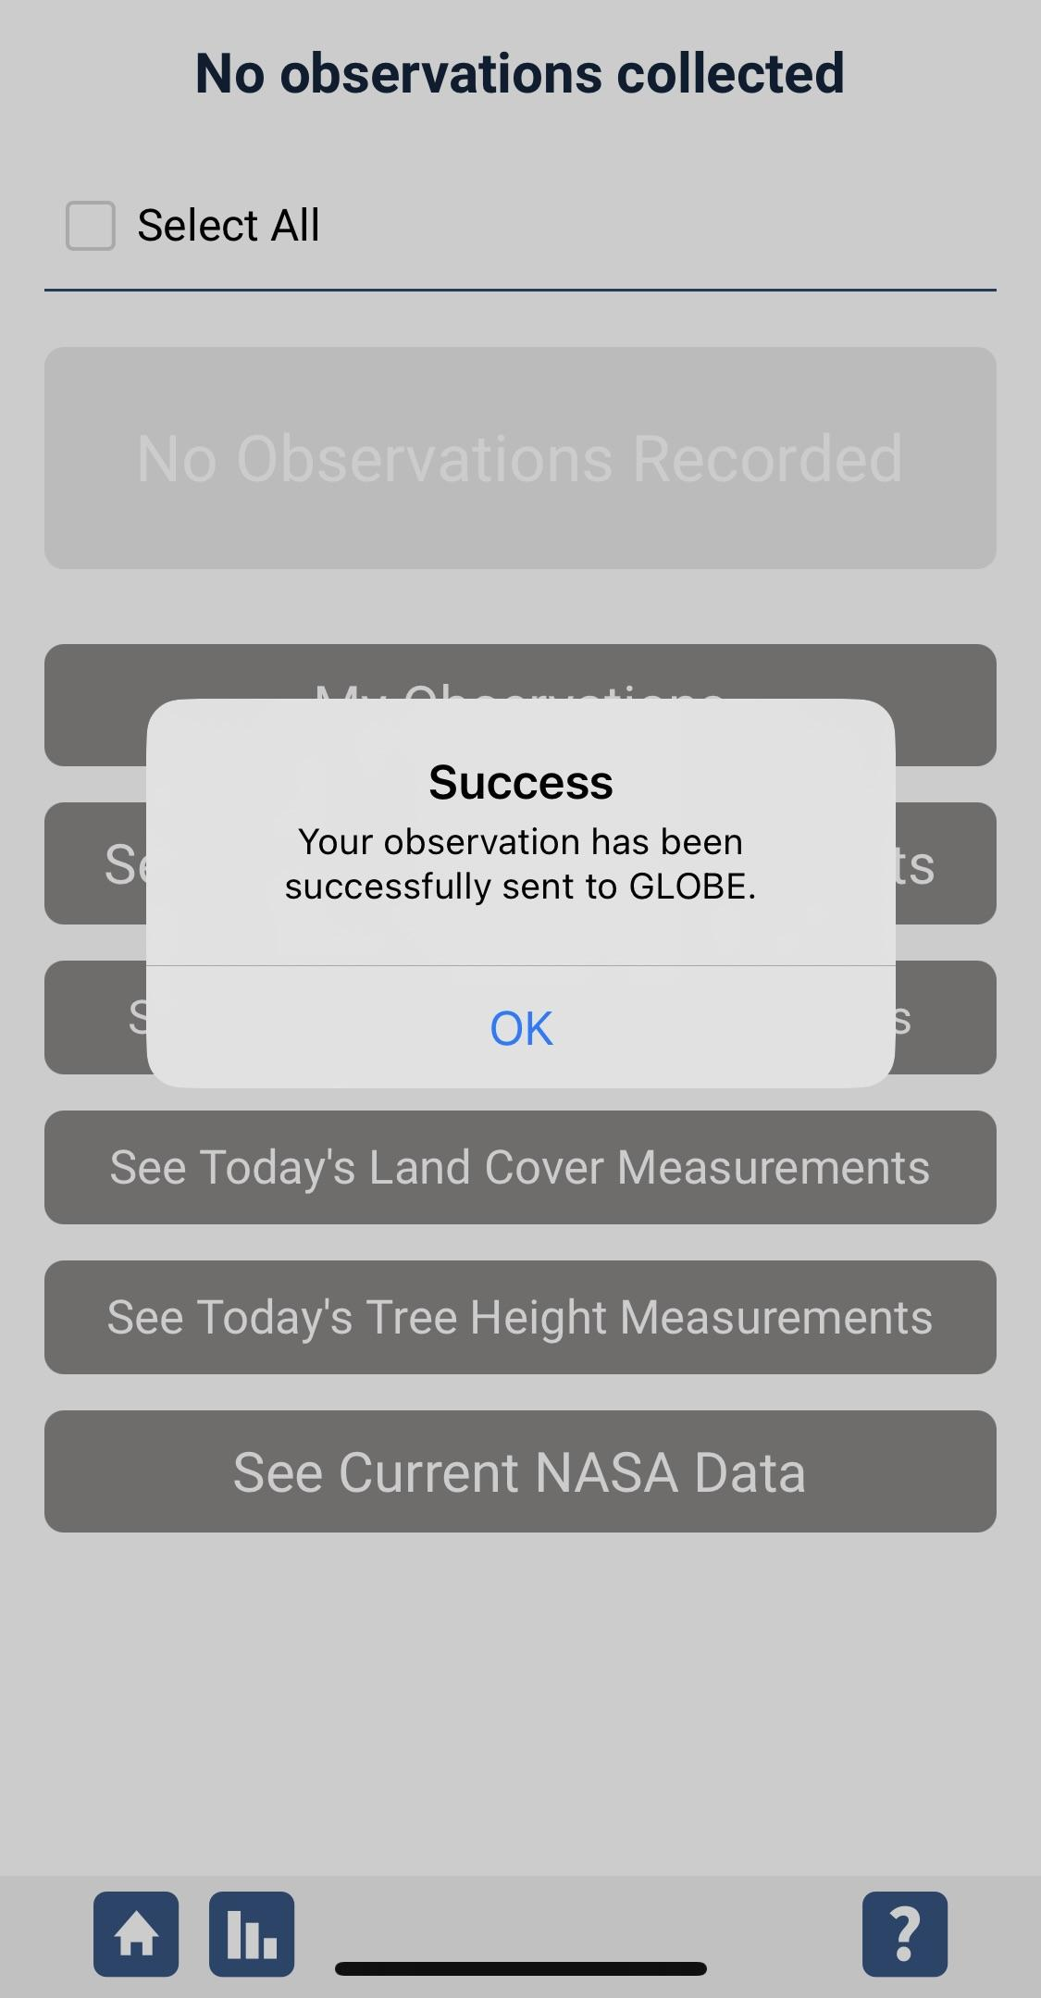
Data System Responses
If your observations are within the appropriate ranges, you will see a green smiley face.
You can review or edit your observation if needed.
When ready, select “Send these measurements now” to send your data to GLOBE. When it has been sent, you will see a “Success” message.

Slide 45

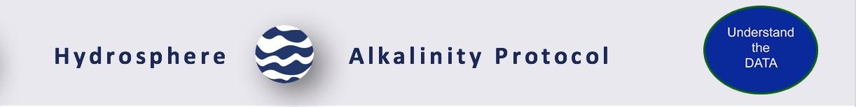
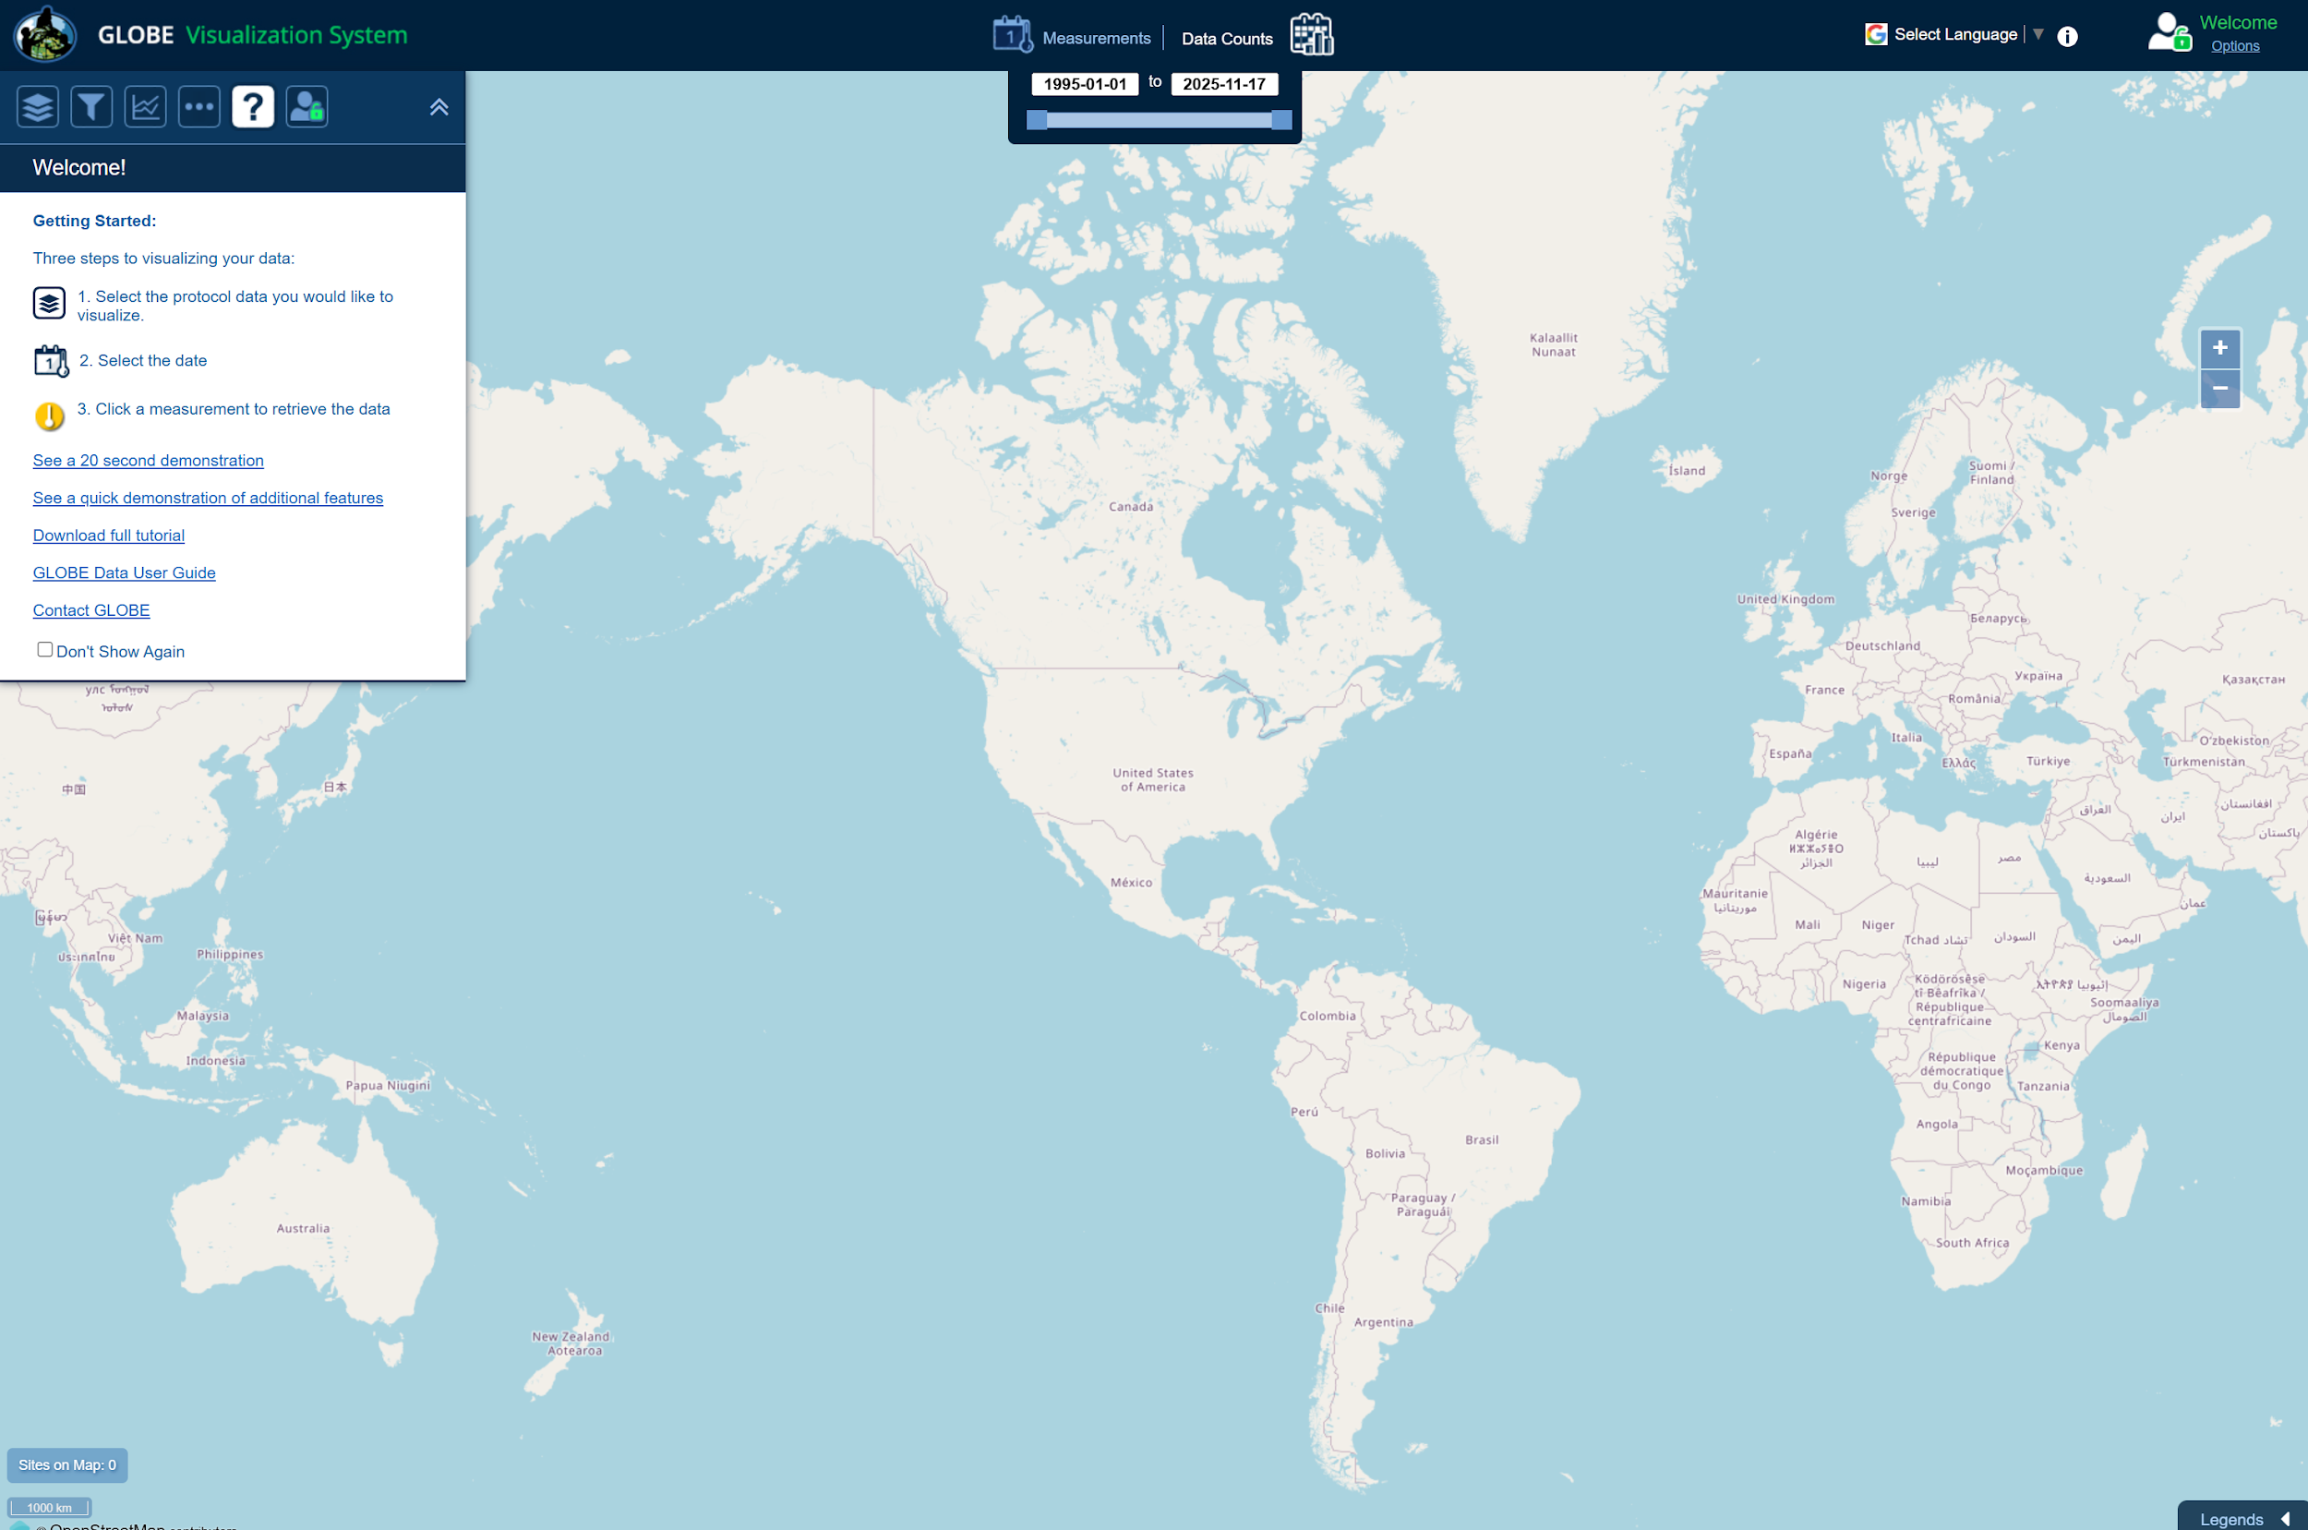
Visualize and Retrieve Alkalinity Data: 1/4
The GLOBE Visualization System page enables you to search to globe for this data. Here is a link to this page: https://vis.globe.gov/GLOBE/
And here is a step-by-step tutorials on Using the Visualization System will assist you in finding and analyzing GLOBE data: PDF version
Follow the three simple steps to visualize your data. Demonstrations and tutorials are also available in the same “Getting Started” window.

Slide 46
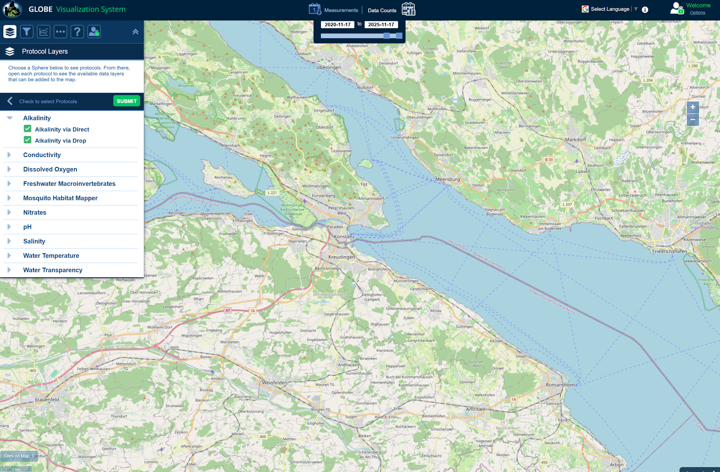
Visualize and Retrieve Alkalinity Data: 2/4
GLOBE provides the ability to view and interact with data measured across the world. Select our visualization tool to map, graph, filter and export nitrate data that have been measured across GLOBE protocols since 1995. Here are screenshots steps you will use when you use the visualization tool:
Select the “Data Counts” option and select your date range.
Select Hydrosphere, then Alkalinity, and then check the two boxes related to Alkalinity. Now, click the “Submit” button.

Slide 47
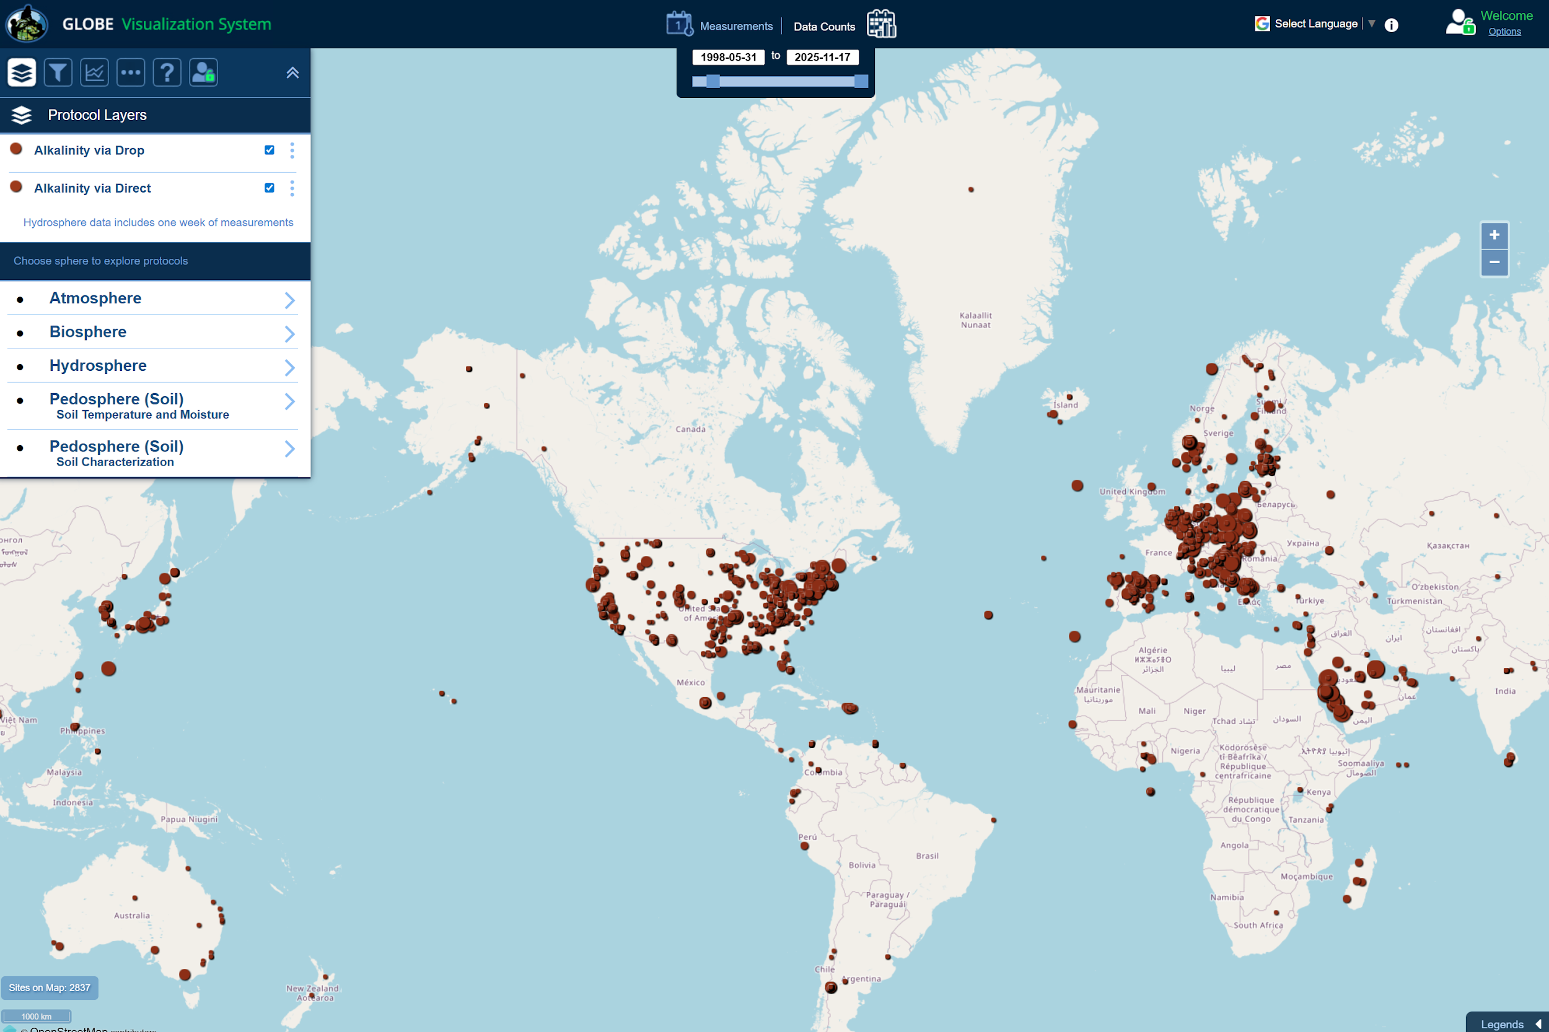
Visualize and Retrieve Alkalinity Data: 3/4
Your Data request will provide you with a map of sites with Alkalinity data. Select the sampling site you are interested in, and a box will open with data summary for that site.

Slide 48
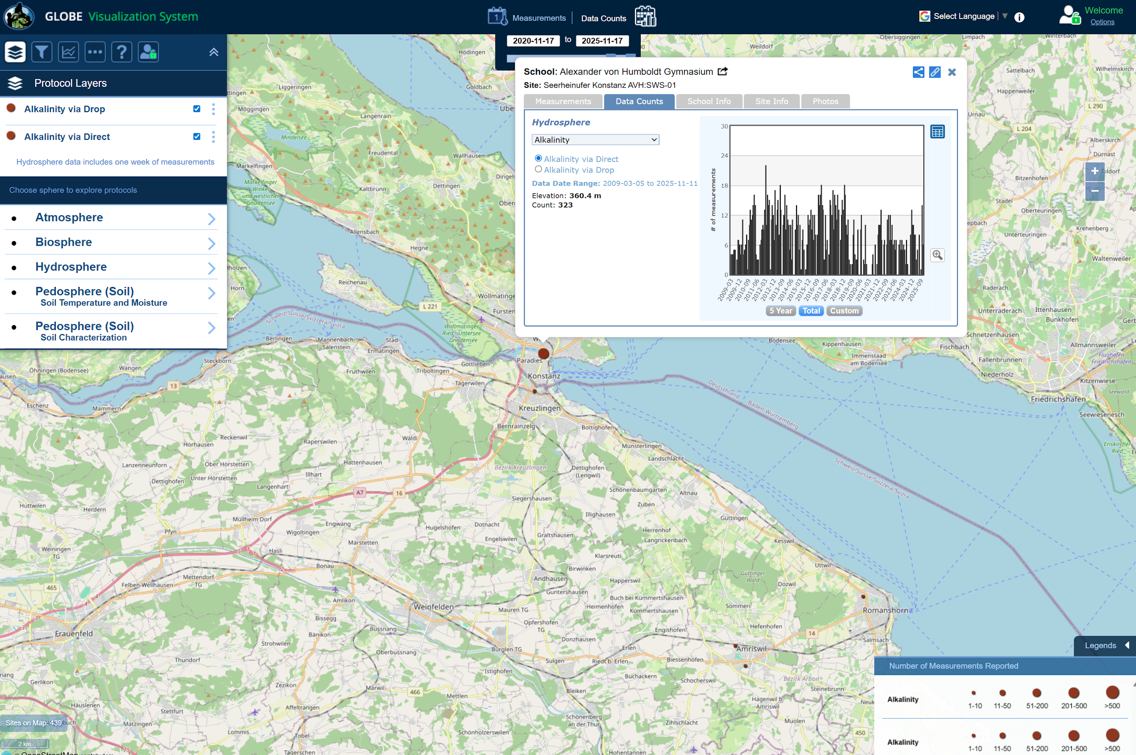
Visualize and Retrieve Alkalinity Data: 4/4
Click on the expand symbol to see a larger plot.
This selection is data from a school in Germany. They collected a lot of data in the selected date range.
School: Alexander von Humboldt Gymnasium

Slide 49
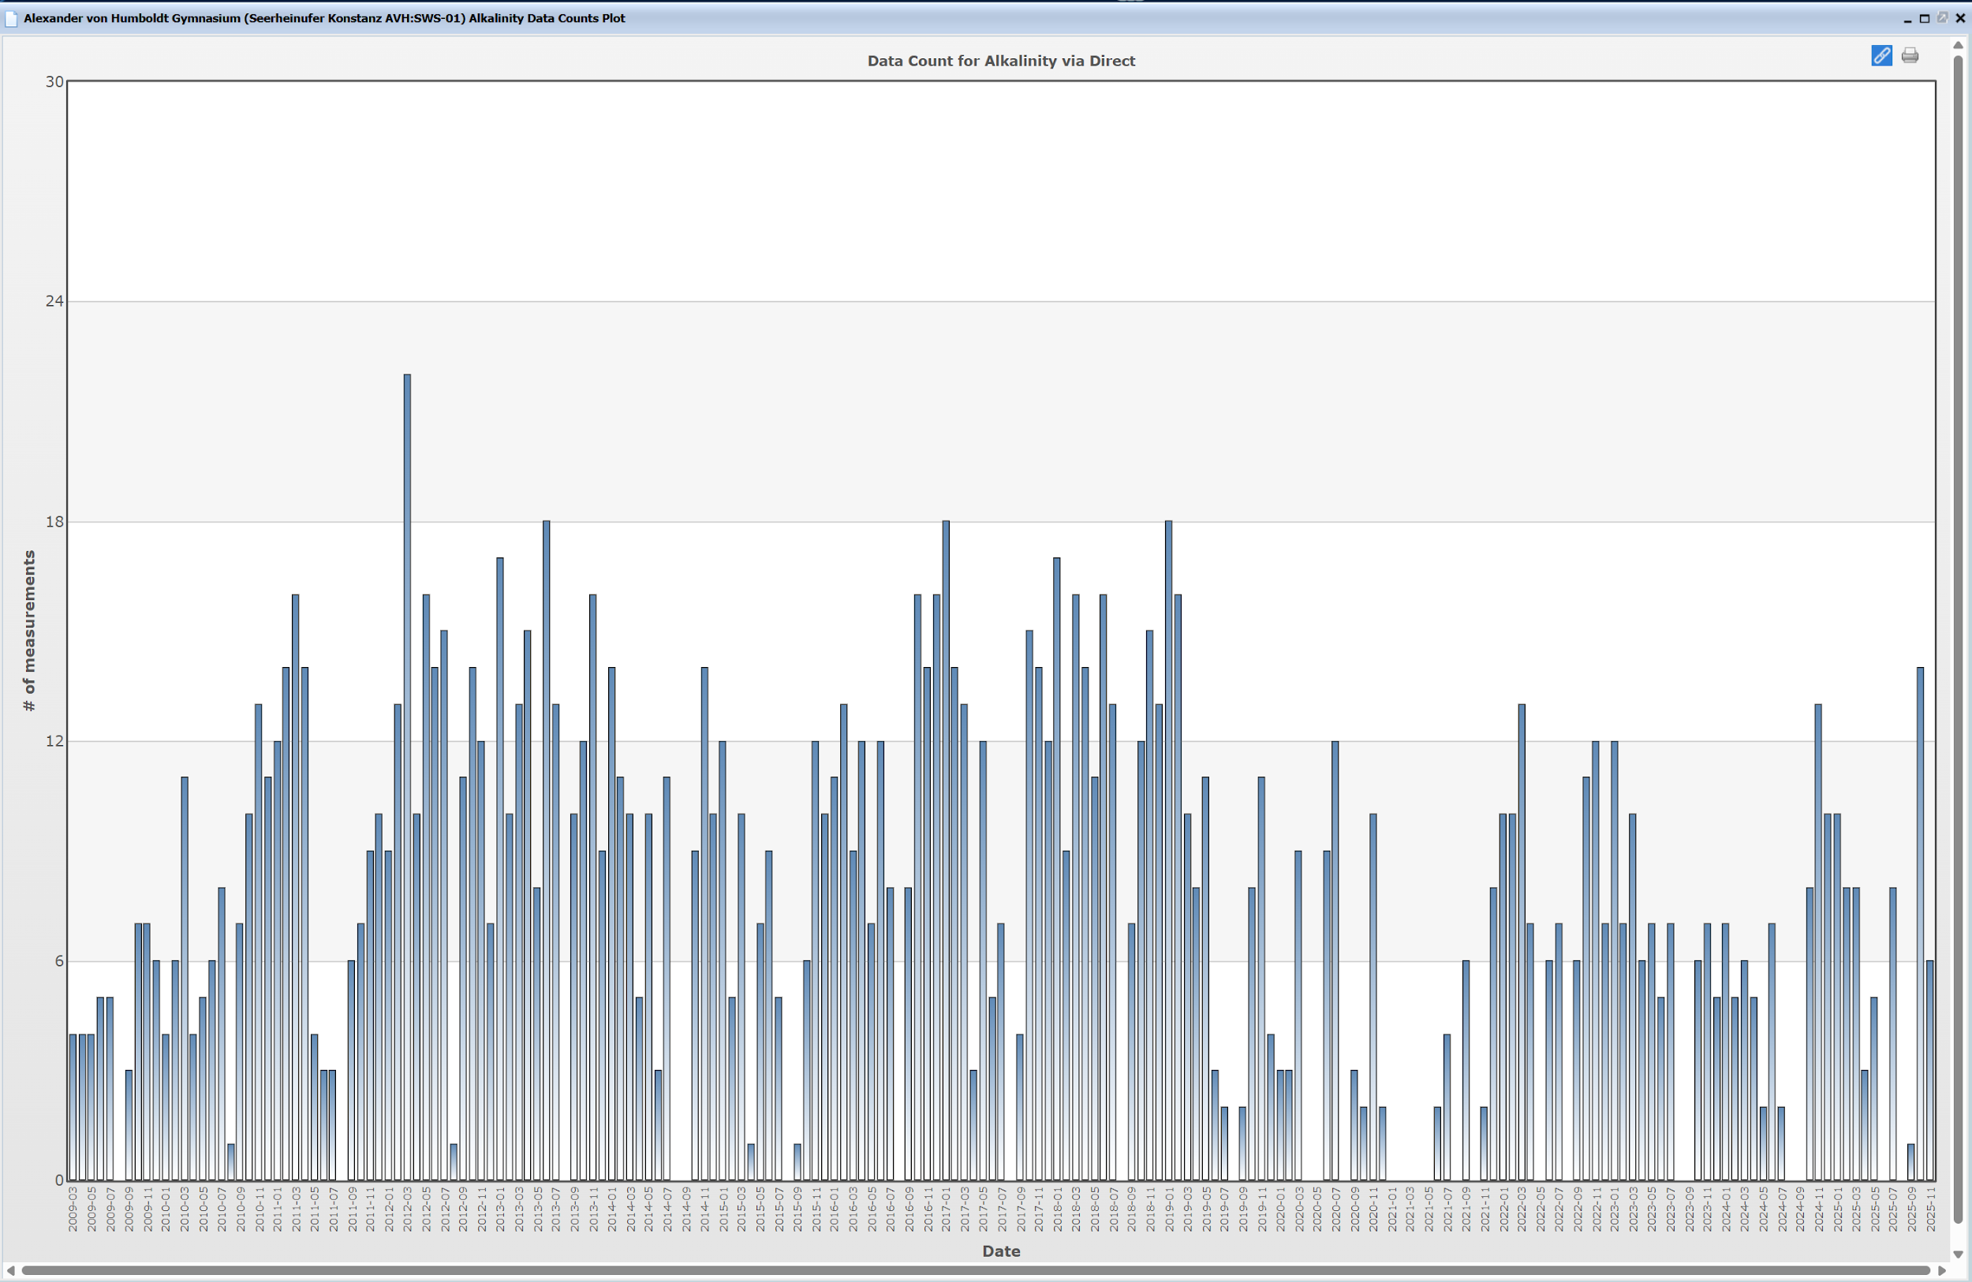
Visualize and Retrieve Alkalinity Data, Expanded Plot for Number of Observations

Slide 50
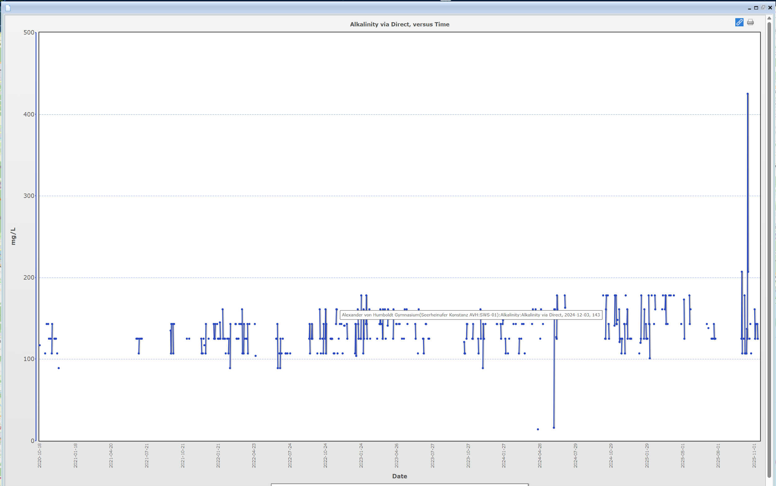
Visualize and Retrieve Alkalinity Data, Expanded Plot for Measurement Data

Slide 51
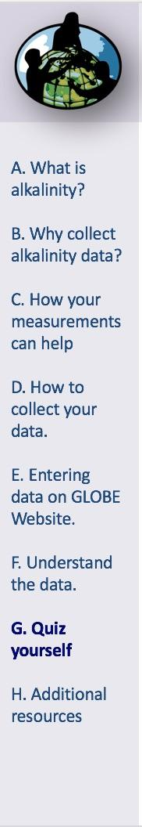
Review questions to help you prepare to conduct the Hydrosphere Alkalinity Protocol
The hydrosphere connects all parts of the Earth system: what are three forms that water can be found on Earth?
Where does a water body’s alkalinity originally come from, in natural settings?
What does it mean when we say that a water body is well-buffered?
Alkalinity is reported as the concentration of (this substance)_________ in units of either ppm or _______.
If the alkalinity of water is below 100 mg/L , would it be described as or pH sensitive or well buffered?
What step do you need to complete before beginning the Alkalinity measurements using the test kit?
You should always hold your titrator at a slight angle/vertically/horizontally
Most water bodies have alkalinity values between 40-300 ppm. What would that measurement be in mg/L?
What are the safety precautions you should take when doing any of the hydrology protocols?
How does alkalinity of a water body relate to its pH?

Slide 52
Are you ready to take the quiz?
You have now completed the slide set. If you are ready to take the quiz, sign on and take the quiz corresponding to Alkalinity Protocol.
You can also review the slide stack, post questions on the discussion board, or look at the FAQs on the next page.
When you pass the quiz, you are ready to take Alkalinity Protocol measurements!

Slide 53
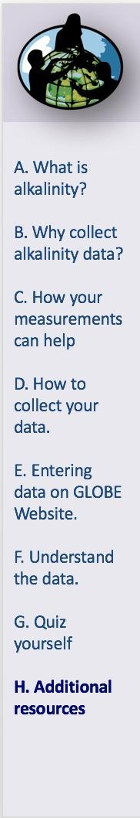
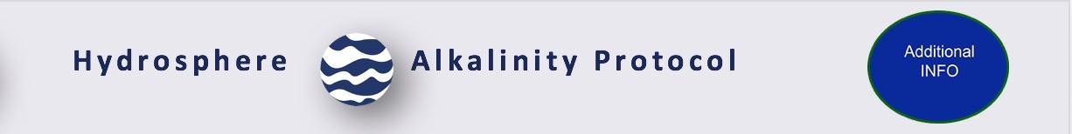
FAQ: Frequently Asked Questions
How can I be sure when the color change has happened?
Become familiar with the color change by doing the Quality Control Procedure.
Should I worry if my water site has very low alkalinity?
Some areas will naturally have low alkalinity. This might be true in mountain streams. The waters have not contacted rocks or soil long enough for the rocks to dissolve. This just means that these areas are more sensitive to acid additions.
How do I know if my data are reasonable?
Alkalinity values range from close to 0.0 ppm to more than 500 ppm, although most water bodies will have values between 40-300 ppm. Discovering unusual values in the data often depends on knowledge of typical patterns at a site. If a site has been measured with almost no alkalinity for many months, then suddenly has 300 ppm, students should recognize a deviation from the normal pattern and investigate further. Other sites may naturally have large swings in alkalinity in response to precipitation, snowmelt, or other inputs into the system.

Slide 54
Additional Questions
What is the relationship between changes in alkalinity and changes in pH?
How does the type of rocks or composition of soil near the site affect the alkalinity of the water?
What environmental factors can alter the alkalinity of the site?
Are there seasonal patterns or changes in alkalinity at your site? Is this site specific?

Slide 55

We want your Feedback!
Please provide us with feedback about this module. This is a community project and we welcome your comments, suggestions and edits! Comment here: Training@nasaglobe.org
Questions about the content of this module? Contact GLOBE: help@nasaglobe.org
Slides:
Russanne Low, Ph.D., University of Nebraska-Lincoln, USA
Rebecca Boger, Ph.D., Brooklyn College, NYC, USA
Photos: Russanne Low
Art: Jenn Glaser, ScribeArts
More Information:
GLOBE Program
NASA Global Climate Change: Vital Signs of the Planet
The GLOBE Program is sponsored by these organizations:
Version 11/17/2025. Modified by GLOBE Implementation Office Science, Training, Education and Public Engagement Team. If you edit and modify this slide set for use for educational purposes, please note “modified by (and your name and date)“ on this page. Thank you.

