Slide 1
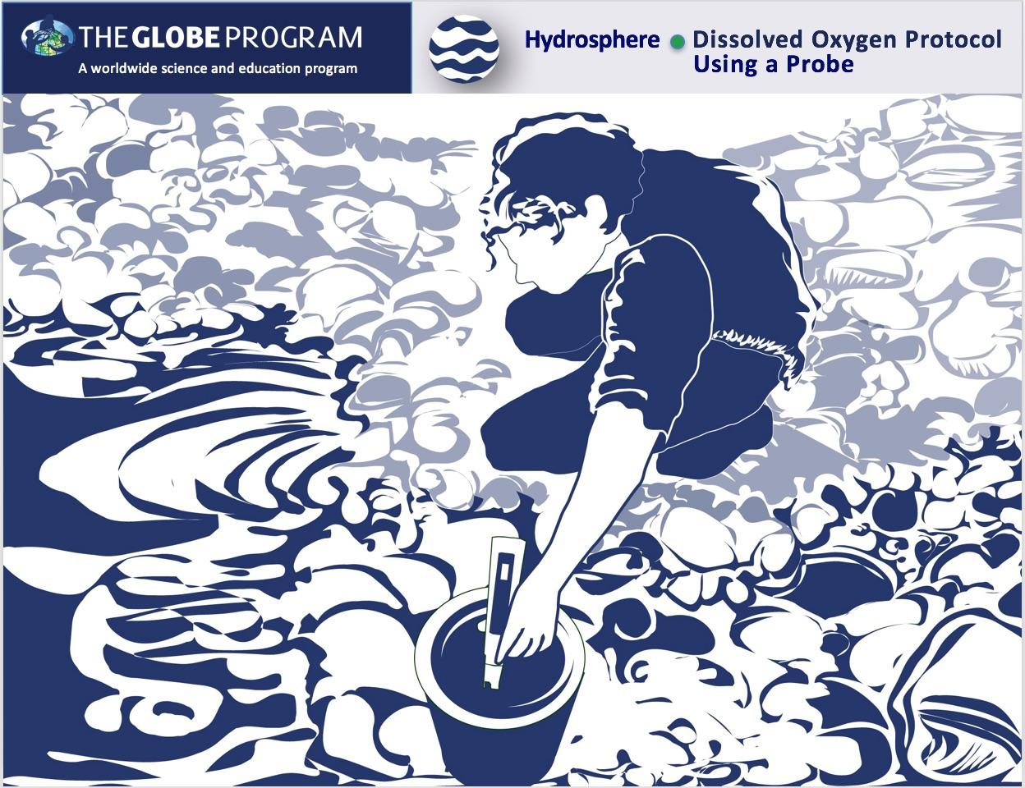


Slide 2

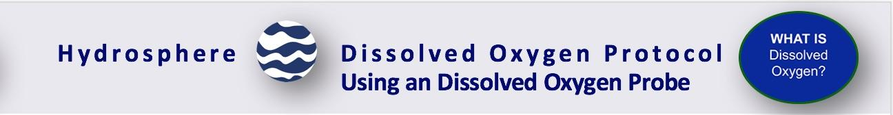
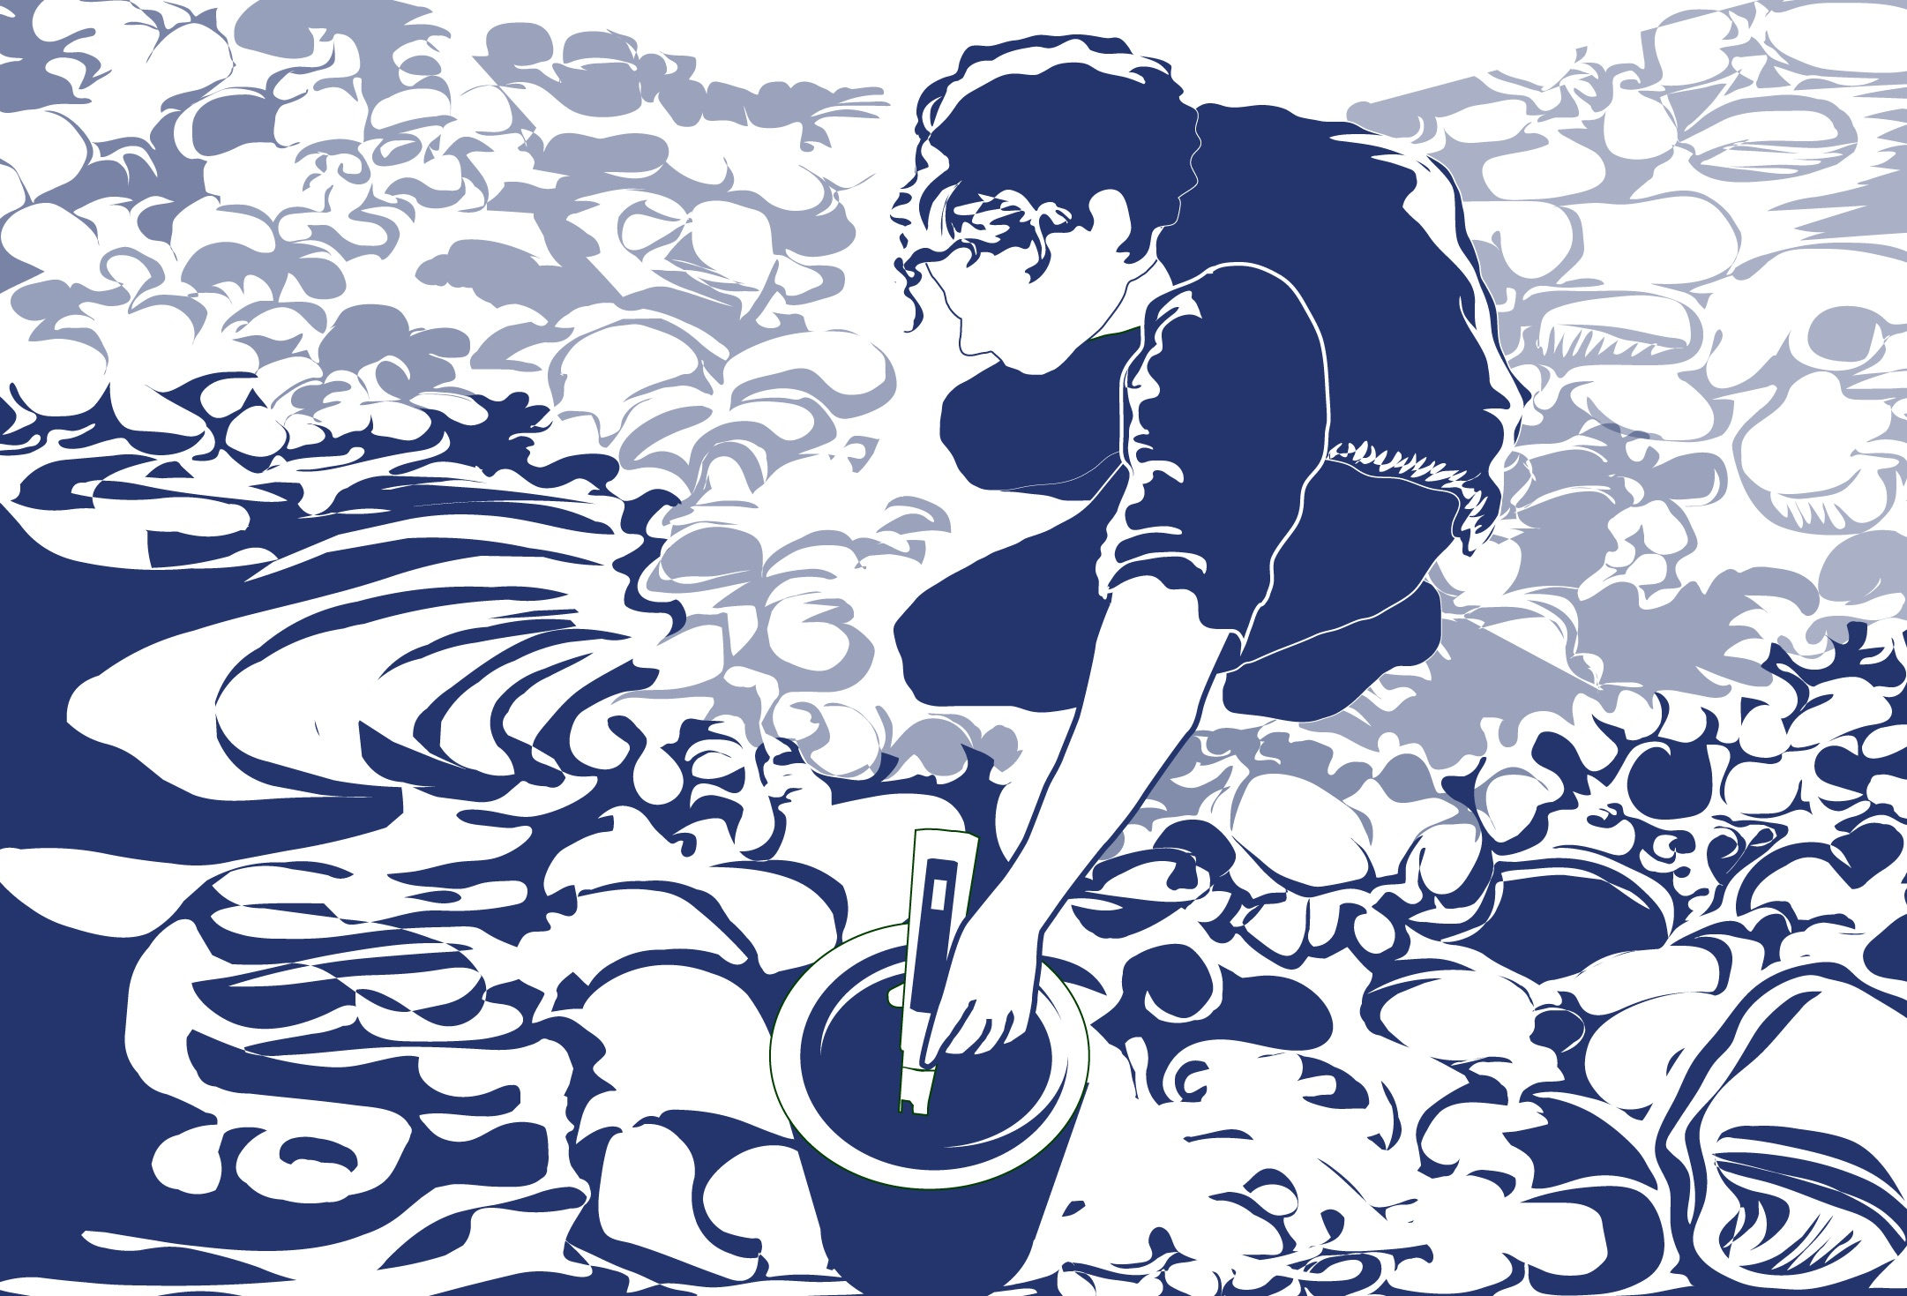
Overview
This module:
Reviews the selection of a GLOBE hydrology site
Reviews the water sampling technique used in GLOBE hydrology protocols
Provides a step by step introduction of the protocol method
Learning Objectives
After completing this module, you will be able to:
Define dissolved oxygen and explain how changing environmental conditions result in different measurements
Describe the importance of instrument calibration in the the collection of accurate data
Conduct dissolved oxygen measurements using a probe
Upload data to the GLOBE portal
Visualize data using GLOBE’s Visualization System

Slide 3
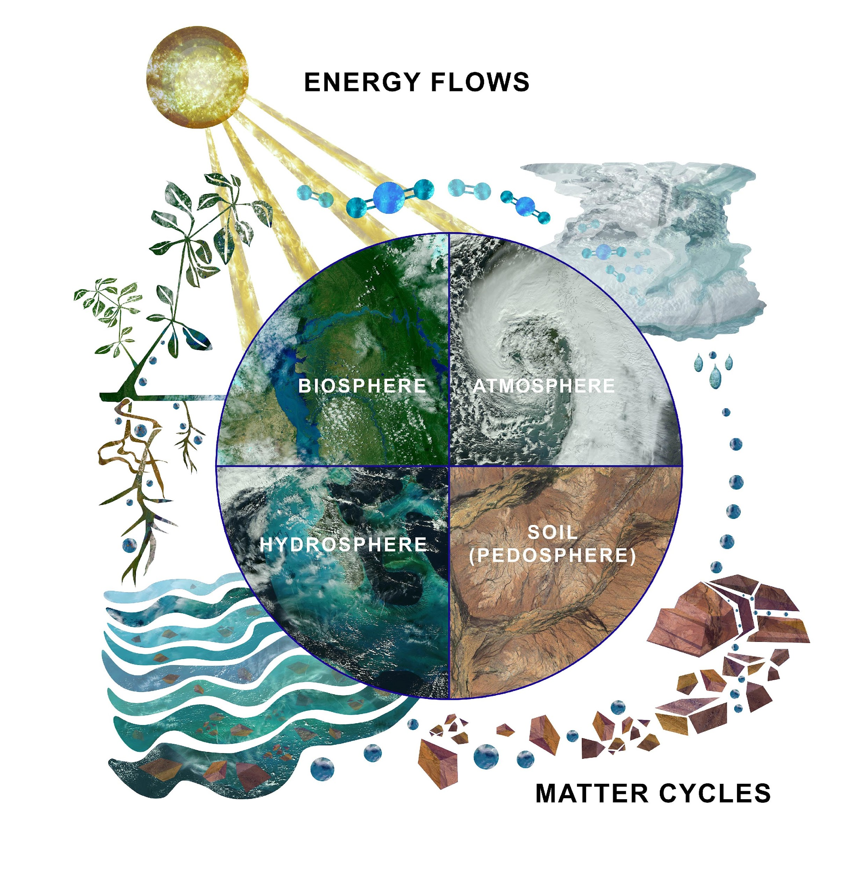
The Hydrosphere
The hydrosphere is the part of the Earth system that includes water, ice and water vapor. Water participates in many important natural chemical reactions and is a good solvent. Changing any part of the Earth system, such as the amount or type of vegetation in a region or from natural land cover to an impervious one, can affect the rest of the system. Rain and snow capture aerosols from the air. Acidic water slowly dissolves rocks, placing dissolved solids in water. Dissolved or suspended impurities determine water's chemical composition.
Current measurement programs in many areas of the world cover only a few water bodies a few times during the year. GLOBE Hydrosphere protocols will allow you to collect valuable data to help fill these gaps and improve our understanding of Earth's natural waters.
The Earth System: Energy flows and matter cycles.

Slide 4
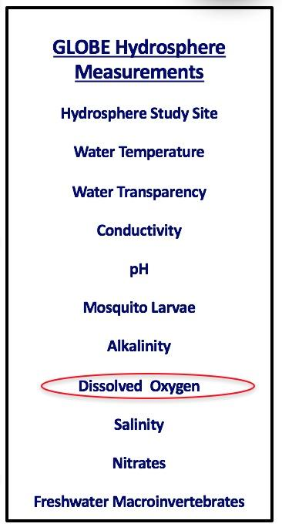
What is Dissolved Oxygen (DO)?
Dissolved oxygen (DO) is one of 10 measurements used by GLOBE to describe the characteristics of a water body. It measures the amount of molecular oxygen (O₂) in the water. It does not measure the amount of oxygen in the water molecule (H₂O).
We call the amount of dissolved oxygen the water will hold (under specific conditions) the solubility of dissolved oxygen. Factors affecting the solubility of dissolved oxygen include water temperature, atmospheric pressure, and salinity. Colder water can dissolve more oxygen than warmer water. Water at higher elevations holds less dissolved oxygen since the atmospheric pressure is less.

Slide 5
What to know about DO
Dissolved oxygen (O₂) in water is measured in parts per million (ppm). The amount of O₂ in water is much less than in air. Roughly, two out of ten air molecules are molecular oxygen. In water, however, there are only five or six oxygen molecules for every million water molecules.
Dissolved oxygen can be added to water by plants during photosynthesis, through diffusion from the atmosphere, or by aeration. Aeration occurs when water is mixed with air. Such mixing occurs in waves, riffles, and waterfalls.
Dissolved oxygen can be consumed during respiration of biota (e.g., animals and bacteria). Many fish species require at least 5 ppm to survive and reproduce.
Hypoxia is a condition when there is less than 2 ppm of DO in the water. Anoxia is when there is little to no DO in the water.

Slide 6

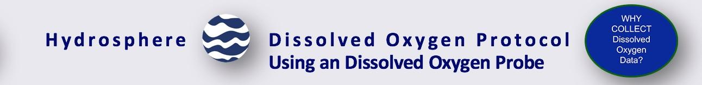
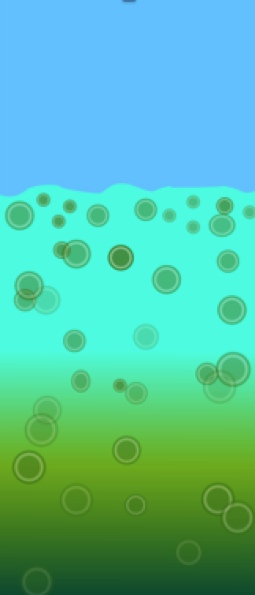
Why Collect Water DO Data?
Just like animals that live on land, animals that live in water need molecular oxygen to breathe.
Most organic matter in aquatic ecosystems is non-living and it is collectively referred to as detritus. The organic matter can be produced in situ or enter water bodies from the surrounding land (from both natural and human sources). The cycling of organic carbon between living and nonliving components is known as the carbon cycle. Organic matter is produced during photosynthesis and is consumed during respiration. During respiration, biota (fish, bacteria, etc.) consume dissolved oxygen.
Although plants and algae add valuable oxygen to the water, overgrowth can potentially lead to reduced light levels in the water body. As plants and algae die and decay, bacteria multiply and use the dissolved oxygen in the water. The amount of available dissolved oxygen in the water may become very low and harm fish and other aquatic animals.
Conceptual Diagram: Eutrophic water column with microscopic algae enlarged for emphasis.

Slide 7

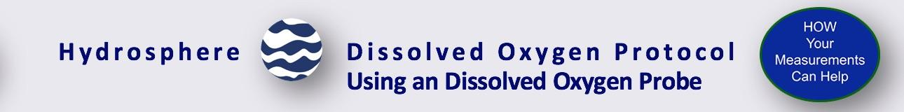
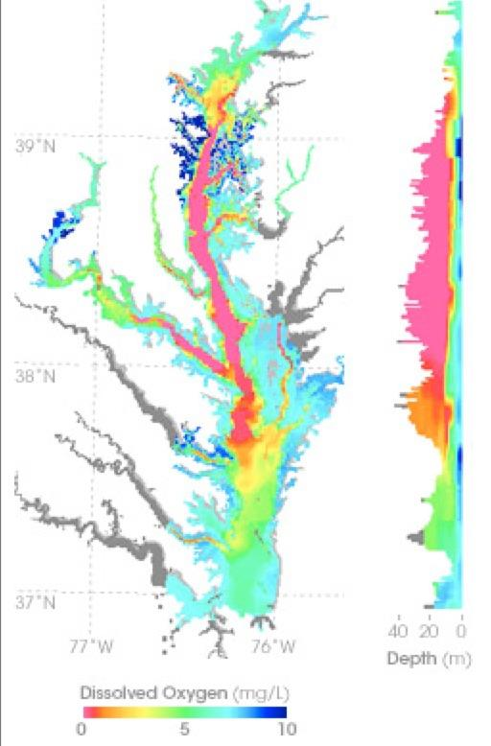
Case Study: Chesapeake Bay, USA-1
In summer 2004, a dead zone spanned more than a third of the Chesapeake Bay floor. Around the world, similar dead zones are occurring with increasing frequency in estuaries and near the mouths of major rivers. Local pork and chicken production creates manure, which runs off into tributaries feeding the Chesapeake Bay. nitrogen in the water makes algae and other single-celled plants (phytoplankton) grow excessively. As the excess algae die, bacteria that decompose the plant matter may use up virtually all the dissolved oxygen in the water, creating bottom-hugging, low-oxygen “dead zones.” This map shows measurements of dissolved oxygen for July 15–30, 2004. The graph on the right shows dissolved oxygen levels between the surface and a depth of 40 meters through the center of the Bay. Orange and red colors correspond to the dead zone.
When you monitor the nitrate concentration at your study site, you are providing exactly the kind of information that is needed to understand how dead zones are created in our aquatic systems.

Slide 8
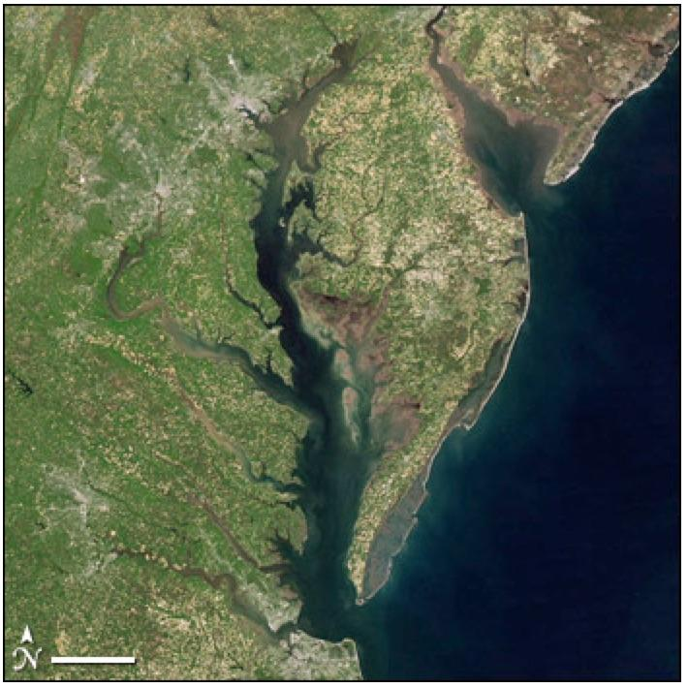
Case Study: Chesapeake Bay, USA-2
Researchers use satellite measurements of ocean color to estimate the amount of microscopic plant life that lives in the Chesapeake Bay and other bodies of water. Ocean color depends on what is in the water. When large numbers of plants are growing in the water, the chlorophyll and other plant pigments affect the water’s color, making it greener, sometimes even with shades of red. The kinds and amounts of plant life are indicators of the health of marine ecosystems.
Read more here: Earth Observatory
(NASA image courtesy Jeff Schmaltz, MODIS Rapid Response)

Slide 9

Let’s test your knowledge so far! Question 1
True or False: All other things being equal, colder water can dissolve more oxygen than warmer water.

Slide 10
Let’s test your knowledge so far! Answer to Question 1
True or False: All other things being equal, colder water can dissolve more oxygen than warmer water.
Answer: True! ☺

Slide 11
Let’s test your knowledge so far! Question 2
True or False: The dissolved oxygen measurement measures oxygen found in the water molecule (H2O).

Slide 12
Let’s test your knowledge so far! Answer to Question 2
True or False: The dissolved oxygen measurement measures oxygen found in the water molecule (H2O).
Answer: False ☺

Slide 13
Let’s test your knowledge so far! Question 3
When is water considered to be anoxic? Anoxia is a condition where there is
Less than 2 ppm of dissolved oxygen in the water
When there is little to no dissolved oxygen in the water
When there is too much dissolved oxygen in the water

Slide 14
Let’s test your knowledge so far! Answer to Question 3
When is water considered to be anoxic? Anoxia is a condition where there is
Less than 2 ppm of dissolved oxygen in he water
When there is little to no dissolved oxygen in the water- Correct! ☺
When there is too much dissolved oxygen in the water
Let’s now move on to review the Dissolved Oxygen Protocol!

Slide 15

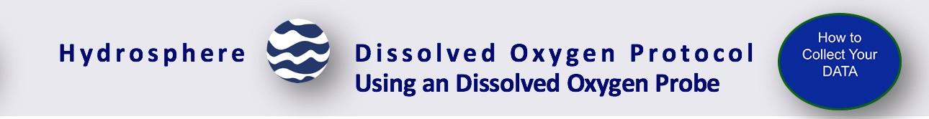
Protocol at a Glance
Where | Hydrology study site
Time Needed | Probe Setup: 20-30 minutes; Probe measurements 10 minutes
Prerequisites | Hydrology Investigation Study Site Definition. Salinity Protocol, if investigating ocean or brackish waters
Key Instrument | Dissolved Oxygen Probe
Skill Level | Middle and Secondary
Frequency | Ideally, weekly. Probe calibration every time probe is used- or within 24 hours.

Slide 16
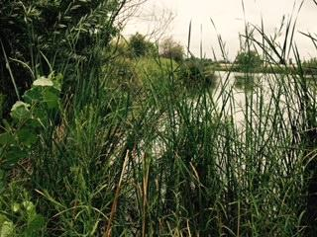
Simultaneous or Prior Investigations Required Prior to Doing the Dissolved Oxygen Protocol
The Water DO Protocol will allow you to determine the amount of dissolved oxygen of a water body. This protocol is conducted at your GLOBE Study Site. You will need to define your GLOBE Study Site where you will conduct your Hydrosphere Investigation prior to beginning this protocol. The Hydrosphere Investigation Data Sheet is used to record all the hydrosphere measurements, including DO. You will also want to map your Hydrosphere Site at some point.
Dissolved Oxygen Data Sheet
GLOBE Study Site Definition Sheet
Hydrosphere All Protocols Data Sheet
Mapping your Hydrosphere Study Site Field Guide

Slide 17
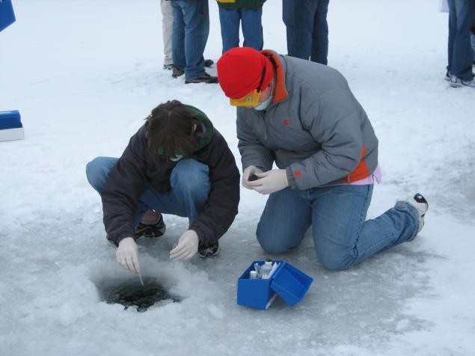
Site Selection: Hydrosphere Study Requirements
All your hydrosphere measurements are taken at the same Hydrosphere Study Site. This may be any surface water site that can be safely visited and monitored regularly, although natural waters are preferred. Sites may include (in order of preference):
1. Stream or river
2. Lake, reservoir, bay or ocean
3. Pond
4. An irrigation ditch or other water
body, if natural body is not available
Students measure nitrate, pH and DO through ice covering the Volga River.

Slide 18
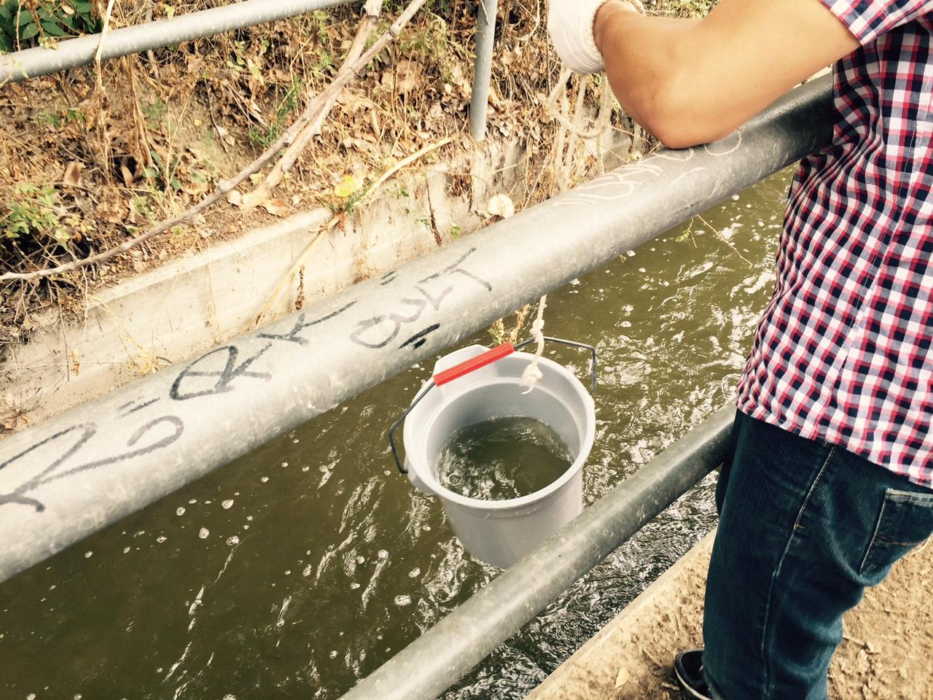
Site Selection: Hydrosphere Study Site
Select a specific site where the hydrosphere measurements (water temperature, dissolved oxygen, nitrate, pH, alkalinity, turbidity, and either conductivity or salinity) will be taken. If the selected study site is a moving body of water (i.e. stream or river), locate your sampling site at a riffle area as opposed to still water or rapids. This will provide a more representative measurement of the water in the stream or river. If the selected study site is a still body of water i.e. a lake or reservoir), find a sampling site near the outlet area or along the middle of the water body. Avoid inlet areas. A bridge or a pier are good choices. If your water body is brackish or salty, you will need to know the times of high and low tide at a location as close as possible to your study site.

Slide 19

Overview of Water DO Protocol
You can collect DO by using DO test kits or probes. The instructions here will focus on the use of a Dissolved Oxygen Probe.
For measuring dissolved oxygen, you will hear references to either conductivity probes or meters. For clarification, probes are the instruments that measure voltage or resistance in a water sample. Meters are instruments that convert electrical (voltage or resistance) measurements to concentrations. In order to measure dissolved oxygen (or other types of measurements), both a probe and meter are required. Sometimes the probe and meter are within one instrument and cannot be taken apart. Other instruments have probes that are separate from the meters and need to be connected to the meters in order to take the water measurements.
The amount of DO can change rapidly after a sample is collected. It is important to preserve the water sample shortly after collecting. After sample preservation, sample testing can be done either in the field or taken back to the lab to determine the amount of DO in the water.

Slide 20

Sources for Equipment You Need for the Water DO Protocol
The following resources summarize the measurements associated with each protocol, associated skill level, scientific specifications for the instruments, and how to access the equipment you need (purchase, build, or download).
Where to find specifications for instruments used in GLOBE investigations
Where to find scientific instruments used in GLOBE investigations
.

Slide 21
Calibration of the Dissolved Oxygen Probe
DO probes MUST be calibrated before use. Check with the probe manufacturer to be sure the probe stores the most recent calibration. If it does, the dissolved oxygen probe will need to be calibrated 24 hours or less before taking measurements. If your probe does not keep the most recent calibration, you will need to calibrate the probe just before taking measurements taking care not to turn the probe or any associated software off.
When you are in the field, check that the calibration has held by placing the probe in 100% saturated air with water. If the value is off by ± 0.2 mg/L then recalibrate in the field. Remember, different temperatures at the site might result in different total mg/L of oxygen at 100% saturation. This does not necessarily mean that your calibration is off. Check the calibration tables for the amount of oxygen present at 100% saturation at that temperature.
Never report Dissolved Oxygen data taken with an instrument that has not been calibrated before using.
Pay close attention to your quality control procedure. Without the quality control steps your DO data will not be meaningful or comparable to data collected by others!
.

Slide 22
Water DO Protocol Using a Probe: Salinity Correction
When measuring dissolved oxygen in salt waters (conductivity greater than 1000 mg/L or salinity greater than 1 ppt), you will need to apply a salinity correction factor to the measurement taken by the probe. Saline water can hold less oxygen at the same temperature and pressure than can fresh water. Different probes have different procedures for this correction. Some have the salinity correction before you measure DO and others afterward. Please refer to your manual for the procedure for your probe. As this correction can affect your measurement, it is necessary to measure salinity each time you measure DO and mark it down on your Hydrosphere Investigation Data Sheet.
Water DO Protocol Using a Probe: Elevation
Determine the elevation at your sampling site if you are not using a barometer.
.

Slide 23
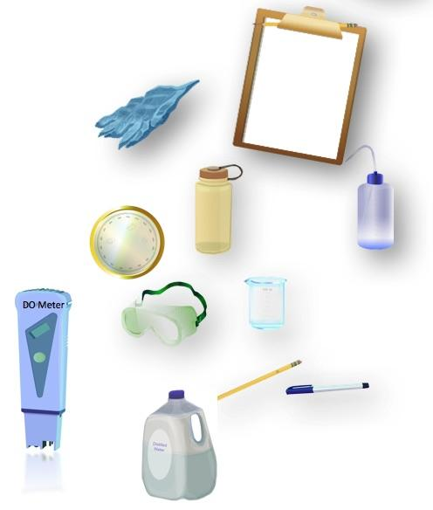
Materials
Assemble Equipment:
Dissolved Oxygen Probe
Zero Oxygen solution (if applicable
for your probe)
250 mL polyethylene bottle with lid
Latex gloves
Distilled water
Salinity correction tables (if appropriate)
Barometer
Pen or pencil
Assemble Necessary Documents:
Dissolved Oxygen Protocol (Probe) Field Guide

Slide 24
Quality Control Procedure: Calibration of a Probe (1/1)
Calibration can take place in the lab or the field. It is done within 24 hours prior to measurement.
Warm up the probe according to manual procedure
Use barometer to measure atmospheric pressure at site or use the elevation to approximate
Follow manual instructions to enter probe’s calibration information
Follow manual instructions to measure the first calibration point (Zero Oxygen point)
Rinse probe with distilled water and pat dry without touching the membrane
Follow manual instructions to measure second calibration point (100% Oxygen)
When these steps are complete, you are ready to take DO measurements of your water sample!

Slide 25
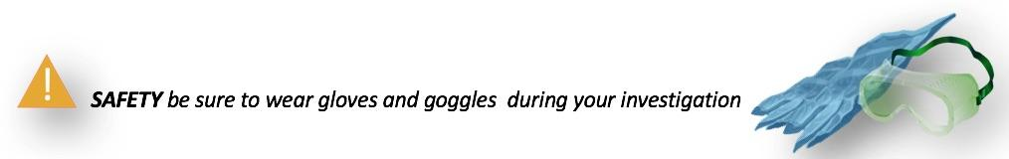
Dissolved Oxygen Protocol Using a DO Probe (1/2)
In the field:
Warm up the probe as described in the probe manual.
Lower the tip of the probe into the water body that you are sampling and slowly move it back and forth. If you are measuring a stream or river and the water is moving past the probe, you can just hold the probe in place.

Slide 26
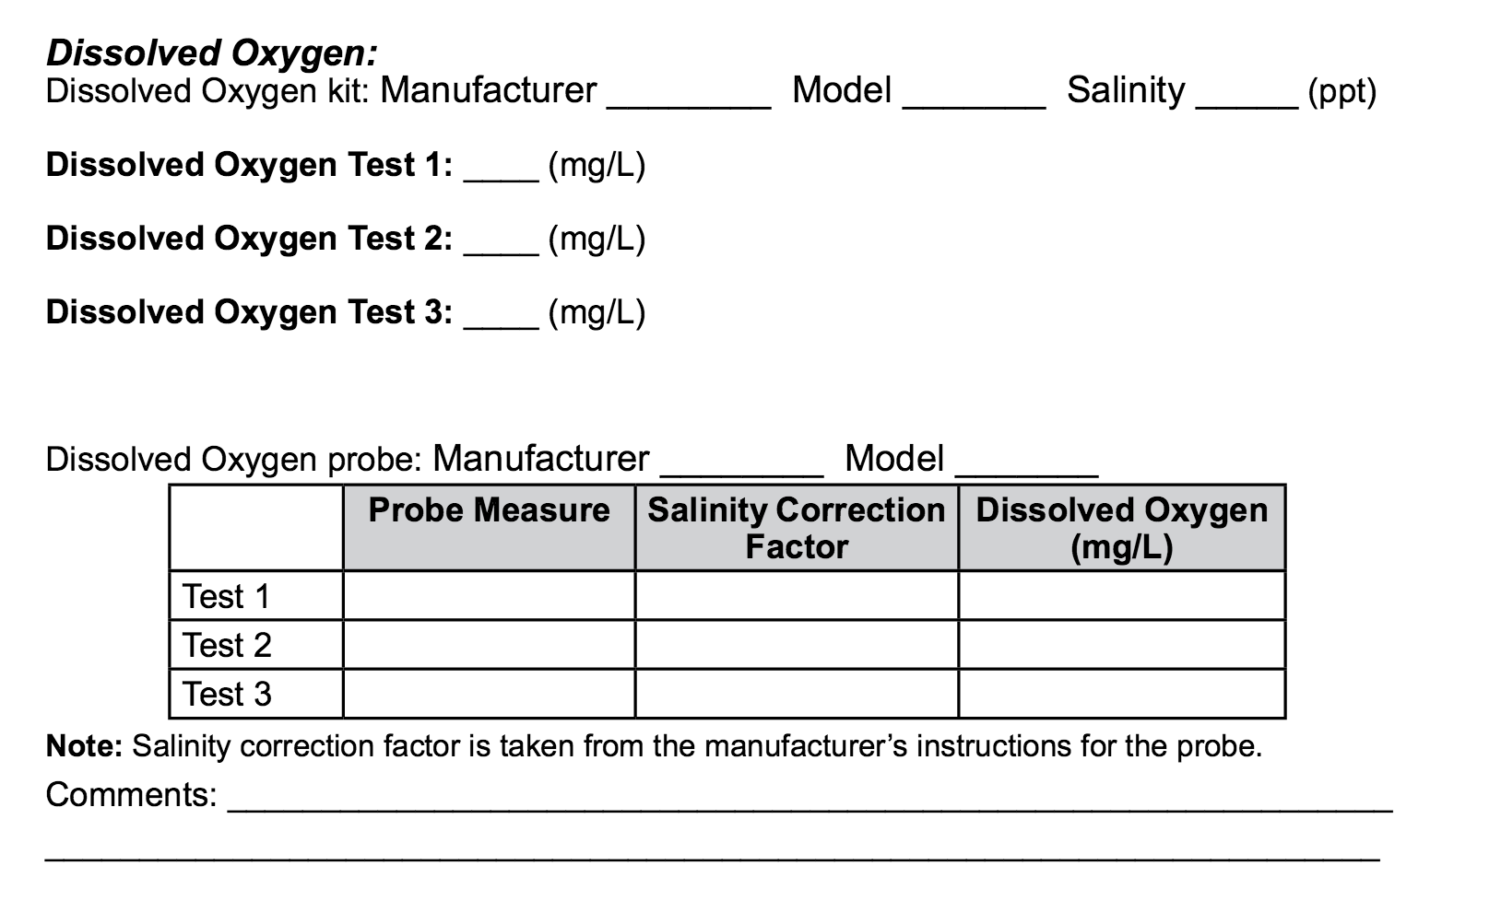
Dissolved Oxygen Protocol Using a DO Probe (2/2)
When reading has stabilized, record the dissolved oxygen in your water body on your Hydrosphere Investigation Data Sheet.
Repeat the readings two more times and record the dissolved oxygen under test 2 and test 3.
Check to make sure that the three readings are within 0.2 mg/L of one another. If they are not, continue taking readings until the last three are within 0.2 mg/L of one another.
Apply the salinity correction (if appropriate).
Calculate the average of the three (adjusted if salinity correction applied measurements.
Rinse the electrode with distilled water and blot dry. Cap electrode to protect membrane and turn off meter.
You have completed your Dissolved Oxygen Measurements!

Slide 27
Let’s test your knowledge so far! Question 4
True or False: The dissolved oxygen content of a sample can change very rapidly upon collection.

Slide 28
Let’s test your knowledge so far! Answer to Question 4
True or False: The dissolved oxygen content of a sample can change very rapidly upon collection.
Answer: True ☺

Slide 29
Let’s test your knowledge so far! Question 5
How often do you need to calibrate your dissolved oxygen probe?
Within 24 hours of using the probe
Within 6 months of using the probe

Slide 30
Let’s test your knowledge so far! Answer to Question 5
How often do you need to calibrate your dissolved oxygen probe?
Within 24 hours of using the probe- correct ☺
Within 6 months of using the probe

Slide 31
Let’s test your knowledge so far! Question 6
In the field, what is necessary to test calibration of the probe?
Place the probe in 100% oxygen saturated water
The value of the dissolved oxygen value in the sample shaken for 5 minutes is within ± 0.2 mg/L of the expected value
Check the calibration tables for the amount of oxygen present at 100% saturation at that temperature.
All of the above
A and C only

Slide 32
Let’s test your knowledge so far! Answer to Question 6
In the field, what is necessary to test calibration of the probe?
Place the probe in 100% oxygen saturated water
The value of the dissolved oxygen value in the sample shaken for 5 minutes is within ± 0.2 mg/L of the expected value
Check the calibration tables for the amount of oxygen present at 100% saturation at that temperature.
All of the above- correct ☺
A and C only

Slide 33
Let’s test your knowledge so far! Question 7
True or False: Saline water can hold more oxygen than fresh water at the same pressure and temperature

Slide 34
Let’s test your knowledge so far! Answer to Question 7
True or False: Saline water can hold more oxygen than fresh water at the same pressure and temperature
Answer: False ☺

Slide 35


Hydrosphere Site Creation
If this is your first time making hydrosphere observations at this location, you will need to create a new Hydrosphere study site before entering data.
To do this, please review the Introduction to Hydrosphere training.

Slide 36

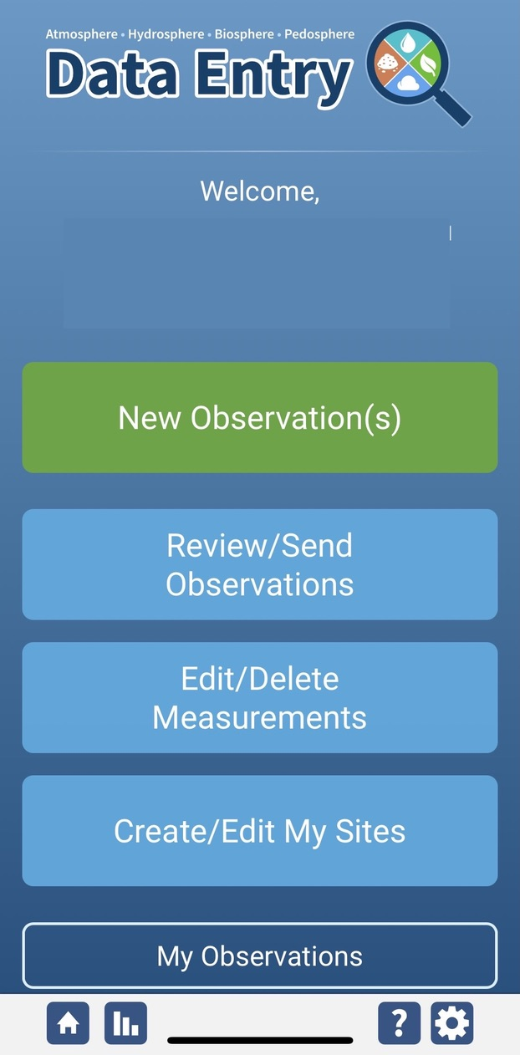
Dissolved Oxygen Protocol Data Entry
To enter data, first return to GLOBE Observer main page by clicking the home button in the bottom left.
Select “Data Entry”.
Next, click “New Observation(s)”

Slide 37
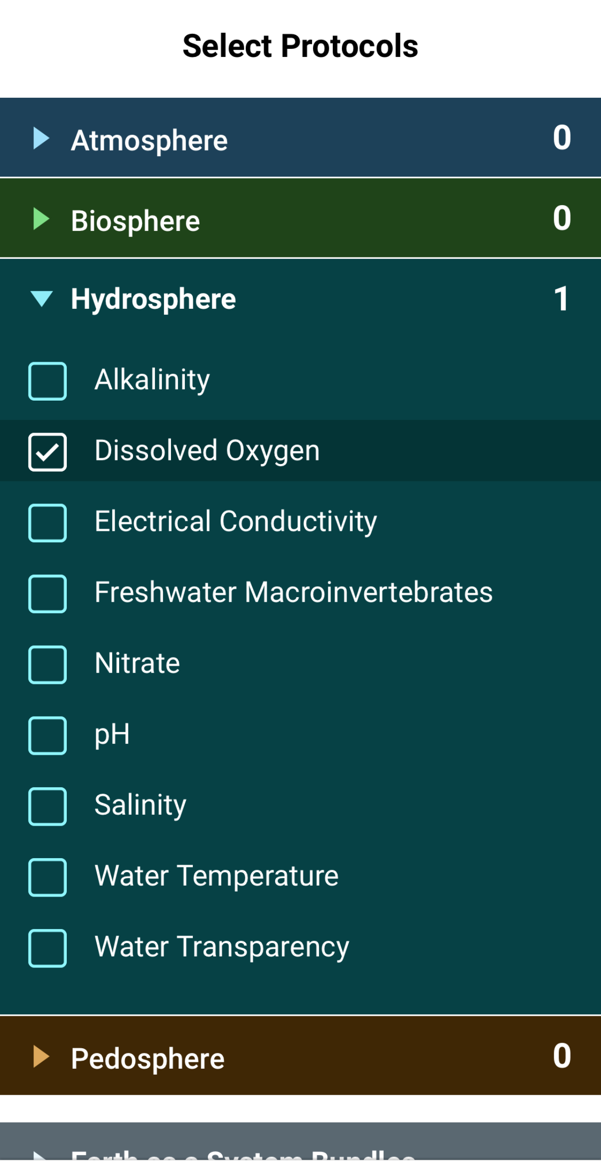
Dissolved Oxygen Protocol Data Entry
Select Dissolved Oxygen from the list of Hydrosphere protocols and click Continue at the bottom of the screen.

Slide 38
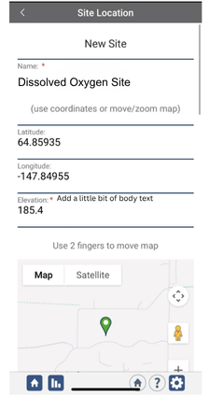
Dissolved Oxygen Protocol Site Information
If you have not already created a Hydrosphere site, create one now.
Click “New Site” at the bottom of the site location screen and choose a name for your new site.

Slide 39
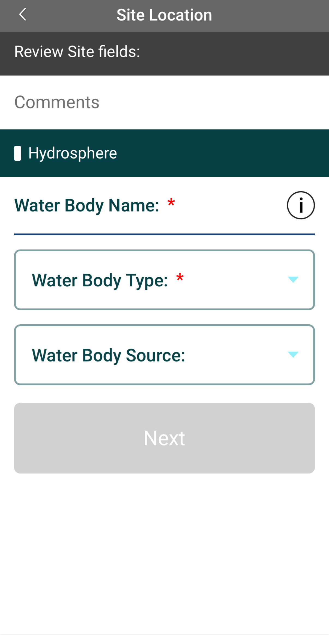
Dissolved Oxygen Protocol Site Information
Enter the Water Body Name.
Select the Water Body Type and Water Body Source from the dropdown list of options.

Slide 40
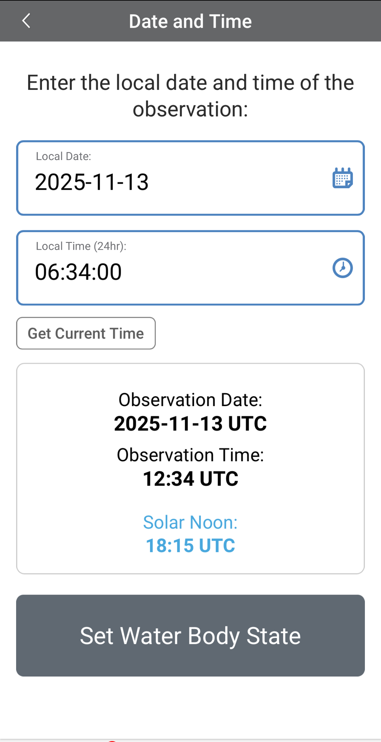
Entering Measurement Data
Enter the date and time you took the measurements.
Once you enter the date, select Set Water Body State to enter your data.

Slide 41
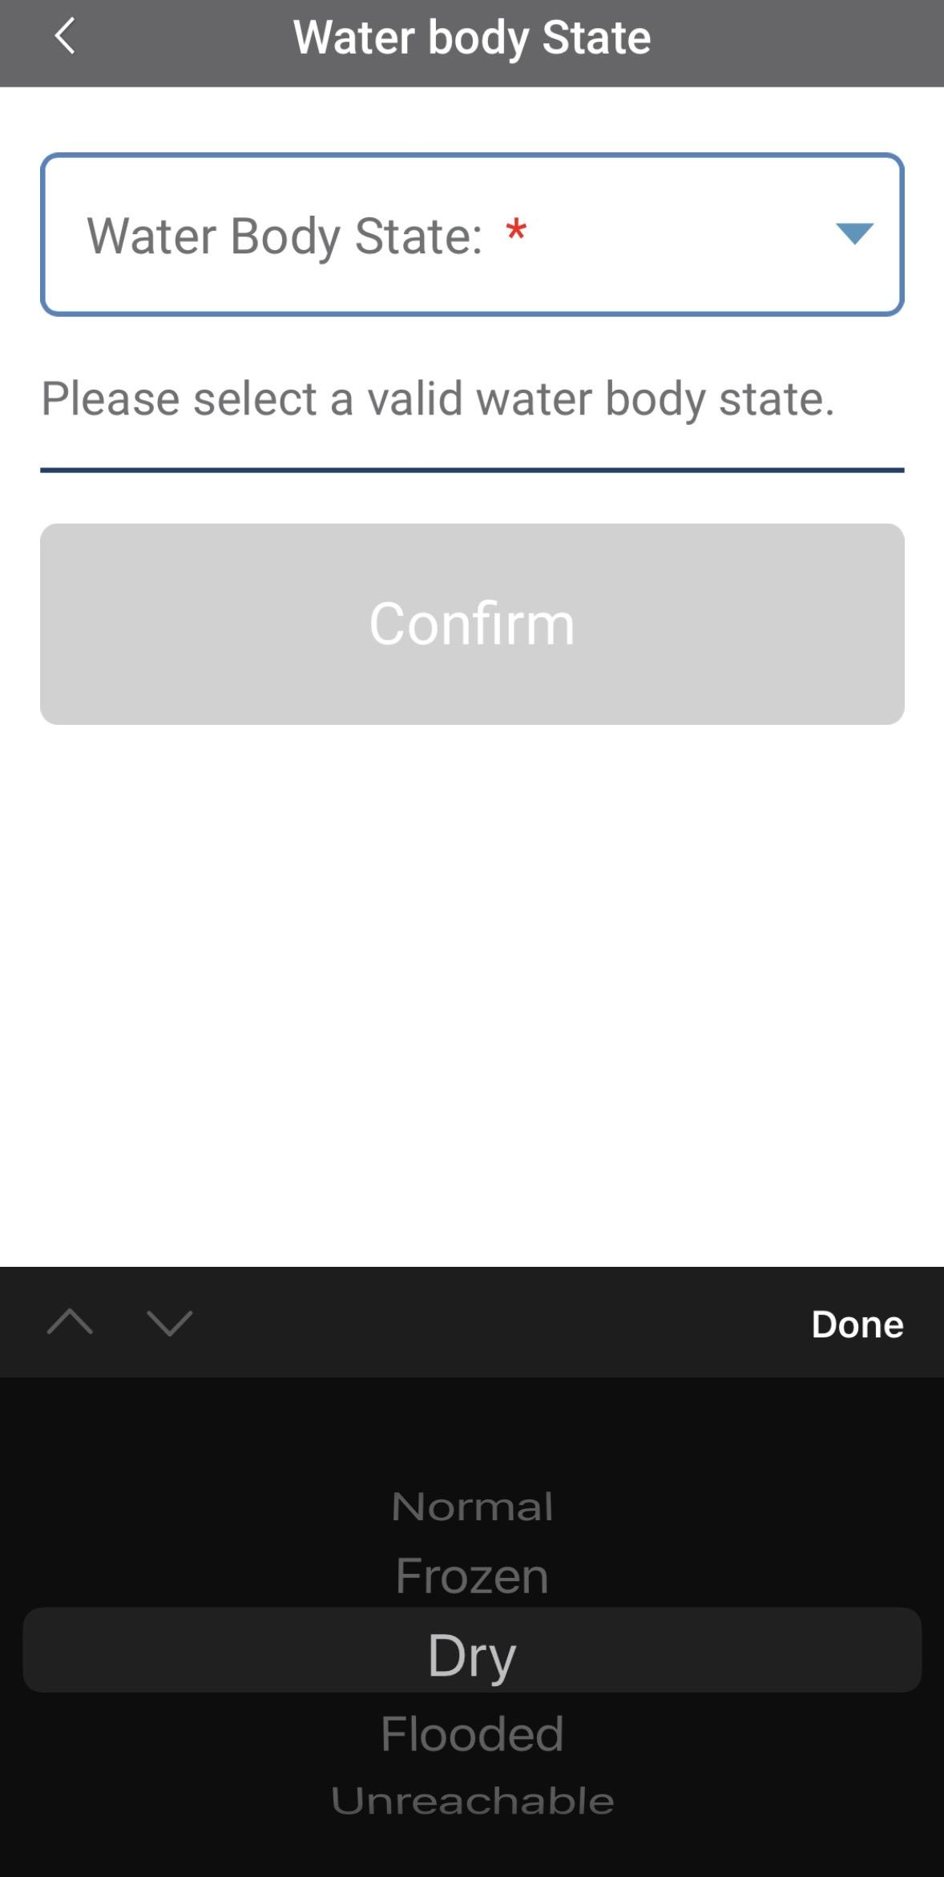
Enter the Water Body State
Select the Water Body State from the dropdown list of options.

Slide 42
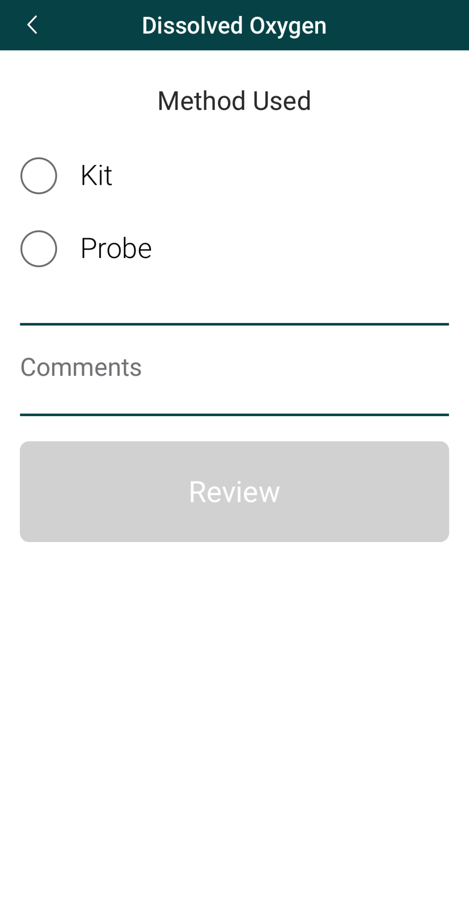
Select the Method Used to Measure Dissolved Oxygen
Select the method used to collect the dissolved oxygen measurement.
If you use a Vernier GO Direct Dissolved Oxygen meter, enter it as a “kit” and write Vernier DO meter in the comments. The instrument has a built-in salinity correction.

Slide 43
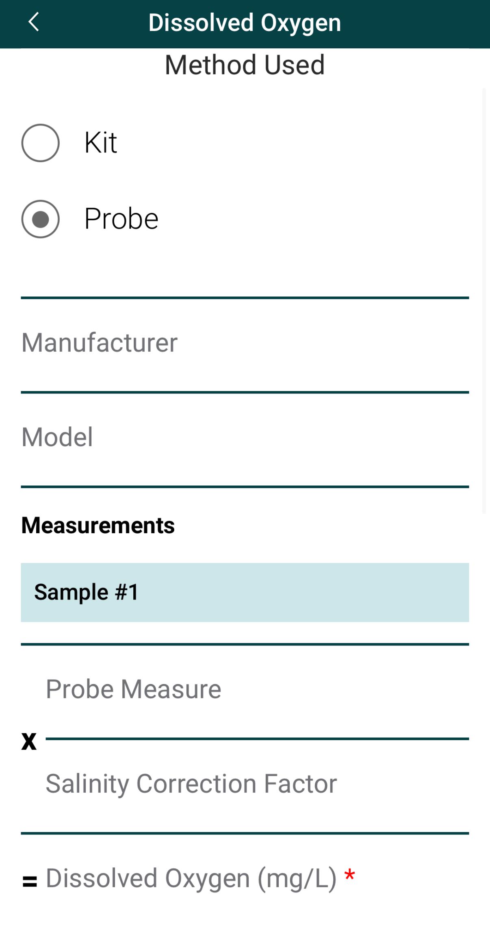
Enter Probe Measurement Data
Enter the probe manufacturer and model.
Enter the probe measurement and salinity correction factor, which is between 0.04296 and 0.08796.
The dissolved oxygen concentration will be calculated automatically.
Pro Tip: If using a probe with built-in salinity correction (such as Vernier GO Direct DO sensor), enter the data as “kit” and add comments with the make and model.

Slide 44
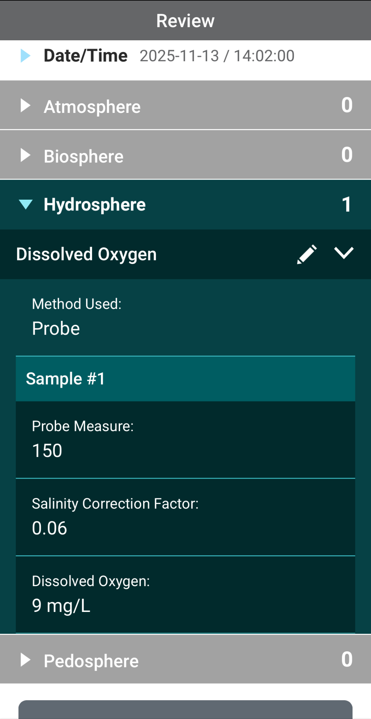
Review Data Entry and Send Data
Review the data you entered and check for errors.
When complete, select Finish to complete the send the observation to GLOBE.

Slide 45
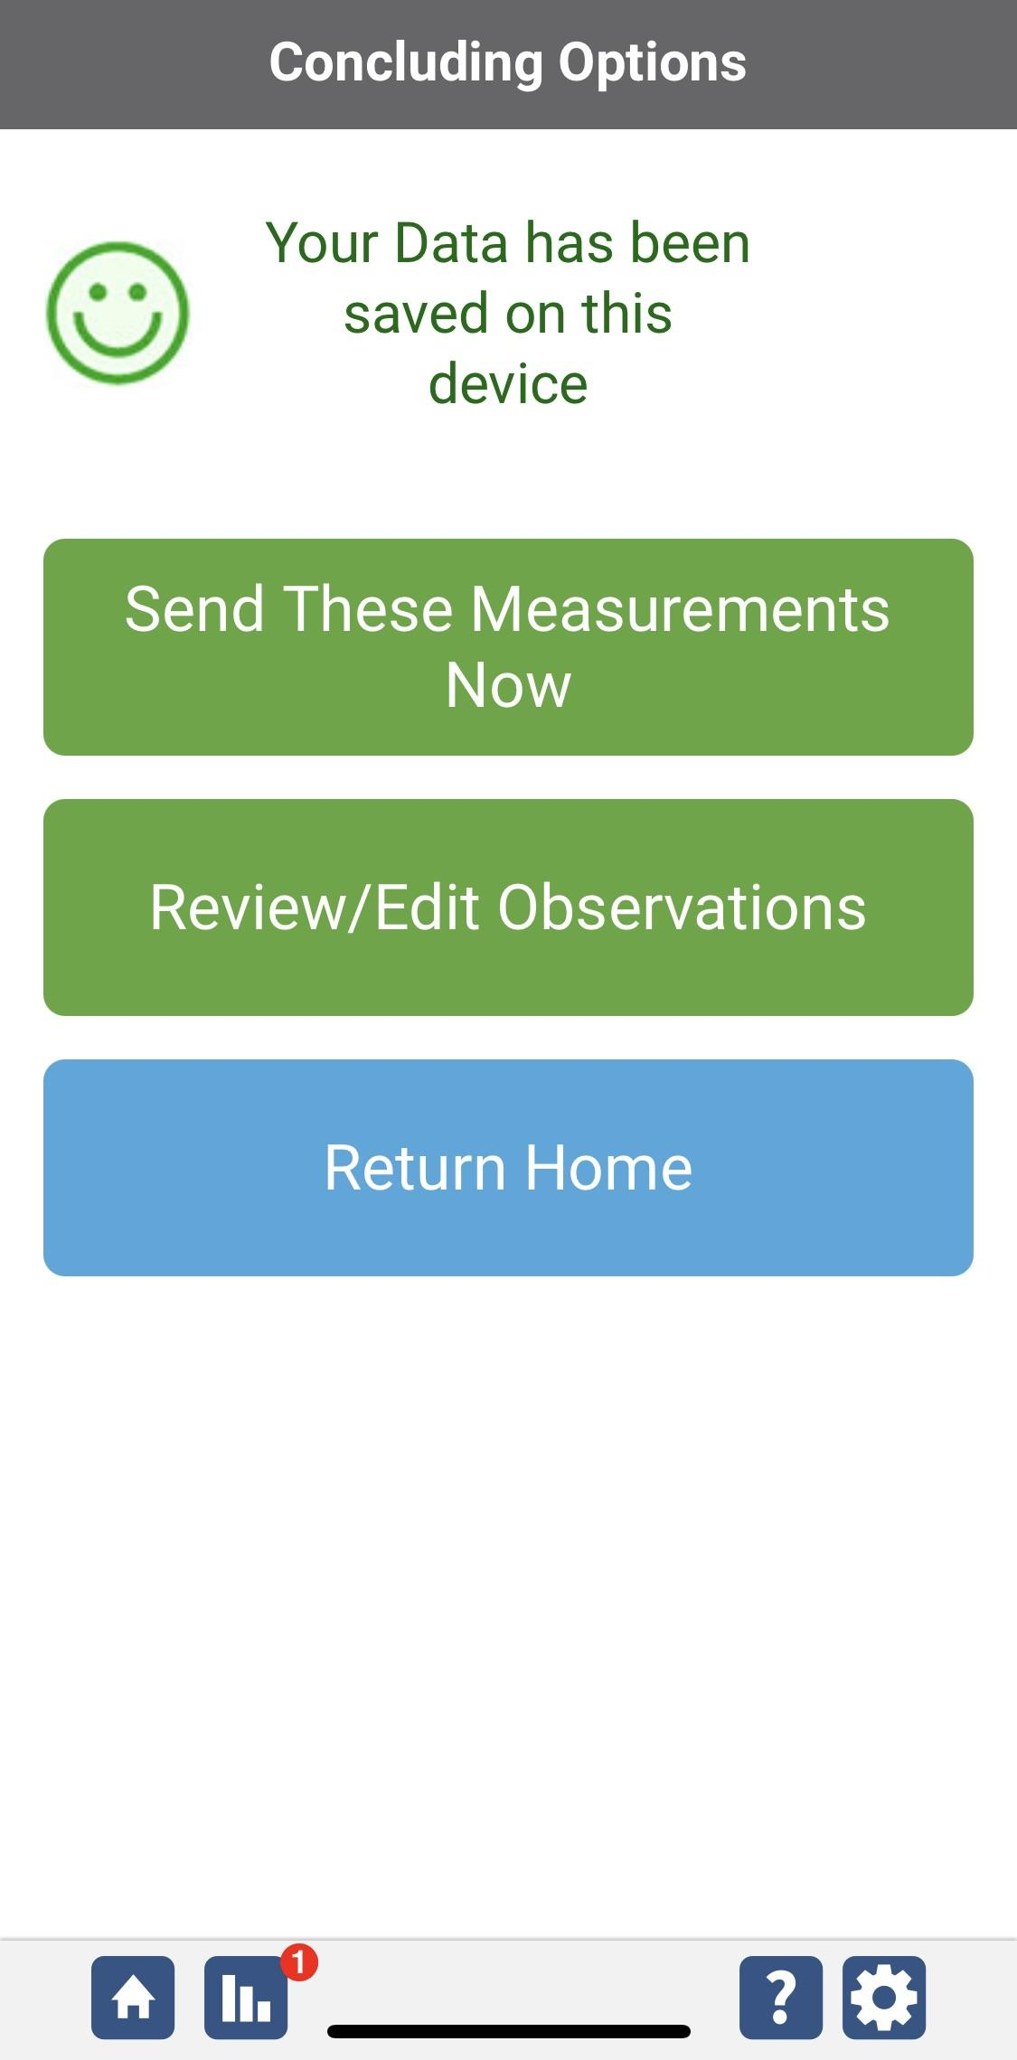
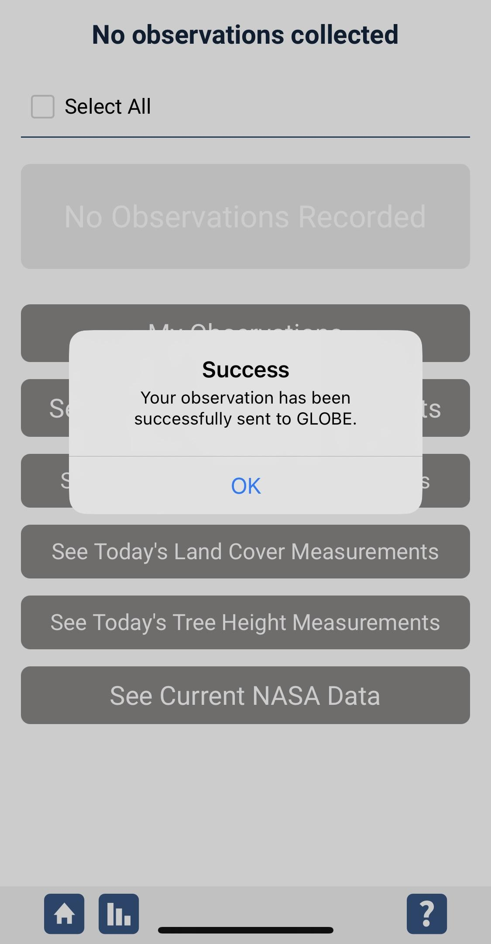
Data System Responses
If your observations are within the appropriate ranges, you will see a green smiley face.
You can review or edit your observation if needed.
When ready, select “Send these measurements now” to send your data to GLOBE. When it has been sent, you will see a “Success” message.

Slide 46

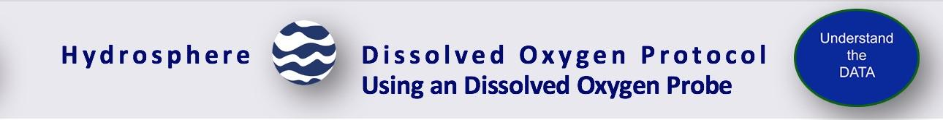
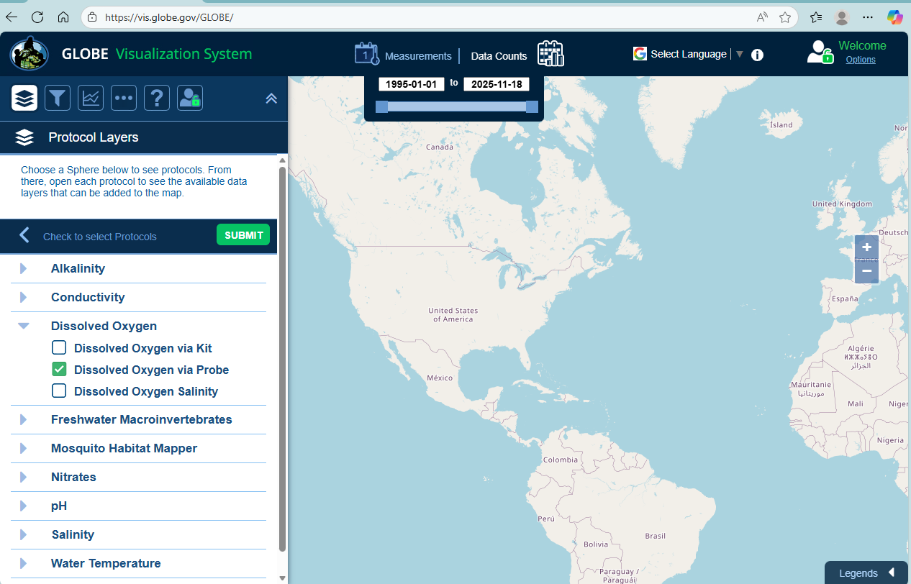
Visualize and Retrieve Water DO Data-1
Select Dissolved Oxygen via Probe, then select “Submit”
GLOBE provides the ability to view and interact with data measured across the world. Select our visualization tool to map, graph, filter and export DO data that have been measured across GLOBE protocols since 1995. Here are screenshots steps you will use when you use the visualization tool.
Link to step-by-step tutorials on Using the Visualization System will assist you in finding and analyzing GLOBE data: PDF verson

Slide 47
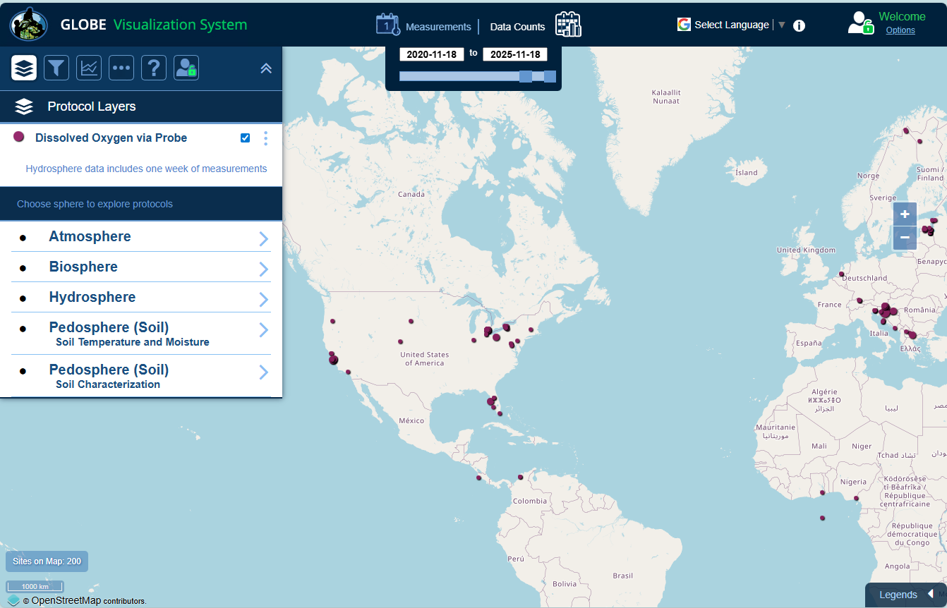
Visualize and Retrieve Water DO Data-2
Select the date for which you need DO data, add layer and you can see where data is available.

Slide 48
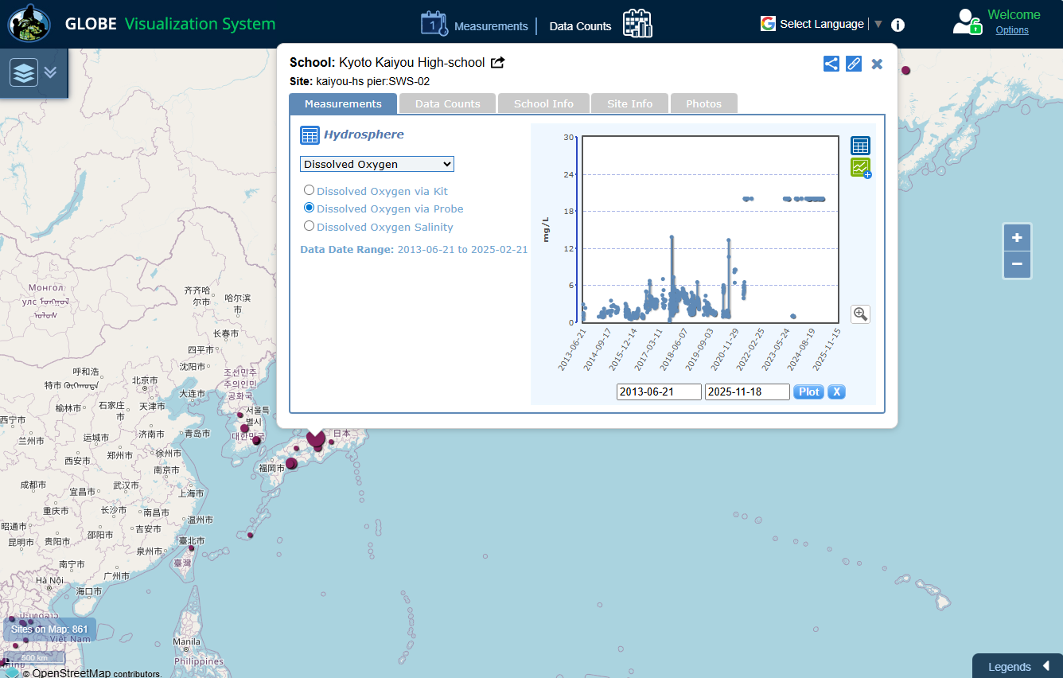
Visualize and Retrieve Water DO Data-3
Select the sampling site for which you need DO data, and a box will open with data summary for that site.
Clicking on an icon on the map will open to a map note providing DO data for that location and time.

Slide 49

Review questions to help you prepare to conduct the Hydrosphere Dissolved Oxygen Protocol
Does the dissolved oxygen protocol also measure the oxygen in water (H2O)?
Which temperature holds more dissolved oxygen: warm water or cold water?
Does salinity affect the solubility of oxygen?
How does atmospheric pressure affect the solubility of oxygen?
What is hypoxia?
How many ppm of dissolved oxygen is in the water when the water is anoxic?
Why do you need to stabilize the dissolved oxygen sample immediately after collecting?
What are the safety precautions you should take when doing any of the hydrology protocols?
What is the acceptable range of error of the three replicate samples you take, in ppm?
What step do you need to complete before starting the Dissolved Oxygen protocol?

Slide 50


You are done!
You have now completed the slide stack. If you are ready to take the quiz, sign on and take the quiz corresponding to Dissolved Oxygen Protocol.
You can also review the slide stack, post questions on the discussion board, or look at the FAQs on the next page.
When you pass the quiz, you are ready to take Dissolved Oxygen Protocol measurements!

Slide 51
FAQ: Frequently Asked Questions-1
Why do we have to do the measurements at the same time of day?
The amount of dissolved oxygen may change during the day as the water begins to warm up. More light penetrating the water causes more photosynthesis to occur. This can also increase the amount of dissolved oxygen. For this reason it is important to do your Hydrosphere measurements at the same time of day each week.
What will make my dissolved oxygen levels change over the year?
Besides seasonal differences in temperature, seasonal changes in the flow of your stream, changes in transparency, or changes in productivity (amount of growth of plants and animals in the water) will cause changes in dissolved oxygen levels.
What is saturated DO?
Saturated DO refers to the maximum oxygen that water can hold at a particular temperature, pressure and salinity. When you calibrate your DO probe, the 100% saturation point is saturated Dissolved Oxygen or saturated
Why do we need to measure salinity each time?
In arid and semi-arid areas, salinity or conductivity levels vary depending on whether it is a dry or rainy season. In estuaries, salinity can vary depending on the time of the tide or even in dry or wet years.

Slide 52
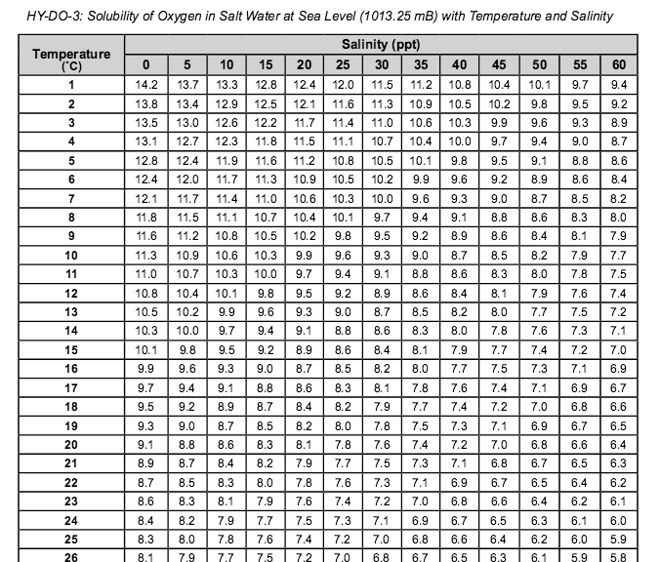
FAQ: Frequently Asked Questions-2
Why does salt concentration affect oxygen saturation?
As the salt content increases in water, fewer oxygen molecules can be dissolved. Therefore, as salinity increases, saturated DO decreases in a water sample under the same temperature and pressure.

Slide 53
FAQ: Frequently Asked Questions-3
Why does the amount of dissolved oxygen I measured not agree with the amount I calculated?
There are two reasons why these numbers may not match. First, you may not have followed the instructions on your kit exactly or you may have made small errors in the procedure you used. Here are some troubleshooting tips:
Make sure you do not have any air bubbles in your sample bottle or your titrator (for kits that use a titrator). To check for air bubbles in the sample bottle, turn the bottle upside down while it is capped and look for bubbles.
Measure accurately. If you are adding drops from a bottle, hold the bottle vertically so that all of the drops are the same size.
Allow all of the precipitate to settle. If you shake the bottle too hard before the precipitate settles, it may take 10minutes or more for the settling to happen.
Record accurately. If your kit asks you to count drops, have two people count to insure accuracy. If your kit asks you to read a titrator, make sure to read the instructions for accurately reading the titrator that come with your kit.
If you are testing in salt waters make sure you refer to Table HY-DO-3 to determine the maximum amount of oxygen that waters with your salinity can hold. Salt waters can hold less oxygen when fully saturated than can freshwaters.
Another reason your measured value may not be the same as your calculated value is that there may be something wrong with the chemicals in your kit. In this case, you will need to get new chemicals.

Slide 54
Questions for Research Investigations
How would a change in the amount of dissolved oxygen affect what lives in a water body?
How could warming or cooling of the atmosphere affect the amount of dissolved oxygen in your water?
How could changes in the land cover around your water site affect the amount of dissolved oxygen in your water?

Slide 55

We want your Feedback!
Please provide us with feedback about this module. This is a community project and we welcome your comments, suggestions and edits! Please take a minute to comment here: Training@nasaglobe.org
Credits:
Slides:
Russanne Low, Ph.D., University of Nebraska-Lincoln, USA
Rebecca Boger, Ph.D., Brooklyn College, NYC, USA
Photos: Russanne Low
Art: Jenn Glaser, ScribeArts
More Information:
GLOBE Program, NASA Earth Science
NASA Global Climate Change: Vital Signs of the Planet
The GLOBE Program is sponsored by these organizations:
Version 11/17/25. Modified by GLOBE Implementation Office – Science, Training, Education, and Public Engagement. If you edit and modify this slide set for use for educational purposes, please note “modified by (and your name and date)" on this page. Thank you.

