Slide 2
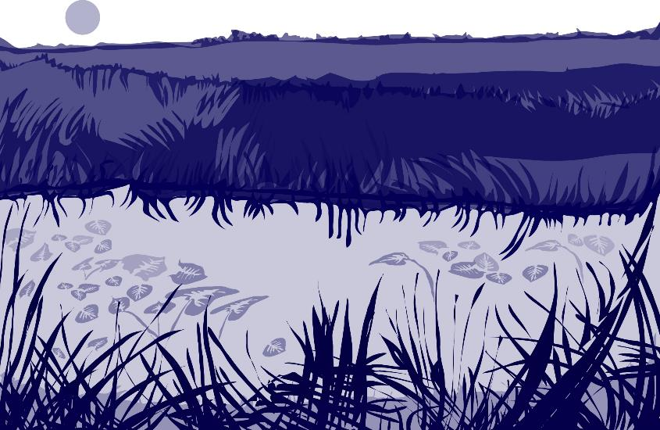
Overview
This module:
Reviews the selection of a GLOBE hydrology site
Reviews the water sampling technique used in GLOBE hydrology protocols
Provides a step by step introduction of the protocol method
Learning Objectives
After completing this module, you will be able to:
Define water pH and explain how environmental variables result in different measurements
Describe the importance of instrument calibration in the the collection of accurate data
Conduct water pH measurements using a pH meter
Upload data to the GLOBE portal
Visualize data using GLOBE’s Visualization Site
2

Slide 3
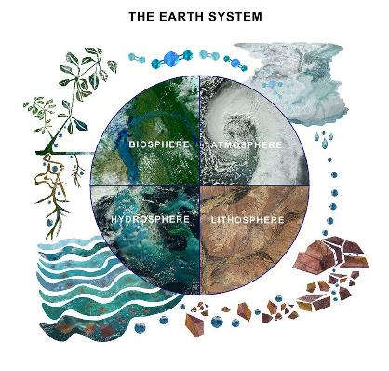
The Hydrosphere
The hydrosphere is the part of the Earth system that includes water, ice and water vapor. Water participates in many important natural chemical reactions and is a good solvent. Changing any part of the Earth system, such as the amount or type of vegetation in a region or from natural land cover to an impervious one, can affect the rest of the system. Rain and snow capture aerosols from the air. Acidic water slowly dissolves rocks, placing dissolved solids in water. Dissolved or suspended impurities determine water's chemical composition.
Current measurement programs in many areas of the world cover only a few water bodies a few times during the year. GLOBE Hydrosphere protocols will allow you to collect valuable data to help fill these gaps and improve our understanding of Earth's natural waters.
The Earth System: Energy flows and matter cycles.

Slide 4
Hydrosphere Protocols
pH is one of the hydrosphere protocols used by GLOBE to describe the status of a water body. The pH of a lake or stream measures water acidity, which influences how much oxygen is dissolved in the water.
Measures of pH directly indicate how hospitable a body of water is to aquatic life. It is interesting to both follow the annual cycle of water parameters, such as dissolved oxygen, alkalinity and pH, and to make comparisons between different water bodies. We can see if pH becomes depressed right after a rain or when there is a lot of snowmelt running off into the lake or stream. If we do find a depression in pH, we would expect this water to have a low level of alkalinity.
GLOBE Hydrosphere Measurements
Hydrosphere Study Site
Water Temperature
Water Transparency
Conductivity
pH
Mosquito Larvae
Alkalinity
Dissolved Oxygen
Salinity
Nitrates
Freshwater Macroinvertebrates

Slide 5

What is Water pH?
PH is a measure of the relative amount of free hydrogen ions there are in the water, which determines the acidity of the water body
The concentration of the hydrogen ion [H+] activity in a solution determines the pH. Mathematically this is expressed as:
pH = - log [H+]
pH is reported in logarithmic units form 0-14, with 7 being neutral. Each number represents a 10x change in the acidity or alkalinity of the water.
The pH values for your water site will depend on the geology, soil and vegetation of your area as well as other inputs into your water body. Where the air masses come from that precipitate into your water body may affect the pH of the water. Most lakes and streams have pH values that range between 6.5 and 8.5. Oceans have a pH value of 8.2. Pure water not in contact with the air has a neutral pH value of 7.0.
Naturally occurring basic waters are found typically in areas where the surrounding geology is rich in minerals such as calcite or limestone.
5

Slide 6
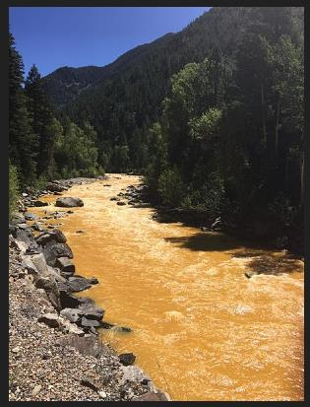
Why Collect Water pH Data?
There are waters that are naturally more acidic when there are certain types of minerals in the water, such as sulfides. Mining can also release acid forming compounds to water bodies.
Pollution can change a water's pH, which in turn can harm animals and plants living in the water. For instance, the 2015 spill of mine waste into the Animas River, caused the Animas to have a pH of 5- acidic. By using the logarithm scale, this mine-drainage water would be 100 times more acidic than neutral water.
A change in pH in a water body can be an indicator of increasing pollution or other environmental factor.
The Animas River between Silverton and Durango in Colorado, USA, within 24 hours of the 2015 Gold King Mine waste water spill Credit: Riverhugger, Wikipedia Commons.
6

Slide 7
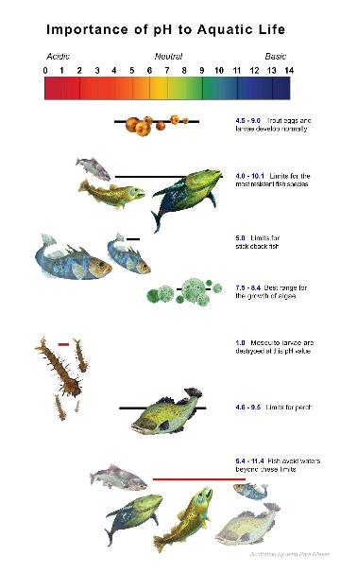
How Your Data Can Help
pH affects most chemical and biological processes that take place in water. pH affects the solubility (amount that can be dissolved in water) and biological availability of nutrients. It also determines the degree to which potentially toxic materials, such as heavy metals, are soluble.
pH has a strong influence on what can live in the water; aquatic organisms have certain pH ranges they prefer or require. Salamanders, frogs and other amphibian life, as well as many macroinvertebrates, are particularly sensitive to extreme pH levels. Most insects, amphibians and fish are absent in water bodies with pH below 4.0 or above 10.0.
Since most organisms are sensitive to changes in water pH, scientists monitor unusual decreases or increases in the pH of water bodies. pH does not normally change a great deal, although you may find some seasonal trends due to changes in temperature, rainfall patterns, or land cover.
7

Slide 8
Overview of Water pH Protocol
pH of a water body can be measured using either a pH meter or pH paper. The accuracy of either method depends on the electrical conductivity of the water. The electrical conductivity needs to be at least 200 µS/cm for these methods to report accurately.
If you are sampling Ocean or brackish water, you can assume that the electrical conductivity of your sample is greater than 200 µS/cm. If you are not sure if the fresh water at your Hydrosphere Study Site has a conductivity value high enough for the measurement technique (paper or meter), you will need to measure the electrical conductivity before taking your pH measurements. After you know the electrical conductivity value of the water, use the appropriate pH field guide.
For more information, see the Electrical Conductivity Field Guide Protocol
8

Slide 9
Simultaneous or Prior Investigations Required to do Water pH Measurements
You will need to define your Hydrosphere Study Site. A Hydrosphere Study Site can be any surface water site that can be safely visited, although natural waters are preferred.
The Hydrosphere Investigation Data Sheet is used to record all the hydrosphere measurements, including Water Transparency. You will also want to map your Hydrosphere Site at some point.
To define you study site you will need these documents:
Selecting and Documenting your Hydrosphere Study Site
Hydrosphere Investigation Data Sheet
Mapping your Hydrosphere Study Site Field Guide
9

Slide 10
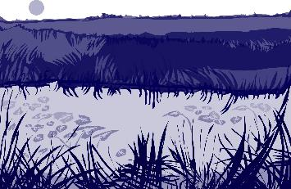
SITE
selection
Site Selection: Hydrosphere Study Site
Ideally, your Hydrosphere Study Site should be within the major watershed of the 15 km by 15 km GLOBE Study Site, and connected to water systems that flow into larger river or estuary systems.
All your hydrosphere measurements are taken at the same Hydrosphere Study Site. This may be any surface water site that can be safely visited and monitored regularly, although natural waters are preferred. Sites may include (in order of preference):
1. stream or river
2. lake, reservoir, bay or ocean
3. pond
4. an irrigation ditch or other water
body, if natural body is not available
10

Slide 11
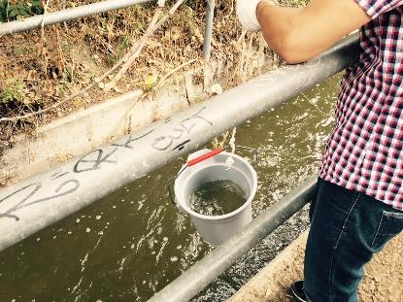
SITE
selection
Site Selection and Sampling- Hydrosphere Study Site
If the selected study site is a moving body of water (i.e. stream or river), locate your sampling site at a riffle area as opposed to still water or rapids. This will provide a more representative measurement of the water in the stream or river. If the selected study site is a still body of water i.e. a lake or reservoir), find a sampling site near the outlet area or along the middle of the water body.
Avoid inlet areas. A bridge or a pier are good choices. If your water body is brackish or salty, you will need to know the times of high and low tide at a location as close as possible to your study site.
11

Slide 12
How to Collect Your Data: Overview of Water pH Protocol
After completing the Electrical Conductivity Protocol, refer to your results and select the pH protocol that is appropriate. In this tutorial, we will review all of the protocols, so you can see the differences in procedure between them. You will see that if the Electrical Conductivity is less than 200 mS/cm, you will need to do an extra step, and add salt to the sample until it is at least 200 mS/cm. This is true for both pH paper and pH meter methods.
This slide set includes these field guides:
Using pH Paper (electrical conductivity greater than 200 mS/cm)
Using pH Paper (electrical conductivity less than 200 mS/cm)
12

Slide 13







I. How to Collect your Data: pH Water Protocol using
pH Paper: Electrical Conductivity Greater than 200 mS/cm
If your study site is brackish or the Ocean, you can assume that the Electrical Conductivity is greater than 200 mS/cm.
Time: 10 minutes
Suggested Frequency: weekly
Assemble Equipment:
Assemble Necessary Documents:
Water pH Data Sheet
pH Water Protocol using pH Paper:
pH with Electrical Conductivity Greater than 200 mS/
Equipment List
pH paper
100-ml beaker
Protective gloves
Goggles
Pen/pencil
Wash bottle
Sample bottle
Cup or beaker
13

Slide 14
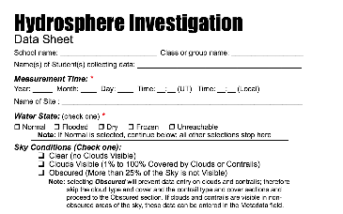
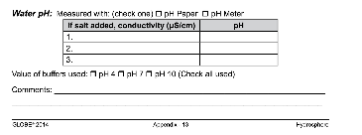


I. pH Water Protocol using pH Paper: Electrical Conductivity Greater than 200 mS/cm (Slide 1/3)
Fill in the top part of the Hydrosphere Investigation Sheet.
In the pH section of the Data Sheet, check the box next to “pH paper”.
Put on protective gloves and goggles
SAFTEY be sure to wear gloves and goggles during your investigation
14

Slide 15





I. pH Water Protocol using pH Paper:
Electrical Conductivity Greater than 200 mS/cm (2/3)
Rinse the beaker with sample water three times.
Fill the beaker halfway with your water sample.
Follow instructions that come with your pH paper for testing the sample
Record your pH on the Data Sheet as Observer 1.
15

Slide 16


I. pH Water Protocol using pH Paper:
Electrical Conductivity Greater than 200 mS/cm (3/3)
Repeat steps 4-6 two more times, using fresh sample water and new pH paper.
Record your data, and find the average of the three observations:
Calculate Average: Observer 1 + Observer 2 + Observer 3
Discard used pH paper and gloves in waste container. Rinse
beaker with distilled water using the wash bottle.
11. Enter your data on the GLOBE Website.
*End of data collection for this Water pH Protocol *
Check to make sure that each observation is within 1.0 pH units of the average.
If they are not within 1.0 units of the average, repeat the measurements
16

Slide 17






II. pH Water Protocol using pH Paper: Electrical Conductivity Less than 200 mS/cm
Time: 10 minutes
Suggested Frequency: weekly
Assemble Equipment:
Assemble Necessary Documents:
Water pH Data Sheet
pH Water Protocol using pH Paper: Electrical Conductivity Less than 200 mS/
Equipment List
pH paper
2 100-ml beaker or cups
Protective gloves
Goggles
Pen/pencil
Wash bottle
Sample bottle
Paper towels or tissue
Stirring rod
Thermometer
Electrical conductivity meter
Salt Crystals
Tweezers
17

Slide 18

II. pH Water Protocol using pH Paper: Electrical Conductivity Less than 200 mS/cm (slide 1/5)
Fill in the top part of the Hydrosphere Investigation Sheet. In the pH section of the Data Sheet, check the box next to “pH paper”.
2. Put on protective gloves and goggles
3. Rinse tweezers in sample water and dry with paper towel
4. Rinse the beakers with sample water three times.
SAFTEY be sure to wear gloves and goggles during your investigation
18

Slide 19

II. pH Water Protocol using pH Paper: Electrical Conductivity Less than 200 mS/cm (slide 2/5)
5. Fill one beaker or cup with about 50 mL of sample water
6. Using the tweezers, place one crystal of salt in the sample water. (If you do not have salt crystals, use several grains of table salt (a pile about 2mm wide at the bottom)
7. Stir thoroughly with stirring rod or spoon.
*A note regarding salt crystals. Crystal of about 0.5 – 2.0 mm in diameter are much easier to work with than the very finely ground “table salt” used is some countries. In North America, the larger salt crystals are often marketed as “sea salt”
SAFTEY be sure to wear gloves and goggles during your investigation
19

Slide 20

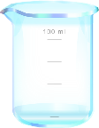
II. How to Collect your Data: pH Water Protocol using
pH Paper: Electrical Conductivity Less than 200 mS/cm
(Slide 3/5)
8. Measure the electrical conductivity of the treated sample water (with the added salt) using the Electrical Conductivity Protocol
a. If the electrical conductivity is at least 200 mS/cm, record value on
Data Sheet. Go to step 9.
b. If the electrical conductivity is still less than 200 mS/cm, go back to step 6 and repeat until you get a value that is at least 200 mS/cm. Record conductivity value on Data Sheet.
20

Slide 21

II. How to Collect your Data: pH Water Protocol using
pH Paper: Electrical Conductivity Less than 200 mS/cm (4/5)
9. Follow instructions that come with your paper for testing of the pH of the sample.
10. Record your pH on the Data Sheet as Observer 1.
11. Repeat steps 3-9 using new water samples and new pieces of paper. Record the the data on the Data Sheet as Observer 2 and Observer 3.
Find the average of the three observations.
Calculate Average: Observer 1 + Observer 2 + Observer 3 3
If you are unable to get readings within 1 pH unit in your three samples, there may be problems with your pH paper.
21

Slide 22
II. pH Water Protocol using pH Paper:
Electrical Conductivity Less than 200 mS/cm (5/5)
13. Check to make sure that each observation is within 1.0 pH units of the average. If they are not within 1.0 units of the average, repeat the measurements.
14. Discard used pH paper and gloves in a waster container. Rinse the beaker with distilled water.
15. Enter your data on the GLOBE Website.
*End of data collection for this pH Water Protocol*
22

Slide 23
Hydrosphere Site Creation
If this is your first time making hydrosphere observations at this location, you will need to create a new Hydrosphere study site before entering data.
To do this, please review the Introduction to Hydrosphere training.
23

Slide 24

Submit Your Data to GLOBE
1.Desktop Data Entry: Log environmental data directly on the GLOBE website.
2.GLOBE Observer App: The app allows users to enter data directly from an iOS or Android device for any GLOBE protocol.
24

Slide 25
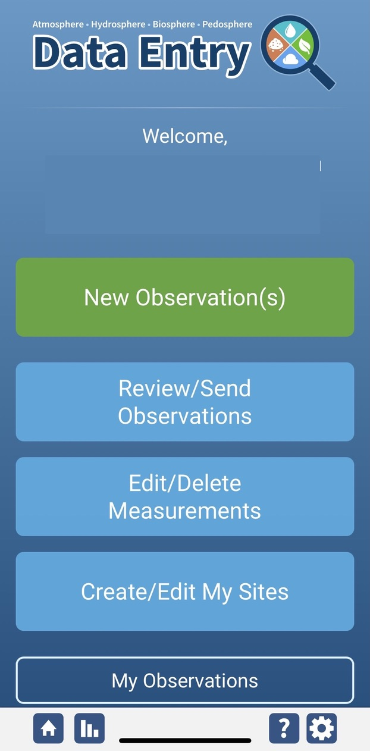
Water pH Protocol Data Entry
To enter data, first return to GLOBE Observer main page by clicking the home button in the bottom left.
Select “Data Entry”.
Next, click “New Observation(s)”
25

Slide 26
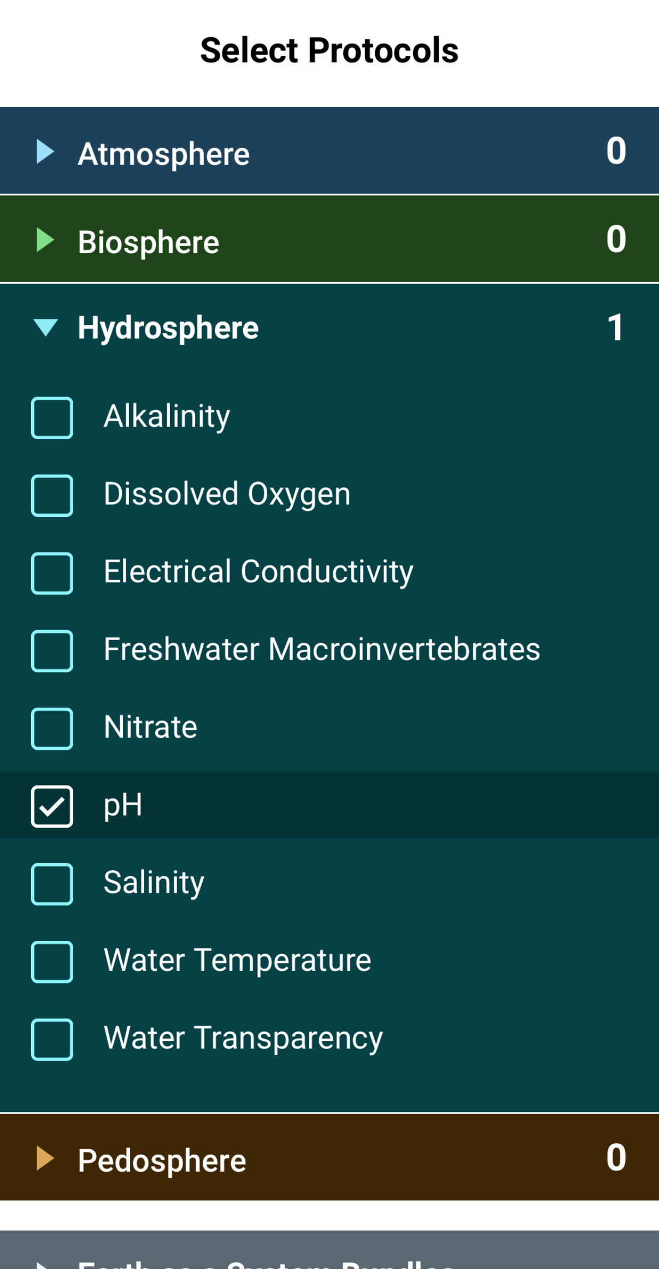
Water pH Protocol Data Entry
Select Water pH from the list of Hydrosphere protocols. Click Continue at the bottom of the screen.
26

Slide 27
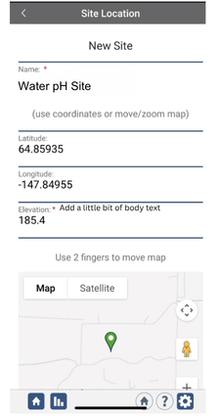
Water pH Protocol Site Information
If you have not already created a Hydrosphere site, create one now.
Click “New Site” at the bottom of the site location screen and choose a name for your new site.
27

Slide 28
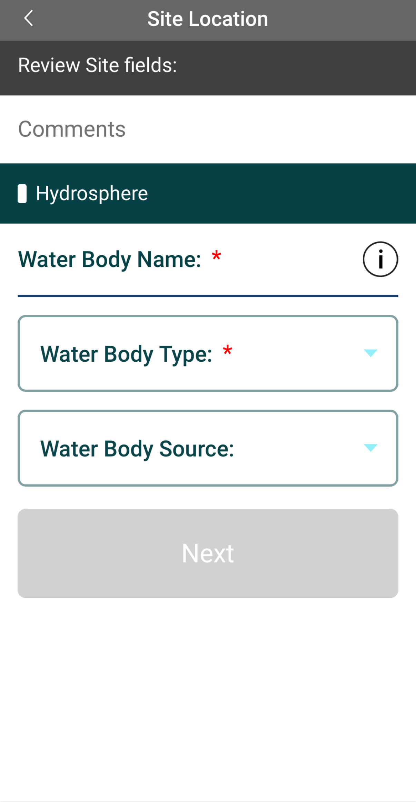
Water pH Protocol Site Information
Enter the Water Body Name.
Select the Water Body Type and Water Body Source from the dropdown list of options.
28

Slide 29
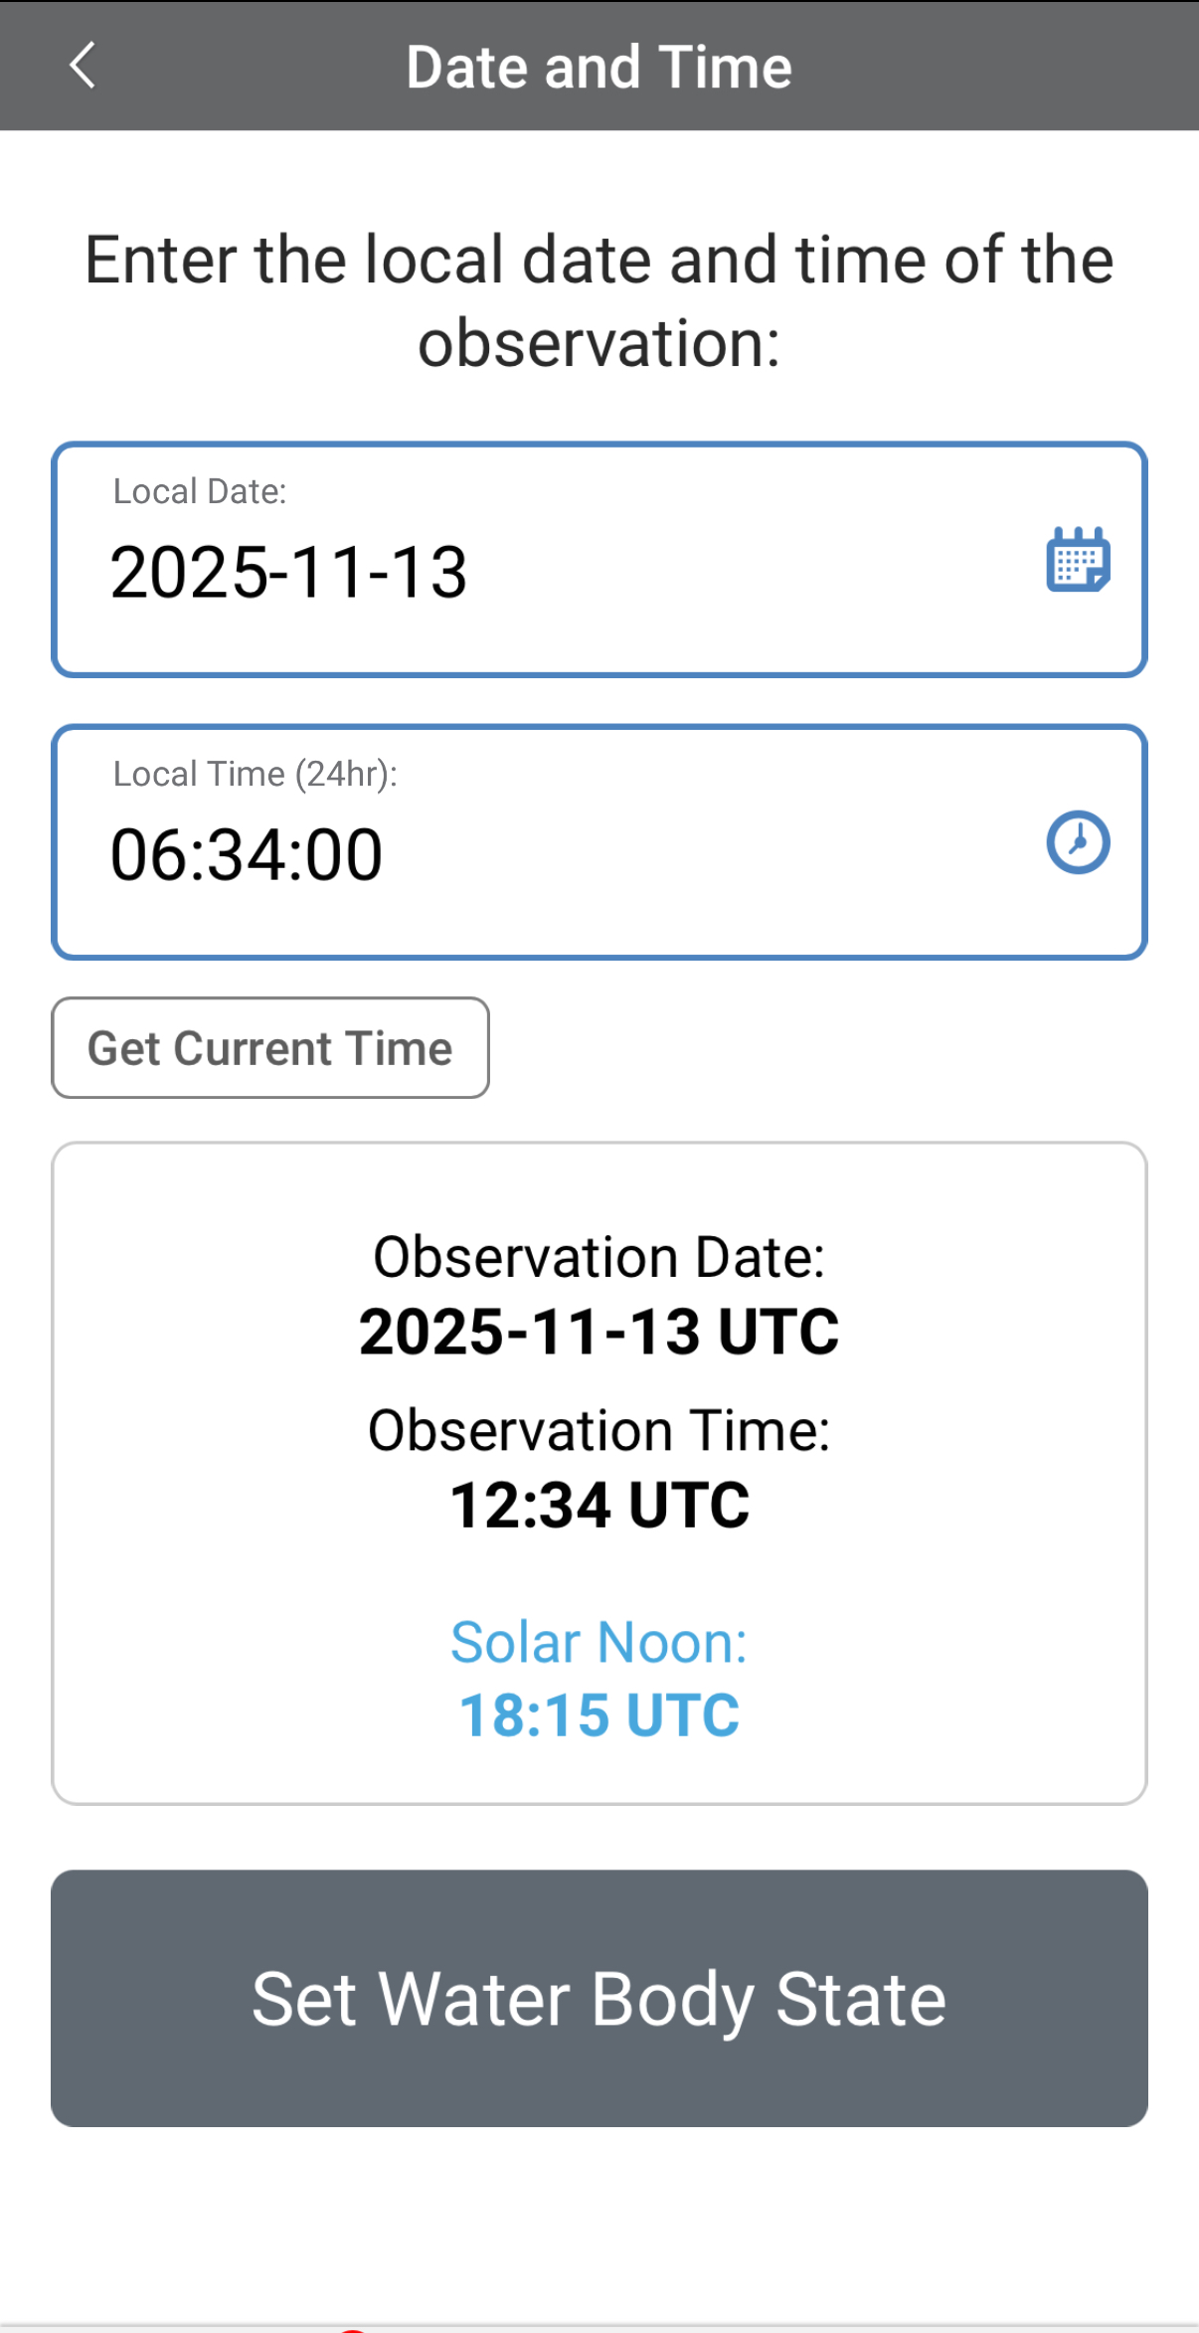
Entering Measurement Data
Enter the date and time you took the measurements.
Once you enter the date, select Set Water Body State to enter your data.
29

Slide 30
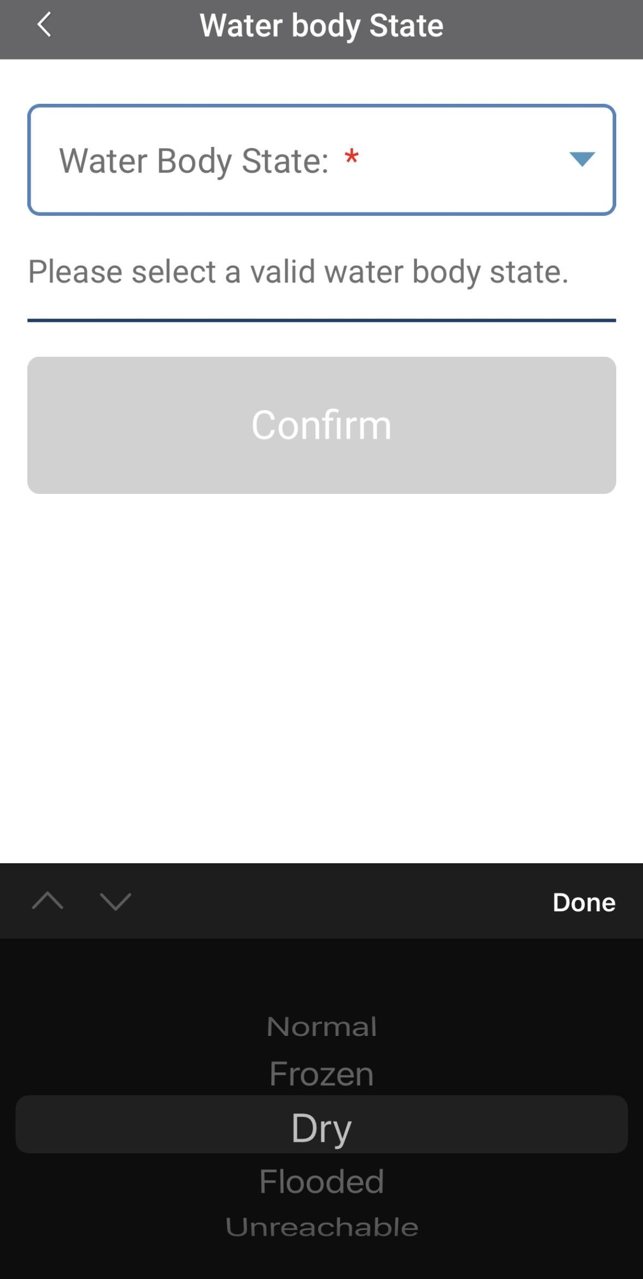
Enter the Water Body State
Select the Water Body State from the dropdown list of options.
Data entry is allowed only when the state is set as “normal.” If the water body is dry, frozen or flooded, the system will not allow the measurements to be entered.
30

Slide 31
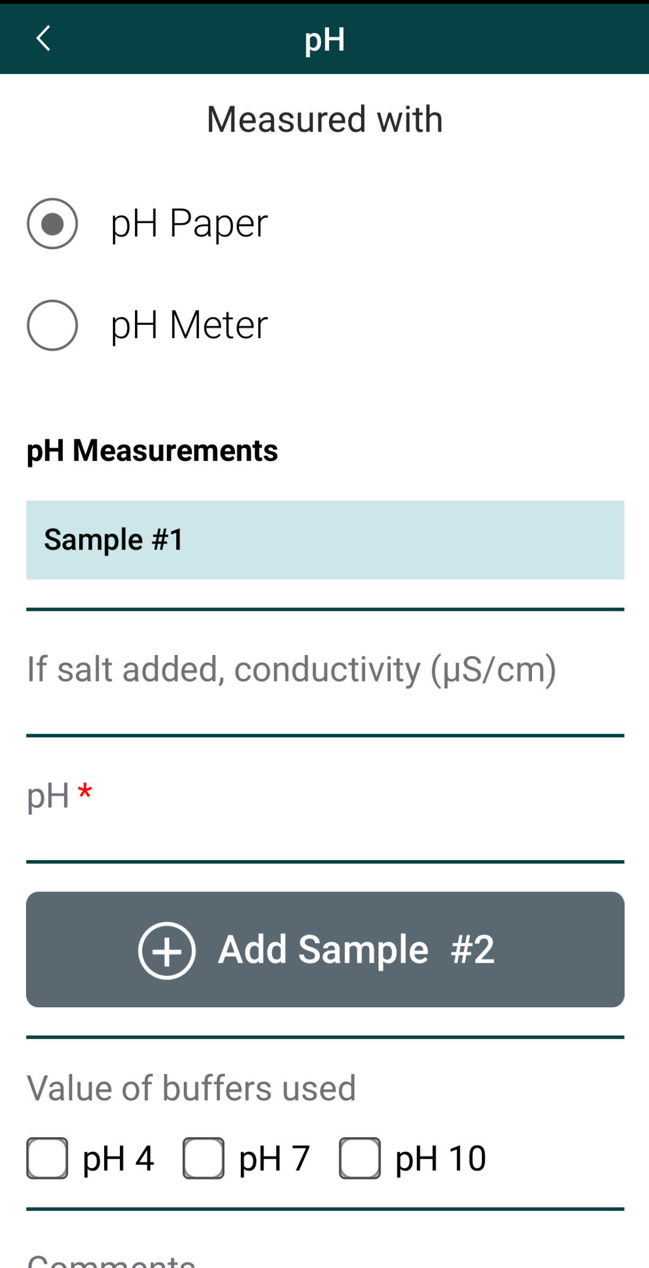
Enter Water pH Measurement Data
Select pH paper as the type of instrument used.
If you added salt to the water sample, enter the conductivity.
Enter the pH measurement.
Select the pH value of buffers used.
31

Slide 32
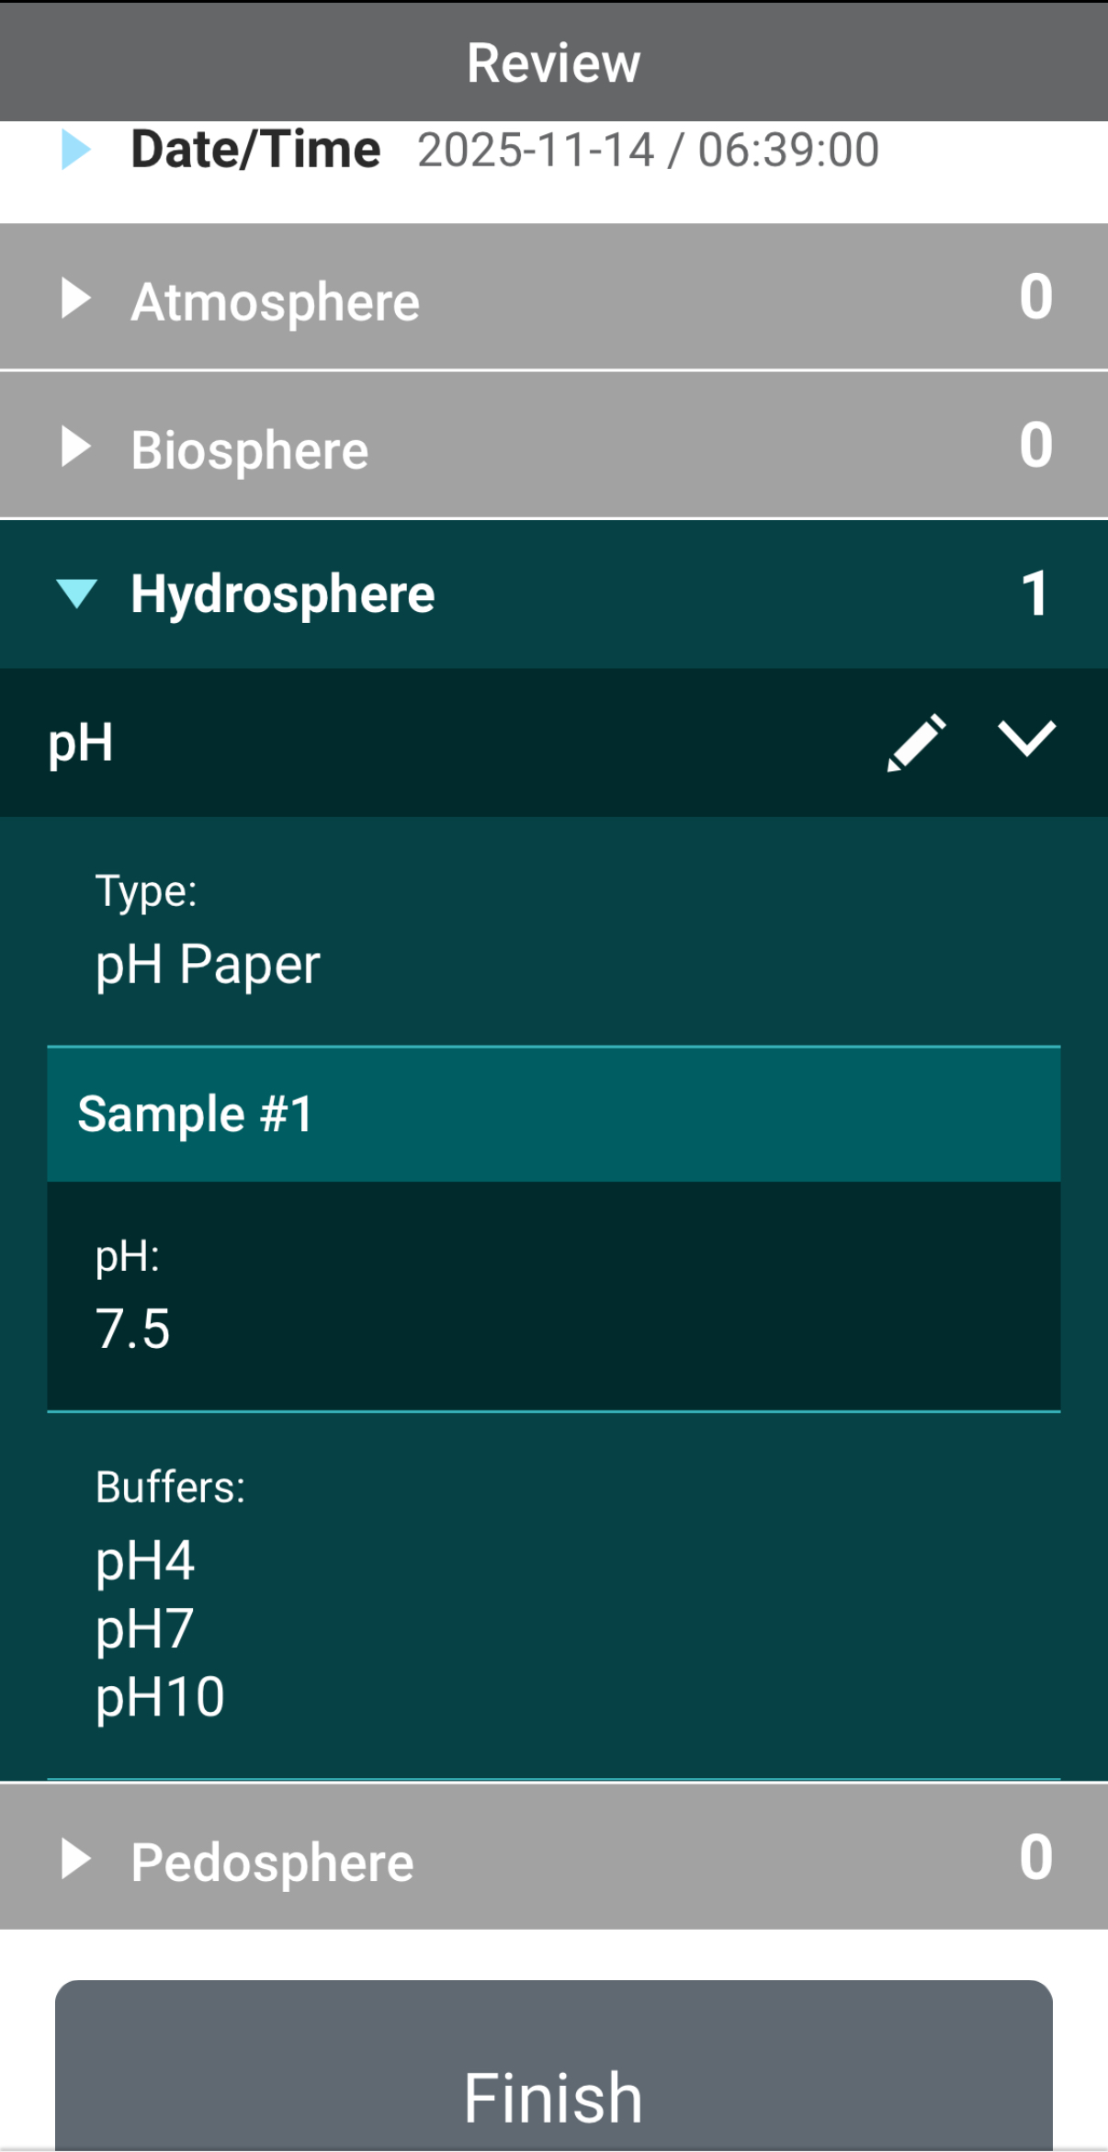
Review Data Entry and Send Data
Review the data you entered and check for errors.
When complete, select Finish to complete the send the observation to GLOBE.
32

Slide 33
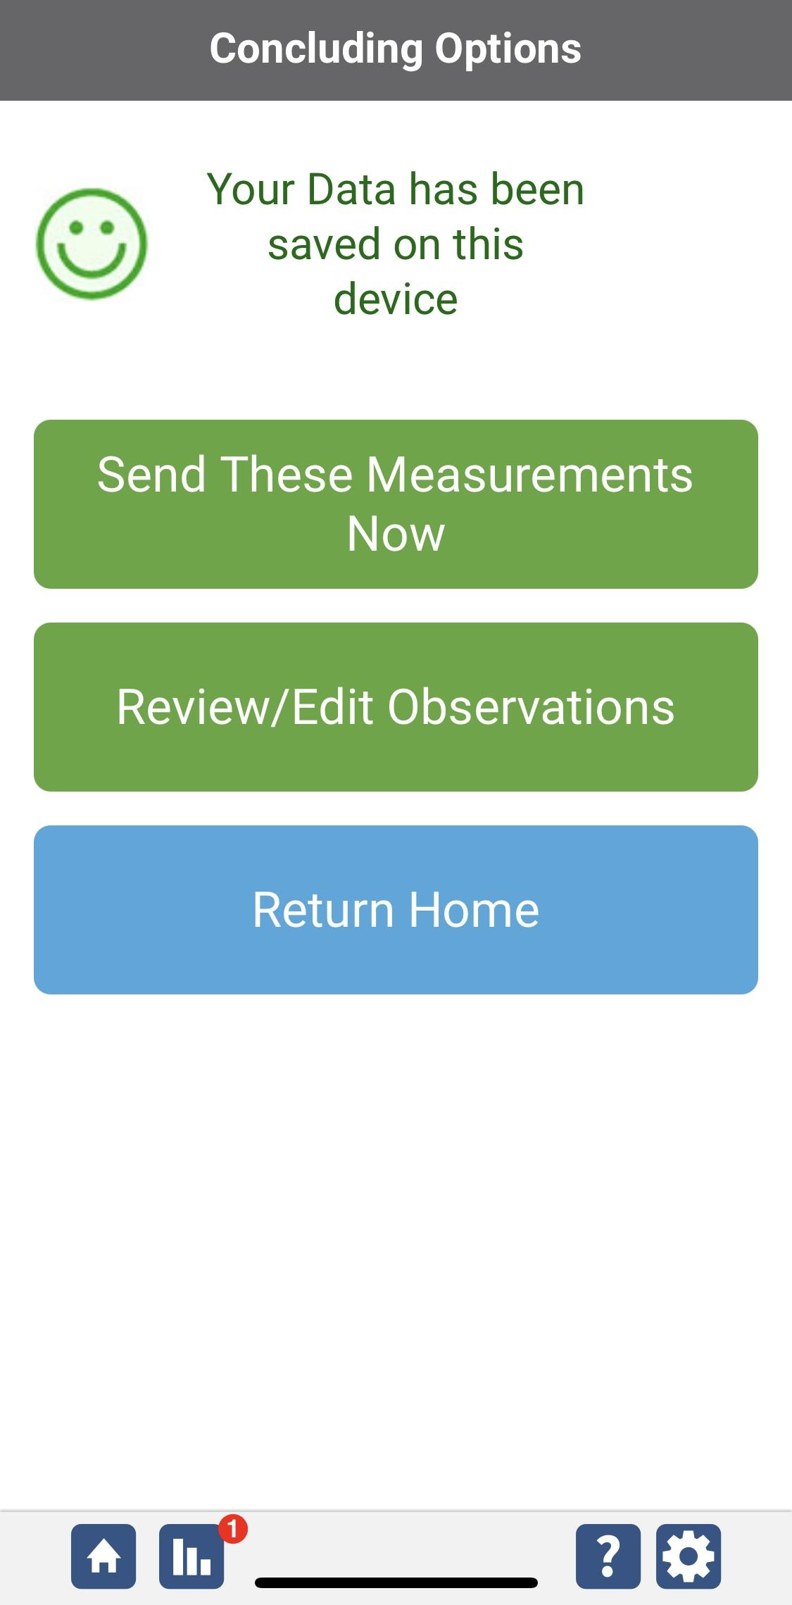
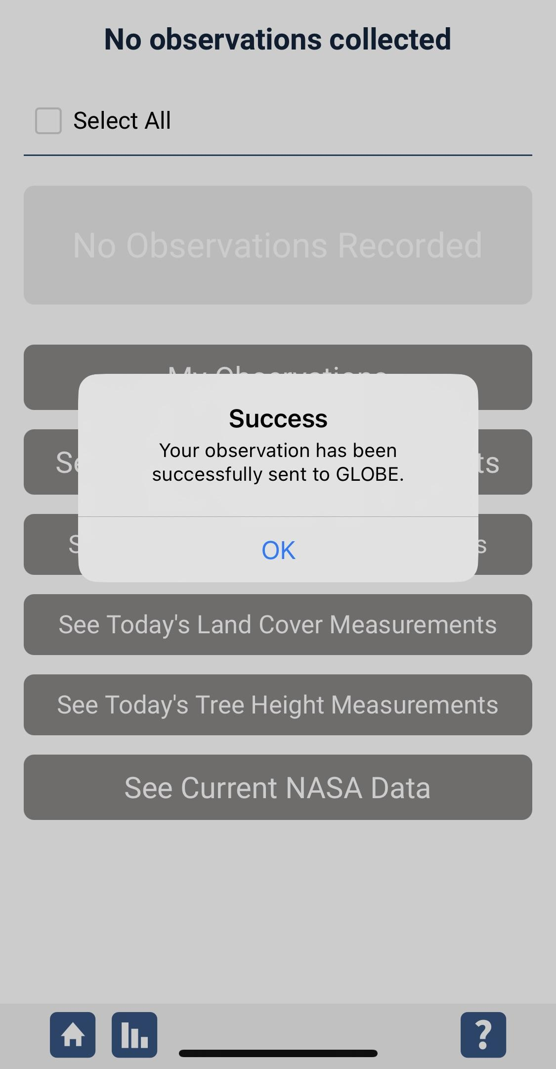
Data System Responses
If your observations are within the appropriate ranges, you will see a green smiley face.
You can review or edit your observation if needed.
When ready, select “Send these measurements now” to send your data to GLOBE. When it has been sent, you will see a “Success” message.
33

Slide 34
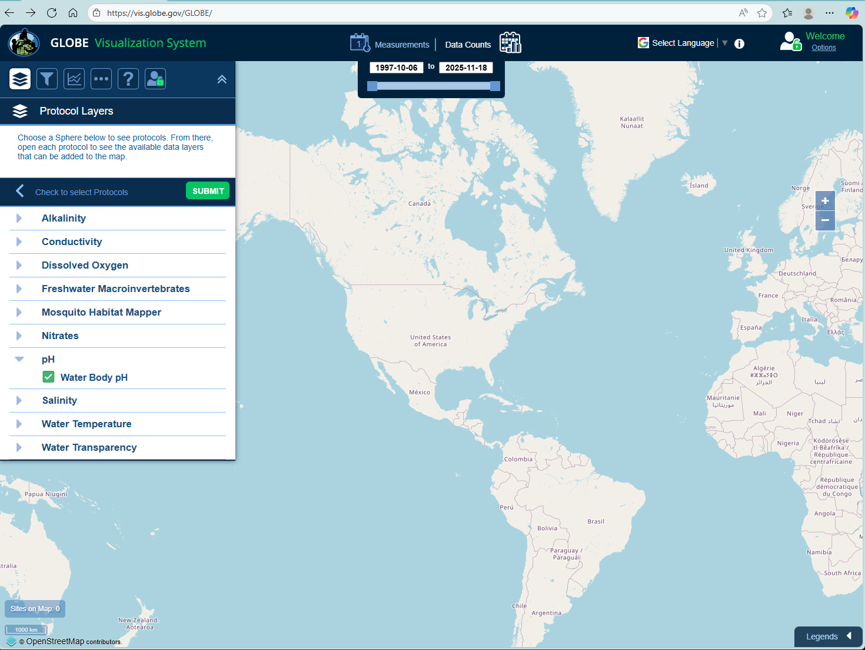
Visualize and Retrieve Water pH Data
GLOBE provides the ability to view and interact with data measured across the world. Select our visualization tool to map, graph, filter and export pH data that have been measured across GLOBE protocols since 1995. Here are screenshots steps you will use when you use the visualization tool:
Select Water Body pH from drop down menu, then click “Submit”
Link to step-by-step tutorial on using the GLOBE Data Visualization Tool
34

Slide 35
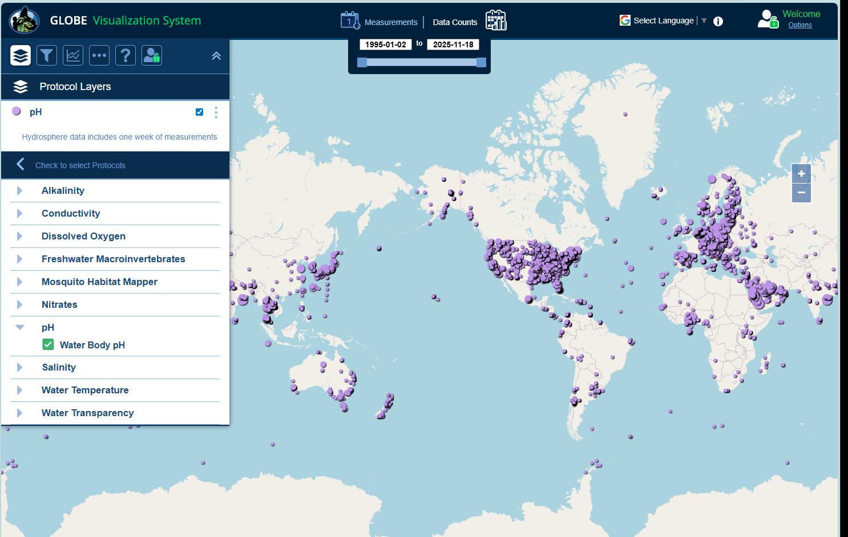
Visualize and Retrieve Water pH Data
Select the date for which you need pH data, add layer and you can see where data is available.
Locations where pH data is available for the week you selected
35

Slide 36
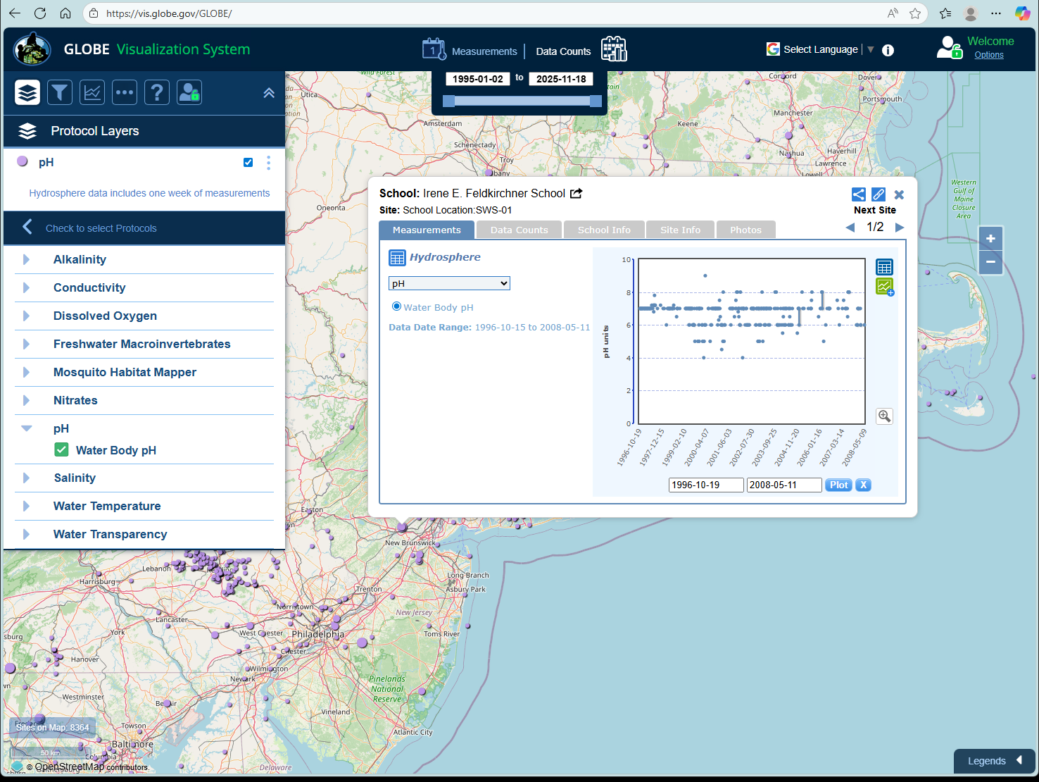
Visualize and Retrieve Water pH Data
Select the sampling site for which you need pH data, and a box will open with data summary for that site.
Clicking on a location will open to a map note providing pH data for that location and time.
36

Slide 37

Review questions to help you prepare to conduct the Hydrosphere pH Protocol
What is the importance of pH to aquatic life?
What is a logarithmic scale? Why is it a useful way to report pH?
True/False pH affects the solubility and biological availability of nutrients.
In a water body, what happens to aquatic life in waters with pH values below 4.0 or above 10.0?
What other measurement, in addition to pH, must you do to ensure that your pH paper or meter is reporting accurately?
What are the safety precautions you should take when doing any of the hydrology protocols?
What is the acceptable range of error of the three replicate samples you take?
What kinds of environmental events could change water pH?
Which pH value is more acid: a pH value of 1 or a pH value of 14?
What is the pH value of pure water?
37

Slide 38
You have now completed the slide stack. If you are ready to take the quiz, sign on and take the quiz corresponding to Water pH Protocol.
You can also review the slide stack, post questions on the discussion board, or look at the FAQs on the next page.
When you pass the quiz, you are ready to take Water pH Protocol measurements!
38

Slide 39
FAQ: Frequently Asked Questions
Does water temperature affect my pH reading?
A change in water temperature can actually change the pH value of your water. Since we want to know the actual pH value, we do not correct for this change.
Temperature can also affect the performance of the meter. The electrode is designed so there is no temperature sensitivity when the pH is 7.0. As the pH moves away from this value, the water temperature affects meter accuracy. Meters with automatic temperature compensation (ATC) correct for the temperature of the water at values above and below 7.0 by a factor of 0.003 pH/ ̊C/pH unit away from pH 7. They correct for meter error.
Does high salt concentration affect pH?
Salt concentration can affect pH. As salt concentration increases, pH can increase. This is not a linear relationship, but can be important in estuaries, where the salinity varies with the tide. Taking into account salinity or conductivity data may be useful in understanding variations in your pH measurements.
39

Slide 40
FAQ: Frequently Asked Questions
Why may pH measurements be inaccurate in low conductivity waters?
To measure the hydrogen ion concentration, you are actually measuring the potential of the hydrogen ions. Other ions have to be present to pass the current to make this measurement. When they are at too low of a concentration the meter slowly drifts and if the drift is really slow, the meter locks in on an incorrect measurement
Can I use a pH meter that connects to my Smart Phone?
Yes, pH meters that connect to iPhones, iPads and other Smart devices can be considered pH meters. For most of these meters an app is required.
40

Slide 41

We want your Feedback!
Please provide us with feedback about this module. This is a community project and we welcome your comments, suggestions and edits! Please take a minute to comment here: Training@nasaglobe.org
Credits:
Slides:
Russanne Low, Ph.D., University of Nebraska-Lincoln, USA
Rebecca Boger, Ph.D., Brooklyn College, NYC, USA
Photos: Russanne Low
Art: Jenn Glaser, ScribeArts
More Information:
GLOBE Program, NASA Earth Science
NASA Global Climate Change: Vital Signs of the Planet
The GLOBE Program is sponsored by these organizations:
Version 11/18/25. Modified by GLOBE Implementation Office – Science, Training, Education, and Public Engagement. If you edit and modify this slide set for use for educational purposes, please note “modified by (and your name and date)" on this page. Thank you.
41

