Slide 2
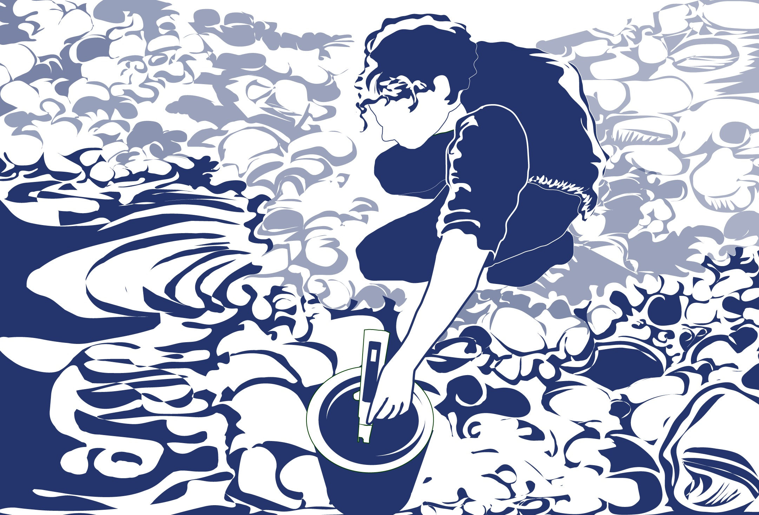
Overview
This module:
Reviews the selection of a GLOBE hydrology site
Reviews the water sampling technique used in GLOBE hydrology protocols
Guides the calibration of the necessary instruments for this protocol
Provides a step by step introduction of the protocol method
Learning Objectives
After completing this module, you will be able to:
Describe why water temperature is considered a master variable
Explain why this measurement accompanies all other hydrology
measurement taken using GLOBE protocols
Describe how the protocol procedures ensure the collection of accurate data
Apply the calibration and measurement steps of this protocol
Upload data to the GLOBE portal
Visualize data using GLOBE’s Visualization Site

Slide 3
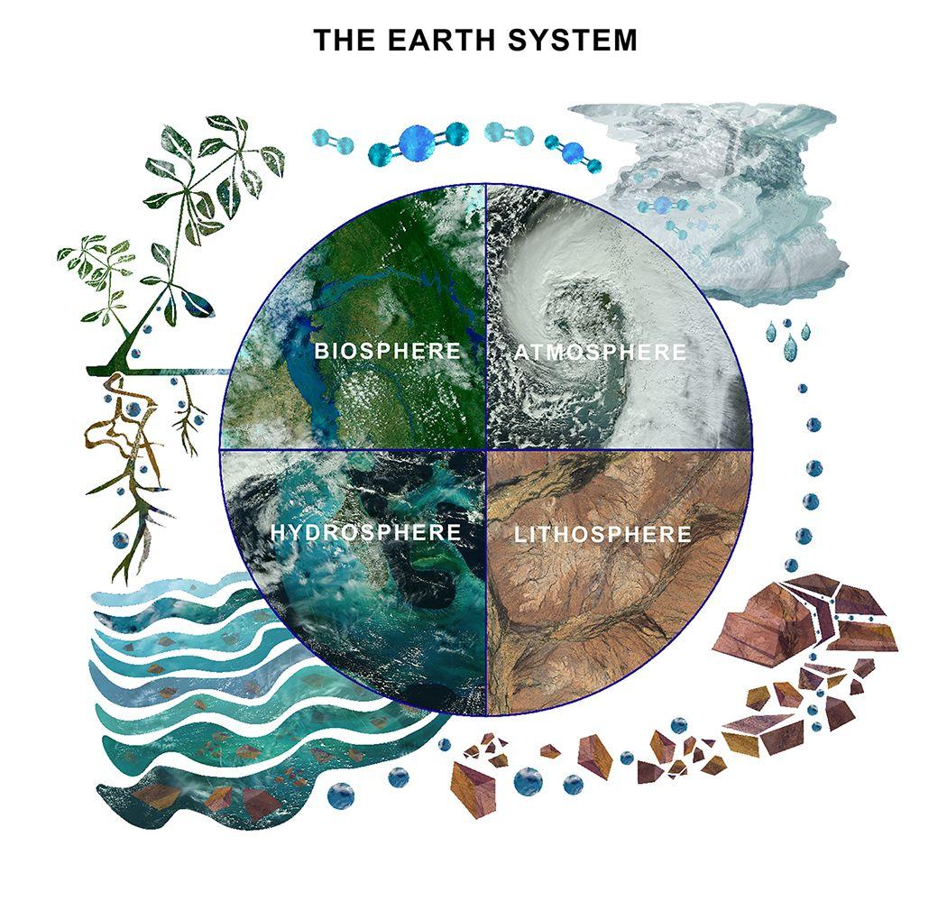
The Hydrosphere
The hydrosphere is the part of the Earth system that includes water, ice and water vapor. Water participates in many important natural chemical reactions and is a good solvent. Changing any part of the Earth system, such as the amount or type of vegetation in a region or from natural land cover to an impervious one, can affect the rest of the system. Rain and snow capture aerosols from the air. Acidic water slowly dissolves rocks, placing dissolved solids in water. Dissolved or suspended impurities determine water's chemical composition.
Current measurement programs in many areas of the world cover only a few water bodies a few times during the year. GLOBE Hydrosphere protocols will allow you to collect valuable data to help fill these gaps and improve our understanding of Earth's natural waters.
The Earth System: Energy flows and matter cycles.

Slide 4
What is Water Temperature?
GLOBE Hydrosphere Measurements
Hydrosphere Study Site
Water Temperature
Water Transparency
Conductivity
pH
Mosquito Larvae
Alkalinity
Dissolved Oxygen
Salinity
Nitrates
Freshwater Macroinvertebrates
The measurement of water temperature determines how hot or cold the water is.
It is sometimes called a master variable because almost all properties of water, as well as chemical reactions taking place in it, are affected by it.
Sudden increases or decreases of water temperature are unusual. Water has a higher heat capacity (specific heat) than air, thus it heats and cools more slowly.

Slide 5
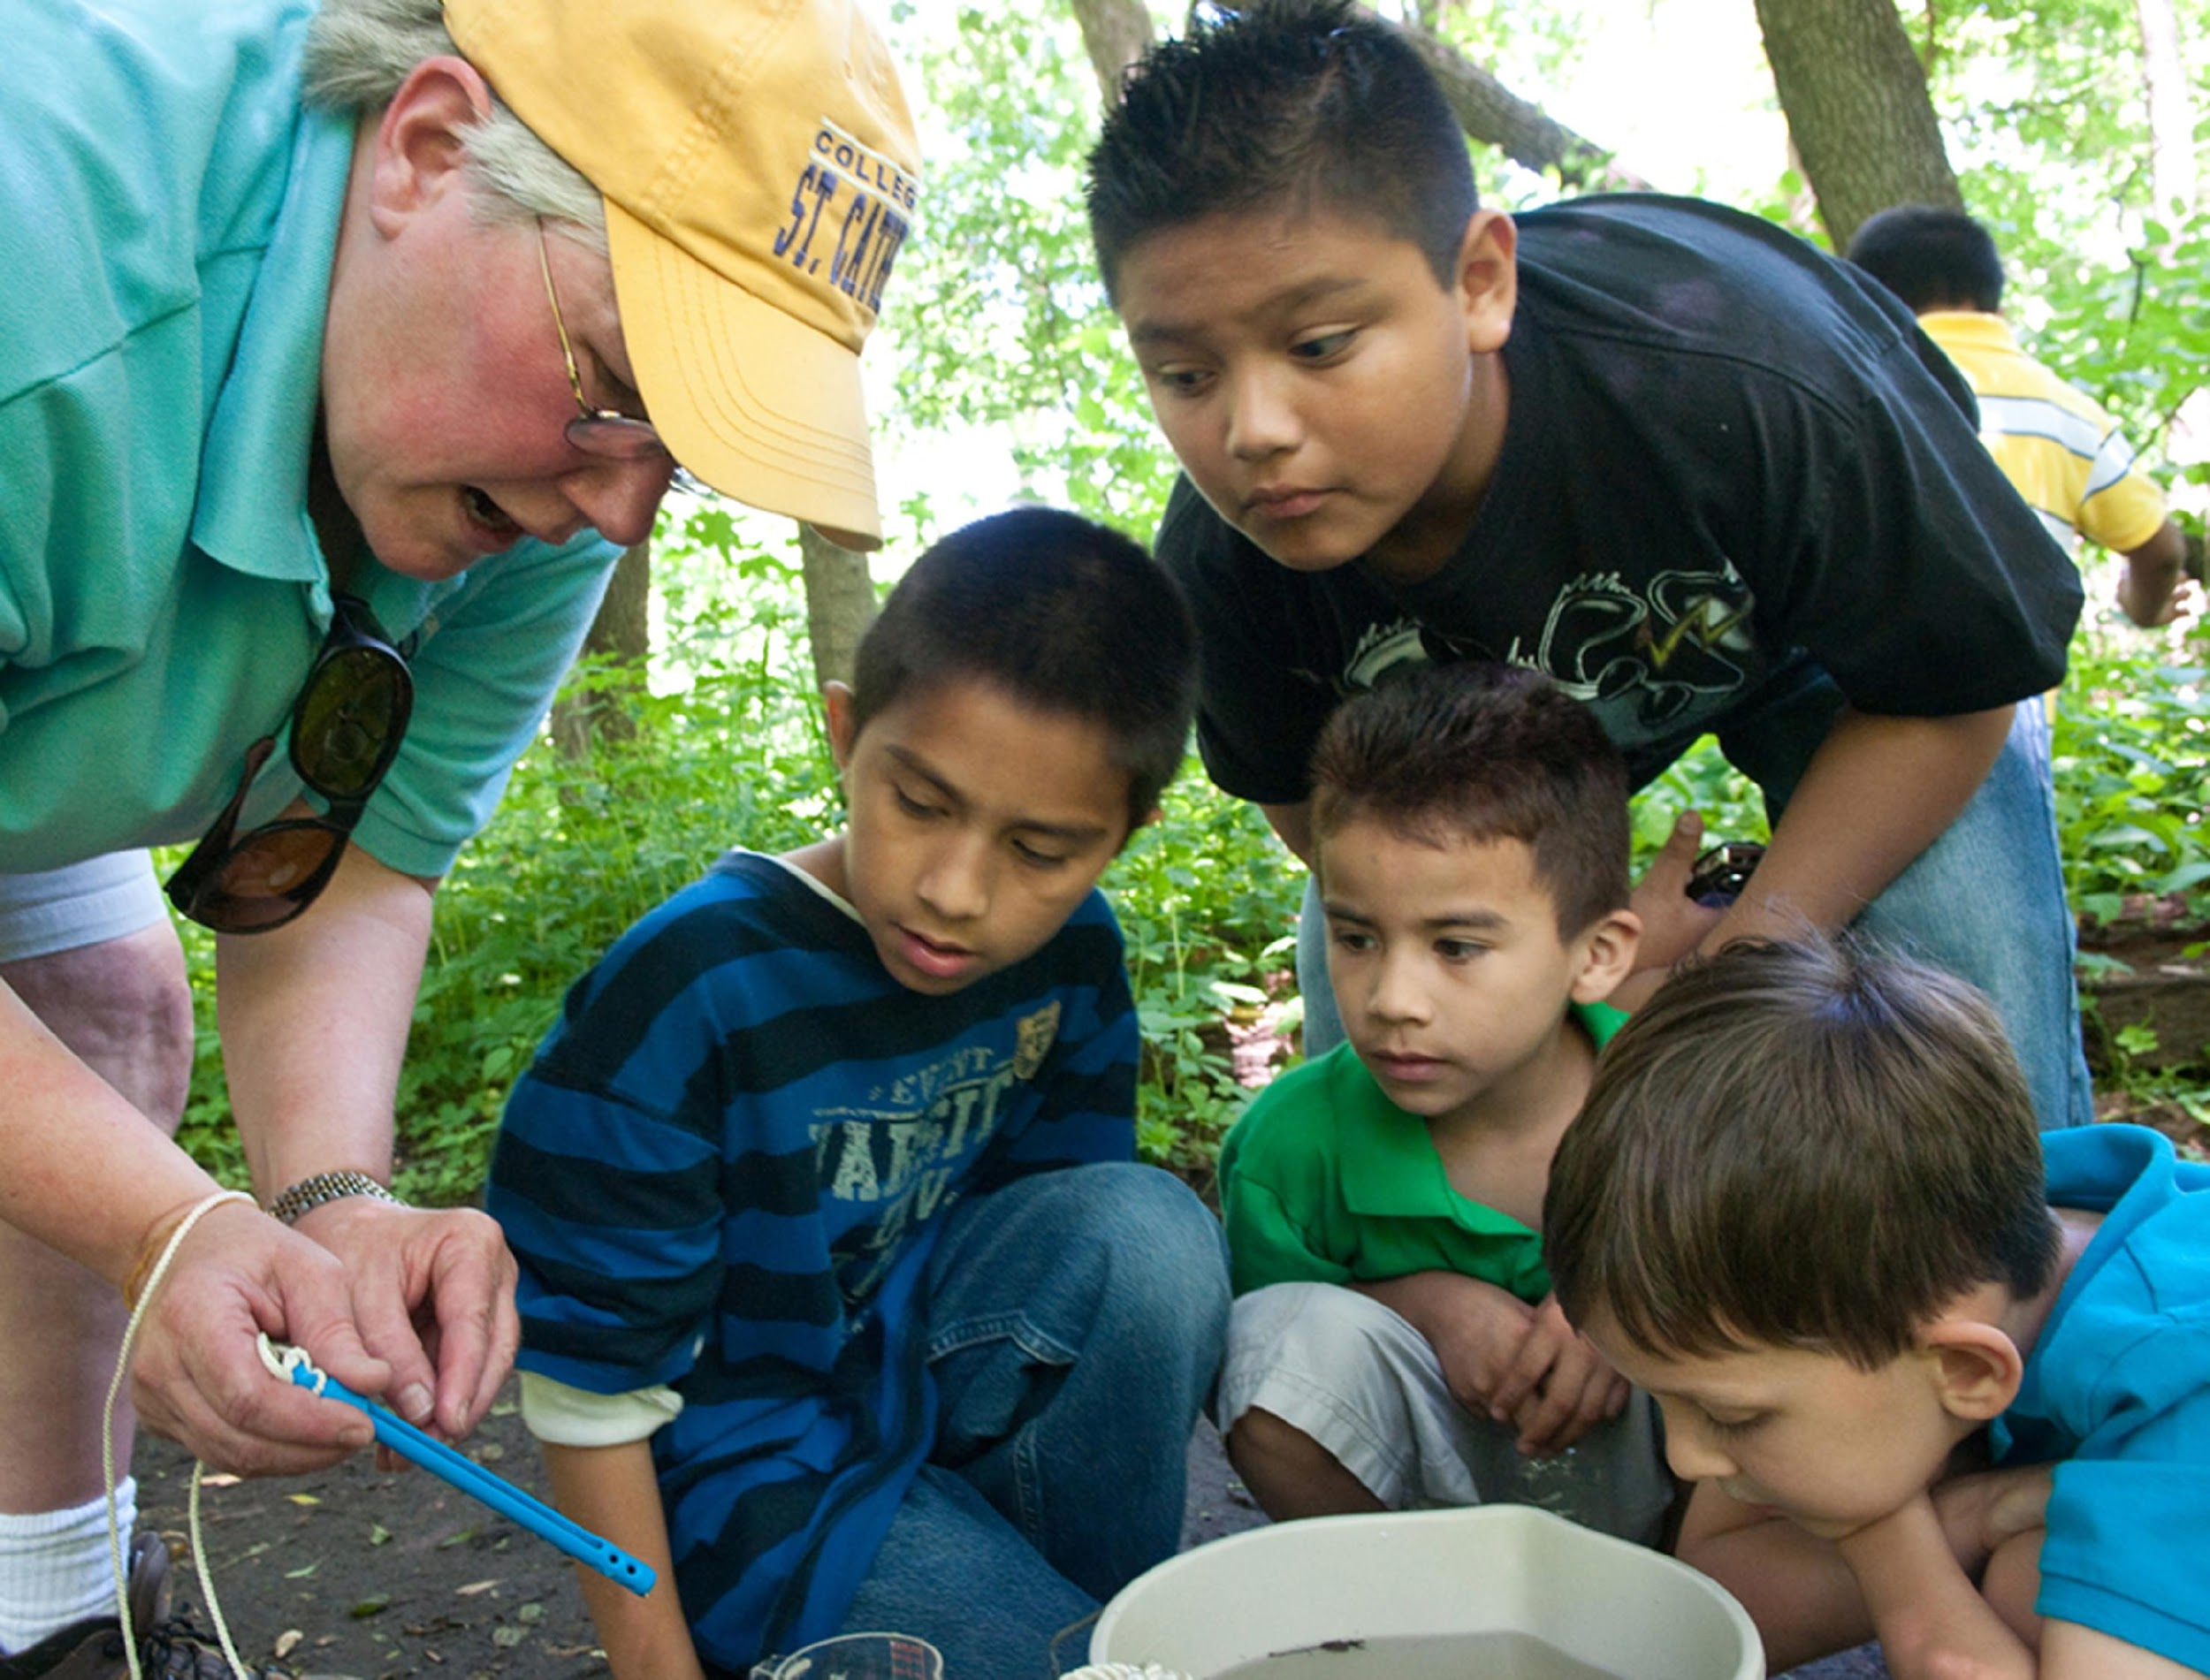
Why Collect Water Temperature Data?
Temperature influences the amount and diversity of aquatic life. Lakes that are cold and have little plant life in winter, bloom in spring and summer when water temperatures rise and the nutrient-rich bottom waters mix with the upper waters. Because of this mixing and the warmer water temperatures, the spring overturn is followed by a period of rapid growth of microscopic aquatic plants and animals.
Many fish and other aquatic animals also spawn at this time of year when the temperatures rise and food is abundant. Shallow lakes are an exception to this cycle, as they mix throughout the year.
Water temperature is also important because warm water can be fatal for sensitive species, such as trout or salmon, which require cold, oxygen-rich conditions. Warmer water tends to have lower levels of dissolved oxygen.

Slide 6
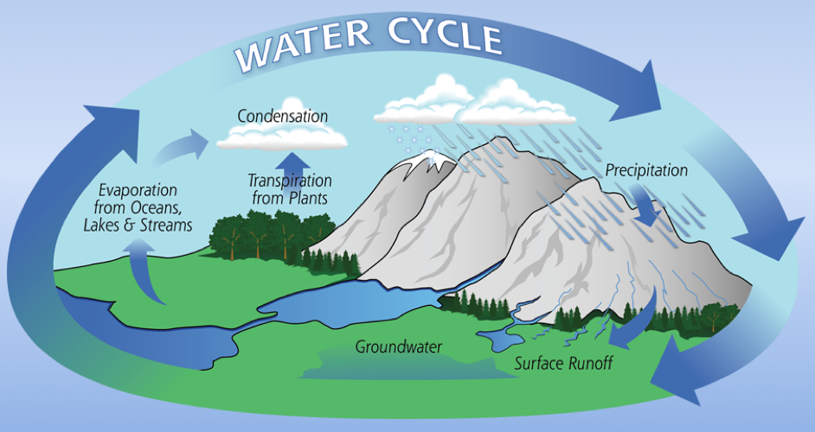
Why Collect Water Temperature Data?
Water temperature is important for understanding local and global weather patterns. Water temperatures change differently than air temperatures because water has a higher heat capacity than air. Water also helps to change air temperature through the processes of evaporation and condensation. The flow of energy, the hydrologic cycle and weather are closely connected.
Image Credit: NASA

Slide 7
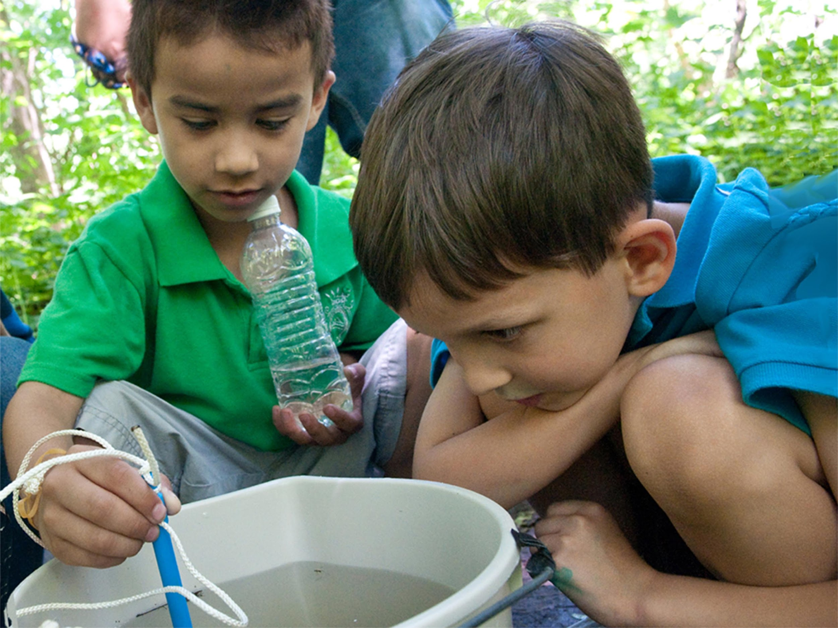
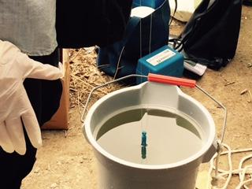
How Your Measurements Can Help
Your water temperature measurements can help in different ways. At the local scale, you are monitoring your local water body and over time keeping track on how it is changing throughout the seasons and over the years.
On a regional and global scale, you and and other GLOBE measurements of water temperature data are helping to better understand hydrologic and energy cycles.

Slide 8
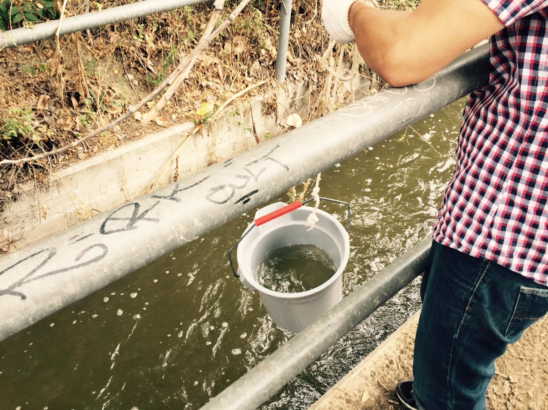
Site Selection: Hydrosphere Study Site
Select a specific site where the hydrosphere measurements (water temperature, dissolved oxygen, nitrate, pH, alkalinity, turbidity, and either conductivity or salinity) will be taken. If the selected study site is a moving body of water (i.e. stream or river), locate your sampling site at a riffle area as opposed to still water or rapids. This will provide a more representative measurement of the water in the stream or river.
If the selected study site is a still body of water i.e. a lake or reservoir), find a sampling site near the outlet area or along the middle of the water body. Avoid inlet areas. A bridge or a pier are good choices. If your water body is brackish or salty, you will need to know the times of high and low tide at a location as close as possible to your study site.

Slide 9
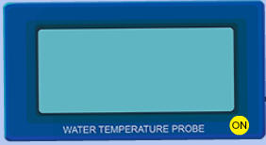
How to Collect Water Temperature Data
There are two ways to ways to collect water temperature for GLOBE: using alcohol-filled thermometers or a probe. This slide stack will discuss the calibration and use of the thermometer probe.
When using temperature probes, you will hear references to either temperature probes or meters. For clarification, probes are the instruments that measure voltage or resistance in a water sample. Meters are instruments that convert voltage or resistance measurements to concentrations. In order to measure temperature (or other types of measurements), both a probe and meter are required. Sometimes the probe and meter are within one instrument and cannot be taken apart. Other instruments have probes that are separate from the meters and need to be connected to the meters in order to take the water measurements.

Slide 10
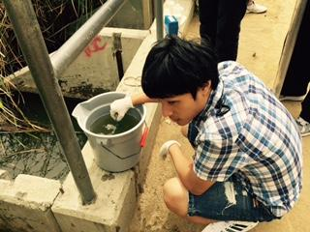
How to Collect Water Temperature Data: Measurement Procedures
Except for transparency, take water temperature before the other water measurements.
Take the water temperature measurement as soon as possible after the water sample is taken because temperature tends to change very rapidly after a sample is collected.
Read the temperature value on the meter while the probe is in the water. The temperature reading can change quickly once the thermometer is out of the water, especially if the air temperature is very different from the water temperature or if it is windy. Wind can cause evaporation to occur rapidly, lowering the temperature.
It is important that the water temperature be taken at the same place every week. There may be several degrees of difference in water temperature over a small area in your water body: sunny areas vs. shady areas, or shallow and deeper areas.

Slide 11
How to Collect Water Temperature Data: Instrument Care
The probe should be stored with the cap on.
The probe should be well rinsed with distilled water after use to avoid mineral deposit accumulation.
The probe should periodically be cleaned with alcohol.

Slide 12
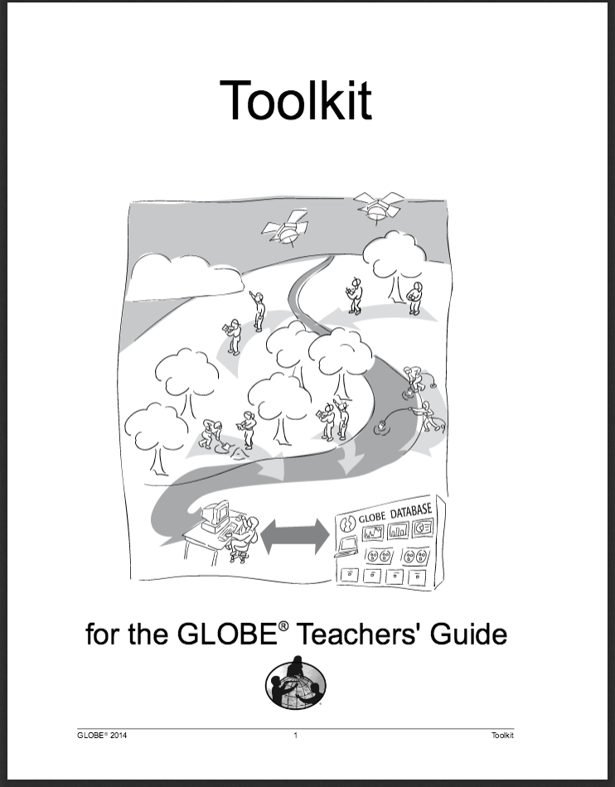
Sources for Equipment You Need for the Water Temperature Protocol
The following resources summarize the measurements associated with each protocol, associated skill level, scientific specifications for the instruments, and how to access the equipment you need (purchase, build, or download).
Where to find specifications for instruments used in GLOBE investigations
Where to find scientific instruments used in GLOBE investigations

Slide 13

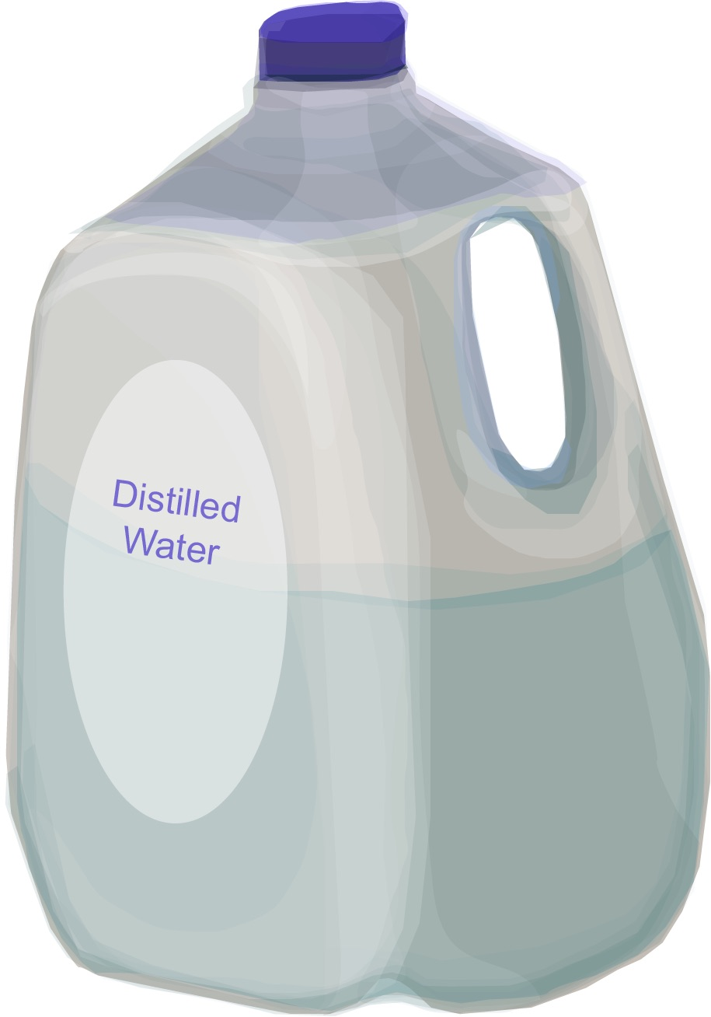
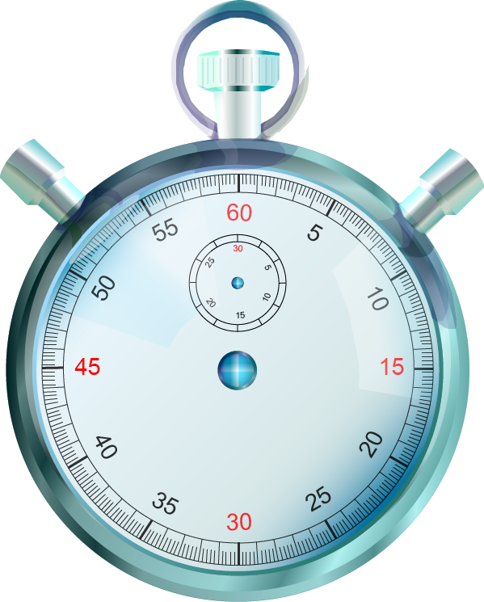
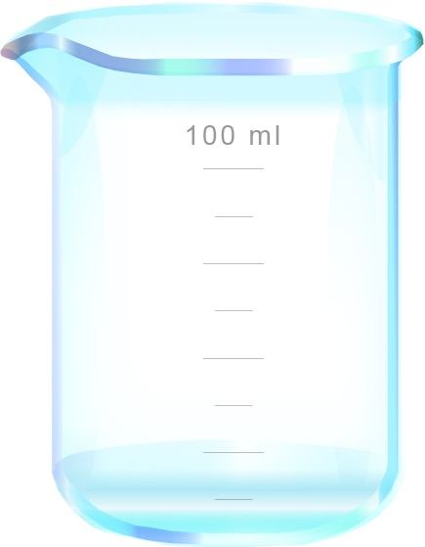
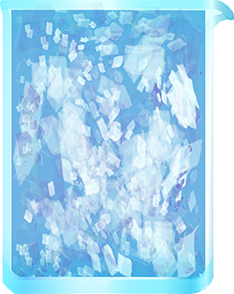
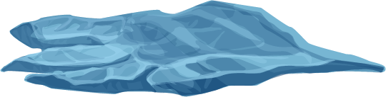
Water Temperature Protocol
Assemble Equipment:
Calibrated meter and probe
Latex gloves
Pen or pencil
Clock or watch
For Calibration:
- Thermometer
- 400 mL ice
- Distilled water
- 500 mL beaker
Equipment List
Calibrated meter and probe
Latex gloves
Pen or pencil
Clock or watch
Assemble Necessary Documents:
Water Temperature Data Sheet
Water Temperature Protocol for Thermometer Probes Field Guide
Calibrating an Alcohol-filled Thermometer Lab Guide
Time: 10 minutes
Temperature probes must be calibrated
before each use.
Suggested Frequency: weekly

Slide 14

How To Collect Your Water Temperature Data: Calibration
Temperature meters must be calibrated before use. Check with your meter manufacturer to be sure it stores the most recent calibration. If it does, the temperature meter should be calibrated in the classroom or lab before going to the Hydrosphere Study Site. If your meter does not keep the most recent calibration, you will need to calibrate it just before you take your measurements taking care not to turn the meter or any associated software off.
Pay close attention to your calibration procedure. Without the calibration step your temperature data will not be meaningful or comparable to data collected by others!

Slide 15
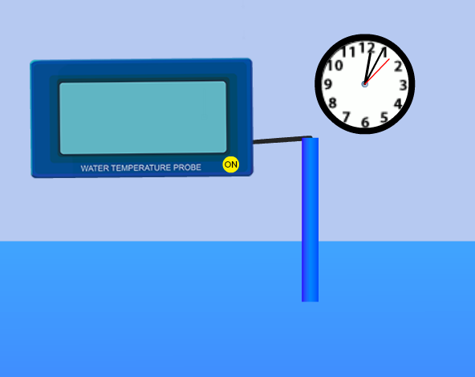
How To Collect Your Water Temperature Data: Probe (Slide 1 of 2)
Make sure that your temperature probe and meter have been calibrated within the last 24 hours (see Manufacturer’s Instructions)
Fill out the top portion of your Hydrosphere Investigation Data Sheet.
Put the probe or the into the sample water to a depth of 10 cm.
Leave the probe in the water for three minutes.
Read the temperature on the meter without removing the probe from the water.
Let the thermometer probe stay in the water sample for one more minute.
Read the temperature again. If the temperature has not changed, go to Step 8. If the temperature has changed since the last reading, repeat Step 6 until the temperature stays the same.

Slide 16
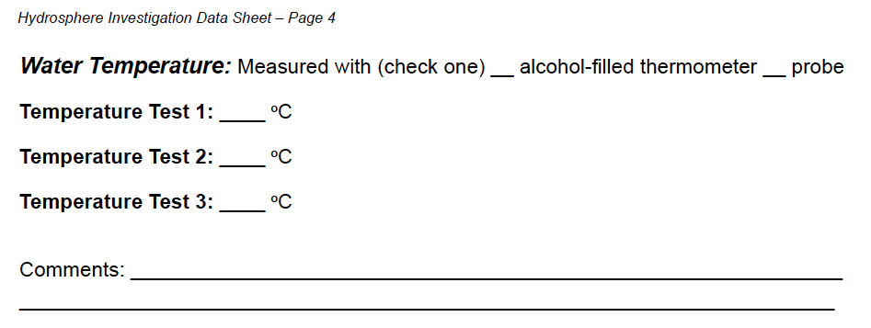
How To Collect Your Water Temperature Data: Probe (Slide 2 of 2)
Record the temperature on the Hydrosphere Investigation Data Sheet.
Have two other students repeat the measurement with new water samples.
Calculate the average of the three measurements.
All temperatures should be within 1.0˚ C of the average. If they are not, repeat the measurement.

Slide 17
Hydrosphere Site Creation
If this is your first time making hydrosphere observations at this location, you will need to create a new Hydrosphere study site before entering data.
To do this, please review the Introduction to Hydrosphere training.

Slide 18

Submit Your Data to GLOBE
1.Desktop Data Entry: Log environmental data directly on the GLOBE website.
2.GLOBE Observer App: The app allows users to enter data directly from an iOS or Android device for any GLOBE protocol.

Slide 19
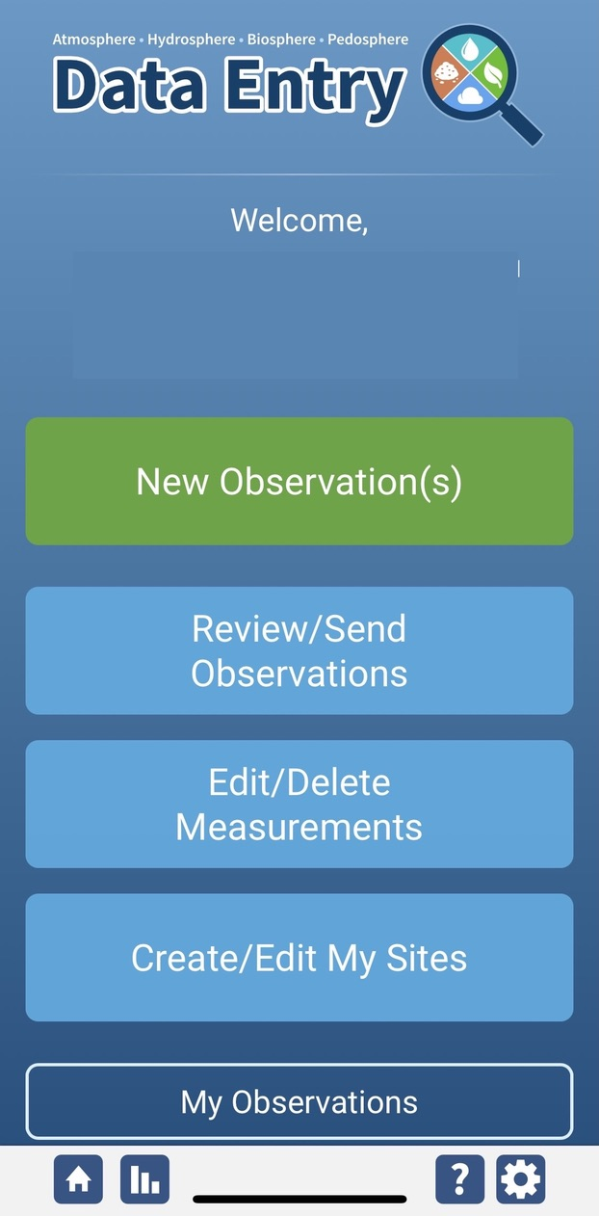
Water Temperature Protocol Data Entry
To enter data, first return to GLOBE Observer main page by clicking the home button in the bottom left.
Select “Data Entry”.
Next, click “New Observation(s)”

Slide 20
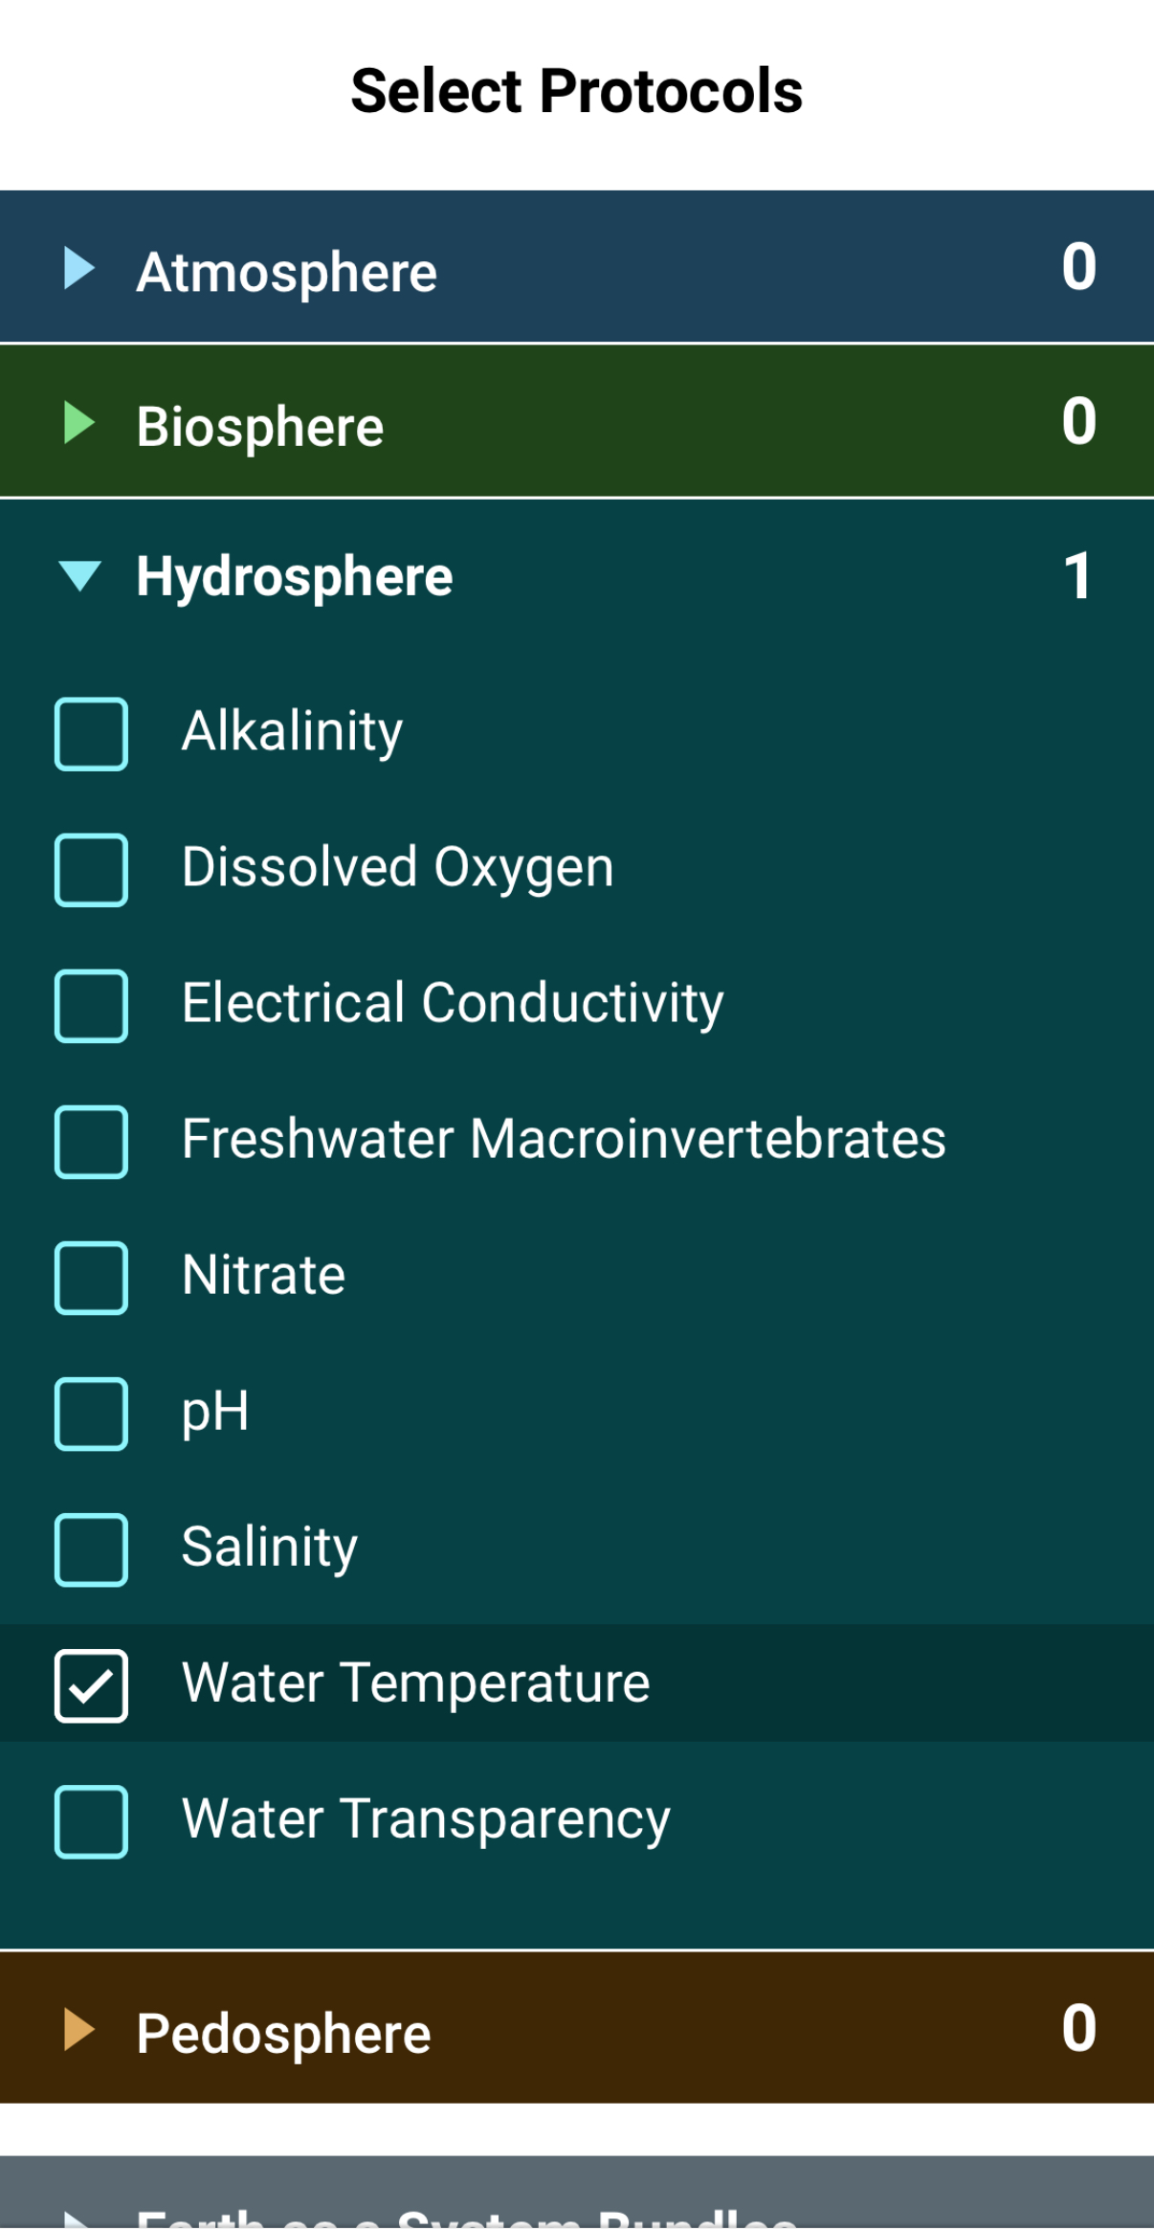
Water Temperature Protocol Data Entry
Select Water Temperature from the list of Hydrosphere. Click continue at the bottom of the screen.

Slide 21
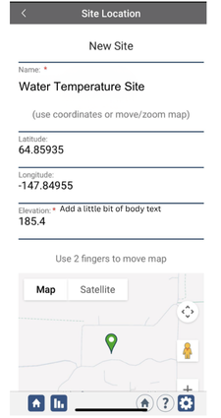
Water Temperature Protocol Site Information
If you have not already created a Hydrosphere site, create one now.
Click “New Site” at the bottom of the site location screen and choose a name for your new site.

Slide 22
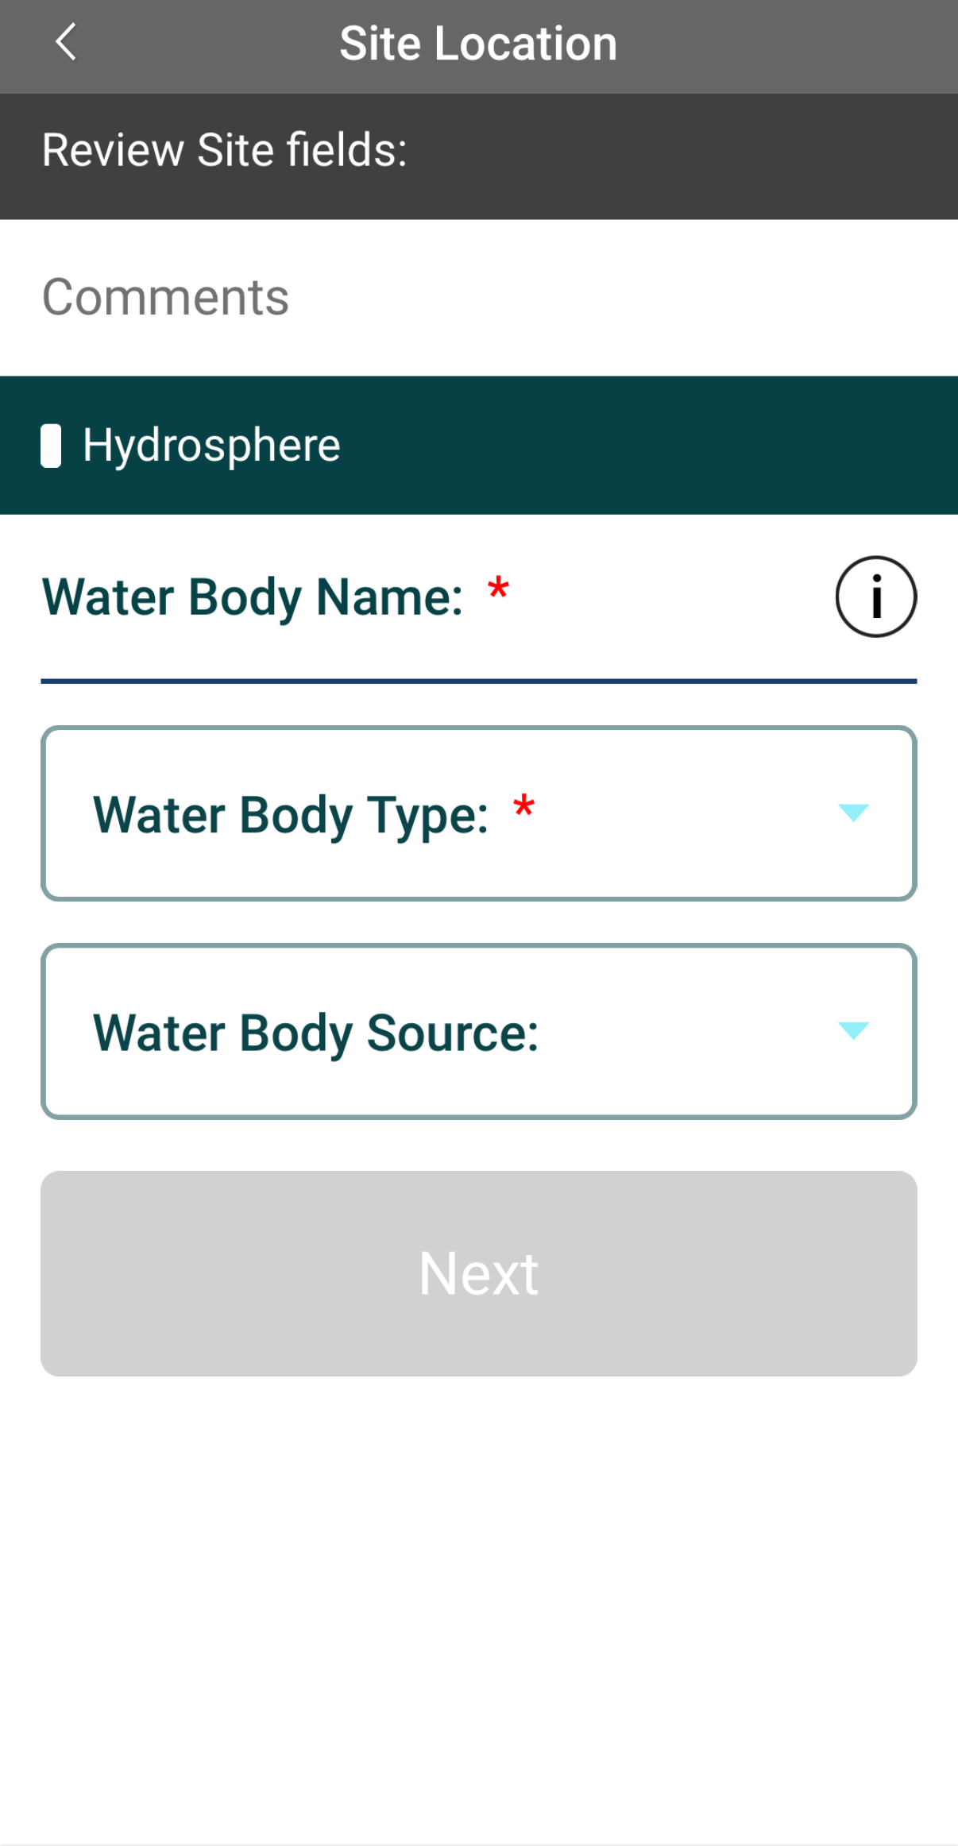
Water Temperature Protocol Site Information
Enter the Water Body Name.
Select the Water Body Type and Water Body Source from the dropdown list of options.

Slide 23
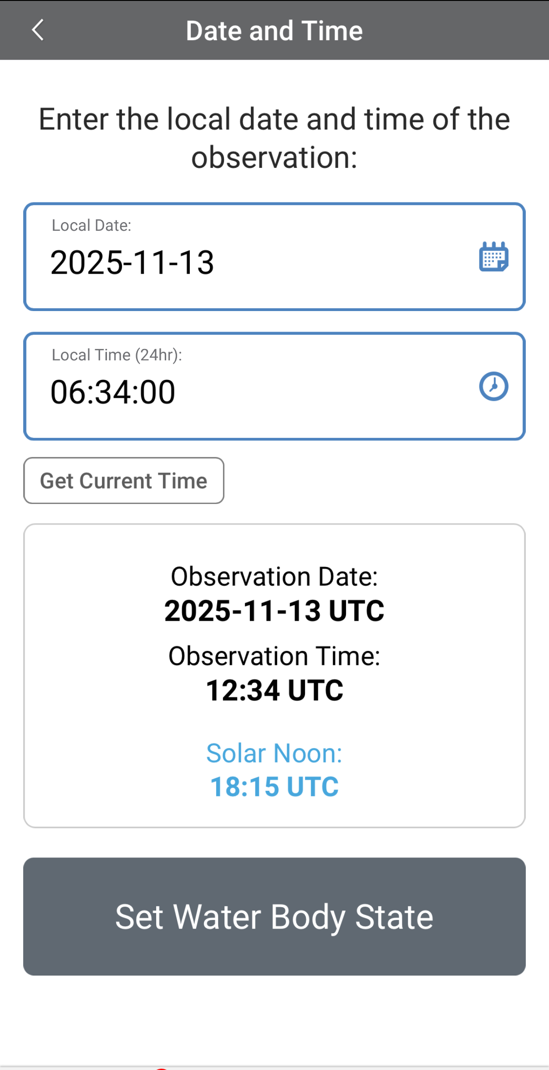
Entering Measurement Data
Enter the date and time you took the measurements.
Once you enter the date, select Set Water Body State to enter your data.

Slide 24
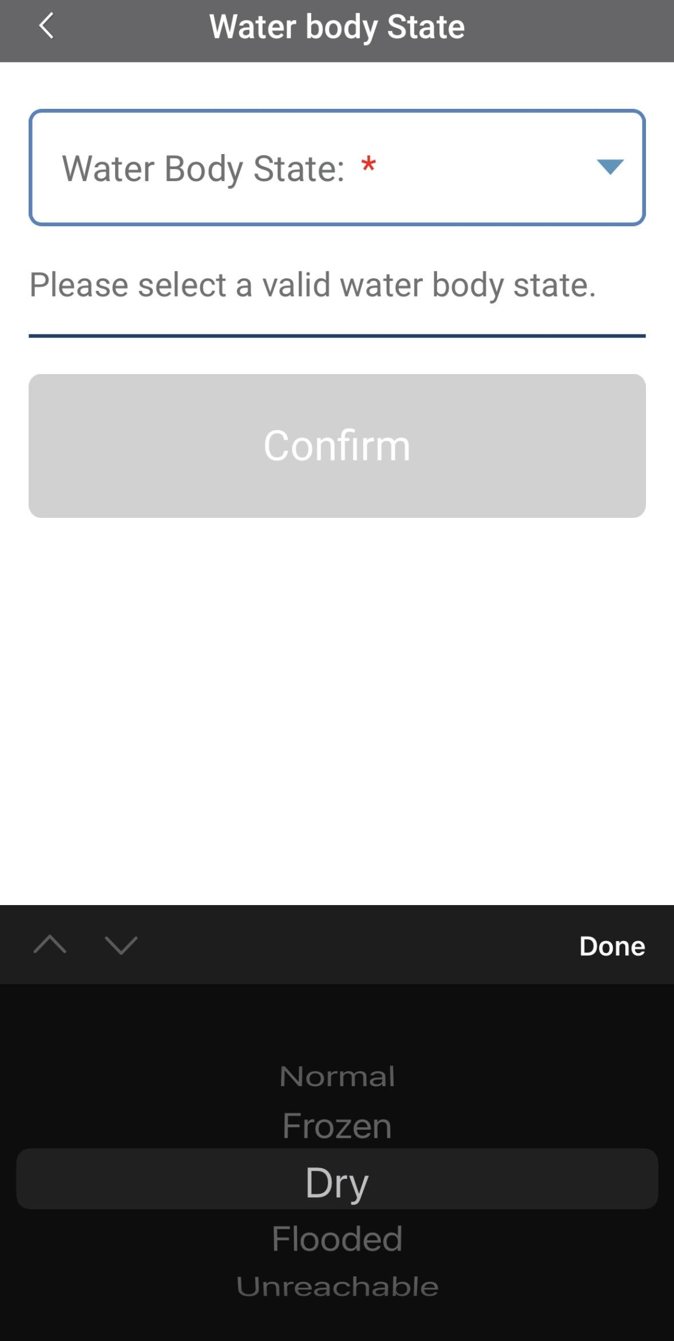

Enter the Water Body State
Select the Water Body State from the dropdown list of options.
Data entry is allowed only when the state is set as “normal.” If the water body is dry, frozen or flooded, the system will not allow the measurements to be entered.

Slide 25
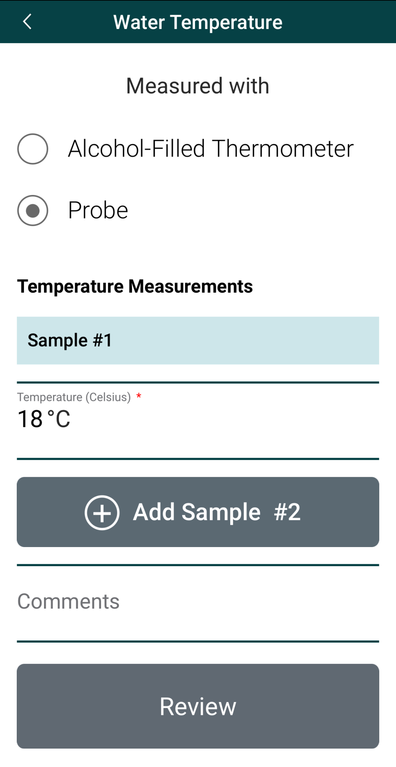
Enter Water Temperature Measurement Data
Select the type of instrument used to measure water temperature.
Enter the water temperature measurement.

Slide 26
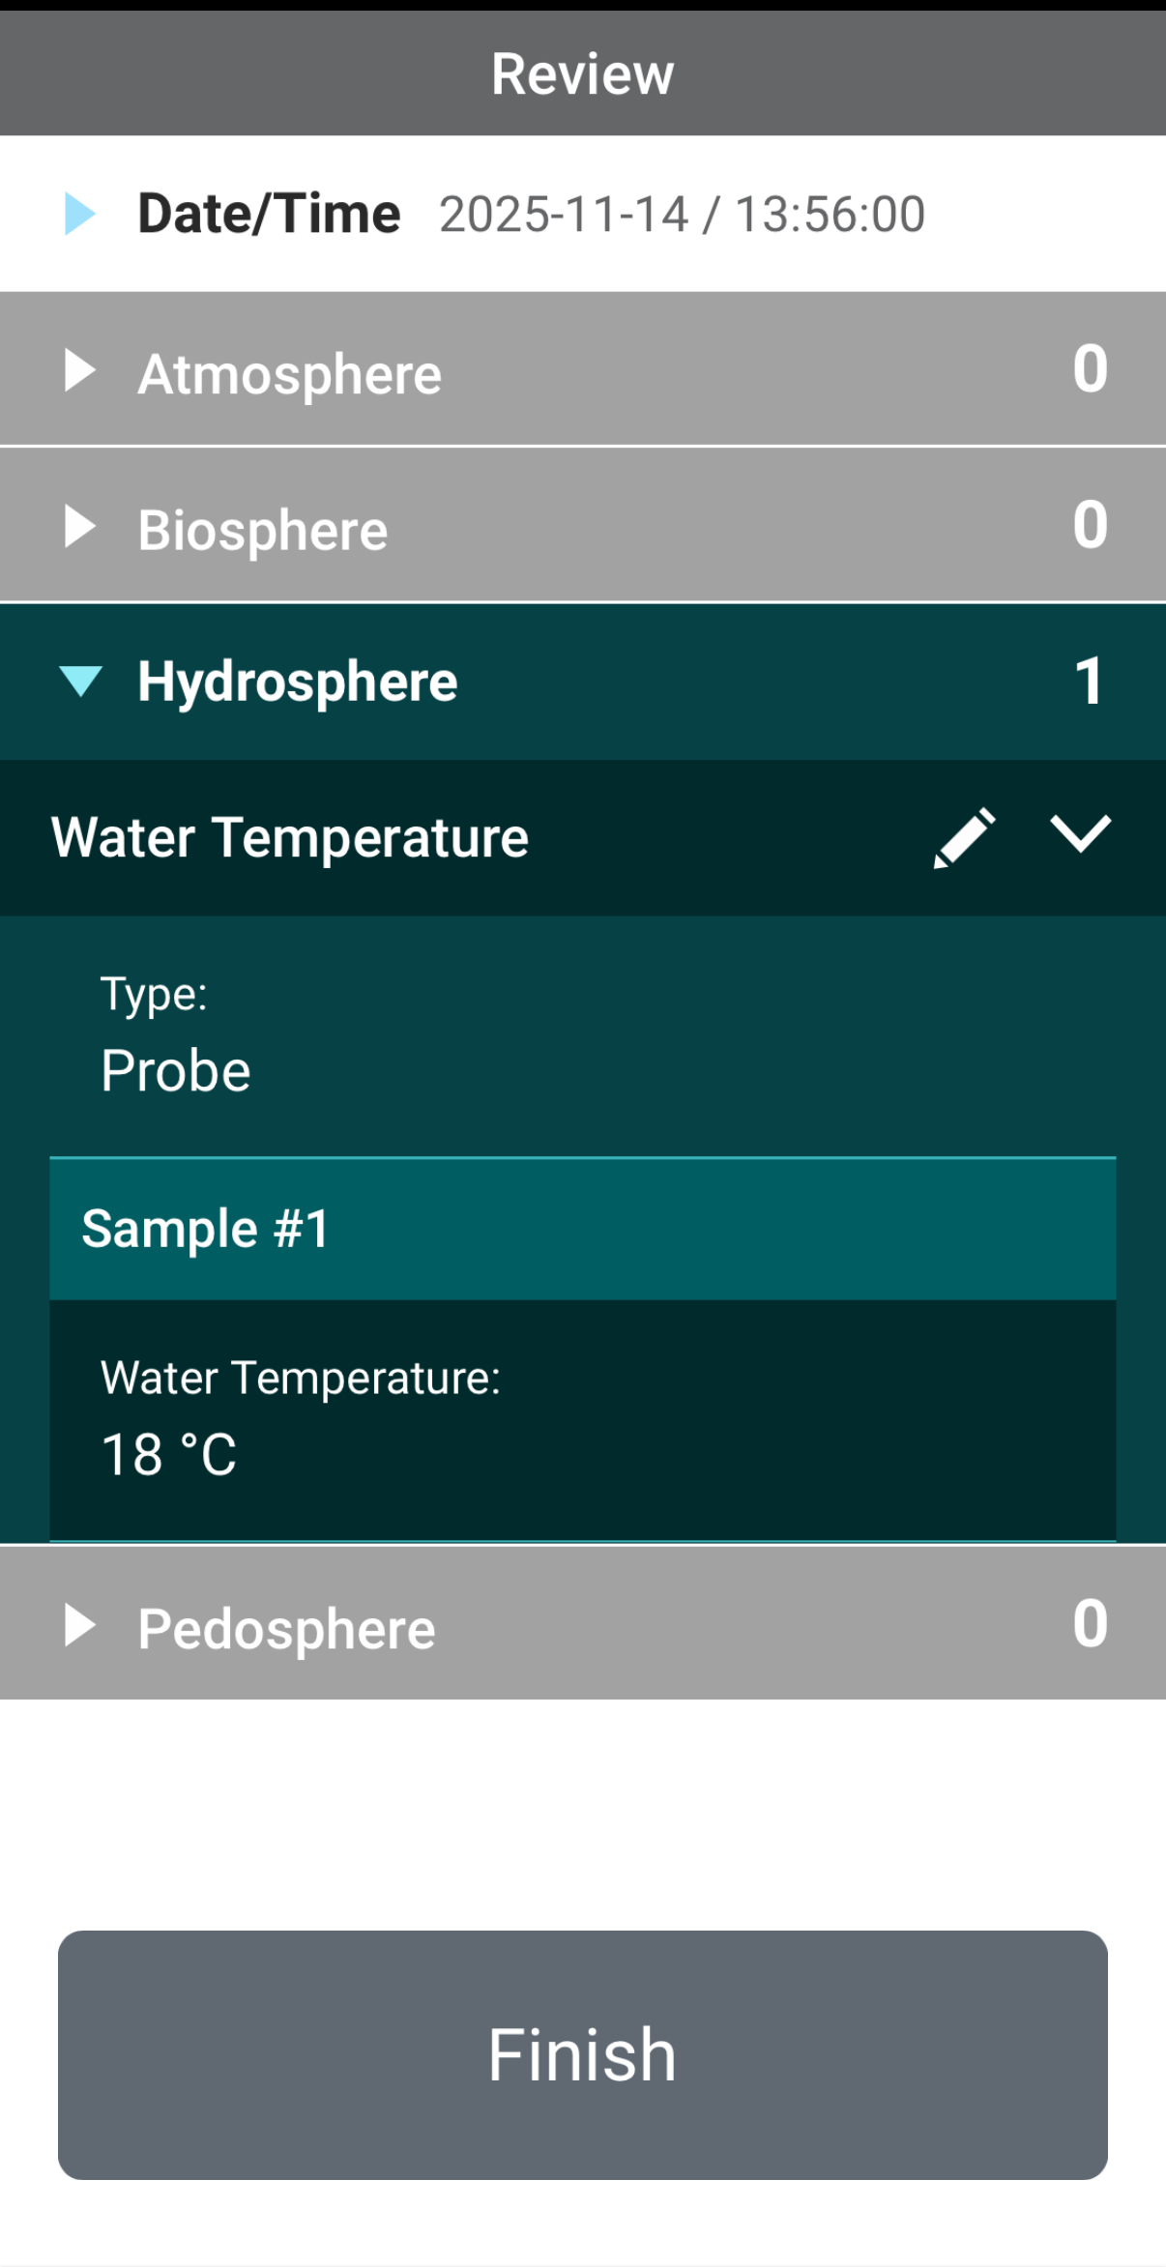
Review Data Entry and Send Data
Review the data you entered and check for errors.
When complete, select Finish to complete the send the observation to GLOBE.

Slide 27
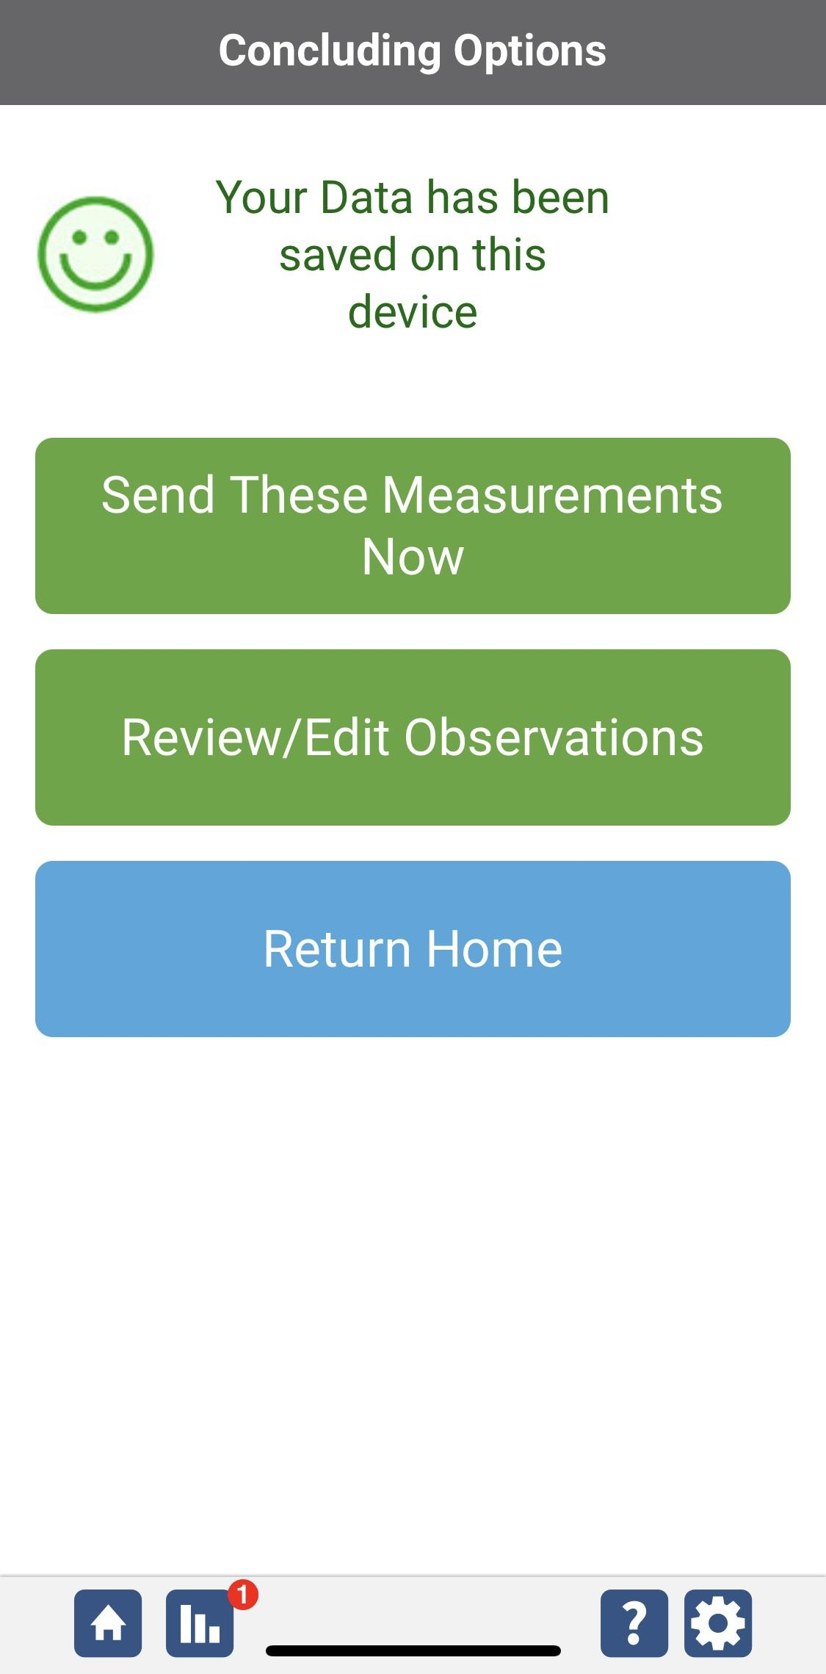
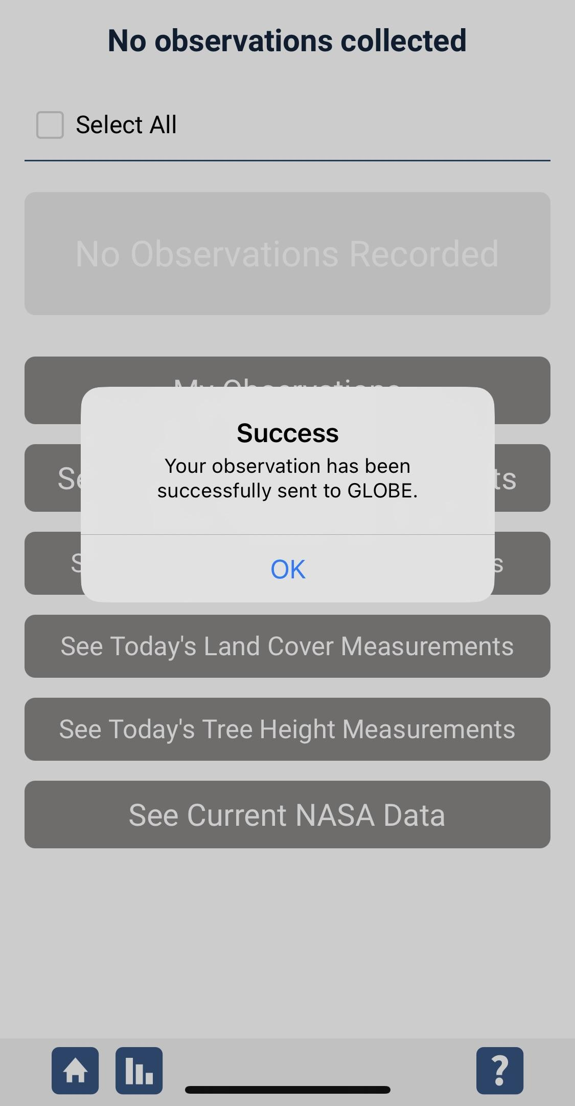
Data System Responses
If your observations are within the appropriate ranges, you will see a green smiley face.
You can review or edit your observation if needed.
When ready, select “Send these measurements now” to send your data to GLOBE. When it has been sent, you will see a “Success” message.

Slide 28
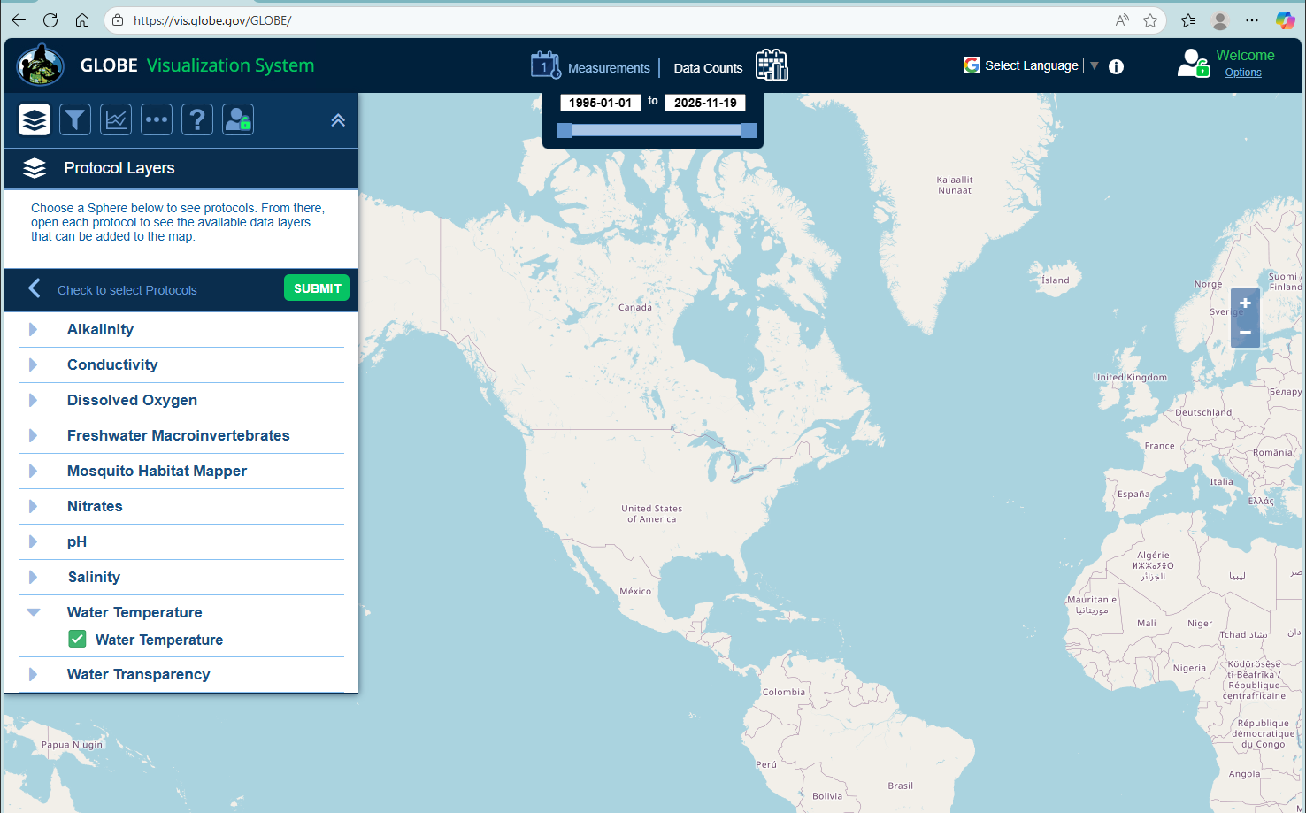
Visualize and Retrieve Water Temperature Data
GLOBE provides the ability to view and interact with data measured across the world. Select our visualization tool to map, graph, filter and export water temperature data that have been measured across GLOBE protocols since 1995. Here are screenshots steps you will use when you use the visualization tool:
Select water temperature from drop down menu, click “Submit”
Link to step-by-step tutorial on using the GLOBE Data Visualization Tool

Slide 29
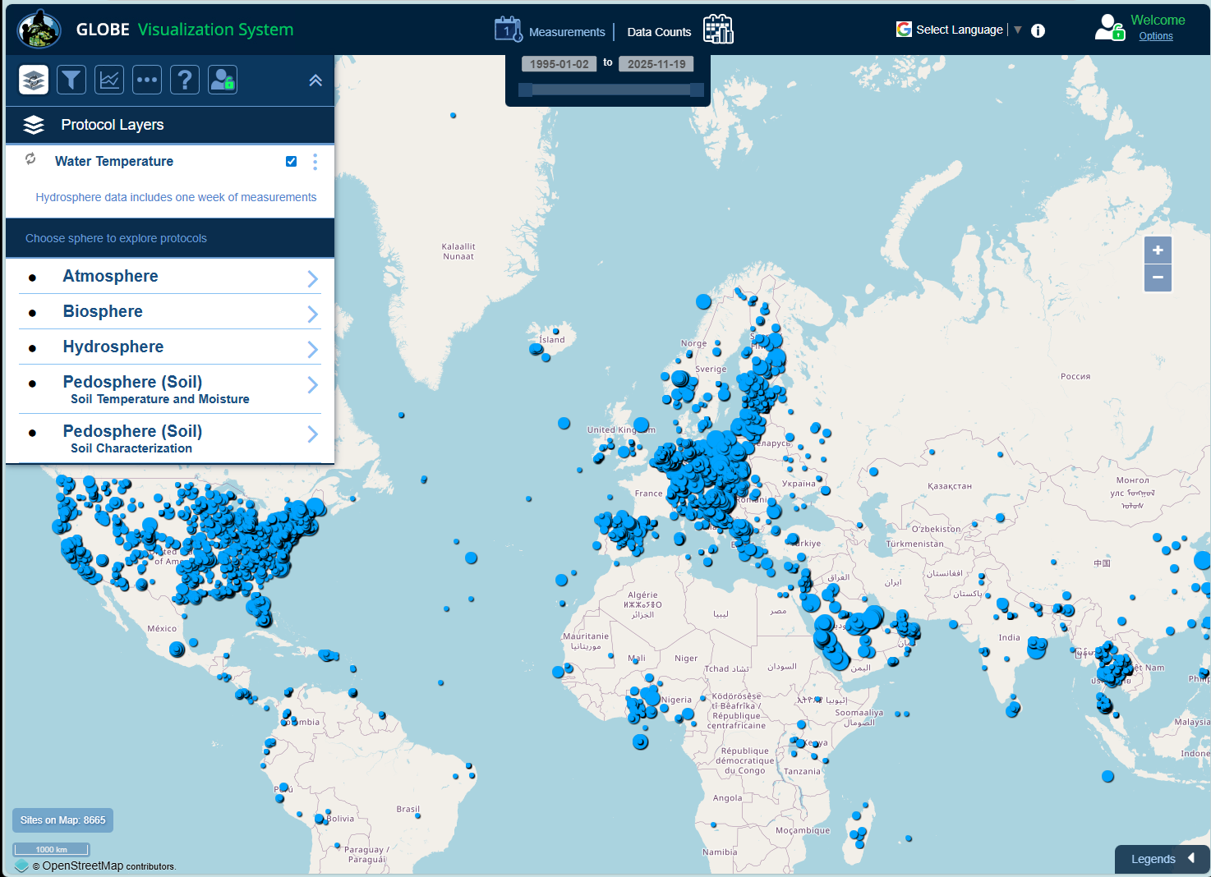
Visualize and Retrieve Water Temperature Data
Select the date for which you need water temperature data, add layer and you can see where data are available.
Locations where water temperature data are available for the dates selected

Slide 30
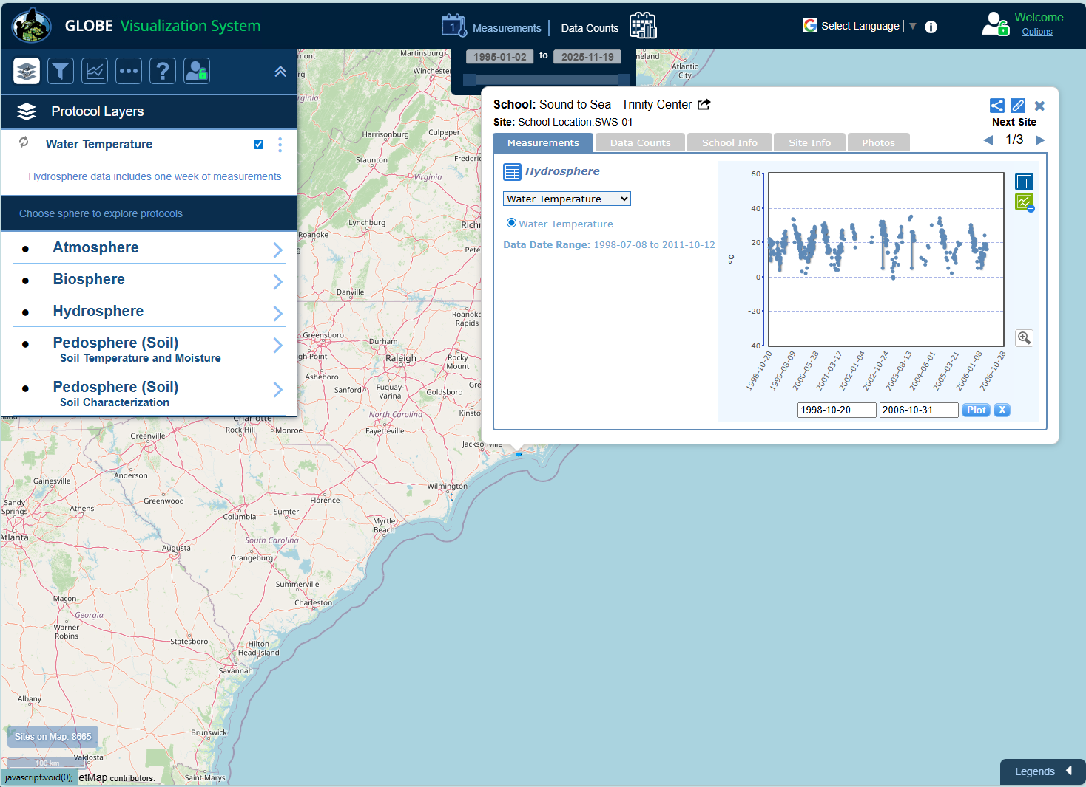
Visualize and Retrieve Water Temperature Data
Select the sampling site for which you need water temperature data, and a box will open with data summary for that site.
Clicking on a location will open to a map note providing water temperature data for that location and time.

Slide 31
Review questions to help you prepare to conduct the water temperature protocol
Which measurement should you take first, if you are conducting water protocols: dissolved oxygen, pH, or temperature?
Do you read the water temperature measurement when the probe or thermometer is in the water, or held just above the water surface?
What step must be conducted on the instruments before the water temperature measurement is made?
All three replicate measurements should be within ___˚ C of the average.
Water has a (higher/lower) heat capacity than air, so it heats and cools more (slowly/quickly).
Warmer water tends to have higher/lower concentrations of dissolved oxygen.
Where would you get the most representative water temperature sample: from a still area of the water, from rapids, or from a riffle?
What are the safety precautions you should take when doing any of the hydrology protocols?

Slide 32
You have now completed the slide stack. If you are ready to take the quiz, sign on and take the quiz corresponding to Water Temperature Protocol.
You can also review the slide stack, post questions on the discussion board, or look at the FAQs on the next page.
When you pass the quiz, you are ready to Water Temperature Protocol measurements!

Slide 33
Additional
INFO
A. What is water transparency?
B. Why collect water transparency data?
C. How your measurements can help
D. How to collect your data.
E. Entering data on GLOBE Website.
F. Understand the data.
G. Quiz yourself
H. Additional
resources
FAQ: Frequently Asked Questions
I noticed on the GLOBE Web site that some schools were reporting water temperatures below 0.0˚ C. Is this possible?
Yes. Distilled water will freeze at 0.0˚ C, but adding dissolved particles in the water may lower the freezing point.
Why is the water temperature sometimes colder and sometimes warmer than the air temperature?
Water has a higher specific heat than air. This means it takes water longer to heat up and longer to cool down than it does air. As a result, air responds much more quickly than water to changes in temperature.

Slide 34
Additional
INFO
A. What is water transparency?
B. Why collect water transparency data?
C. How your measurements can help
D. How to collect your data.
E. Entering data on GLOBE Website.
F. Understand the data.
G. Quiz yourself
H. Additional
resources
Questions for Further Investigation
How does a sudden change in air temperature affect water temperature?
Is the range of air temperature different in areas next to large water bodies as compared to areas away from water bodies?
How do water temperatures compare to air temperatures in the winter? In the summer?

Slide 35

Additional
INFO
We want your Feedback!
A. What is water transparency?
B. Why collect water transparency data?
C. How your measurements can help
D. How to collect your data.
E. Entering data on GLOBE Website.
F. Understand the data.
G. Quiz yourself
H. Additional
resources
Please provide us with feedback about this module. This is a community project and we welcome your comments, suggestions and edits! Please take a minute to comment here: Training@nasaglobe.org
Credits:
Slides:
Russanne Low, Ph.D., University of Nebraska-Lincoln, USA
Rebecca Boger, Ph.D., Brooklyn College, NYC, USA
Photos: Russanne Low
Art: Jenn Glaser, ScribeArts
More Information:
GLOBE Program, NASA Earth Science
NASA Global Climate Change: Vital Signs of the Planet
The GLOBE Program is sponsored by these organizations:
Version 11/19/25. Modified by GLOBE Implementation Office – Science, Training, Education, and Public Engagement. If you edit and modify this slide set for use for educational purposes, please note “modified by (and your name and date)" on this page. Thank you.
35

