Slide 2
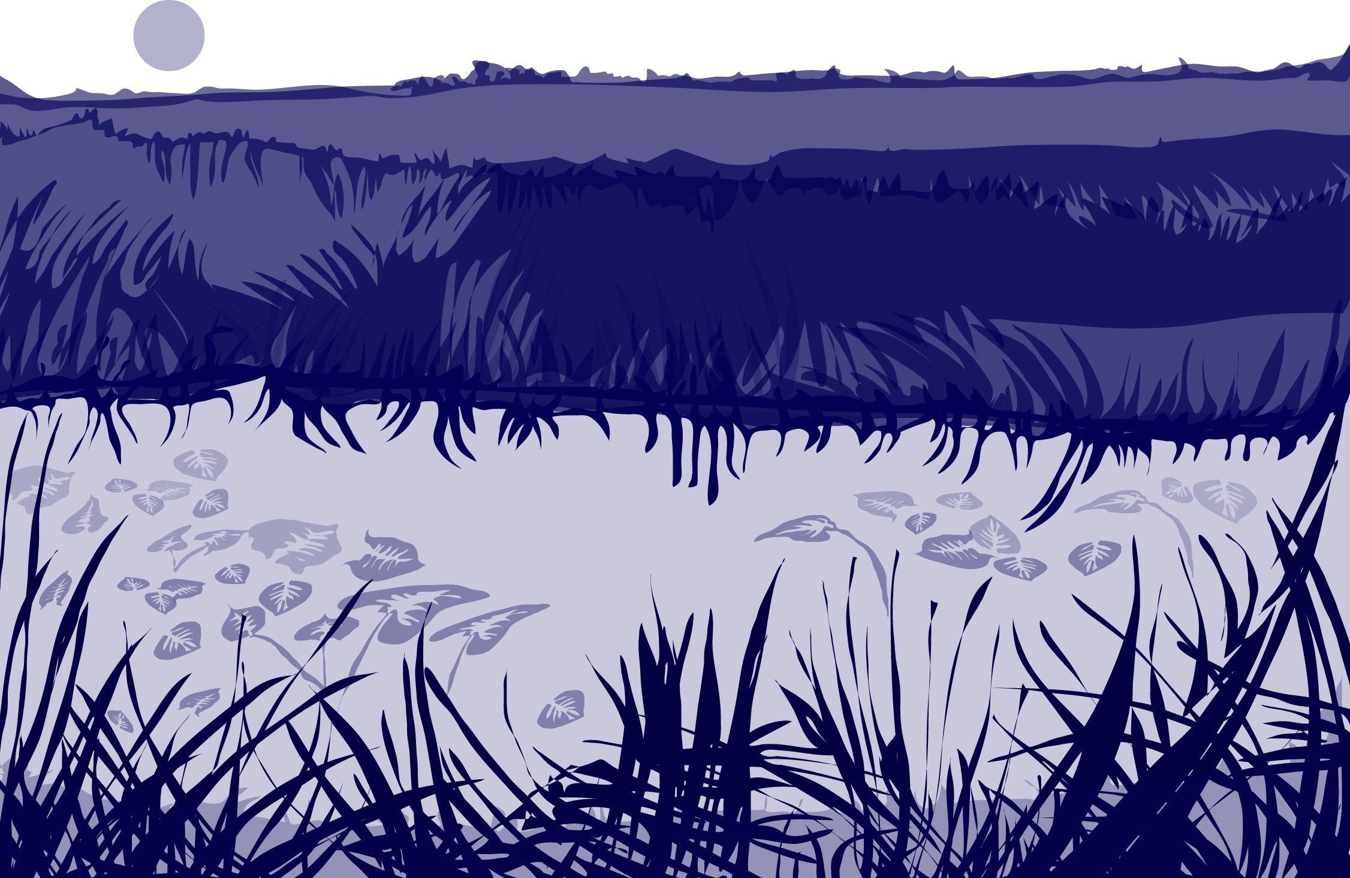
Overview
This module:
Reviews the selection of a GLOBE hydrology site
Reviews the water sampling technique used in GLOBE hydrology protocols
Guides the calibration of the necessary instruments for this protocol
Provides a step by step introduction of the protocol method
Learning Objectives
After completing this module, you will be able to:
Describe why water temperature is considered a master variable
Explain why this measurement accompanies all other hydrology measurement taken using GLOBE protocols
Describe how the protocol procedures ensure the collection of accurate data
Conduct the calibration and measurement steps of this protocol
Upload data to the GLOBE portal
Visualize data using GLOBE’s Visualization Site
2

Slide 3
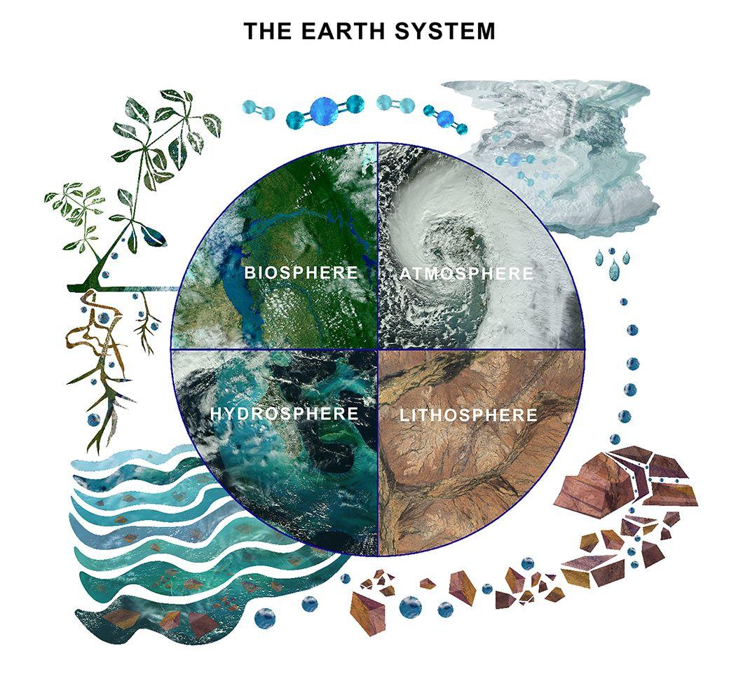
The Hydrosphere
The hydrosphere is the part of the Earth system that includes water, ice and water vapor. Water participates in many important natural chemical reactions and is a good solvent. Changing any part of the Earth system, such as the amount or type of vegetation in a region or from natural land cover to an impervious one, can affect the rest of the system. Rain and snow capture aerosols from the air. Acidic water slowly dissolves rocks, placing dissolved solids in water. Dissolved or suspended impurities determine water's chemical composition.
Current measurement programs in many areas of the world cover only a few water bodies a few times during the year. GLOBE Hydrosphere protocols will allow you to collect valuable data to help fill these gaps and improve our understanding of Earth's natural waters.
The Earth System: Energy flows and matter cycles.
3

Slide 4
What is Water Temperature?
GLOBE Hydrosphere Measurements
Hydrosphere Study Site
Water Temperature
Water Transparency
Conductivity
pH
Mosquito Larvae
Alkalinity
Dissolved Oxygen
Salinity
Nitrates
Freshwater Macroinvertebrates
The measurement of water temperature determines how hot or cold the water is.
It is sometimes called a master variable because almost all properties of water, as well as chemical reactions taking place in it, are affected by it.
Sudden increases or decreases of water temperature are unusual. Water has a higher heat capacity (specific heat) than air, thus it heats and cools more slowly.
4

Slide 5
Why Collect Water Temperature Data?
Temperature influences the amount and diversity of aquatic life. Lakes that are cold and have little plant life in winter, bloom in spring and summer when water temperatures rise and the nutrient-rich bottom waters mix with the upper waters. Because of this mixing and the warmer water temperatures, the spring overturn is followed by a period of rapid growth of microscopic aquatic plants and animals. Many fish and other aquatic animals also spawn at this time of year when the temperatures rise and food is abundant. Shallow lakes are an exception to this cycle, as they mix throughout the year.
Water temperature is also important because warm water can be fatal for sensitive species, such as trout or salmon, which require cold, oxygen-rich conditions. Warmer water tends to have lower levels of dissolved oxygen.
5

Slide 6
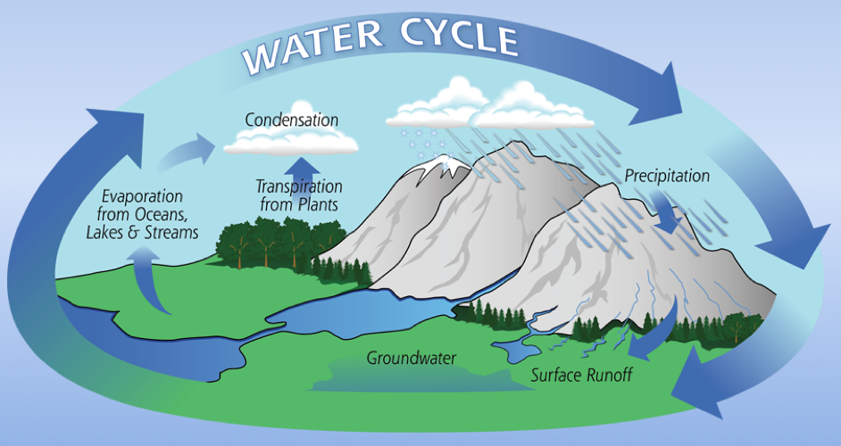
Why Collect Water Temperature Data?
Water temperature is important for understanding local and global weather patterns. Water temperatures change differently than air temperatures because water has a higher heat capacity than air. Water also helps to change air temperature through the processes of evaporation and condensation. The flow of energy, the hydrologic cycle and weather are closely connected.
6
Image Credit: NASA

Slide 7
How Your Measurements Can Help
Your water temperature measurements can help in different ways. At the local scale, you are monitoring your local water body and over time keeping track on how it is changing throughout the seasons and over the years.
On a regional and global scale, you and and other GLOBE measurements of water temperature data are helping to better understand the flow of energy and the cycling of matter in the hydrology cycle.
7

Slide 8
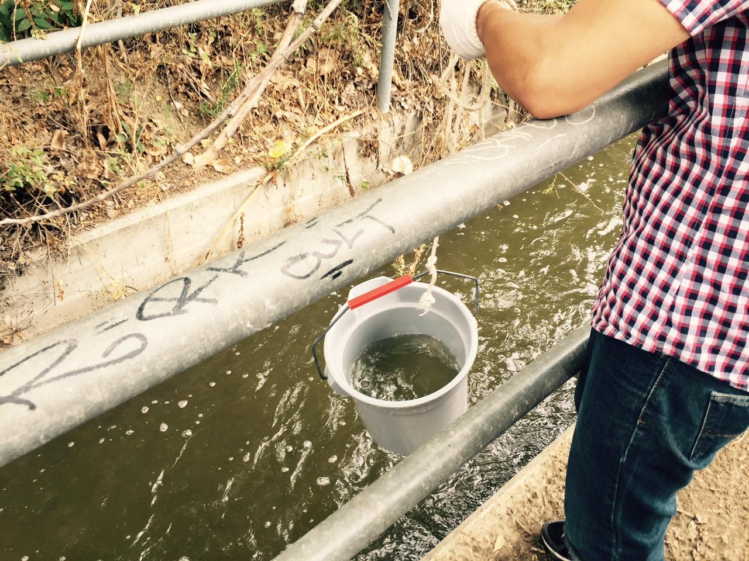
Site Selection: Hydrosphere Study Site
Select a specific site where the hydrosphere measurements (water temperature, dissolved oxygen, nitrate, pH, alkalinity, turbidity, and either conductivity or salinity) will be taken. If the selected study site is a moving body of water (i.e. stream or river), locate your sampling site at a riffle area as opposed to still water or rapids. This will provide a more representative measurement of the water in the stream or river.
If the selected study site is a still body of water (i.e. a lake or reservoir), find a sampling site near the outlet area or along the middle of the water body. Avoid inlet areas. A bridge or a pier are good choices. If your water body is brackish or salty, you will need to know the times of high and low tide at a location as close as possible to your study site.
8

Slide 9
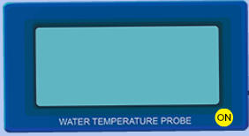
How to Collect Water Temperature Data
There are two ways to ways to collect water temperature for GLOBE: using alcohol-filled thermometers or a probe. This slide stack will discuss the calibration and use of the alcohol-filled thermometer.
9

Slide 10
How to Collect Water Temperature Data: Overview
Except for transparency, take water temperature before the other water measurements.
Take the water temperature measurement as soon as possible after the water sample is taken because temperature tends to change very rapidly after a sample is collected.
Read the temperature value on the thermometer or meter while the bulb of the thermometer or probe is in the water. The temperature reading can change quickly once the thermometer is out of the water, especially if the air temperature is very different from the water temperature or if it is windy. Wind can cause evaporation to occur rapidly, lowering the temperature
It is important that the water temperature be taken at the same place every week. There may be several degrees of difference in water temperature over a small area in your water body: sunny areas vs. shady areas, or shallow and deeper areas.
The alcohol column in the thermometer may become separated, especially if the
thermometer is not stored in an upright position. The column may be rejoined by holding tightly to the top of the thermometer and shaking it down or swinging it.
10

Slide 11
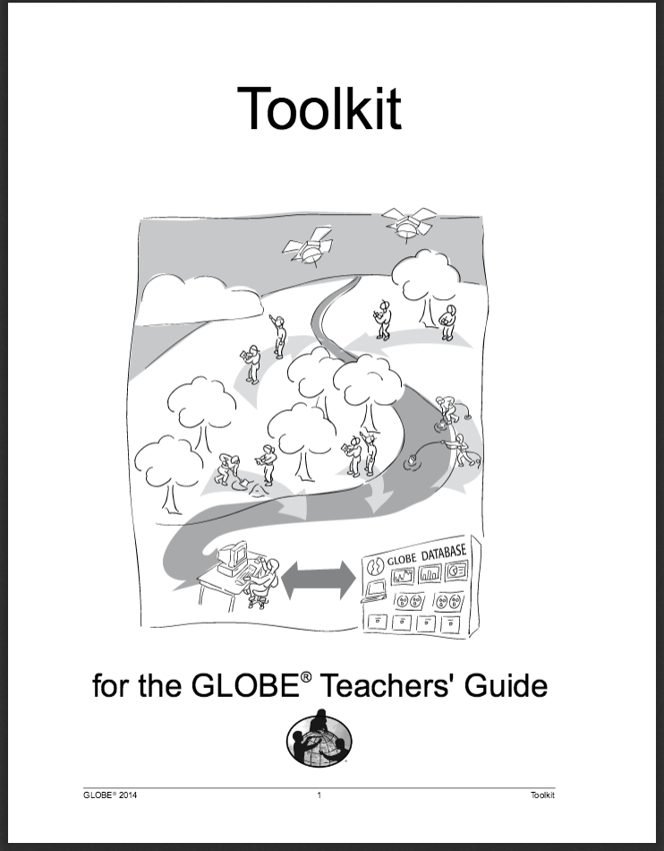
Sources for Equipment You Need for the Water Temperature Protocol
The following resources summarize the measurements associated with each protocol, associated skill level, scientific specifications for the instruments, and how to access the equipment you need (purchase, build, or download).
Where to find specifications for instruments used in GLOBE investigations
Where to find scientific instruments used in GLOBE investigations
11

Slide 12

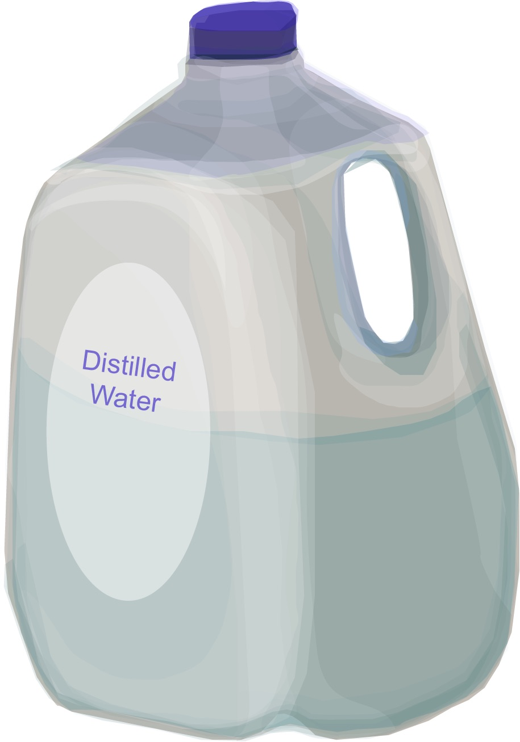
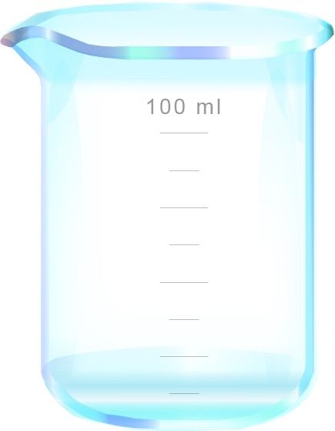
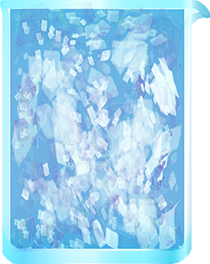
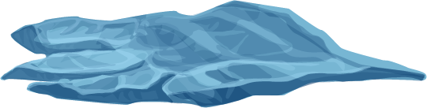
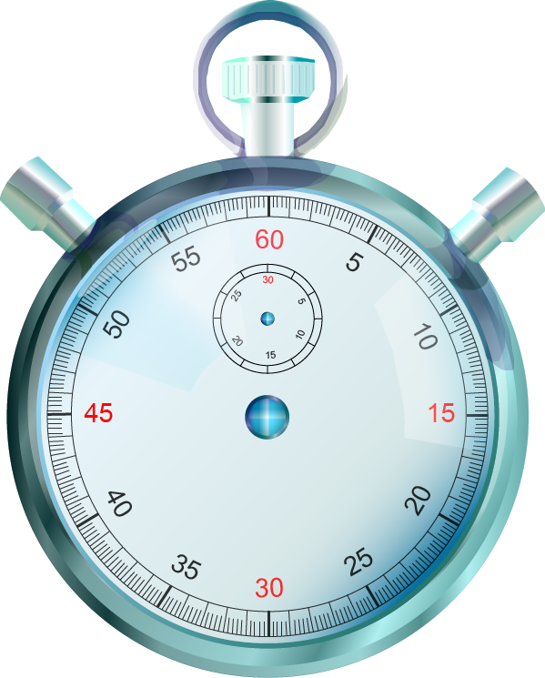
Water Temperature Protocol
Assemble Equipment:
Alcohol-filled thermometer
Latex gloves
Clock or watch
Enough string to lower the thermometer into the water
Rubber band
For Calibration of Probe, You Also Need:
- Thermometer
- 400 mL ice
- Distilled water
- 500 mL beaker
Equipment List
Alcohol filled thermometer
Clock or watch
String
Rubber band
Latex glove
Assemble Necessary Documents:
Water Temperature Data Sheet
Water Temperature Protocol for Thermometers Field Guide
Calibrating a Hydology Thermometer Lab Guide
Time: 10 minutes; calibration: 5 minutes
Suggested Frequency: weekly
12

Slide 13
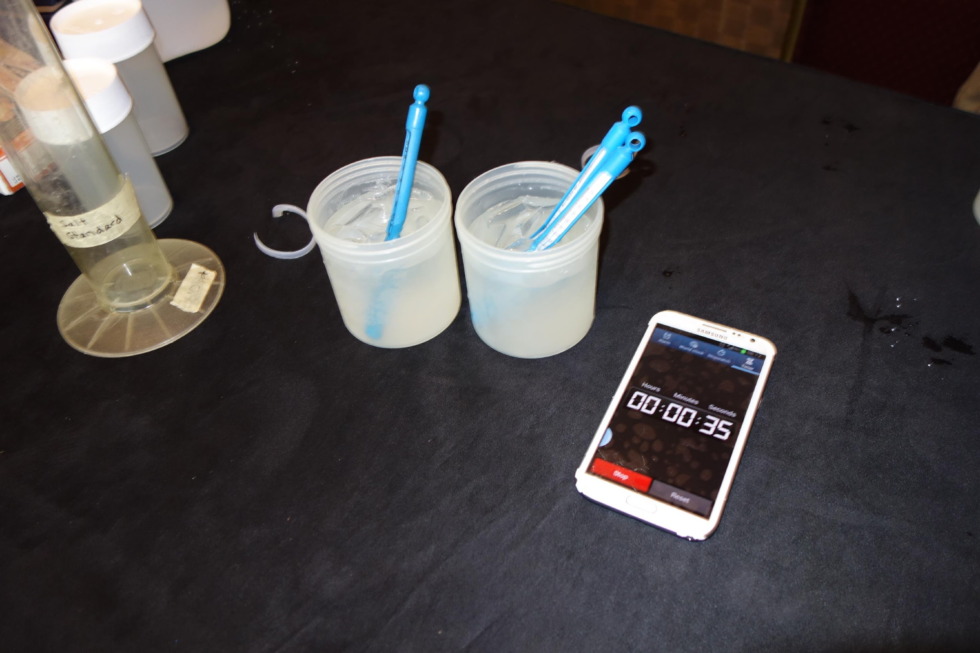

How To Collect Your Water Temperature Data: Calibration
Stir together 100 mL of water and 400 mL of crushed ice in the beaker to make an ice-water bath.
Let the ice-water bath sit for 10 to 15 minutes so that it reaches its lowest temperature.
Put the bulb of the thermometer into the bath. Gently move the thermometer around in the ice-water bath.
Leave the thermometer in the water for three minutes.
Pay close attention to your calibration procedure. Without the calibration step your temperature data will not be meaningful or comparable to data collected by others!
13

Slide 14
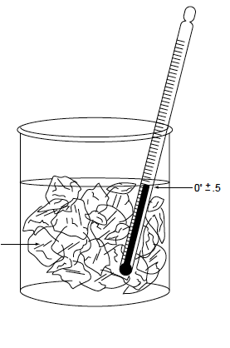
How To Collect Your Water Temperature Data: Calibration
Read the temperature without removing the bulb of the thermometer from the water.
Let the thermometer stay in the water sample for one more minute.
Read the temperature again. If the temperature has not changed, go to Step 8. If the temperature has changed since the last reading, repeat Step 6 until the temperature stays the same.
The thermometer should read between -0.5˚ and 0.5˚ C.
Alcohol-filled thermometers do not have an adjustment and must be replaced if they do not read temperature with the expected accuracy (± 0.5° C).
Crushed ice
Perform calibration every 3 months
14

Slide 15
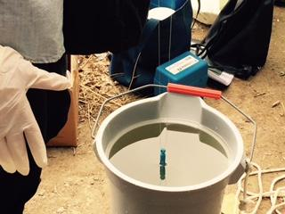
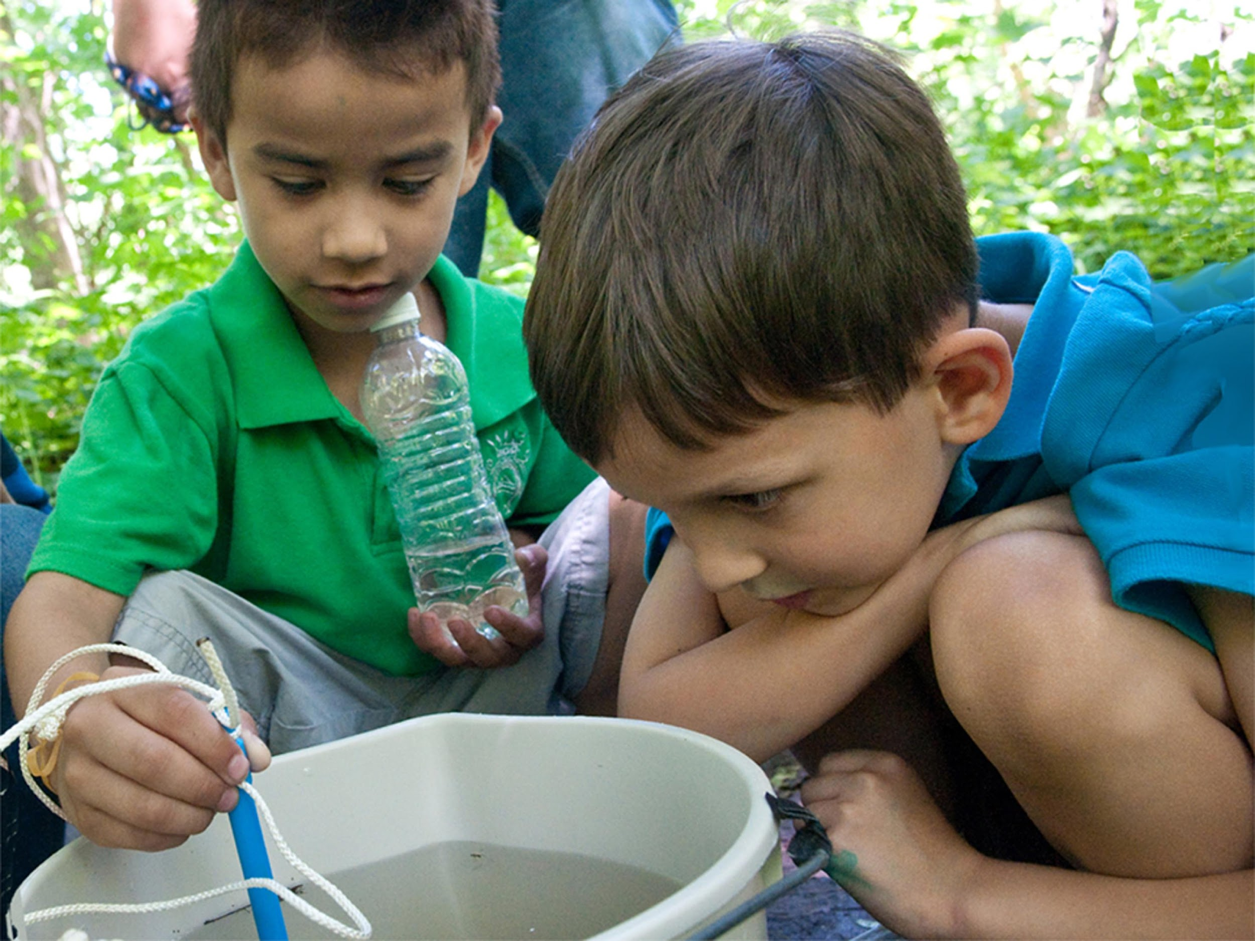
How To Collect Your Water Temperature Data: Thermometer (1 of 2)
In the Field
Fill out the top portion of your Hydrosphere Investigation Data Sheet.
Put on the gloves.
Slip the rubber band around your wrist so that the thermometer is not accidentally lost or dropped into the water.
Check the alcohol column on your thermometer to make sure there are no air bubbles trapped in the liquid. If the liquid line is separated, notify your teacher.
Put the bulb end of the thermometer into the sample water to a depth of 10 cm.
15

Slide 16
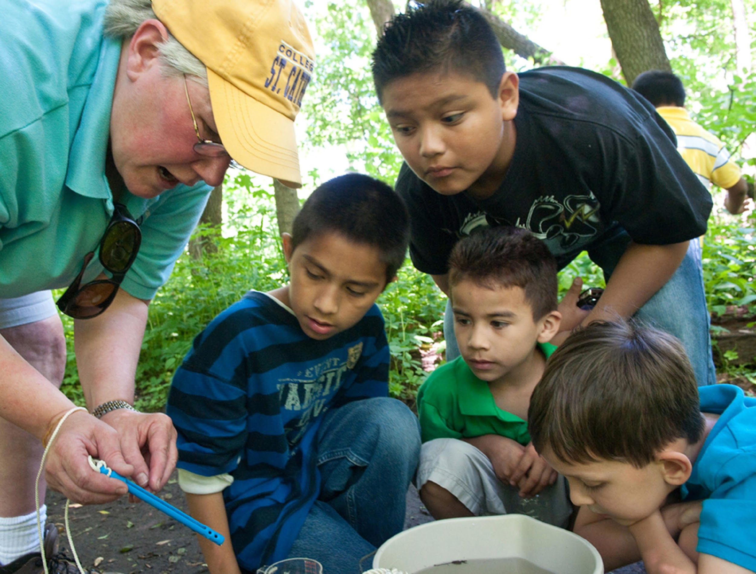
How To Collect Your Water Temperature Data (2 of 2)
Leave the thermometer in the water for three minutes.
Read the temperature without removing the bulb of the thermometer from the water.
Let the thermometer stay in the water sample for one more minute.
Read the temperature again. If the temperature has not changed, go to Step 10. If the temperature has changed since the last reading, repeat Step 8 until the temperature stays the same.
Record the temperature on the Hydrosphere Investigation Data Sheet
16

Slide 17
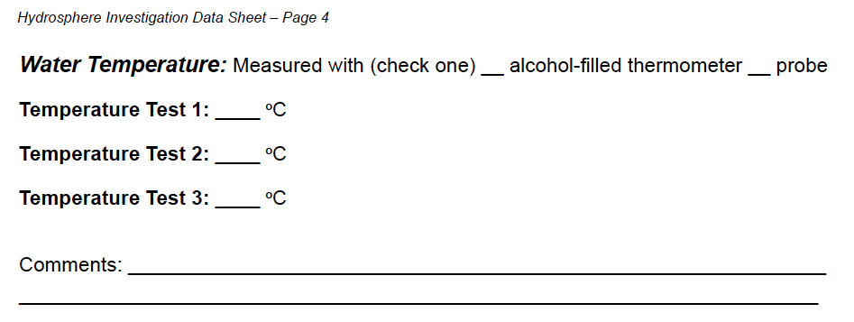
How To Collect Your Water Temperature Data
Have two other students repeat the measurement with new water samples.
Calculate the average of the three measurements.
All temperatures should be within 1.0˚ C of the average. If they are not, repeat the measurement.
17

Slide 18
Hydrosphere Site Creation
If this is your first time making hydrosphere observations at this location, you will need to create a new Hydrosphere study site before entering data.
To do this, please review the Introduction to Hydrosphere training.
18

Slide 19

Submit Your Data to GLOBE
1.Desktop Data Entry: Log environmental data directly on the GLOBE website.
2.GLOBE Observer App: The app allows users to enter data directly from an iOS or Android device for any GLOBE protocol.
19

Slide 20
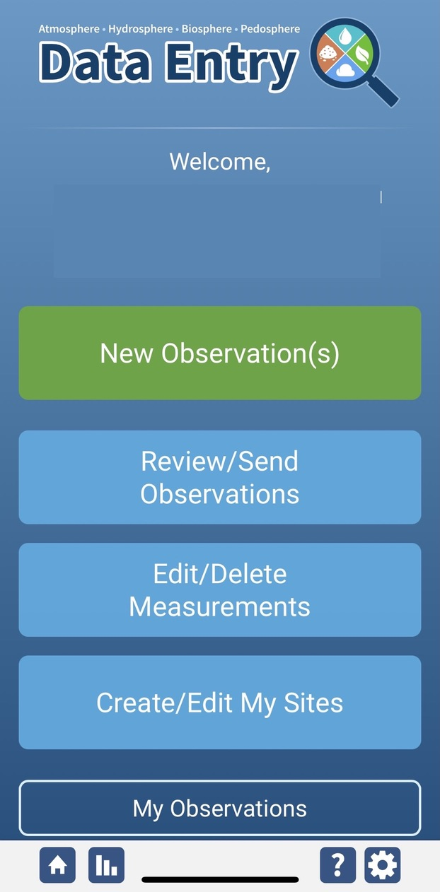
Water Temperature Protocol Data Entry
To enter data, first return to GLOBE Observer main page by clicking the home button in the bottom left.
Select “Data Entry”.
Next, click “New Observation(s)”
20

Slide 21
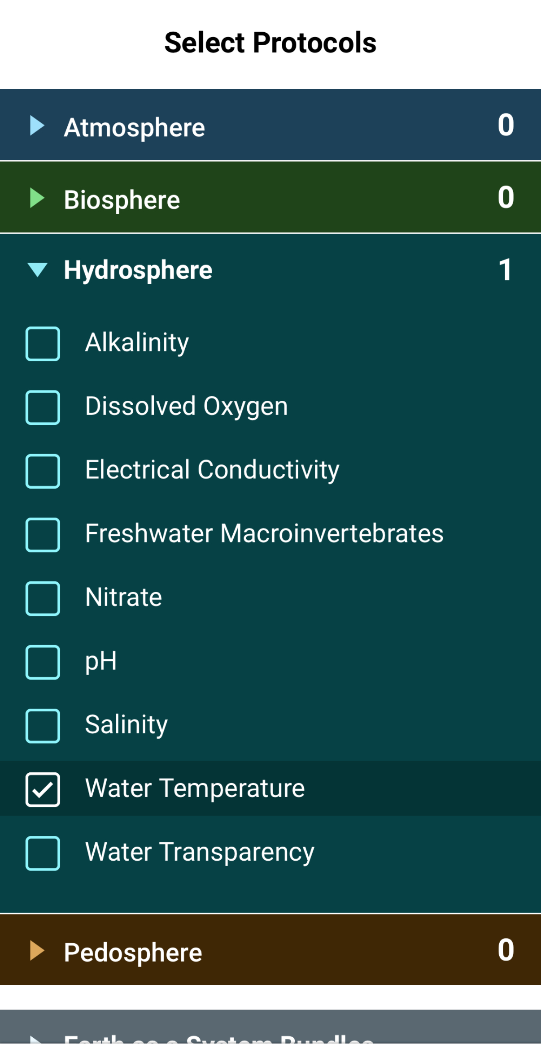
Water Temperature Protocol Data Entry
Select Water Temperature from the list of Hydrosphere. Click continue at the bottom of the screen.
21

Slide 22
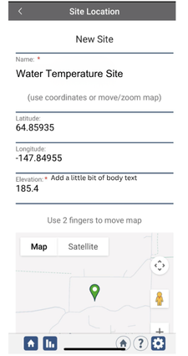
Water Temperature Protocol Site Information
If you have not already created a Hydrosphere site, create one now.
Click “New Site” at the bottom of the site location screen and choose a name for your new site.

Slide 23
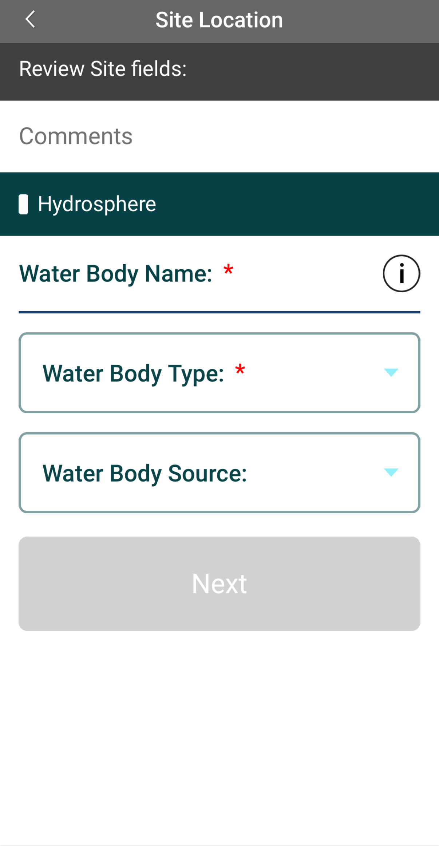
Water Temperature Protocol Site Information
Enter the Water Body Name.
Select the Water Body Type and Water Body Source from the dropdown list of options.
23

Slide 24
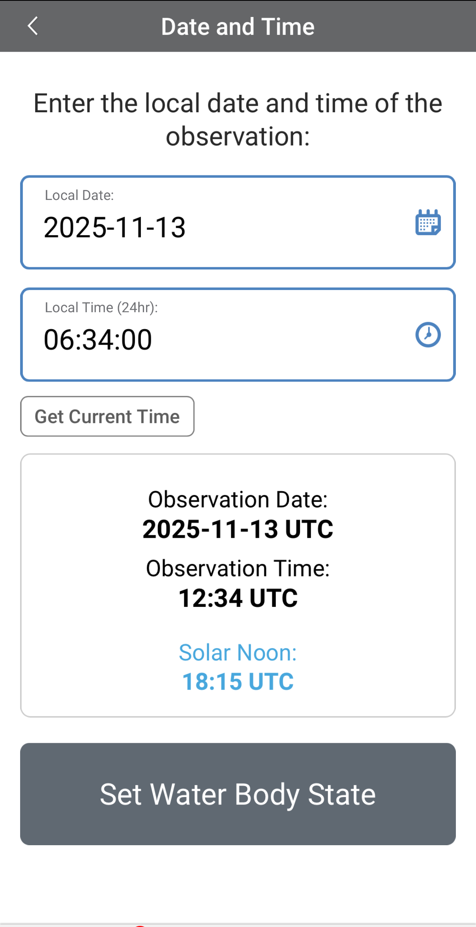
Entering Measurement Data
Enter the date and time you took the measurements.
Once you enter the date, select Set Water Body State to enter your data.
24

Slide 25
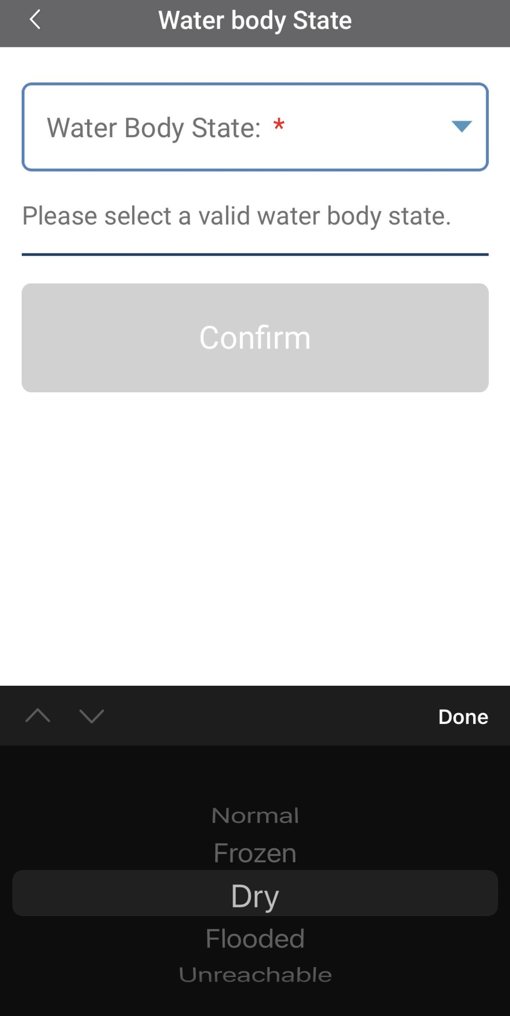

Enter the Water Body State
Select the Water Body State from the dropdown list of options.
Data entry is allowed only when the state is set as “normal.” If the water body is dry, frozen or flooded, the system will not allow the measurements to be entered.
25

Slide 26
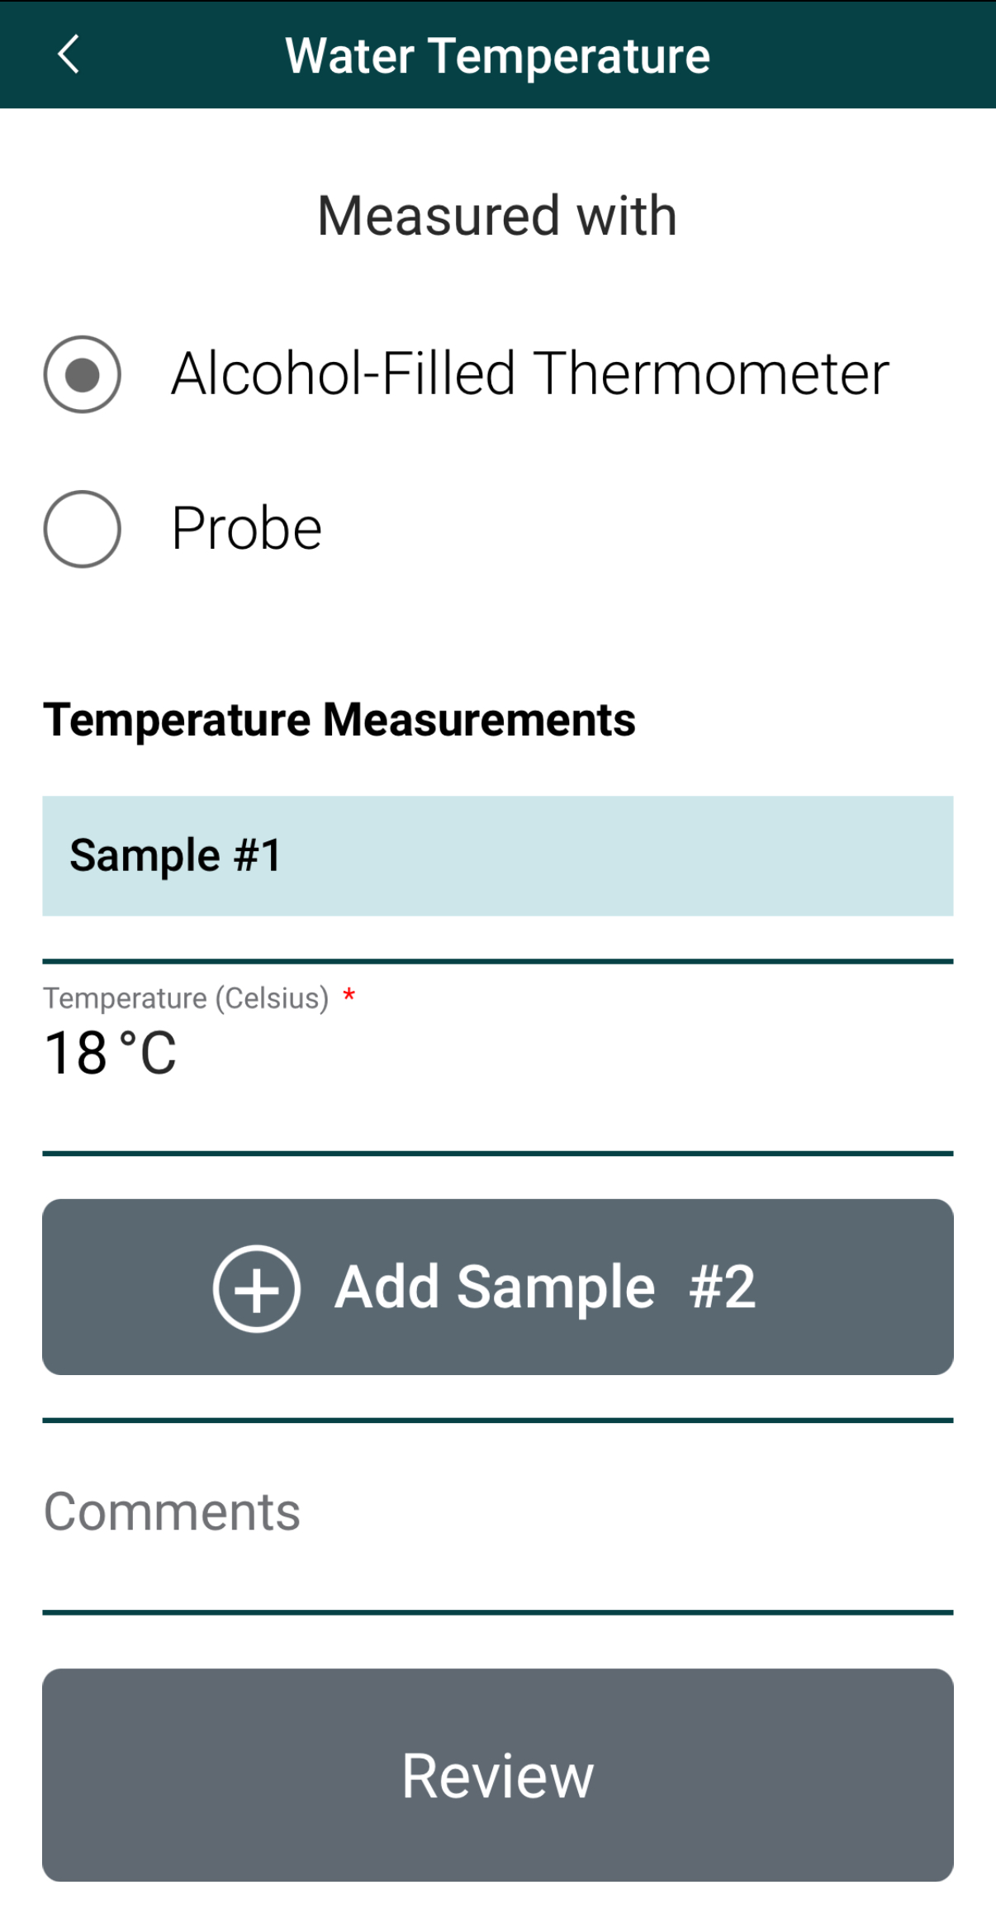
Enter Water Temperature Measurement Data
Select the type of instrument used to measure water temperature.
Enter the water temperature measurement.
26

Slide 27
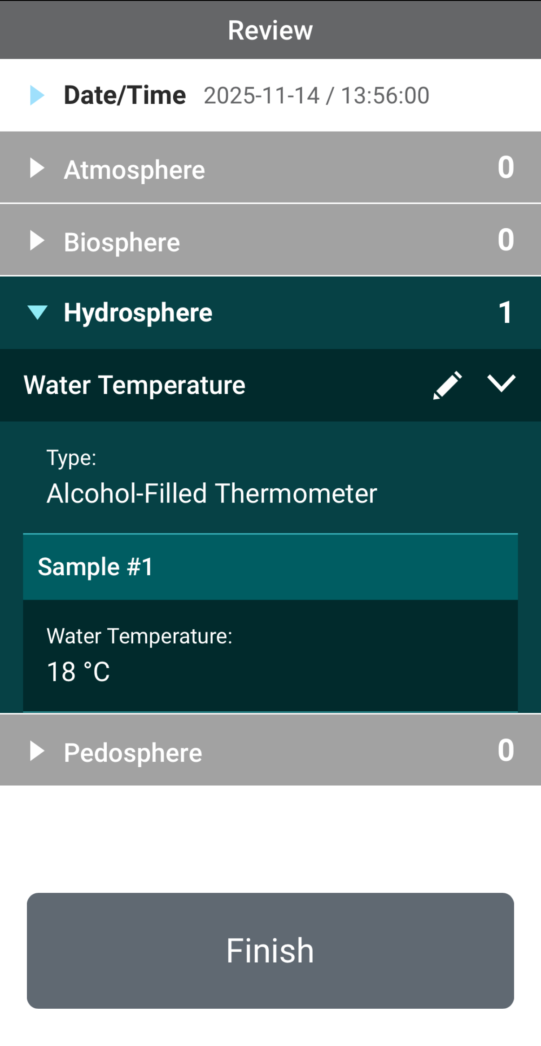
Review Data Entry and Send Data
Review the data you entered and check for errors.
When complete, select Finish to complete the send the observation to GLOBE.
27

Slide 28
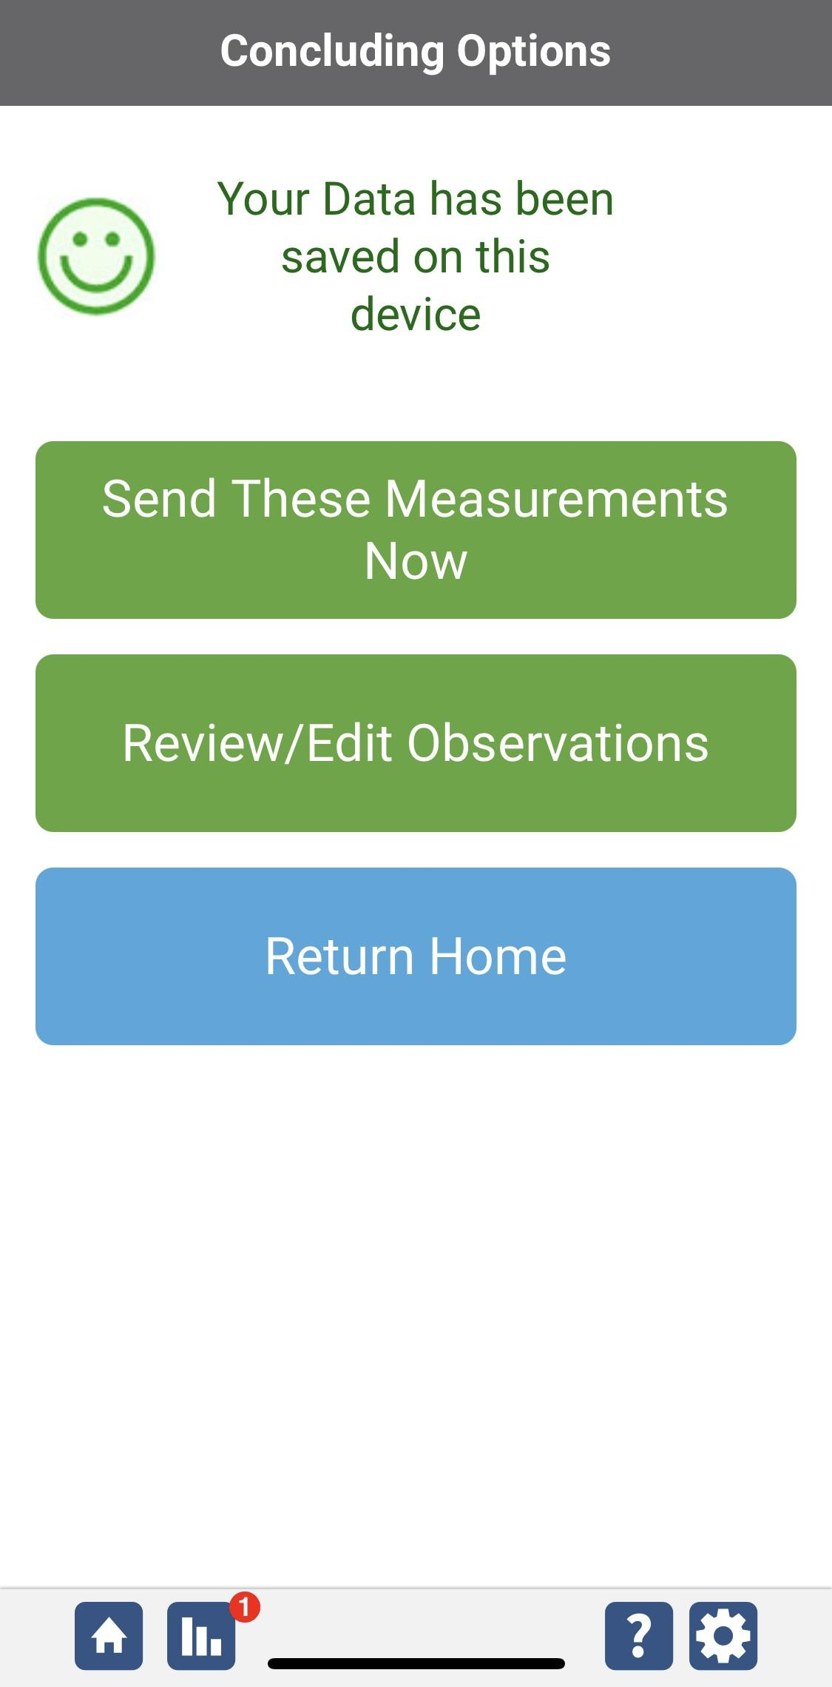
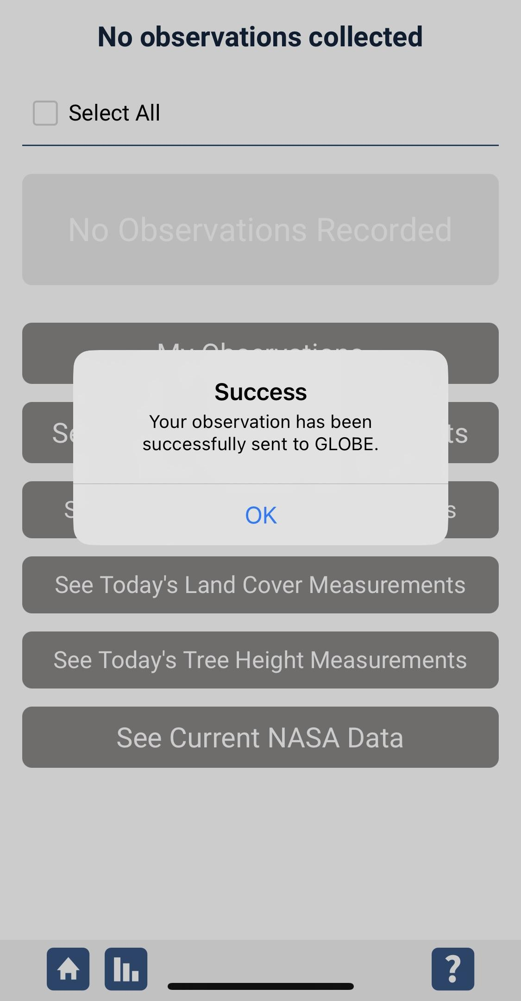
Data System Responses
If your observations are within the appropriate ranges, you will see a green smiley face.
You can review or edit your observation if needed.
When ready, select “Send these measurements now” to send your data to GLOBE. When it has been sent, you will see a “Success” message.
28

Slide 29
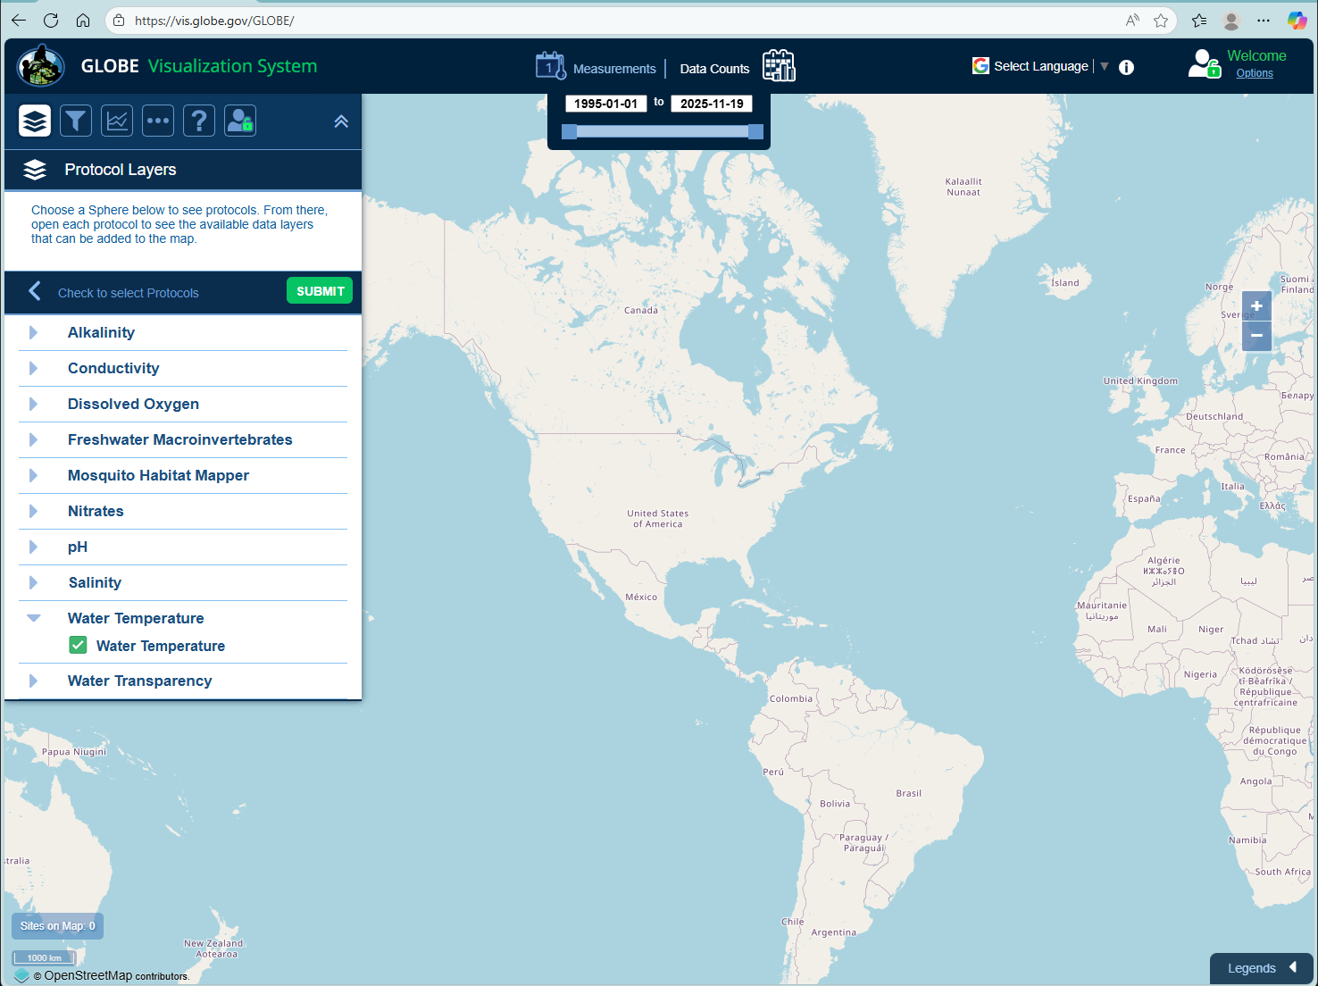
Visualize and Retrieve Water Temperature Data
GLOBE provides the ability to view and interact with data measured across the world. Select our visualization tool to map, graph, filter and export water temperature data that have been measured across GLOBE protocols since 1995. Here are screenshots steps you will use when you use the visualization tool:
Select water temperature from drop down menu, click “Submit”
Link to step-by-step tutorial on using the GLOBE Data Visualization Tool
29

Slide 30
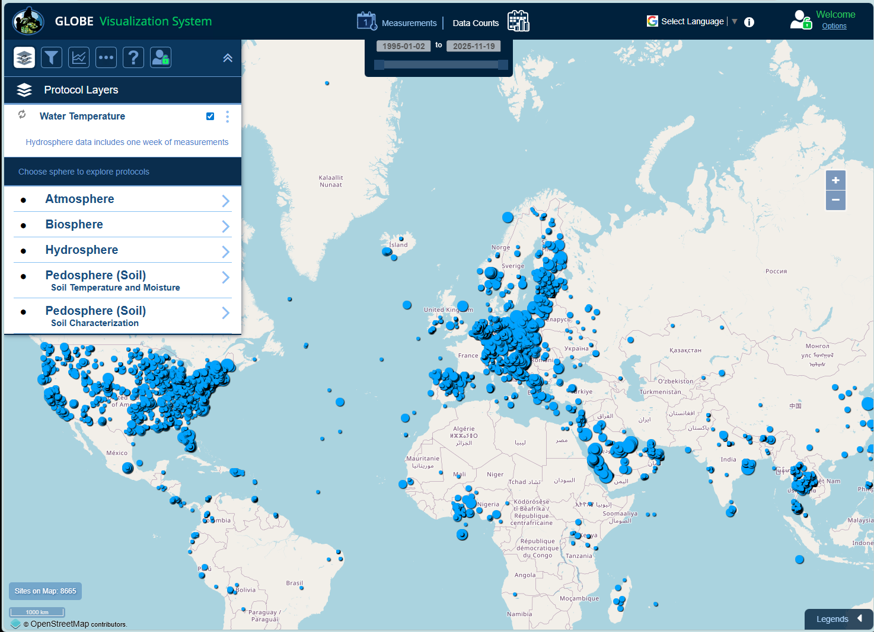
Visualize and Retrieve Water Temperature Data
Select the date for which you need water temperature data, add layer and you can see where data are available.
Locations where water temperature data are available for the dates you selected.
30

Slide 31
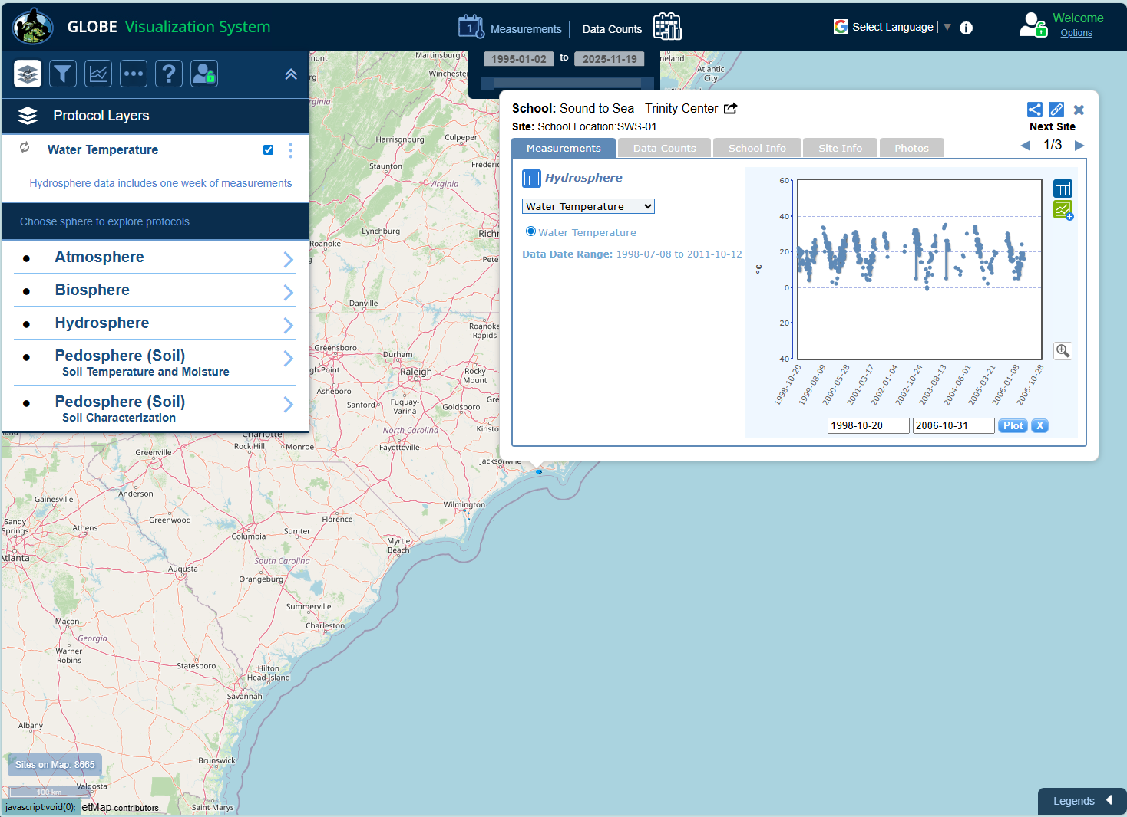
Visualize and Retrieve Water Temperature Data
Select the sampling site for which you need water temperature data, and a box will open with data summary for that site.
Clicking on a location will open to a map note providing water temperature data for that location and time.
31

Slide 32
Review questions to help you prepare to conduct the water temperature protocol
Which measurement should you take first, if you are conducting water protocols: dissolved oxygen, pH, or temperature?
Do you read the water temperature measurement when the probe or thermometer is in the water, or held just above the water surface?
What step must be conducted on the instruments before the water temperature measurement is made?
All three replicate measurements should be within ___˚ C of the average.
Water has a (higher/lower) heat capacity than air, so it heats and cools more (slowly/quickly).
Warmer water tends to have higher/lower concentrations of dissolved oxygen.
Where would you get the most representative water temperature sample: from a still area of the water, from rapids, or from a riffle?
What are the safety precautions you should take when doing any of the hydrology protocols?
32

Slide 33
You have now completed the slide stack. If you are ready to take the quiz, sign on and take the quiz corresponding to Water Temperature Protocol.
You can also review the slide stack, post questions on the discussion board, or look at the FAQs on the next page.
When you pass the quiz, you are ready to Water Temperature Protocol measurements!
33

Slide 34
Additional
INFO
A. What is water transparency?
B. Why collect water transparency data?
C. How your measurements can help
D. How to collect your data.
E. Entering data on GLOBE Website.
F. Understand the data.
G. Quiz yourself
H. Additional
resources
FAQ: Frequently Asked Questions
I noticed on the GLOBE Web site that some schools were reporting water temperatures below 0.0˚ C. Is this possible?
Yes. Distilled water will freeze at 0.0˚ C, but adding dissolved particles in the water may lower the freezing point.
Why is the water temperature sometimes colder and sometimes warmer than the air temperature?
Water has a higher specific heat than air. This means it takes water longer to heat up and longer to cool down than it does air. As a result, air responds much more quickly than water to changes in temperature.
34

Slide 35
Additional
INFO
A. What is water transparency?
B. Why collect water transparency data?
C. How your measurements can help
D. How to collect your data.
E. Entering data on GLOBE Website.
F. Understand the data.
G. Quiz yourself
H. Additional
resources
Questions for Further Investigation
How does a sudden change in air temperature affect water temperature?
Is the range of air temperature different in areas next to large water bodies as compared to areas away from water bodies?
How do water temperatures compare to air temperatures in the winter? In the summer?
35

Slide 36

Additional
INFO
We want your Feedback!
A. What is water transparency?
B. Why collect water transparency data?
C. How your measurements can help
D. How to collect your data.
E. Entering data on GLOBE Website.
F. Understand the data.
G. Quiz yourself
H. Additional
resources
Please provide us with feedback about this module. This is a community project and we welcome your comments, suggestions and edits! Please take a minute to comment here: Training@nasaglobe.org
Credits:
Slides:
Russanne Low, Ph.D., University of Nebraska-Lincoln, USA
Rebecca Boger, Ph.D., Brooklyn College, NYC, USA
Photos: Russanne Low
Art: Jenn Glaser, ScribeArts
More Information:
GLOBE Program, NASA Earth Science
NASA Global Climate Change: Vital Signs of the Planet
The GLOBE Program is sponsored by these organizations:
Version 11/18/25. Modified by GLOBE Implementation Office – Science, Training, Education, and Public Engagement. If you edit and modify this slide set for use for educational purposes, please note “modified by (and your name and date)" on this page. Thank you.
36

