Slide 2
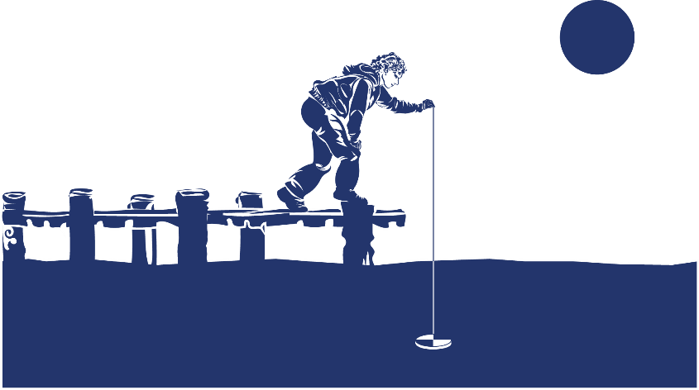
Overview
This module:
Reviews the selection of a GLOBE hydrosphere site
Reviews the water sampling technique used in GLOBE hydrosphere protocols
Guides the construction of the necessary instrument for this protocol
Provides a step by step introduction of the protocol method
Learning Objectives
After completing this module, you will be able to:
Define water transparency and explain how environmental variables result in different transparency measurements
Understand how the protocol procedures ensure the collection of accurate data
Conduct transparency measurements in the field
Upload data to the GLOBE portal
Visualize data using GLOBE’s Visualization Site

Slide 3
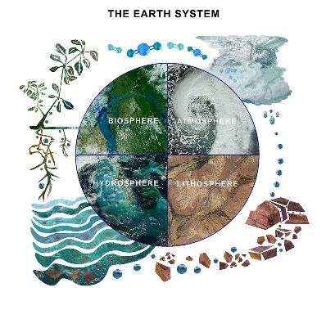
The Hydrosphere
The hydrosphere is the part of the Earth system that includes water, ice and water vapor. Water participates in many important natural chemical reactions and is a good solvent. Changing any part of the Earth system, such as the amount or type of vegetation in a region or from natural land cover to an impervious one, can affect the rest of the system. Rain and snow capture aerosols from the air. Acidic water slowly dissolves rocks, placing dissolved solids in water. Dissolved or suspended impurities determine water's chemical composition.
Current measurement programs in many areas of the world cover only a few water bodies a few times during the year. GLOBE Hydrosphere protocols will allow you to collect valuable data to help fill these gaps and improve our understanding of Earth's natural waters.
The Earth System: Energy flows and matter cycles.

Slide 4
Hydrosphere Protocols
What is the condition of Earth’s many surface waters – the streams, rivers, lakes, and coastal waters? How do these conditions vary over the year? Are these conditions changing from year to year? These are questions that are answered by the hydrosphere investigations in the GLOBE program.
Water Transparency is one the measurements used by GLOBE to describe the status of a water body. Water Transparency measures depth of light penetration into the water.
Water transparency depends on the amount of suspended particles. These can be organic, such as phytoplankton and algae, or inorganic, such as sediments, as well as other dissolved impurities such as organic or inorganic carbonates. These particles contribute to both the color and the transparency of the water.
GLOBE Hydrosphere Measurements
Hydrosphere Study Site
Water Temperature
Water Transparency
Conductivity
pH
Mosquito Larvae
Alkalinity
Dissolved Oxygen
Salinity
Nitrates
Freshwater Macroinvertebrates

Slide 5
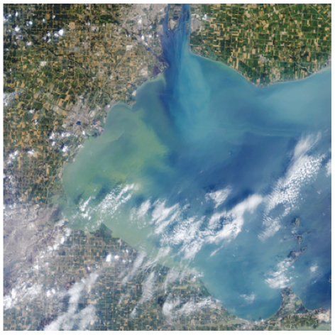
Water transparency describes water clarity. It is measured by determining the the depth of light penetration into the water column from the surface.
The Operational Land Imager (OLI) on the Landsat 8 satellite captured this view of an algae bloom, Lake Erie, August 2014.
Algal blooms such as this significantly reduce water transparency and contaminate onshore drinking water.
Image: NASA

Slide 6
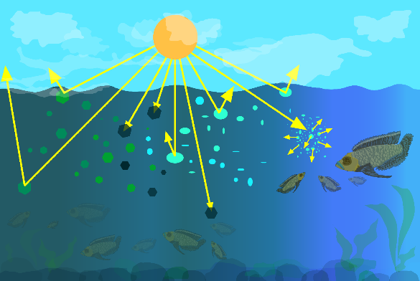
What is Water Transparency?
Particles in the water will reflect, absorb or scatter light, thus determining the depth at which more light can’t penetrate. This is called the extinction depth. The Water Transparency Protocol measures the light extinction depth of the water in your selected Hydrology Investigation Site.

Slide 7
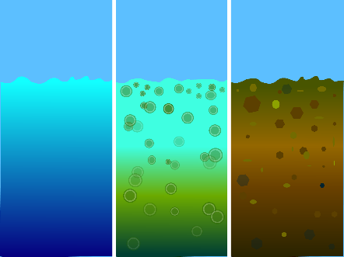
What is Water Transparency?
Suspended particles in our water behave similarly to dust in the atmosphere. They reduce the depth to which light can penetrate. Sunlight provides the energy for photosynthesis (the process by which plants grow by taking up carbon, nitrogen, phosphorus and other nutrients, and releasing oxygen). How deeply light penetrates into a water body determines the depth to which aquatic plants can grow.
Transparency decreases with the presence of molecules and particles that can absorb or scatter light. Dark or black material absorb most wavelengths of light, whereas white or light materials reflect most wavelengths of light. The size of a particle is important as well. Small particles (diameters less than 1 μm) can scatter light.
Blue/Cloudy
suspended carbonates scatter blue-green light
Green
algae and phytoplankton
Brown
sediments

Slide 8
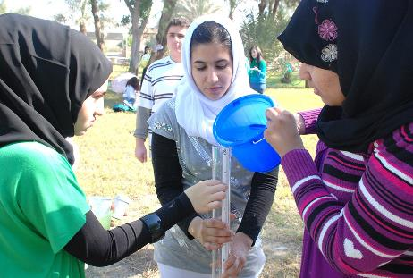
Why Collect Water Transparency Data?
In most countries current measurement programs cover only a few water bodies a few times during the year. As a consequence, the archives of GLOBE hydrology data provides important data about water chemistry and water quality not found elsewhere.
  By taking measurements over time in multiple locations, it is often possible to determine the times of year and the source of pollution, for instance, and if necessary, remediate the situation to improve water quality.

Slide 9
Why Collect Water Transparency Data?
Water transparency changes over time in response to environmental factors.
Suspended particles such as phytoplankton, zooplankton, sediment, organic matter...) are optically active components and their density and distribution varies over time. Erosion and run off during a storm is one source of sediment particles. The influx of nutrients such as phosphorus into a water body can cause an algal bloom, greatly increasing the density of these organisms.
The more suspended particles, the less transparency
An increase in suspended particles in a water body will decrease transparency, and light will be unable to penetrate into deeper water.
Light energy is needed by plants to conduct photosynthesis
Less light penetration into the water will affect the health of organisms living in the water body.
Water transparency affects water quality
Suspended particulates impact water quality, both for human consumption and for use by aquatic organisms

Slide 10
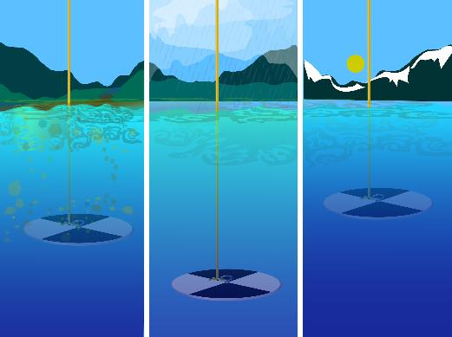
Scientists measure water transparency to determine water body health.
Measurement of water transparency allows scientists to calculate inputs from erosion and nutrients. By taking measurements over time in multiple locations, it is often possible to determine the source of the inputs, and if necessary, remediate the situation to improve water quality.

Slide 11
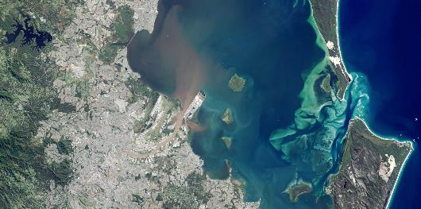
How Your Measurements Can Help
Credit: NASA Earth Observatory
Your observations are valuable contributions to the scientific community and may be used by educators, students, researchers, and the general public to increase environmental awareness and STEM literacy, as well as advance Earth system science. Here is an example of how this might be done for transparency.
Water transparency and color can be observed in satellite imagery. In May 2015, the east coast of Australia was hit by a severe storm and deadly flooding, dropping more than 360 millimeters (14 inches) of rain within about three hours in southeast Queensland, Australia. This image of the Brisbane River entering Moreton Bay was acquired on May 3, 2015 by the Operational Land Imager on Landsat 8.
As a result of the rainfall, flash flooding caused distinct river plumes to form along the coastline. Flood waters usually contain elevated levels of sediment and colored dissolved organic matter (CDOM). Sediment tends to scatter red light, and CDOM absorbs blue light. As a result, a brown color is visible where the Brisbane River mouth where these two optical phenomena work in concert. Further from the mouth, the coarser sediments tend to settle to the bottom but the CDOM is still observed in the water column absorbing blue light. What is coloring the yellow-green patches in the water? Scientists believe it is CDOM, but ground verification is needed to be sure.

Slide 12
How to Collect Your Data
Simultaneous or Prior Investigations Required to do Water Transparency Measurements
You will need to define your Hydrosphere Study Site. A Hydrosphere Study Site can be any surface water site that can be safely visited, although natural waters are preferred.
Sites, in order of preference, may include:
Streams or rivers
Lakes, reservoirs, bays or ocean
Pond
Irrigation ditch or other water body, if those above are not available
To define you study site you will need these documents:
Selecting and Documenting your Hydrosphere Study Site
Water Transparency Secchi Disk Data Sheet OR Hydrosphere All Protocols Data Sheet
Mapping your Hydrosphere Study Site Field Guide

Slide 13
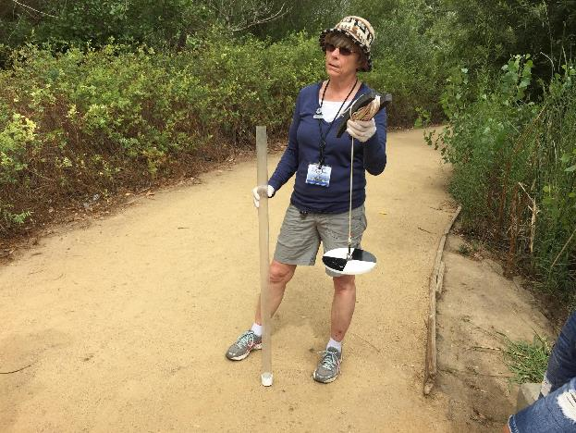
Determine Which is Appropriate for Your Water Body: Secchi Disk or Transparency Tube?

Slide 14
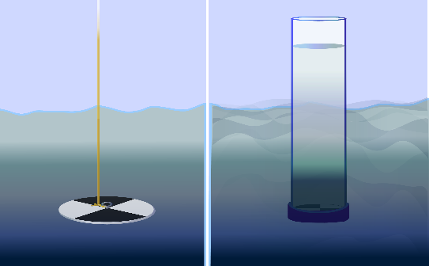
How to Collect Your Data: Select Appropriate Instrument
First, determine if your study site has deep, still water or shallow and/or flowing water. If the water is deep and still, you will use a Secchi Disk for your water transparency measurements. If the water is shallow or flowing, you will use a Transparency Tube (also called a Turbidity Tube). If you will be using the Secchi Disk, use instructions in the the Water Transparency Secchi Disk Field Guide.
Secchi Disk used with deep and still water
Transparency Tube used with shallow or Flowing water

Slide 15
Sechhi Disk Depth is Measured from the Water Surface
Secchi Disk Depth is the distance from the water surface to the depth when the Secchi disk is no longer visible.
GLOBE asks for two depths measured in meters: the depth when the Secchi Disk no longer appears and the depth when the Secchi Disk first reappears after lowering it another 10 cm.
Pro Tip
Use waterproof tape or a black permanent marker to mark the rope in 1 meter increments.
As you lower the rope, keep track of the how many meters you have lowered the Sechhi disk by counting the times the marks hit the water surface.
When you pull up the rope, you can also feel where the rope first got wet. This represents the water surface.
Secchi Disk used with deep and still water

Slide 16
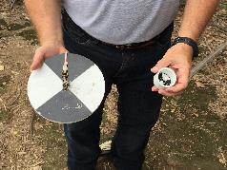
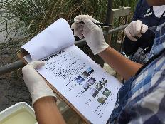
Secchi Disk Protocol Overview
Assemble field equipment. Mark the rope in 1 m increments or get clothes pins to mark the rope.
Collect site data
Conduct cloud type and cloud cover measurements
In the Field: Take the measurements using a Secchi disk
Repeat 3 times to ensure accuracy and precision
Verify that the data from the three measurements are within 10 cm of the mean, (but do not average your data for reporting)
Report your data to the GLOBE Citizen Science website

Slide 17
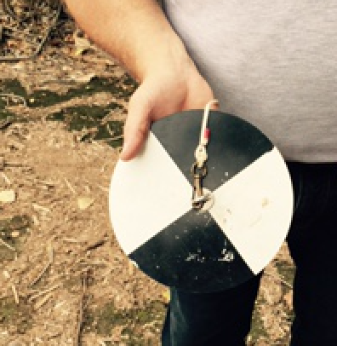
Time Requirements
Time to complete protocol: About 10 minutes
Frequency: Ideally, weekly measurements at the same sampling site
Ease of Protocol: Beginner Level

Slide 18
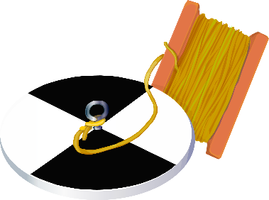



Assemble Field Equipment
Secchi disk
with rope attached
Latex or Nitrile gloves
Pencil or something to write with
Meter stick
Clothespins (optional)
Permanent marker (or waterproof tape) to mark 1 meter increments

Slide 19
Assemble Field Documents
Before measuring water transparency, cloud type and cover must be measured for the site. Measurement of water transparency must be done in the shade to avoid sun glare and differences in visibility.
What You Need:
Water Transparency Secchi Disk Data Sheet OR Hydrosphere All Protocols Data Sheet
Cloud and Contrail Cover Protocol Field Guide
Cloud and Contrail Type Protocol Field Guide
Globe Cloud Chart

Slide 20
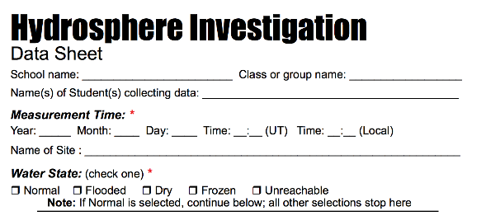
In The Field
Fill out top portion of Data Sheet (or app)

Slide 21
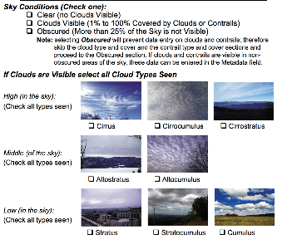

In The Field
On data sheet, characterize the sky conditions and clouds

Slide 22
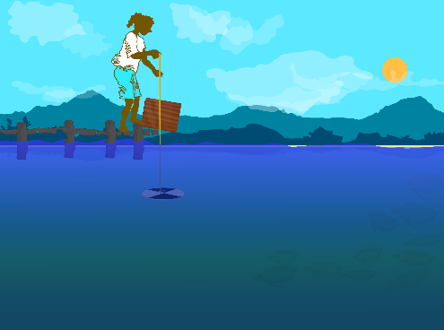


In the Field
Stand so that the Secchi disk will be shaded or use an umbrella or cardboard to shade the measurement area.
If you cannot reach the water surface, establish a reference point from the observer to the water.
Write down the distance from the reference point to the water surface as metadata.
SAFTEY Before lowering the Secchi disk put on Latex or Nitrile gloves

Slide 23
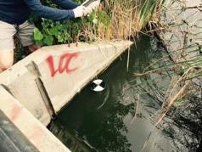
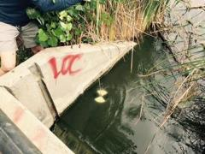
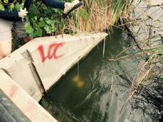
In the Field
Lower the Secchi disk until it disappears.
Record the depth from the water surface* until the Secchi disk disappears.
Lower the Secchi disk 10 cm deeper into the water until you cannot see it.
Slowly lift the Secchi disk again until it is just visible.
Record the depth from the water surface until the Secchi disk reappears.
Both depths are entered into the GLOBE database to the nearest 0.1 meter (10 cm).
*From the water surface is a change from the previous instructions, Dec. 2025.

Slide 24
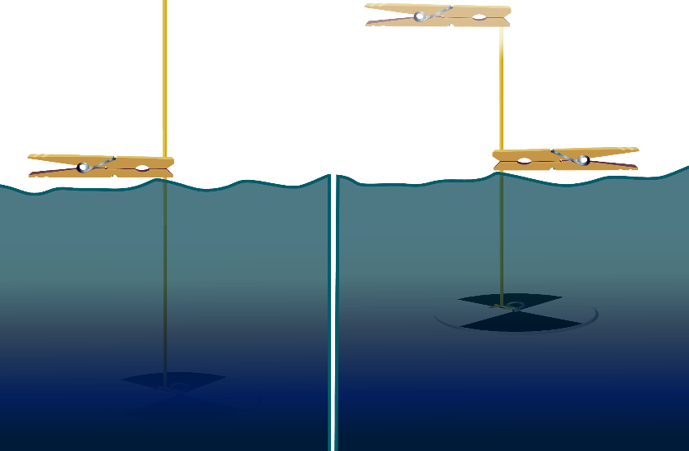
In the field • Deploy the Secchi disk
1. Lower disk from the water surface
into the water until it just disappears.
2. If your rope is marked in 1 m increments, count the meters the rope has been lowered.
Optional: at water surface, mark rope with clothespin, which will get wet.
3. Lower disk again
another 10 cm into water.
4. Raise disk
until it reappears. Optional: mark the rope with a second clothespin.
Tip: If you can’t reach the water surface
from where you are standing, mark the
rope with a clothespin at your reference
height (such as a dock).

Slide 25
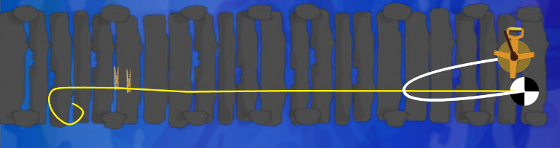
Record your data
There should now be two points marked on the rope. Record the length of the rope between each mark and the Secchi disk on your Data Sheet to the nearest meter.
Metadata: Record the distance from the observer to the water surface. If you marked the rope at the water surface, record “0” as the distance between the observer and the water surface. If you were on a dock or boat, lower the Secchi disk until it reaches the surface of the water, mark the rope there with a pin or tape, pull up the rope and measure the distance along the rope from your hands to the water surface.
Distance from reference point to surface of water
Secchi depth

Slide 26
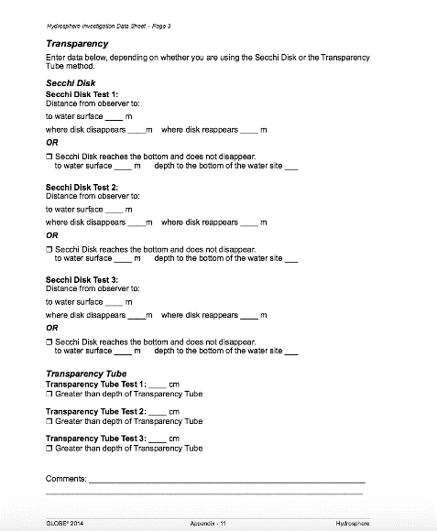
Repeat the Secchi disk measurement for a total of 3x and record your data
water surface to
water surface to
water surface to
2025

Slide 27
Hydrosphere Site Creation
If this is your first time making hydrosphere observations at this location, you will need to create a new Hydrosphere study site before entering data.
To do this, please review the Introduction to Hydrosphere training.

Slide 28

Submit Your Data to GLOBE
1.Desktop Data Entry: Log environmental data directly on the GLOBE website.
2.GLOBE Observer App: The app allows users to enter data directly from an iOS or Android device for any GLOBE protocol.

Slide 29
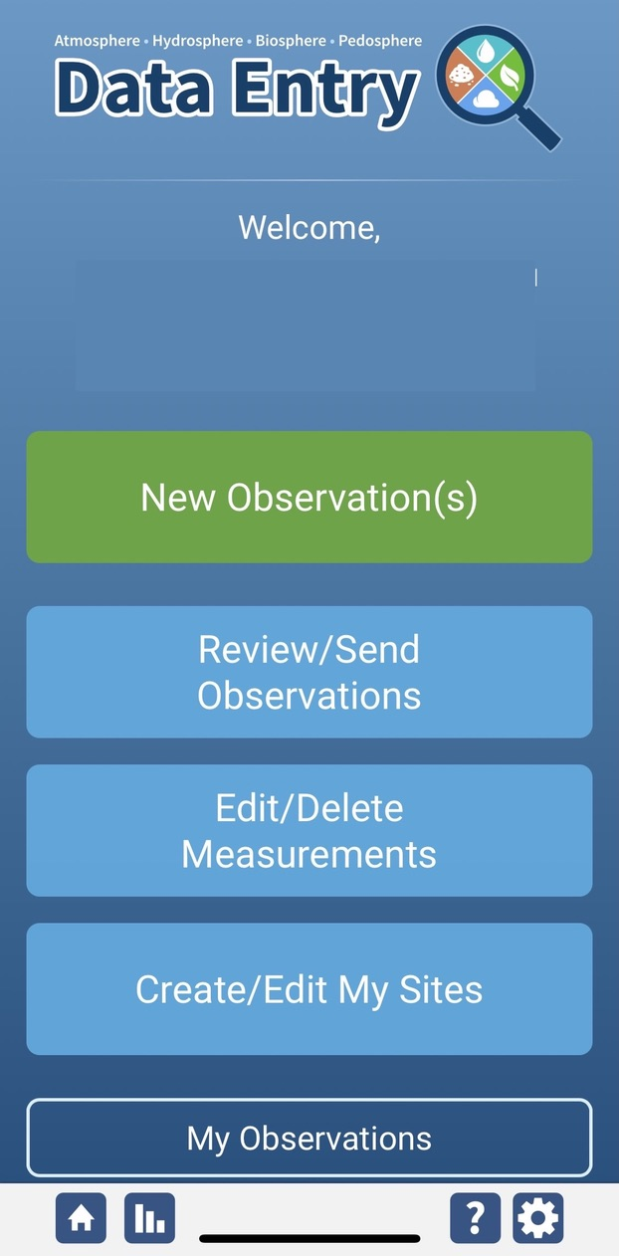
Water Transparency Protocol Data Entry
To enter data, first return to GLOBE Observer main page by clicking the home button in the bottom left.
Select “Data Entry”.
Next, click “New Observation(s)”

Slide 30
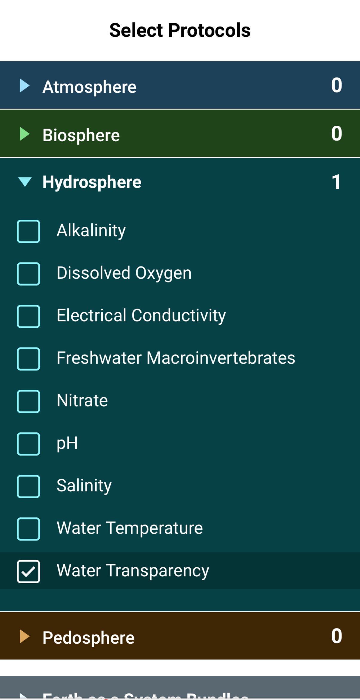
Water Transparency Protocol Data Entry
Select Water Transparency from the list of Hydrosphere protocols. Click continue at the bottom of the screen.

Slide 31
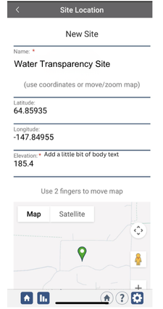
Water Transparency Protocol Site Information
If you have not already created a Hydrosphere site, create one now.
Click “New Site” at the bottom of the site location screen and choose a name for your new site.

Slide 32
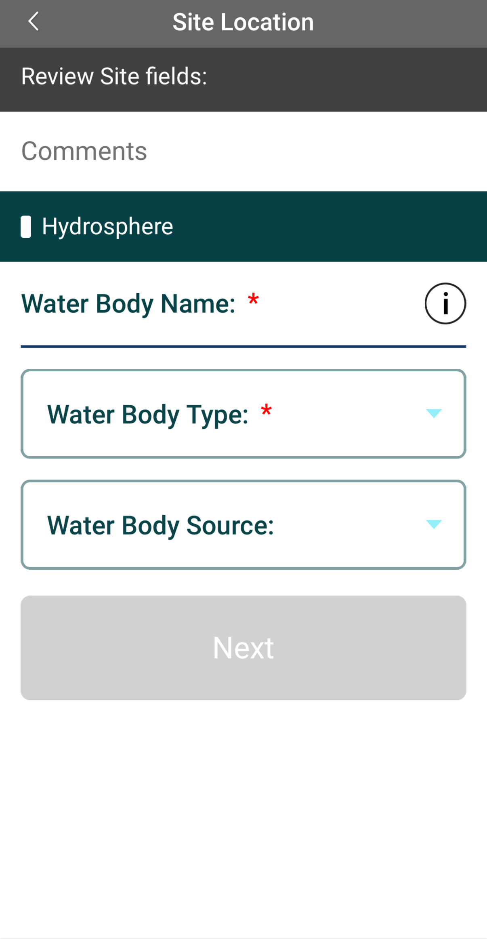
Water Transparency Protocol Site Information
Enter the Water Body Name.
Select the Water Body Type and Water Body Source from the dropdown list of options.

Slide 33
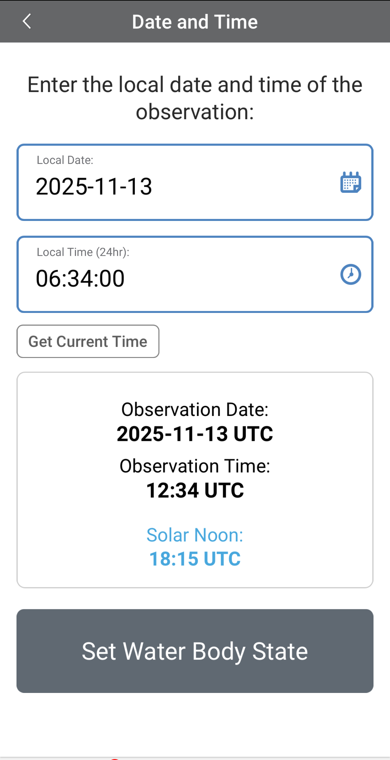
Entering Measurement Data
Enter the date and time you took the measurements.
Once you enter the date, select Set Water Body State to enter your data.

Slide 34
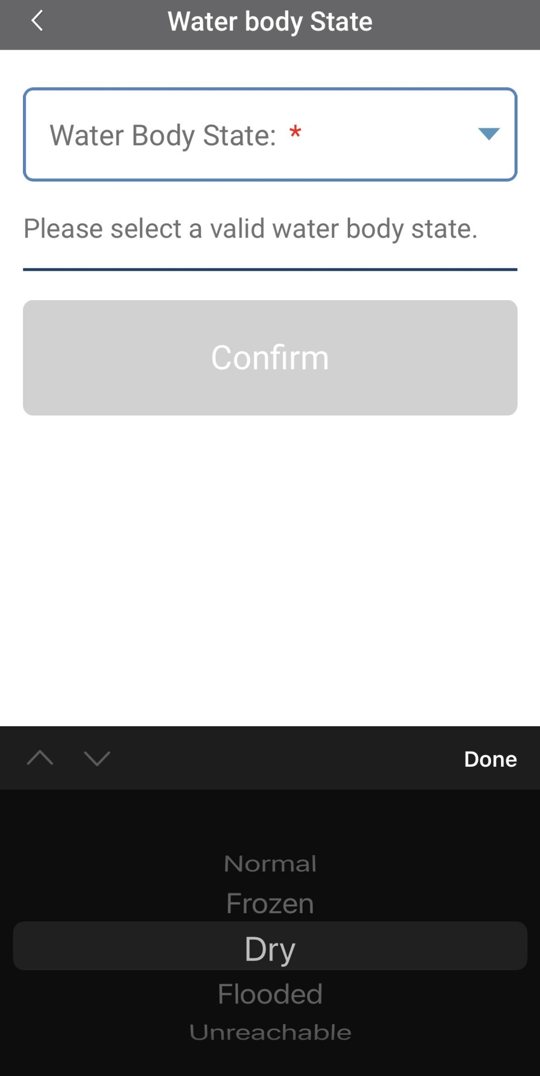
Enter the Water Body State
Select the Water Body State from the dropdown list of options.

Slide 35
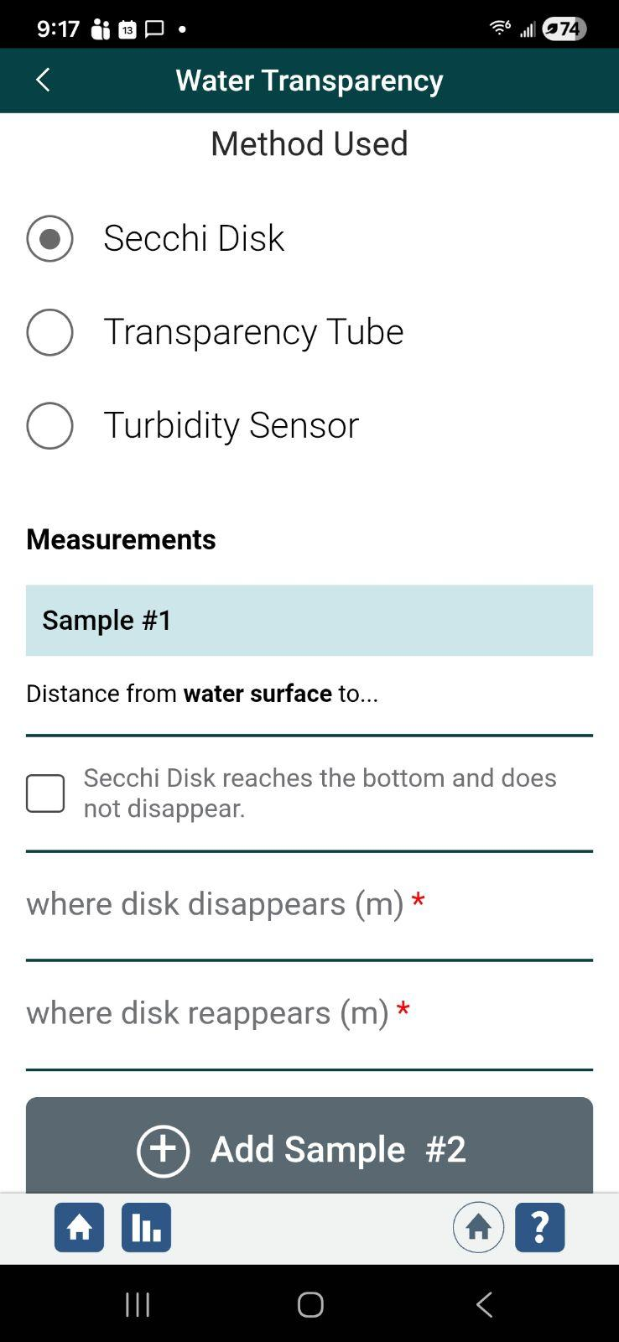
Enter Water Transparency Measurement Data
Select the method used to measure water transparency.
Enter the distance from the water surface to where the disk disappears and reappears in meters and tenths of meters.
Note that the distance where the disk disappears and reappears should be within 10 cm or 0.1 m.

Slide 36
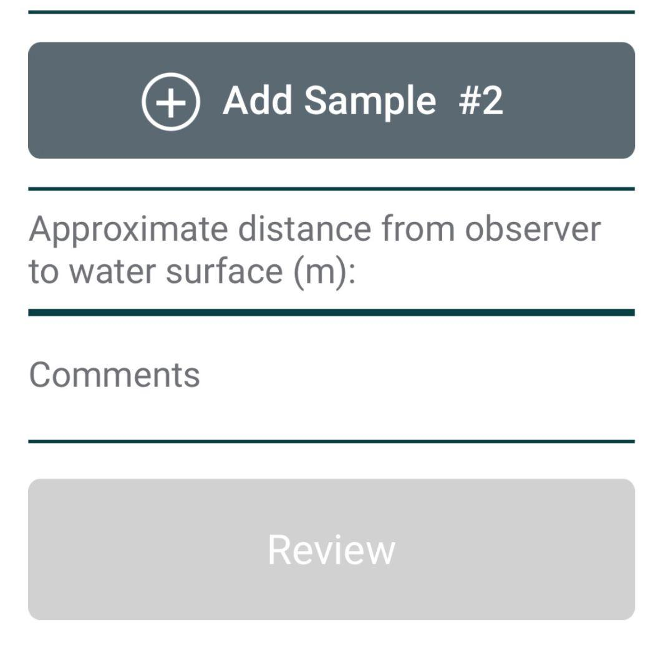
Enter approximate distance from observer to water surface (m)
Metadata
To help people interpret your data, enter distance from the observer to the water surface in meters to the nearest tenth.
If you were in a canoe at the water surface, record “0” as the distance between the observer and the water surface.
If you were on a dock or boat, enter to the nearest tenth of a meter. A dock that is three and a half meters above the water surface would be 3.5 m.

Slide 37
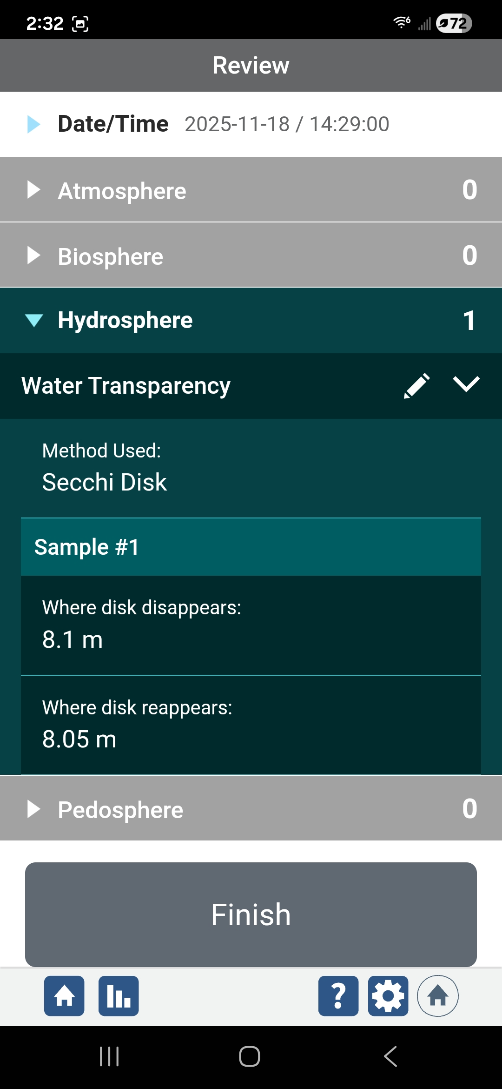
Review Data Entry and Send Data
Review the data you entered and check for errors.
The two Secchi depths (8.1 m and 8.05 m) are within 5 cm (0.05 m) from each other.
When complete, select Finish to save the observation. You are almost done!

Slide 38
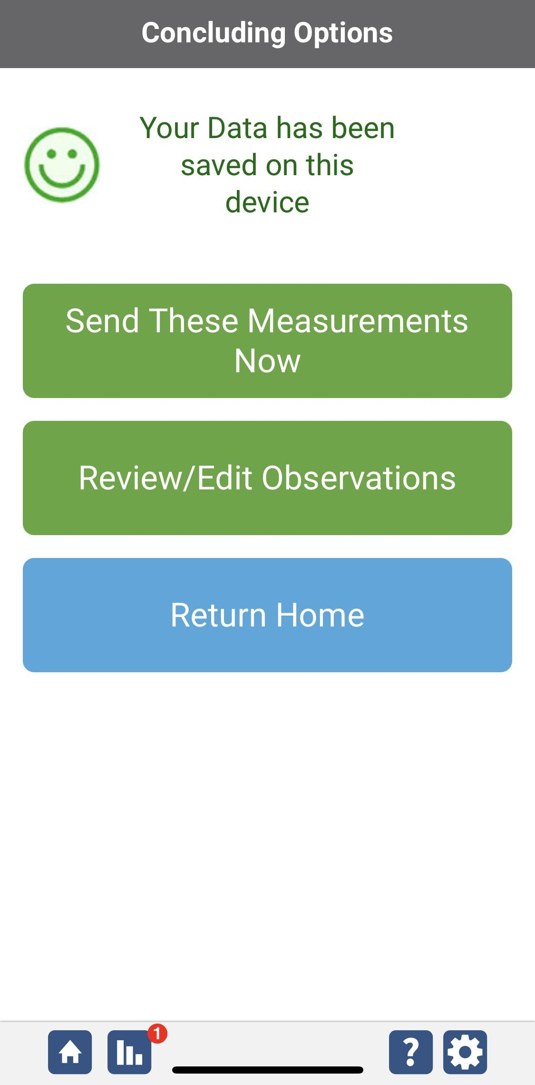
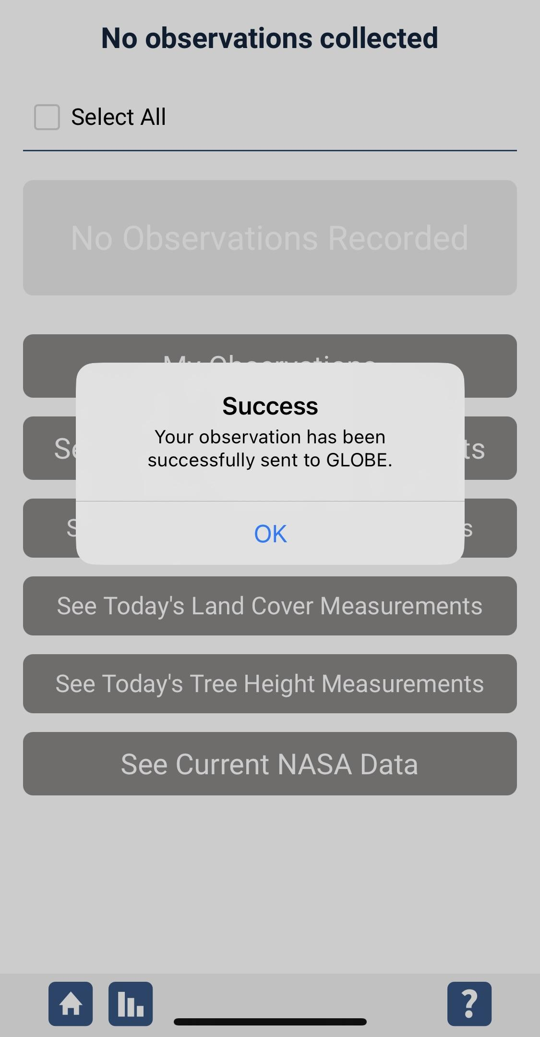
Data System Responses
If your observations are within the appropriate ranges, you will see a green smiley face.
You can review or edit your observation if needed.
When ready, select “Send these measurements now” to send your data to GLOBE. When it has been sent, you will see a “Success” message.

Slide 39
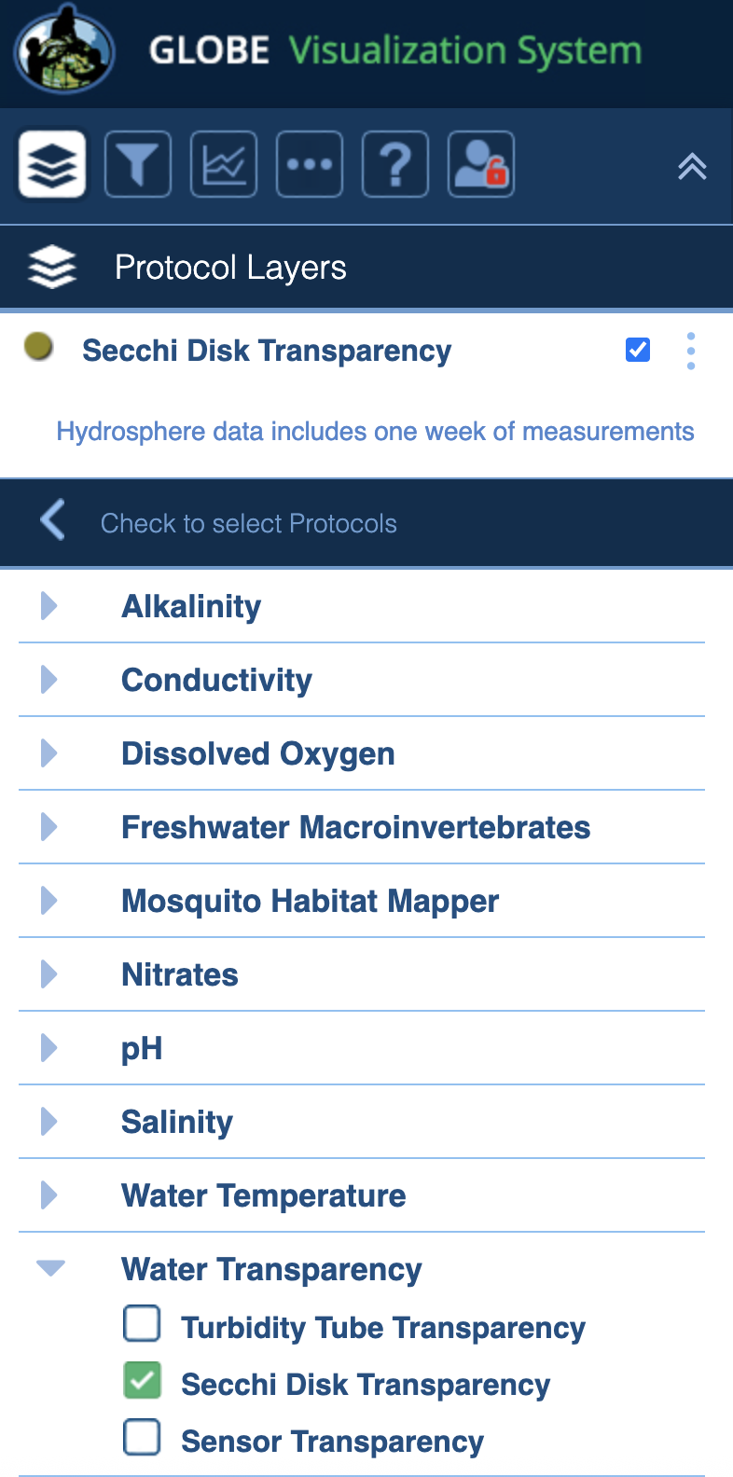
Visualize and Retrieve Data
GLOBE provides the ability to view and interact with data measured across the world. Select our visualization tool to map, graph, filter and export Secchi Disk transparency data that have been measured across GLOBE protocols since 1995.
Select Hydrosphere
Expand the Water Transparency menu
Select Secchi Disk transparency data from drop down menu
Notes:
Screenshot of map interface, GLOBE Visualization System. From drop down menu, select “Water Transparency”

Slide 40
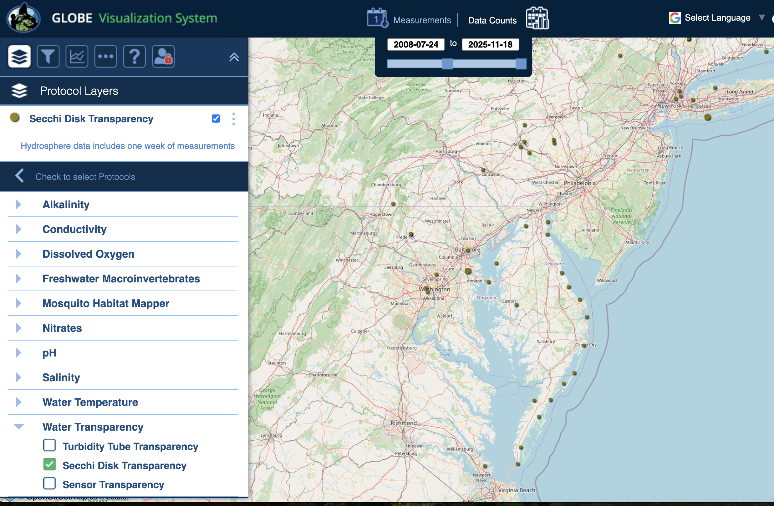
Visualize and Retrieve Data
Select the date for which you need Secchi Disk Transparency data, add layer, zoom to the region of interest and see where data is available.
Locations where Secchi Disk Transparency data is available for the selected date range and region.

Slide 41
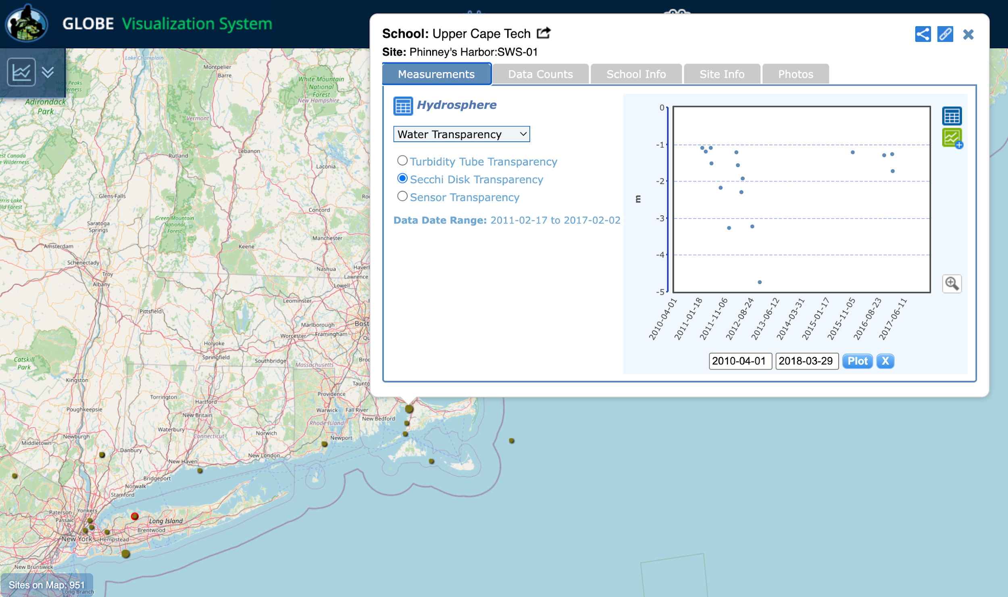
Visualize and Retrieve Data
Select the sampling site for which you need Secchi Disk Transparency data, and a box will open with a data summary for that site.
Clicking on a location will open to a map note providing Secchi Disk Transparency data for that location and time. Follow instructions in the tutorial to download data as a .csv file for analysis.
The Transparency Secchi disk depth ranged from 1 meter to 5 meters below the water surface at the Phinney’s Harbor Site. Data was collected by Upper Cape Tech.

Slide 42
Review questions to help you prepare to measure Water Transparency at your Hydrosphere Study Site
What does water transparency measure?
What kind of suspended particles are found in water bodies?
The absolute depth at which light can penetrate through a water column is called ______?
The more suspended particles, the (more/less) transparency.
When water is still and deep, the appropriate transparency instrument is (Secchi disk/Transparency Tube).
Your three replicate measurements should be within _______cm of the mean.
Why do you need to take your transparency measurement in the shade?
Why is it necessary to describe cloud cover when taking transparency measurements?
What are some reasons water transparency measurements may change over the course of a year?
What safety precautions should you take prior to conducting any of GLOBE’s hydrosphere protocols?

Slide 43
You have now completed the slide stack. If you are ready to take the quiz, sign on and take the quiz corresponding to Water Transparency Secchi Disk Protocol.
You can also review the slide stack, post questions on the discussion board, or look at the FAQs on the next page.
When you pass the quiz, you are ready to take Water Transparency Secchi Disk Protocol measurements!

Slide 44
Additional
INFO
A. What is water transparency?
B. Why collect water transparency data?
C. How your measurements can help
D. How to collect your data.
E. Entering data on GLOBE Website.
F. Understand the data.
G. Quiz yourself
H. Additional
resources
Frequently Asked Questions
When comparing data between sites, do you need to make an adjustment for data taken at the water surface compared to data taken from a bridge or dock?
This distance is not used to adjust the Secchi disk data. However, reporting the distance between the observer and the water helps in data interpretation.
My students are using a pond for our hydrosphere measurements. They go out in a boat and use a Secchi disk for the transparency. We are not sure of the two measurements we are asked to give. They measure the line at the surface of the water to the top of the disk when it disappears and reappears. What is the other measurement?
For the other measurement, distance from where you read the line to the water surface, you should enter zero. Some schools will make Secchi disk readings from a bridge or pier, and report the depth measured using a reference level that is not the water surface, but some distance above the water surface. So they need to also enter the distance from the pier to the water. That way we have all of
the raw data in the database.

Slide 45

Additional
INFO
Please provide us with feedback about this module. This is a community project and we welcome and need your comments, suggestions and edits!
Questions about the content of this module? Contact GLOBE: help@nasaglobe.org
A. What is water transparency?
B. Why collect water transparency data?
C. How your measurements can help
D. How to collect your data.
E. Entering data on GLOBE Website.
F. Understand the data.
G. Quiz yourself
H. Additional
resources
Credits
Slides:
Russanne Low, Ph.D., University of Nebraska, Lincoln, USA
Rebecca Boger, Ph.D., Brooklyn College, NYC, USA
Photo Credits: Russanne Low
Illustrations and Cover Art: Jenn Glaser, ScribeArts
Additional Information:
GLOBE Program
NASA Global Climate Change: Vital Signs of the Planet
The GLOBE Program is made possible by these organizations:
Version November 2025. Modified by GLOBE Implementation Office Science, Training, Education and Public Engagement Team. If you edit and modify this slide set for use for educational purposes, please note “modified by (and your name and date)“ on this page. Thank you.

