Slide 2
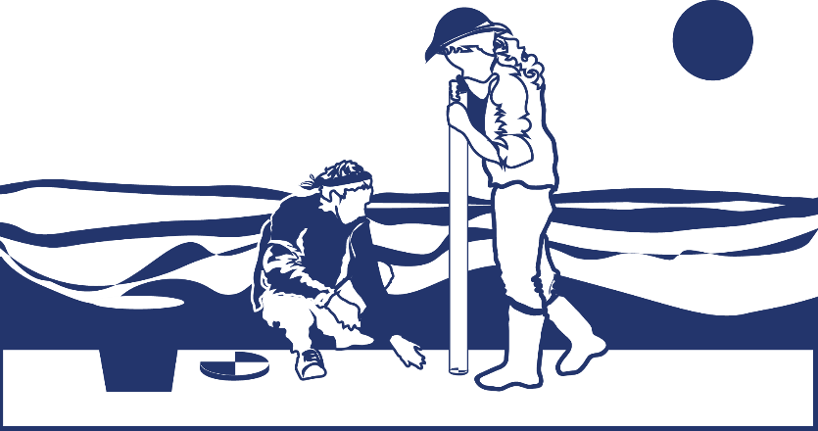
Overview
This module:
Reviews the selection of a GLOBE hydrology site
Reviews the water sampling technique used in GLOBE hydrology protocols
Guides the construction of the necessary instrument for this protocol
Provides a step by step introduction of the protocol method
Learning Objectives
After completing this module, you will be able to:
Define water transparency and explain how environmental variables result in different transparency measurements
Describe how the protocol procedures ensure the collection of accurate data
Conduct transparency measurements in the field
Upload data to the GLOBE portal
Visualize data using GLOBE’s Visualization Site
2

Slide 3
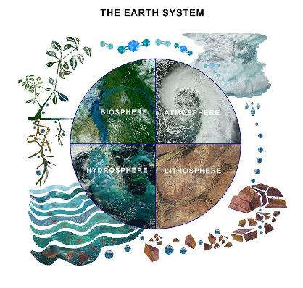
The Hydrosphere
The hydrosphere is the part of the Earth system that includes water, ice and water vapor. Water participates in many important natural chemical reactions and is a good solvent. Changing any part of the Earth system, such as the amount or type of vegetation in a region or from natural land cover to an impervious one, can affect the rest of the system. Rain and snow capture aerosols from the air. Acidic water slowly dissolves rocks, placing dissolved solids in water. Dissolved or suspended impurities determine water's chemical composition.
Current measurement programs in many areas of the world cover only a few water bodies a few times during the year. GLOBE Hydrosphere protocols will allow you to collect valuable data to help fill these gaps and improve our understanding of Earth's natural waters.
The Earth System: Energy flows and matter cycles.
3

Slide 4
Hydrosphere Protocols
What is the condition of Earth’s many surface waters – the streams, rivers, lakes, and coastal waters? How do these conditions vary over the year? Are these conditions changing from year to year? These are questions that are answered by the Hydosphere investigations in the GLOBE program.
Water Transparency is one of 10 measurements used by GLOBE to describe the status of a water body. Water transparency measures depth of light penetration into the water.
Water transparency depends on the amount of suspended particles - organic, such as phytoplankton and algae; inorganic, such as sediments, as well as other dissolved impurities such as organic or inorganic carbonates. These factors contribute to both the color and the transparency of the water.
GLOBE Hydrosphere Measurements
Hydrosphere Study Site
Water Temperature
Water Transparency
Conductivity
pH
Mosquito Larvae
Alkalinity
Dissolved Oxygen
Salinity
Nitrates
Freshwater Macroinvertebrates
4

Slide 5
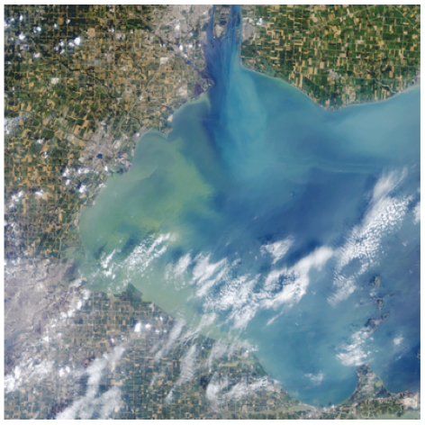
Water transparency describes water clarity. It is measured by determining the the depth of light penetration into the water column from the surface.
The Operational Land Imager (OLI) on the Landsat 8 satellite captured this view of an algae bloom, Lake Erie, August 2014.
Algal blooms such as this significantly reduce water transparency and contaminate onshore drinking water.
5

Slide 6
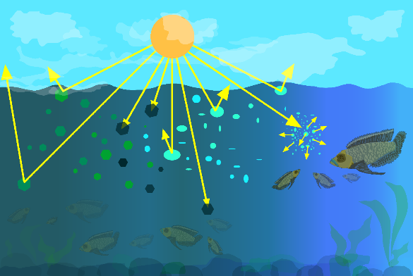
What is Water Transparency?
Particles in the water will reflect, absorb or scatter light, thus determining the depth at which more light can’t penetrate. This is called the extinction depth. The Water Transparency Protocol measures the light extinction depth of the water in your selected Hydrology Investigation Site.
Particles in water can reflect, absorb or scatter light.
Credit: Jenn Paul Glaser
6

Slide 7
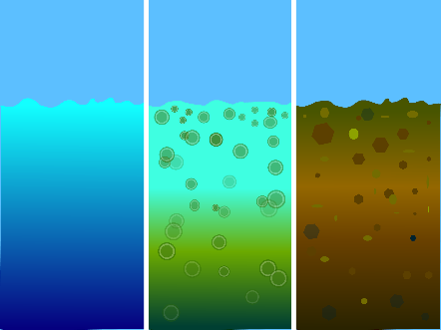
What is Water Transparency?
Suspended particles in our water behave similarly to dust in the atmosphere. They reduce the depth to which light can penetrate. Sunlight provides the energy for photosynthesis (the process by which plants grow by taking up carbon, nitrogen, phosphorus and other nutrients, and releasing oxygen). How deeply light penetrates into a water body determines the depth to which aquatic plants can grow.
Transparency decreases with the presence of molecules and particles that can absorb or scatter light. Dark or black material absorb most wavelengths of light, whereas white or light materials reflect most wavelengths of light. The size of a particle is important as well. Small particles (diameters less than 1 μm) can scatter light.
Blue/Cloudy
suspended carbonates scatter blue-green light
Green
algae and phytoplankton
Brown
sediments
Light penetrates through the water sample, coming in through the top and possibly also the sides of the transparency tube. The color of the suspended particles affects how light penetrates in the transparency tube.
7

Slide 8
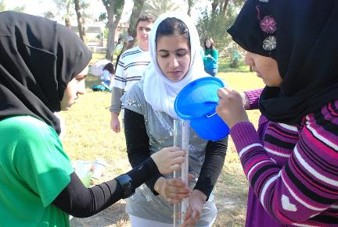
Why Collect Water Transparency Data?
In most countries current measurement programs cover only a few water bodies a few times during the year. As a consequence, the archives of GLOBE hydrology data provides important data about water chemistry and water quality not found elsewhere.
  By taking measurements over time in multiple locations, it is often possible to determine the times of year and the source of pollution, for instance, and if necessary, remediate the situation to improve water quality.
8

Slide 9
Why Collect Water Transparency Data?
Water transparency changes over time in response to environmental factors. Suspended particles such as phytoplankton, zooplankton, sediment, organic matter...) are optically active components and their density and distribution varies over time. Erosion and runoff during a storm is one source of sediment particles. The influx of nutrients such as phosphorus into a water body can cause an algal bloom, greatly increasing the density of these organisms.
The more suspended particles, the less transparency
An increase in suspended particles in a water body will decrease transparency, and light will be unable to penetrate into deeper water.
Light energy is needed by plants to conduct photosynthesis.
  Less light penetration into the water will affect the health of organisms living in the water body.
Water transparency affects water quality.
  Suspended particulates impact water quality, both for human consumption and for use by aquatic organisms
9

Slide 10
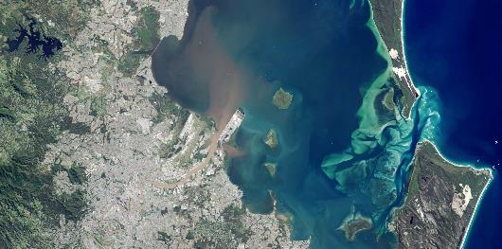
HOW
your
measurements
can help
How Your Measurements Can Help
Credit: NASA Earth Observatory
Your observations are valuable contributions to the scientific community and may be used by educators, students, researchers, and the general public to increase environmental awareness and STEM literacy, as well as advance Earth system science. Here is an example of how this might be done for transparency.
Water transparency and color can be observed in satellite imagery. In May 2015, the east coast of Australia was hit by a severe storm and deadly flooding, dropping more than 360 millimeters (14 inches) of rain within about three hours in southeast Queensland, Australia. This image of the Brisbane River entering Moreton Bay was acquired on May 3, 2015 by the Operational Land Imager on Landsat 8.
As a result of the rainfall, flash flooding caused distinct river plumes to form along the coastline. Flood waters usually contain elevated levels of sediment and colored dissolved organic matter (CDOM). Sediment tends to scatter red light, and CDOM absorbs blue light. As a result, a brown color is visible where the Brisbane River mouth where these two optical phenomena work in concert. Further from the mouth, the coarser sediments tend to settle to the bottom but the CDOM is still observed in the water column absorbing blue light. What is coloring the yellow-green patches in the water? Scientists believe it is CDOM, but ground verification is needed to be sure.
10

Slide 11
How to Collect Your Data
Simultaneous or Prior Investigations Required to do Water Transparency Measurements
You will need to define your Hydrosphere Study Site. A Hydrosphere Study Site can be any surface water site that can be safely visited, although natural waters are preferred.
Sites, in order of preference, may include:
Streams or rivers
Lakes, reservoirs, bays or ocean
Pond
Irrigation ditch or other water body, if those above are not available
To define you study site you will need these documents:
Selecting and Documenting your Hydrosphere Study Site Hydrosphere Investigation Data Sheet
Mapping your Hydrosphere Study Site Field Guide
11

Slide 12
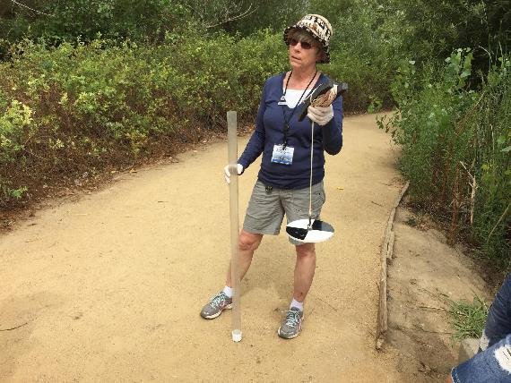
Determine Which is Appropriate for Your Water Body: Secchi Disk or Transparency Tube?
12

Slide 13
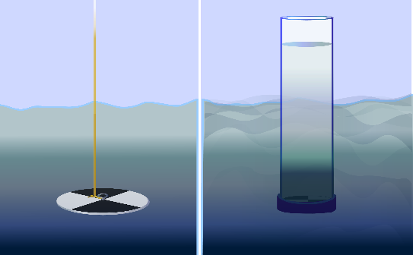
How to Collect Your Data: Select Appropriate Instrument
First, determine if your study site has deep, still water or shallow and/or flowing water. If the water is deep and still, you will use a Secchi Disk for your water transparency measurements. If the water is shallow or flowing, you will use a Transparency Tube (also called a Turbidity Tube). If you will be using the Secchi Disk, use instructions in the the Water Transparency Secchi Disk Field Guide.
Secchi Disk used with deep and still water
Transparency Tube used with shallow or Flowing water
13

Slide 14
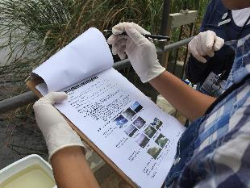
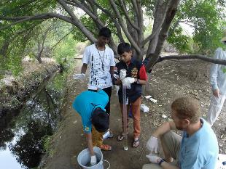
Overview of the Water Transparency Protocol
Assemble field equipment
Collect site data
Conduct cloud type and cloud cover measurements
Take the measurements using a Secchi Disk or Transparency Tube
Repeat 3 times to ensure accuracy and precision
Verify that the data from the three measurements are within 10 cm of the mean
Report your data to the GLOBE Website
14

Slide 15
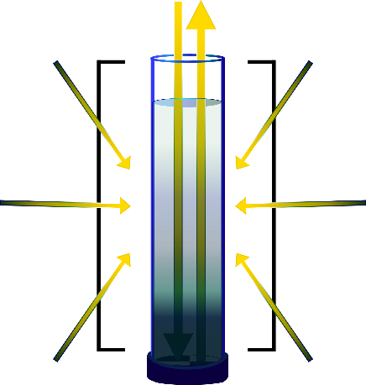
Using the Transparency Tube
The transparency tube measures light penetration through surface waters
Light penetrates through the water sample, coming in through the top and possibly also the sides of the transparency tube.
Pro Tip: It is important to shade the tube with your body to prevent light from coming from the sides of the tube.
Transparency varies with the amount of suspended particles in the water
15

Slide 16

Time Requirements
Time Requirements: about ten minutes
Frequency: ideally, weekly measurements at the same sampling site.
Ease of Protocol: Beginner Level
16

Slide 17


Assemble Transparency Tube Field Equipment
Transparency Tube: (Instructions to build homemade transparency tube next slide)
Latex or Nitrile gloves
Permanent marker or pencil
Bucket and rope
Meter stick
17

Slide 18
Assemble Documents Needed in Field
Transparency Tube Transparency Protocol
Collecting Water Sample in a Bucket
Water Transparency Tube Data Sheet OR Hydrosphere All Protocols Data Sheet
Cloud and Cover Contrail Protocol Field Guide
Cloud and Contrail Type Protocol Field Guide
Globe Cloud Chart
18

Slide 19
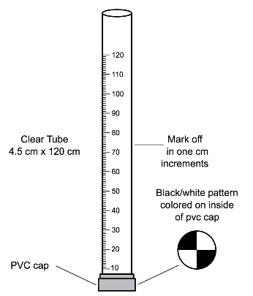
Instrument Construction Instructions for Making a Transparency Tube
Materials:
*Clear tube approximately 4.5 cm x 120 cm
PVC cap (to fit snugly over one end of the tube)
Permanent black marker
Meter stick or meter tape
Construction:
1. On the bottom of the inside of the PVC cap, draw a Secchi disk pattern (alternating black and white quadrants) with the black permanent marker.
2. Put the PVC cap over one end of the tube. Cap should fit tightly so water cannot leak out.
3.Use the marker and meter stick to draw a scale on the side of the tube. The bottom of the inside of the PVC cap where the Secchi disk pattern is drawn is 0 cm. Mark every cm up from that point.
4. A shutoff valve can be installed near the bottom of the tube to allow water to escape in a controlled manner; this would resemble commercially-available transparency tubes. You can also drill a small hole near the bottom that you can plug with your finger when you are making measurements.
*Many hardware stores carry long tubes for protecting fluorescent light bulbs. These are inexpensive and make excellent transparency tubes. If these are not available, any long, clear plastic tube may be used: the length is more important than the diameter.
19

Slide 20
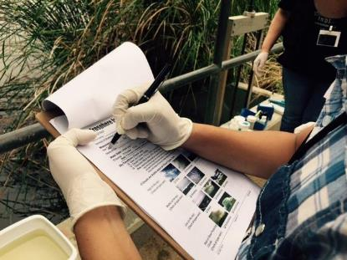
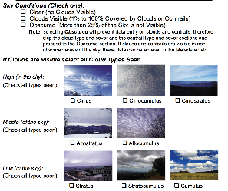
In the Field: Collect Hydrosphere Investigation Site Data
Fill out top portion of the data sheet
Characterize the sky conditions and clouds
20

Slide 21
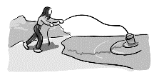
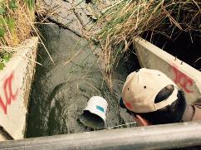
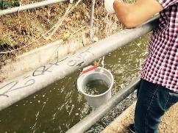
In the Field: Collect Your Water Sample
3. Put on protective gloves
4. Collect a surface water sample as follows:
Rinse bucket with water from the site to avoid contamination. Do not use distilled water to clean the bucket.
Hold tightly onto the rope.
If your sampling site is a stream, throw the bucket out to a well-mixed area (a riffle), a little distance from the shore. Ideally, the water should be flowing at least slightly. If you are sampling from a lake, bay, or the ocean, stand on the shore and throw the bucket as far out as possible to collect your sample
If the bucket floats, jostle the rope until some water enters the bucket.
You should always take a sample from the top surface water. Be careful not to let the bucket sink to the bottom or stir up bottom sediment.
Allow the bucket to fill about 2/3 to 3/4 full and pull it back in with the rope.
Be sure to rinse bucket with sample water
21

Slide 22
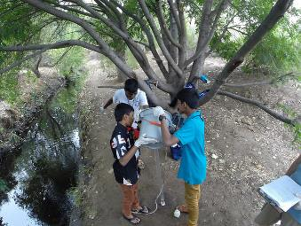


In the Field
Using the Transparency Tube
5. Stand with your back to the sun, so that the transparency tube is shaded.
6. Pour sample water slowly into the tube using a cup. Look straight down into the tube with your eye close to its opening.
Stop adding water when you can’t see the Secchi pattern at tube’s bottom.
Measurement of water transparency must be done in the shade to avoid sun glare and differences in visibility.
TIP If you can’t reach the water surface
(EG: You are standing on a dock or bridge), mark the rope at your reference height
22

Slide 23
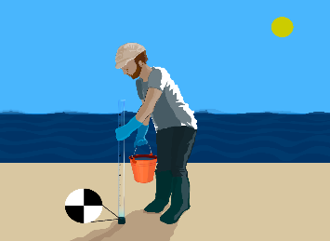
Collect your Data Using the Transparency Tube
7. Rotate the tube slowly as you look to ensure that you can’t see the Secchi pattern.
The Secchi pattern at the bottom of the tube should be completely unrecognizable when you look through the tube.
TIP If you can’t reach the water surface
(EG: You are standing on a dock or bridge), mark the rope at your reference height
Measurement of water transparency must be done in the shade to avoid sun glare and differences in visibility.
23

Slide 24
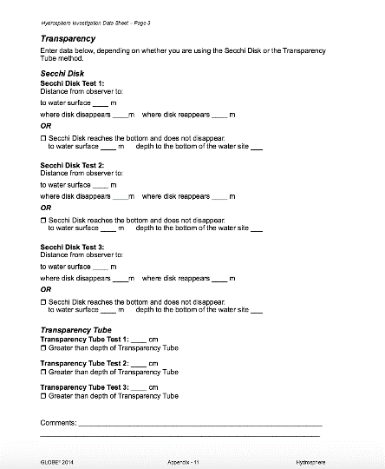
Repeat and record your measurement for a total of 3x and record your data
24

Slide 25
Hydrosphere Site Creation
If this is your first time making hydrosphere observations at this location, you will need to create a new Hydrosphere study site before entering data.
To do this, please review the Introduction to Hydrosphere training.
25

Slide 26

Submit Your Data to GLOBE
1.Desktop Data Entry: Log environmental data directly on the GLOBE website.
2.GLOBE Observer App: The app allows users to enter data directly from an iOS or Android device for any GLOBE protocol.
26

Slide 27
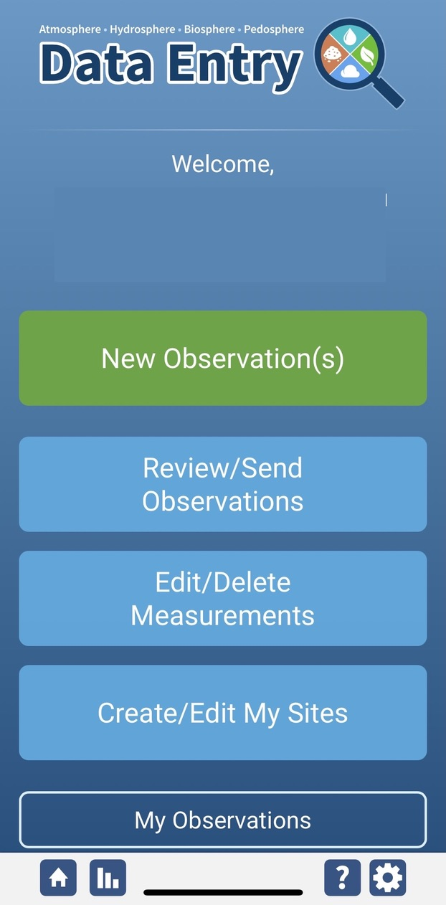
Water Transparency Protocol Data Entry
To enter data, first return to GLOBE Observer main page by clicking the home button in the bottom left.
Select “Data Entry”.
Next, click “New Observation(s)”
27

Slide 28
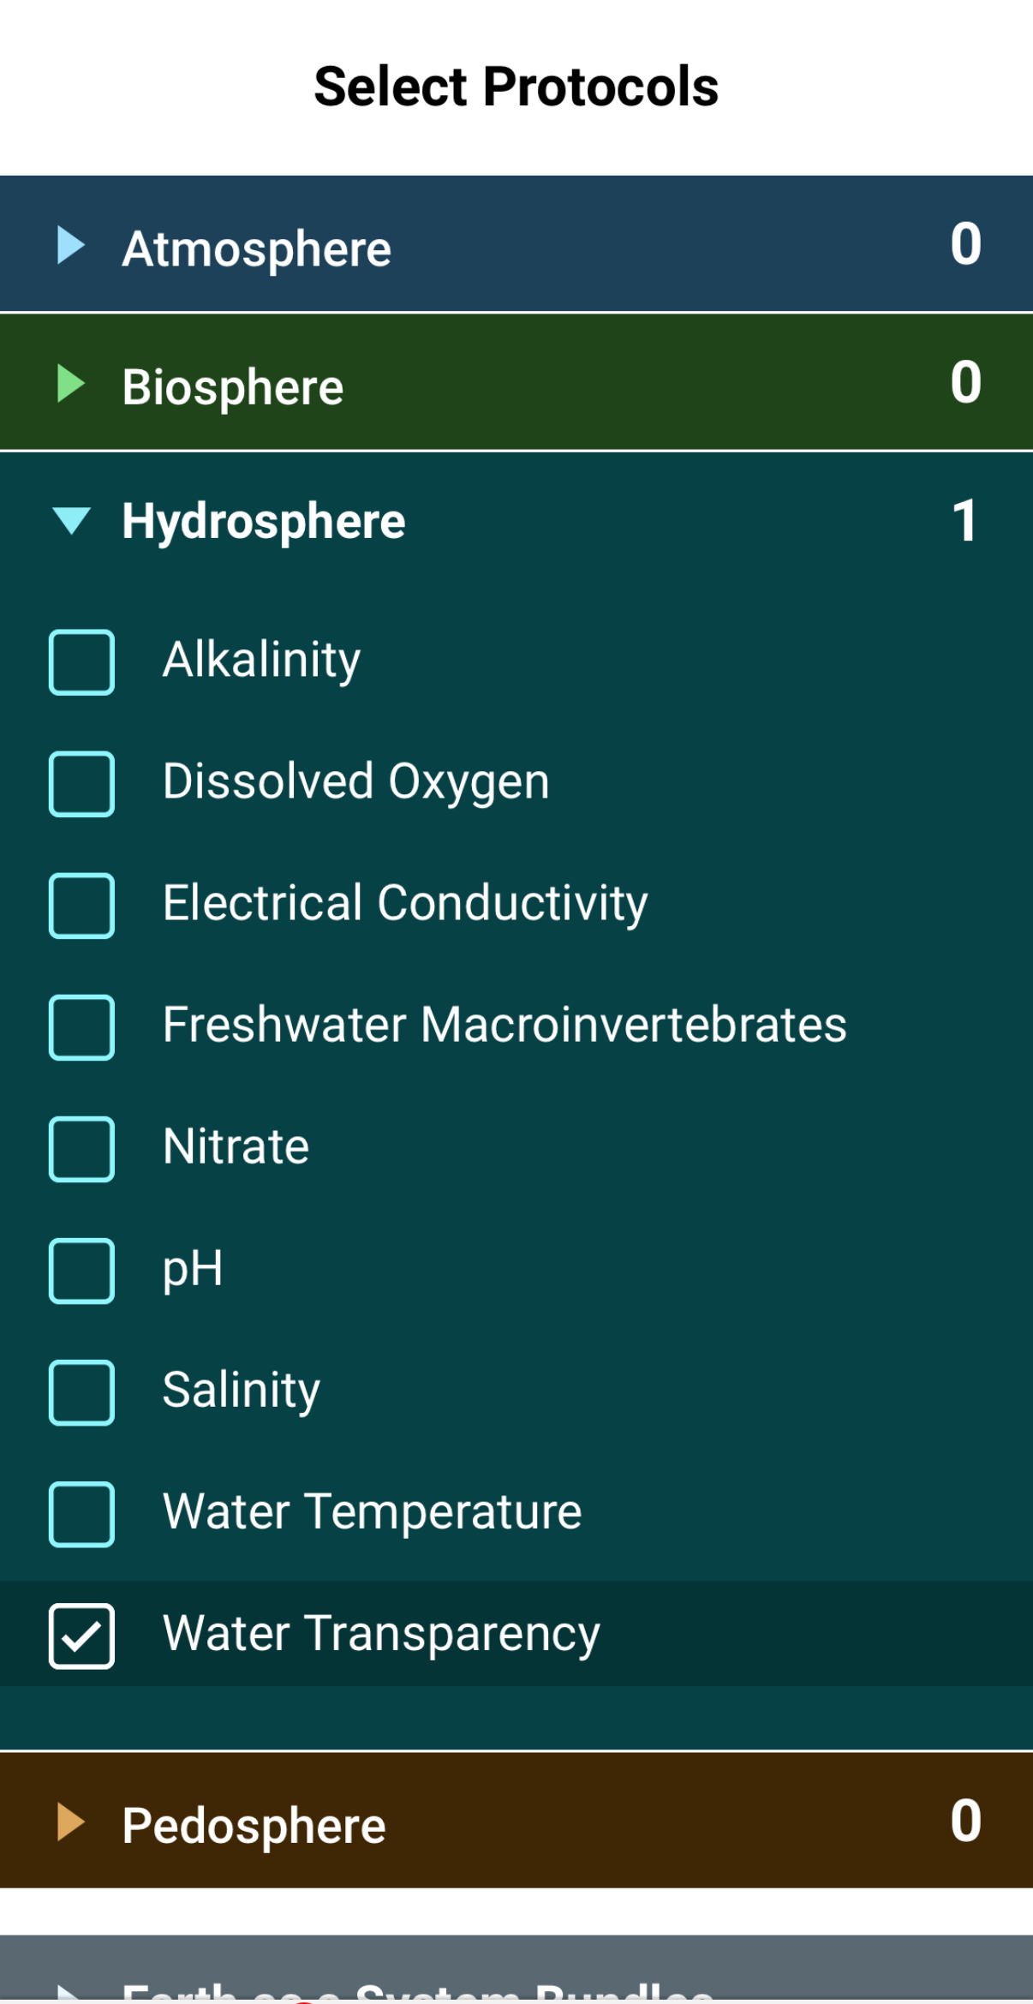
Water Transparency Protocol Data Entry
Select Water Transparency from the list of Hydrosphere protocols. Click continue at the bottom of the screen.
28

Slide 29
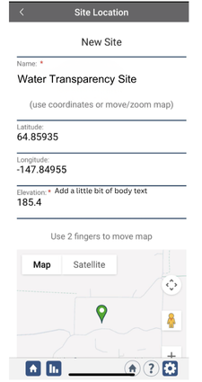
Water Transparency Protocol Site Information
If you have not already created a Hydrosphere site, create one now.
Click “New Site” at the bottom of the site location screen and choose a name for your new site.
29

Slide 30
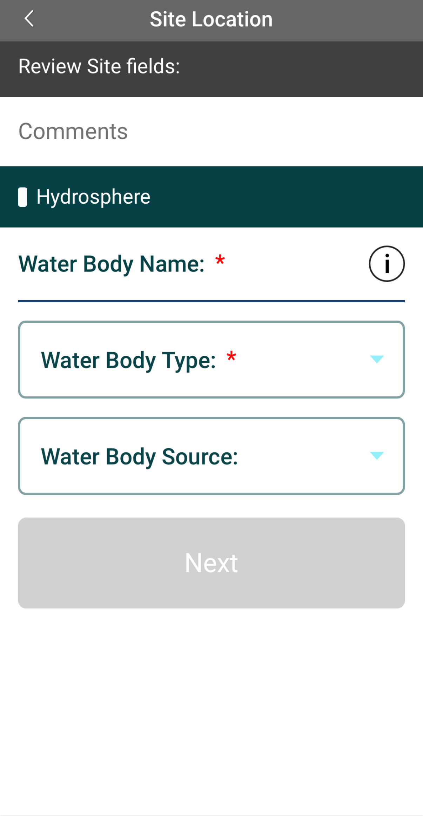
Water Transparency Protocol Site Information
Enter the Water Body Name.
Select the Water Body Type and Water Body Source from the dropdown list of options.
30

Slide 31
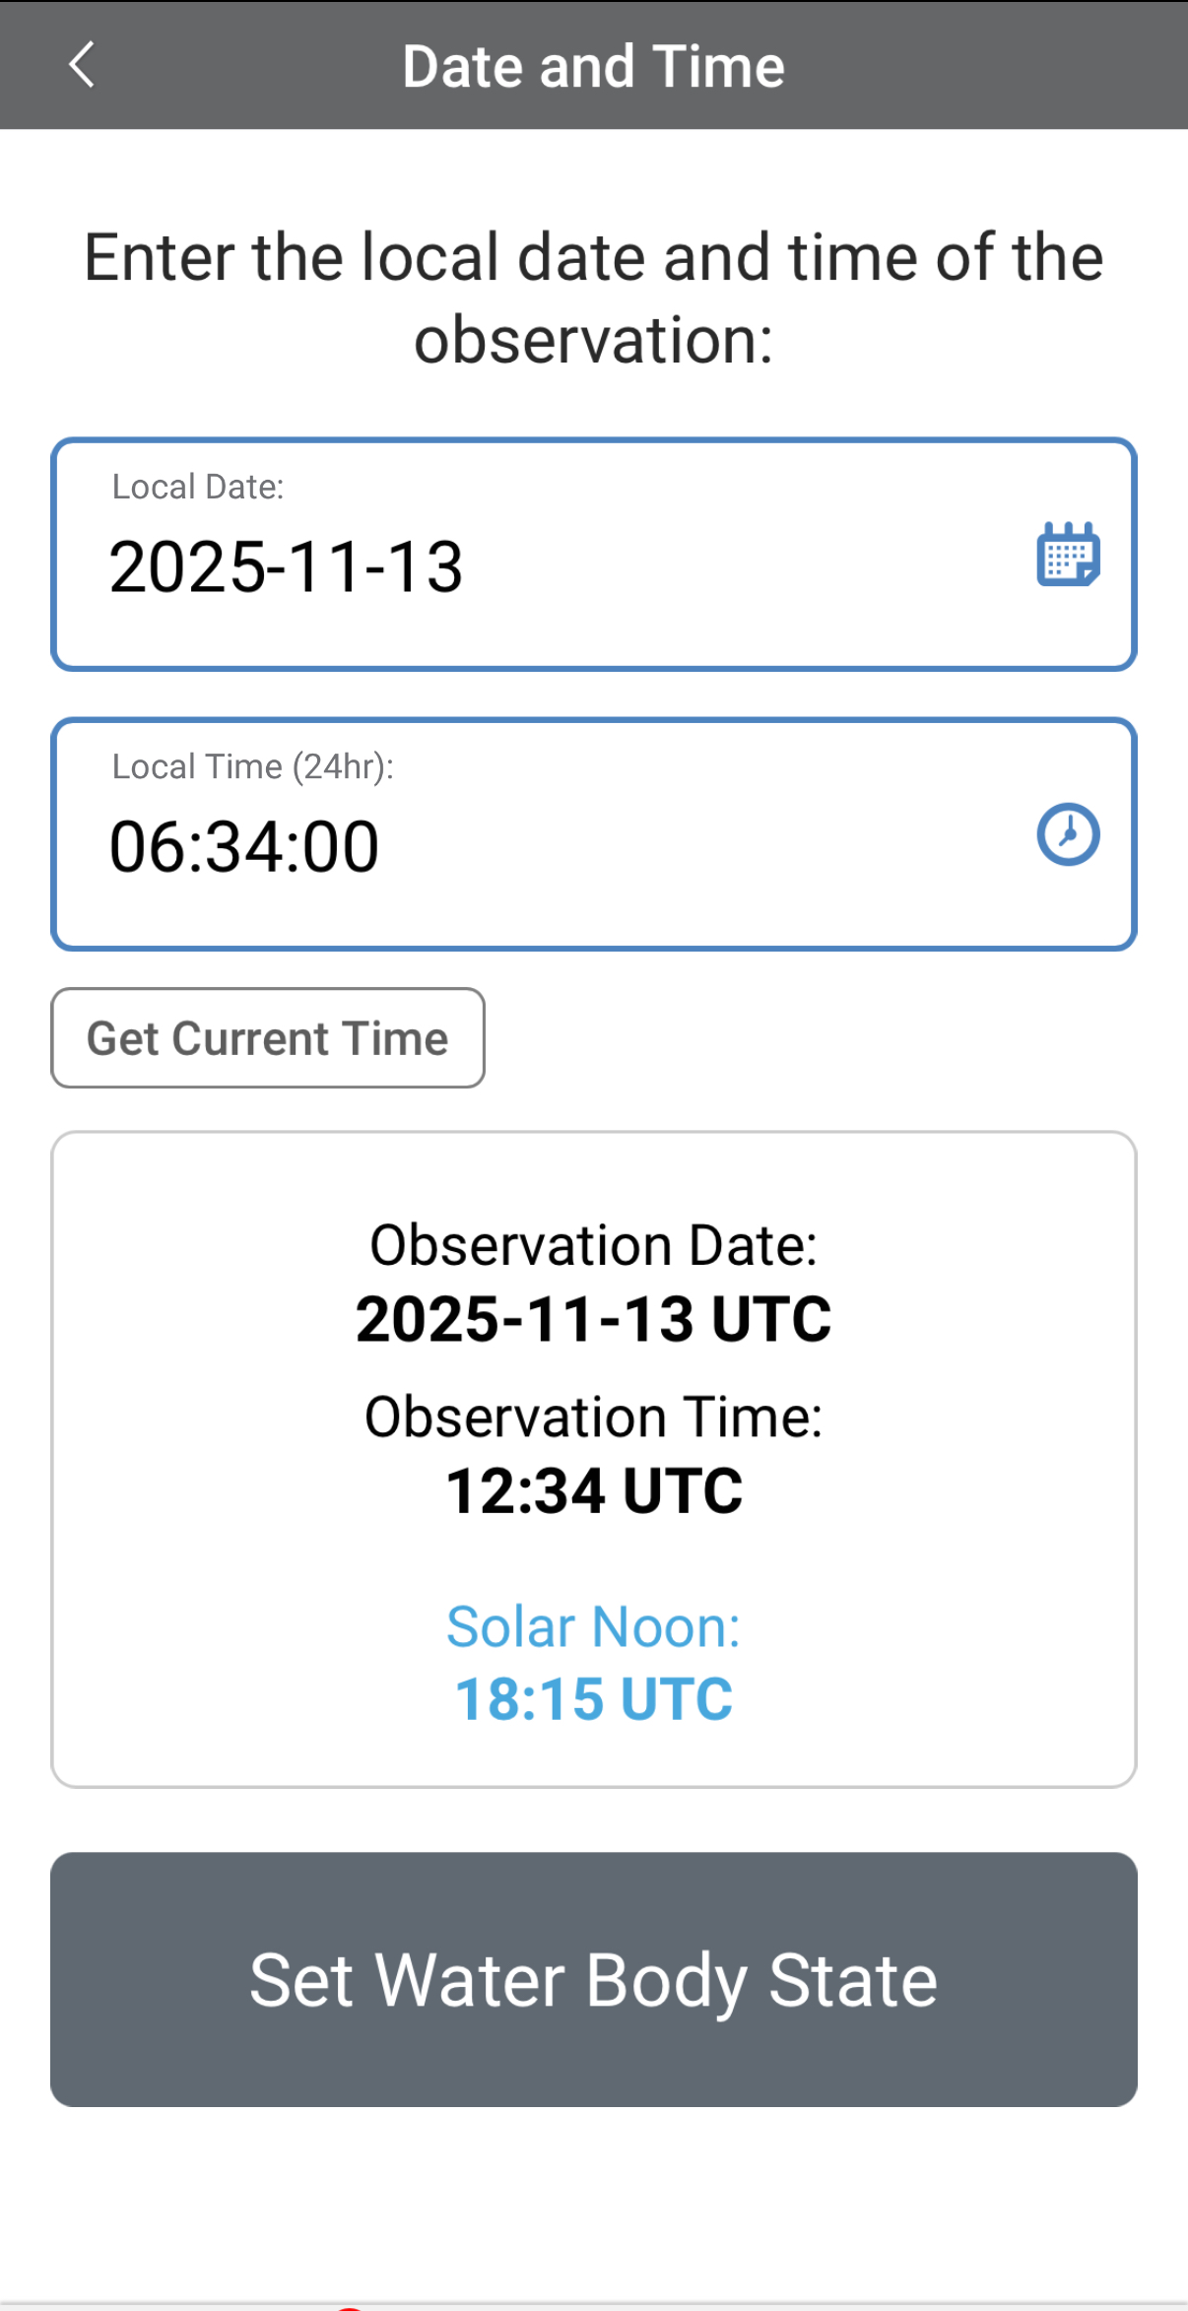
Entering Measurement Data
Enter the date and time you took the measurements.
Once you enter the date, select Set Water Body State to enter your data.
31

Slide 32
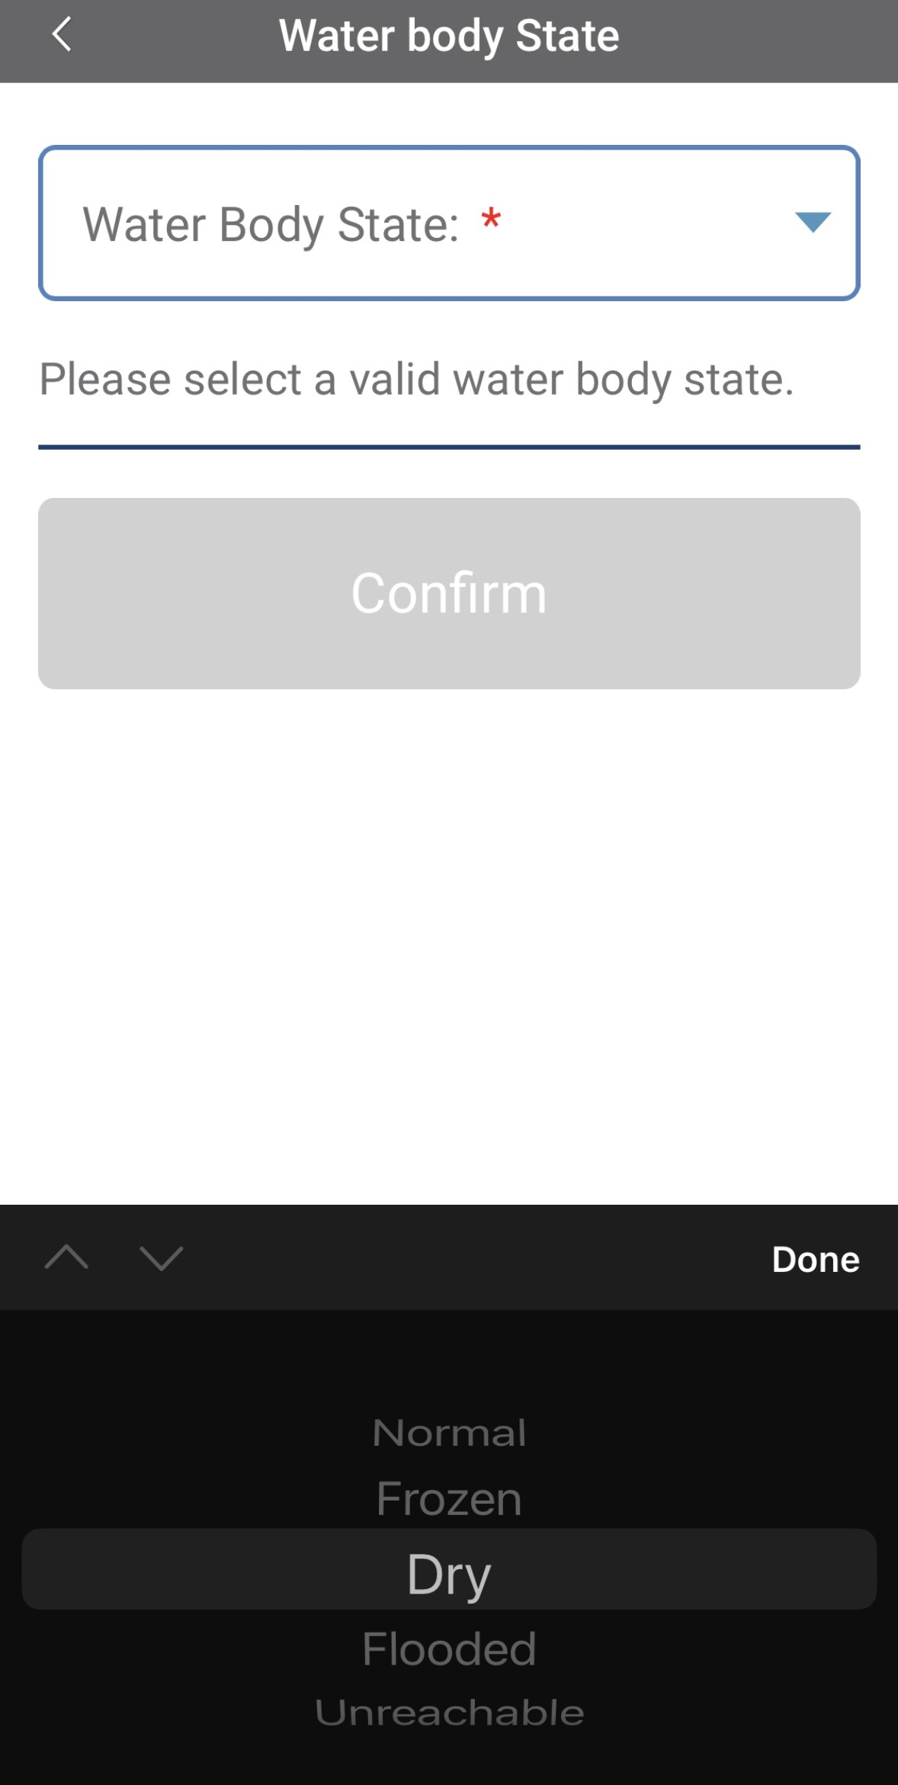
Enter the Water Body State
Select the Water Body State from the dropdown list of options.
Data entry is allowed only when the state is set as “normal.” If the water body is dry, frozen or flooded, the system will not allow the measurements to be entered.
32

Slide 33
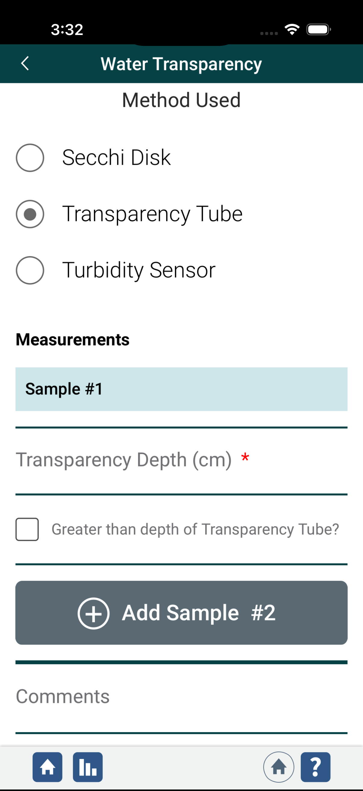
Enter Water Transparency Measurement Data
Select the method used to measure water transparency.
Enter the transparency depth measurement in cm.
If the water fills the tube and you can see the Secchi pattern at the bottom, click “Greater than depth of transparency tube.”
A new field will open and ask you to enter the length of the transparency tube.
33

Slide 34
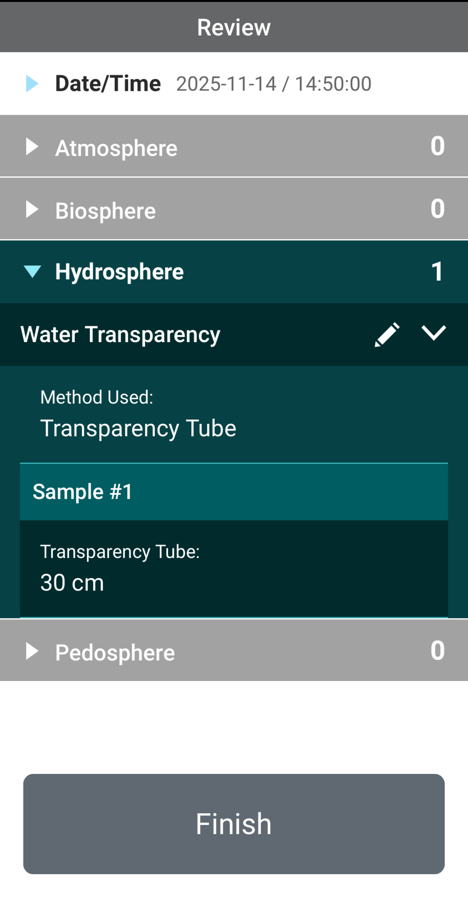
Review Data Entry and Send Data
Review the data you entered and check for errors.
When complete, select Finish to complete the send the observation to GLOBE.
34

Slide 35
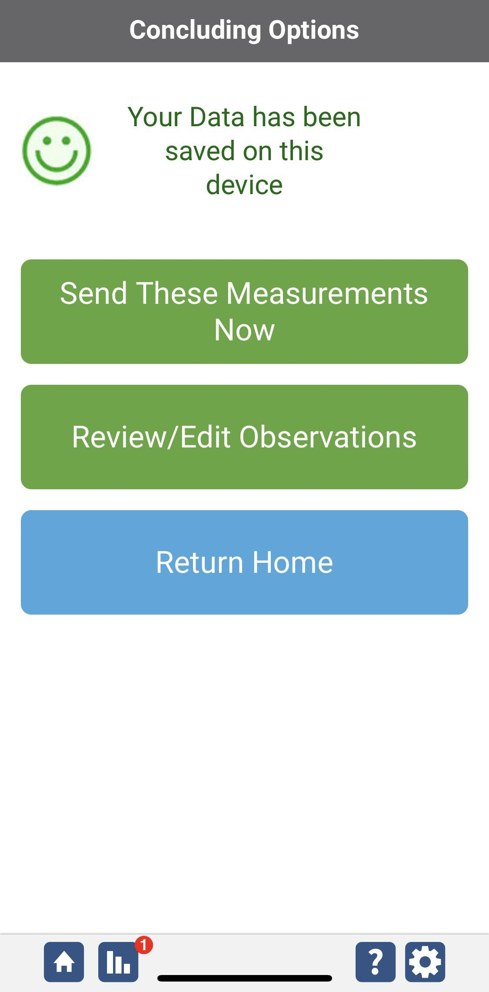
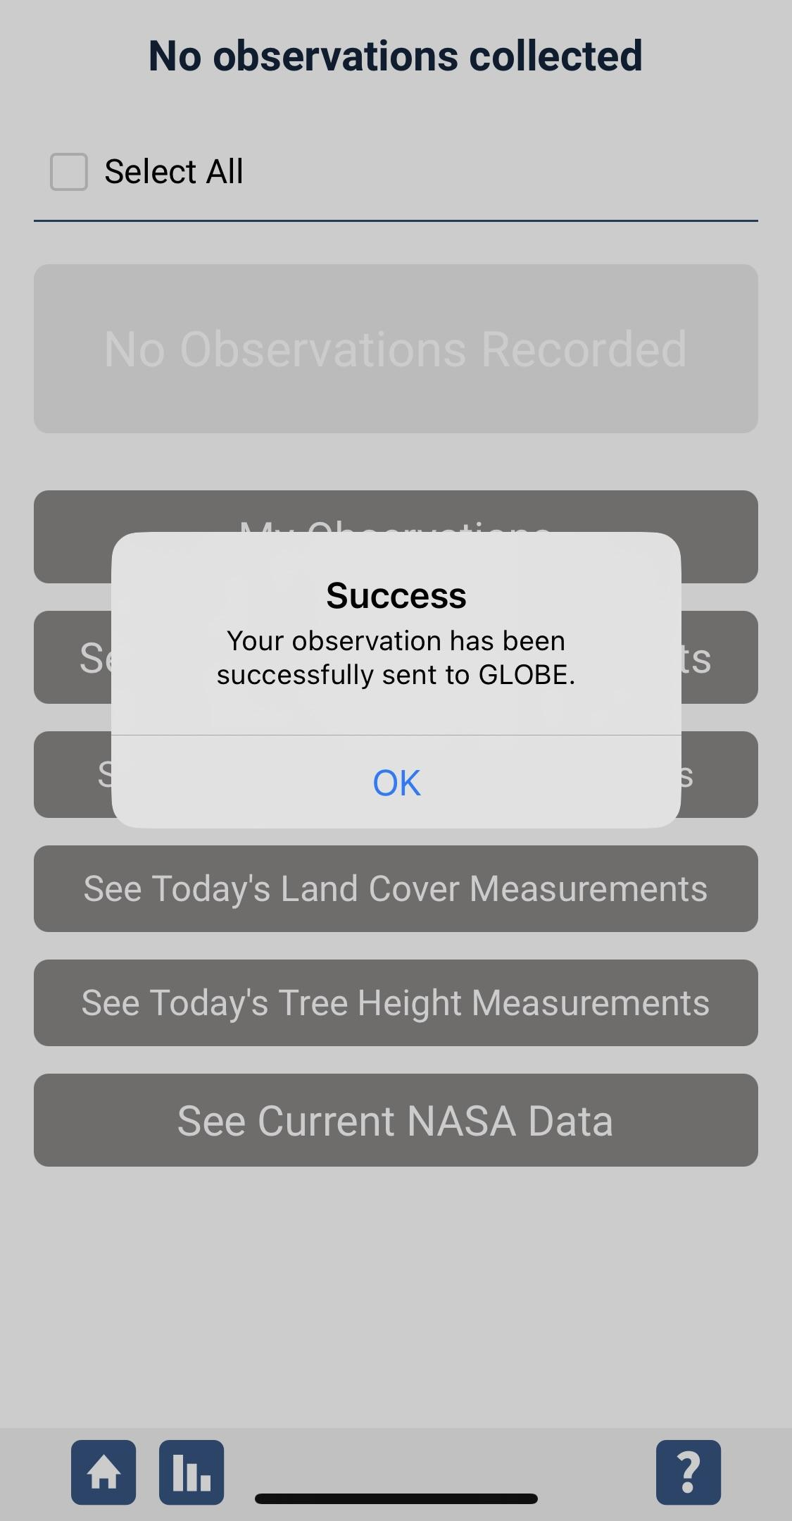
Data System Responses
If your observations are within the appropriate ranges, you will see a green smiley face.
You can review or edit your observation if needed.
When ready, select “Send these measurements now” to send your data to GLOBE. When it has been sent, you will see a “Success” message.
35

Slide 36
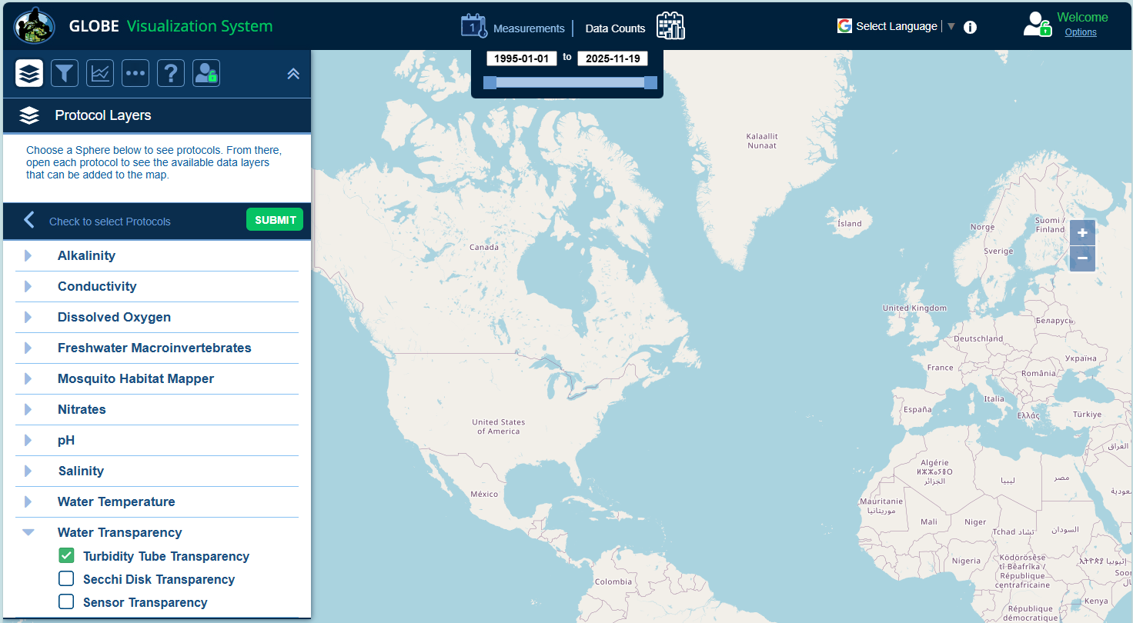
Visualize and Retrieve Data
GLOBE provides the ability to view and interact with data measured across the world. Select our visualization tool to map, graph, filter and export transparency tube data that have been measured across GLOBE protocols since 1995. Here is a screenshot of GLOBE’s Visualization System.
Select Turbidity Tube
Transparency from
drop down menu
Link to step-by-step tutorial on using the GLOBE Data Visualization Tool
36

Slide 37
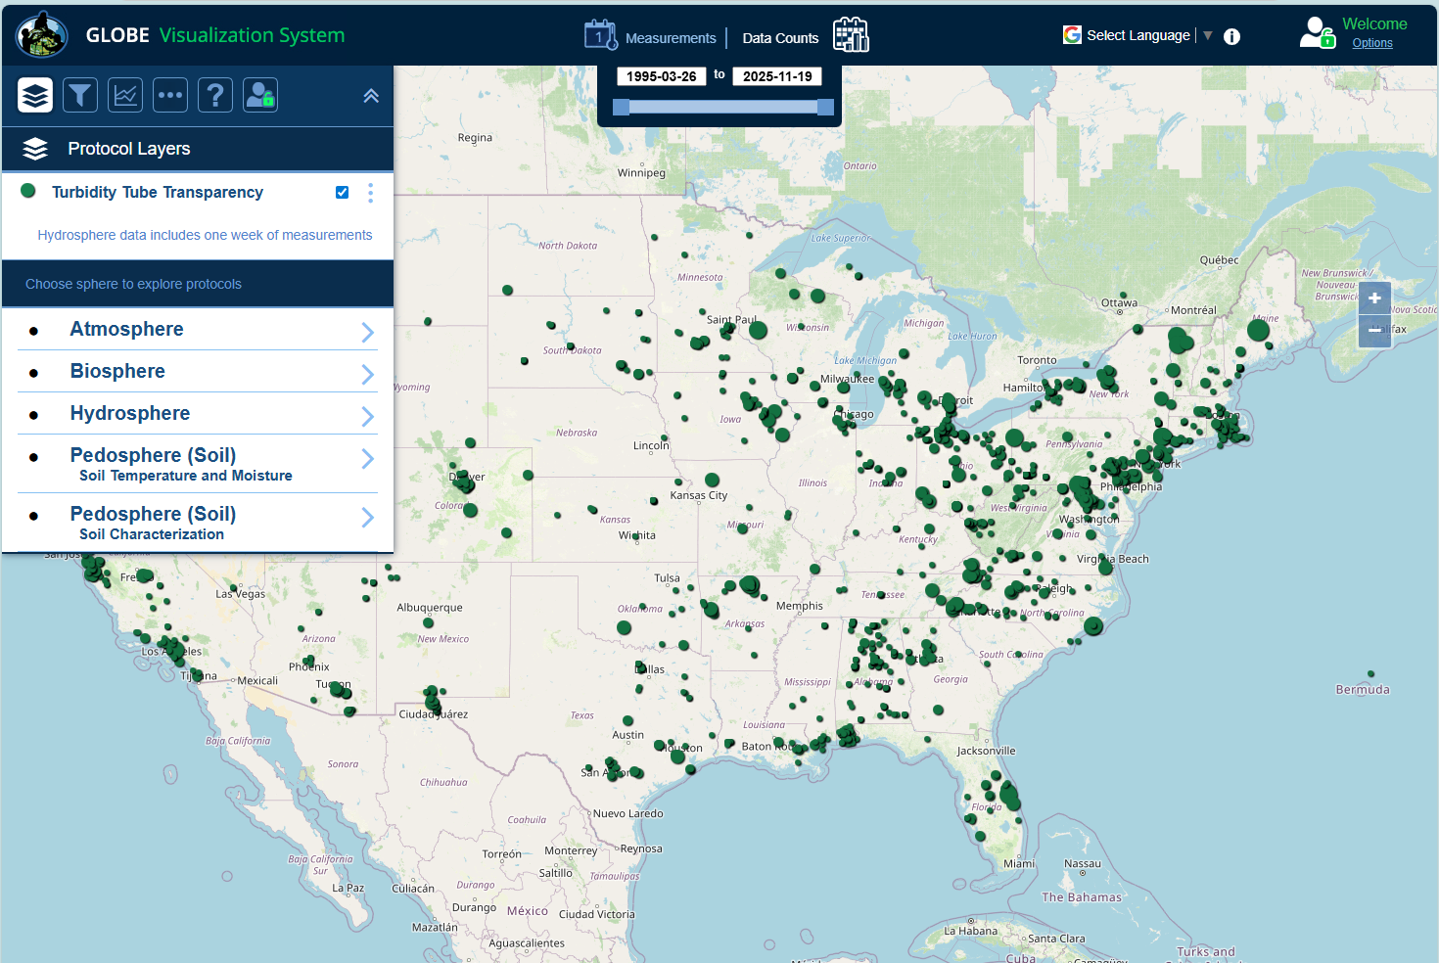
Visualize and Retrieve Data
Select the data for which you need Turbidity Tube Transparency data, add layer and you can see where data is available.
Locations where Turbidity Tube Transparency data is available for the week you selected
37

Slide 38
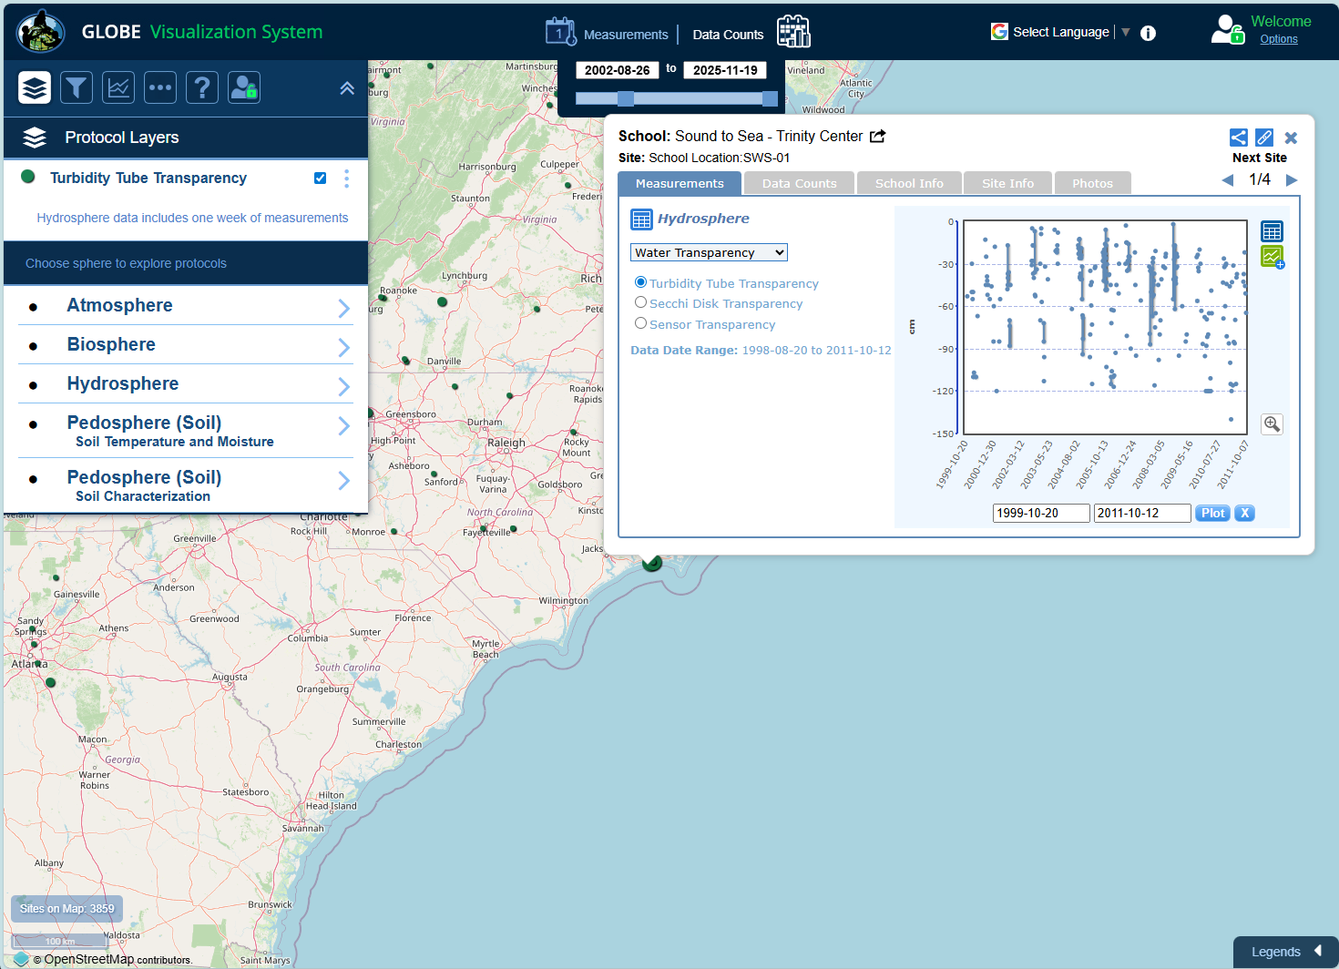
Visualize and Retrieve Data
Select the sampling site for which you need Turbidity Tube Transparency data, and a box will open with data summary for that site.
Pro Tip: Transparency values are positive. The Visualization system shows transparency depths as negative, yet the depth in cm in the tube is positive.
Clicking on a location will open to a map note providing Turbidity Tube Transparency data for that location and time.
38

Slide 39
Review questions to help you prepare to measure Water Transparency at your Hydrosphere Study Site
What does water transparency measure?
What kind of suspended particles are found in water bodies?
The absolute depth at which light can penetrate through a water column is called ______?
The more suspended particles, the (more/less) transparency.
When water is flowing or shallow, the appropriate transparency instrument is (Secchi disk/Transparency Tube).
Your three replicate measurements should be within _______cm of the mean.
Why do you need to take your transparency measurement in the shade?
Why is it necessary to describe cloud cover when taking transparency measurements?
What are some reasons water transparency measurements may change over the course of a year?
What safety precautions should you take prior to conducting any of GLOBE’s hydrosphere protocols?
39

Slide 40
You have now completed the slide stack. If you are ready to take the quiz, sign on and take the quiz corresponding to Water Transparency Tube Protocol.
You can also review the slide stack, post questions on the discussion board, or look at the FAQs on the next page.
When you pass the quiz, you are ready to take Water Transparency Tube Protocol measurements!
40

Slide 41
FAQ: Frequently Asked Questions
Question: Where are the measurements taken?
All hydrosphere measurements are taken at the Hydrosphere Study Site. This may be any surface water site that can be safely visited and monitored regularly from your school, although natural waters are preferred.
Sites may include (in order of preference):
1. stream or river
2. lake, reservoir, bay or ocean
3. pond
4. an irrigation ditch or other water body if none of the above options are accessible or available
41

Slide 42
FAQ: Frequently Asked Questions
Question: When are the measurements taken?
Collect all water measurements at roughly the same time each day, on a weekly basis. If your sampling site freezes over in winter or runs dry, be sure to enter this information each week until you again have free-flowing surface water to measure.
Note: Certain times of the year provide more exciting measurements. When runoff from a spring snowmelt is occurring on a river, the increased flow and sediment will dramatically change water measurements. One or more times a year, lakes can ‘turnover’ and the
waters in the lake totally mix. This can occur in spring after the ice melts. Turnover can cause surprising changes to your measurement
results. Be observant of seasonal and monthly changes. Use the Comments section of the GLOBE data entry pages to record observations that may help others interpret your water data.
42

Slide 43

We want your Feedback!
A. What is water transparency?
B. Why collect water transparency data?
C. How your measurements can help
D. How to collect your data.
E. Entering data on GLOBE Website.
F. Understand the data.
G. Quiz yourself
H. Additional
resources
Please provide us with feedback about this module. This is a community project and we welcome your comments, suggestions and edits! Please take a minute to comment here: Training@nasaglobe.org
Credits:
Slides:
Russanne Low, Ph.D., University of Nebraska-Lincoln, USA
Rebecca Boger, Ph.D., Brooklyn College, NYC, USA
Photos: Russanne Low
Art: Jenn Glaser, ScribeArts
More Information:
GLOBE Program, NASA Earth Science
NASA Global Climate Change: Vital Signs of the Planet
The GLOBE Program is sponsored by these organizations:
Version 11/18/25. Modified by GLOBE Implementation Office – Science, Training, Education, and Public Engagement. If you edit and modify this slide set for use for educational purposes, please note “modified by (and your name and date)" on this page. Thank you.
43

