Slide 1


Joint Research Project
“Seasons & Climate Studying”
Natalia Pustilnik, deputy country coordinator of GLOBE in Ukraine

Slide 2
Purpose
To compare observations of the beginning and the end of plant growing season for species which are native both to Israel and Ukraine and to exchange experiences between GLOBE students.
Duration: September, 2013 –May, 2014.
Participants: 2 groups of students from Ukraine and Israel aged 13-18 engaged in GLOBE Program and their teacher.

Slide 3
Stages
Choosing one (or several) specie(s) to observe from the suggested list of species native to Israel and Ukraine. Define the phenology site.
Observation of the green-down of the chosen plant, recording data and submitting it to the GLOBE archive.
Observation of the green-up of the chosen plant, recording data and submitting it to the GLOBE archive.
Doing the atmospheric observations measuring maximum, minimum and average temperatures and monitoring the amount of precipitation.
Presenting findings in the form of graphs and charts using GLOBE Visualization Tools or any other program (e.g. Microsoft Excel).

Slide 4
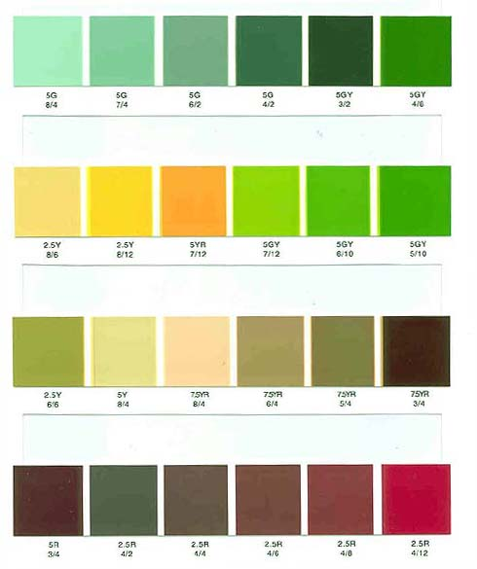
Methods
GLOBE Protocols and Sheets which you will need:
Green-Up and Green-Down Site Definition Sheet
Tree and Shrub Green-Down Data Sheet
Tree and Shrub Green-Down Protocol
Tree and Shrub Green-Up Data Sheet
Tree and Shrub Green-Up Protocol
Atmosphere Investigation Data Sheet
Atmosphere Investigation Protocol

Slide 5
Features
Studying the same species students can make conclusions about local climate conditions and compare them to climate conditions in other country.
The project provides opportunity to conduct a long-term research
Students and teachers can study the changes in plant growing cycles in time and how they relate to climate change
Compare your data with archive temperature data and draw conclusions about changing of the temperature

Slide 6
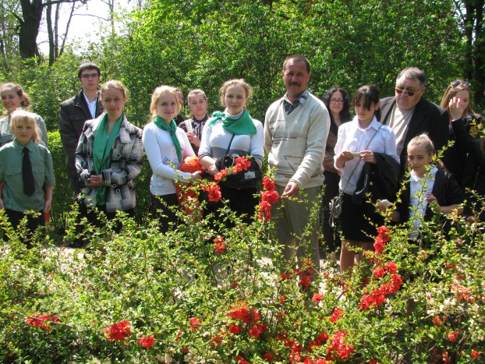
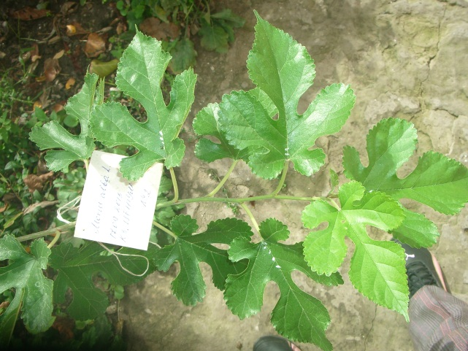
Ukrainian GLOBE school
Our students started collecting data on 17 September 2013.
The objects of research:
  Robinia pseudoacacia – black locust or false acacia;
  Morus alba L. – white mulberry.
Phenological observations are taken every Friday.
Atmospheric measurements are taken every day

Slide 7
Results for the students
Students will learn to compare phenology cycles, green-up and green-down peculiarities of the same species in Israel and Ukraine and identify the reasons for their differences;
Examine the relationships between local climate conditions and plant growing cycle;
Learn to make conclusions from their observations and predict long-term consequences
Students can use their data for scientific projects
Share observations by submitting data to the GLOBE archive.

Slide 8
Results for teachers and schools
For the teachers
Collaboration with colleagues from other GLOBE schools;
Sharing the experience on GLOBE program;
An opportunity to create new researches and offer their ideas about the future of the project.
For schools (or other educational institutions) of both countries
Sharing the experience on GLOBE program with other schools;
GLOBE Program development and its promotion among teachers and students;
Possibility of long-term cooperation with foreign counterparts.

Slide 9
Contacts
Natalia Pustilnik – deputy Country Coordinator of GLOBE in Ukraine
Email: natalipustilnik@gmail.com, inter@nenc.gov.ua
Tel: +380679491756, Skype: nata_pustilnik

