Slide 1
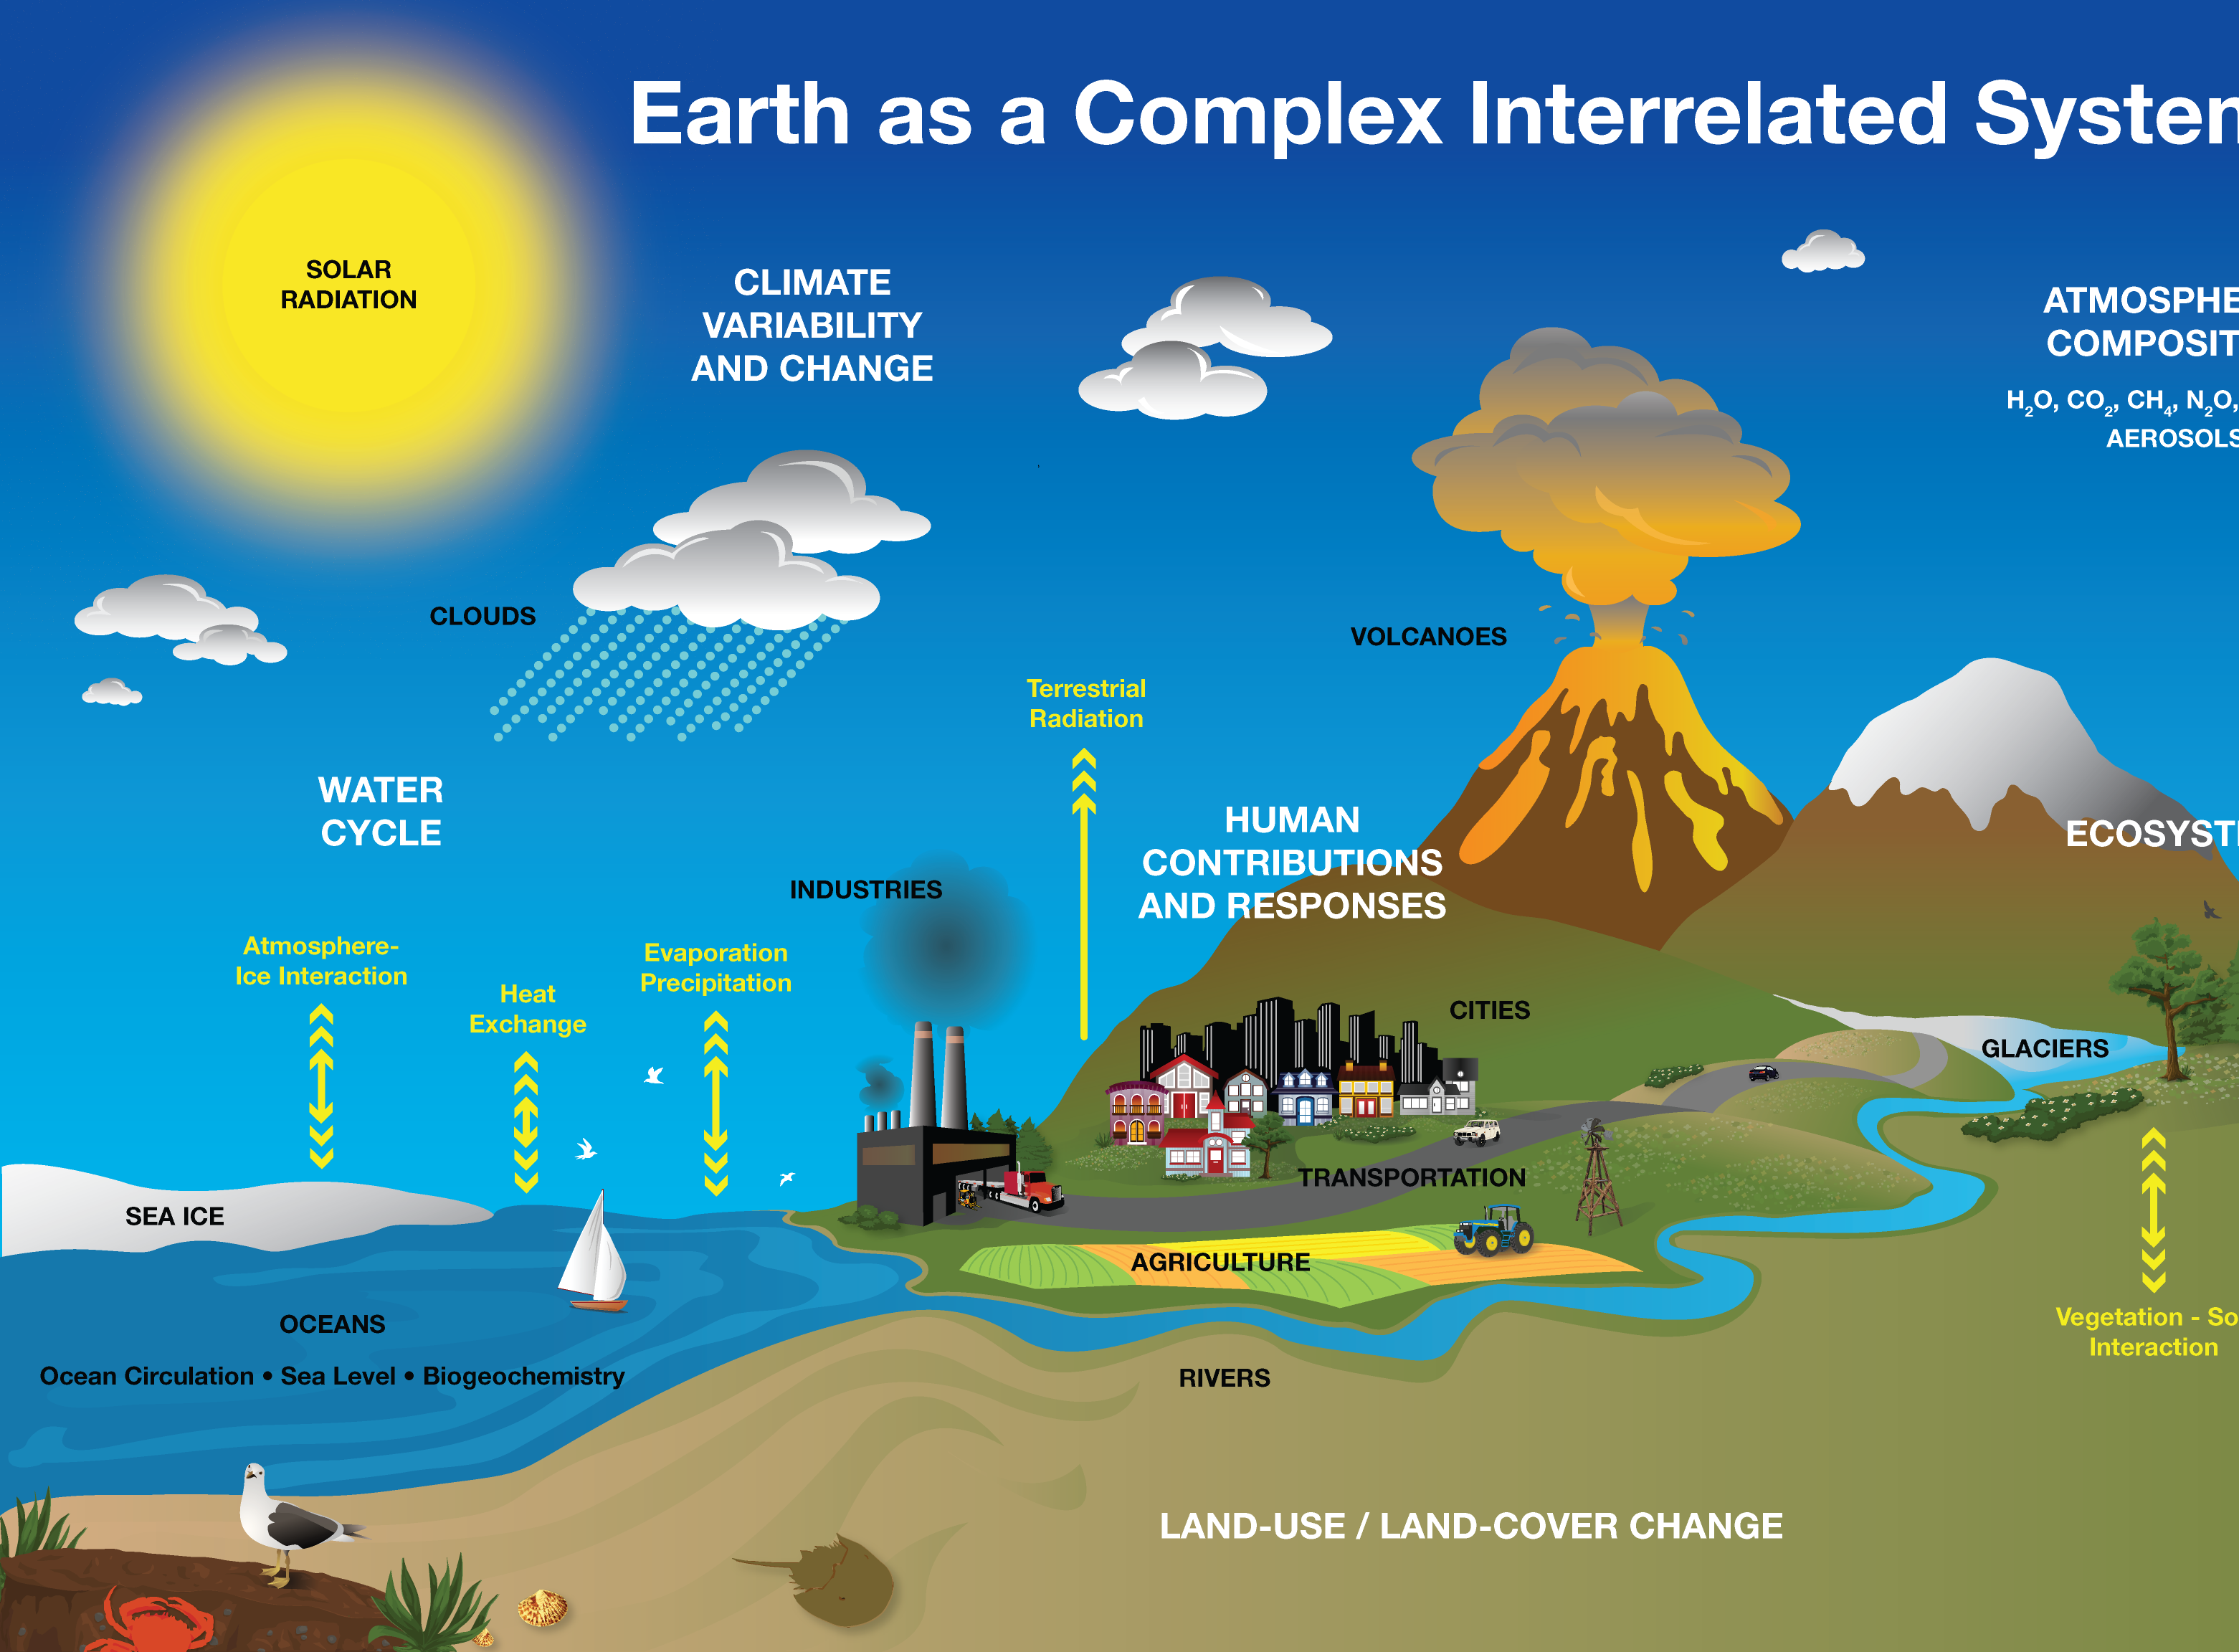
OŠ Šime Budinića Zadar, Croatia
Activity 2 –
Carbon Around Me

Slide 2
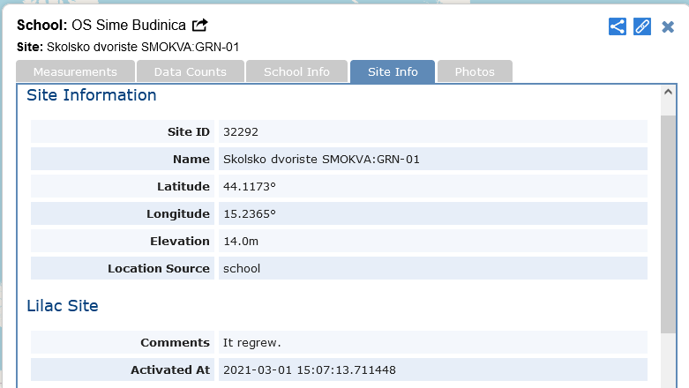
Site Name: Skolsko dvoriste SMOKVA: GRN-01
GPS coordinates
N 44.1173
E 15.2365
Lilac tree
Latin name: Lilac (Syringa vulgaris L.)

Slide 3
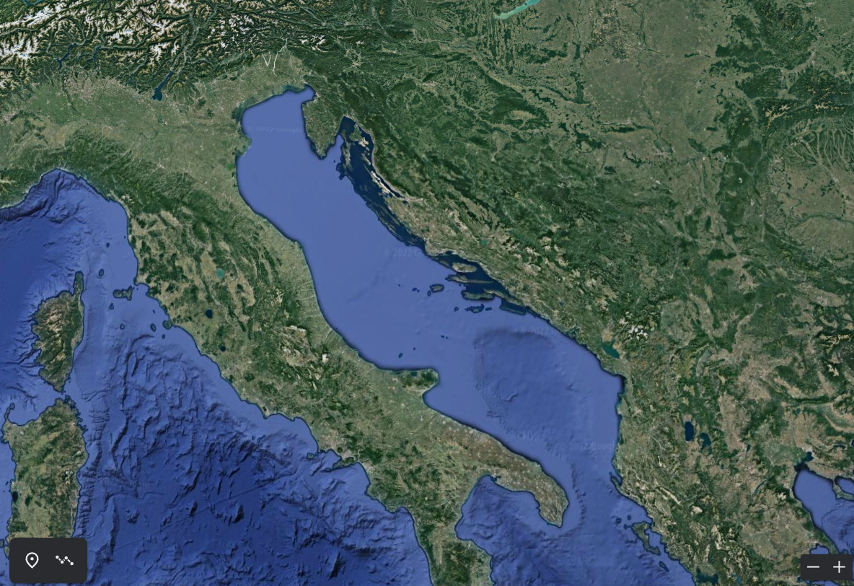
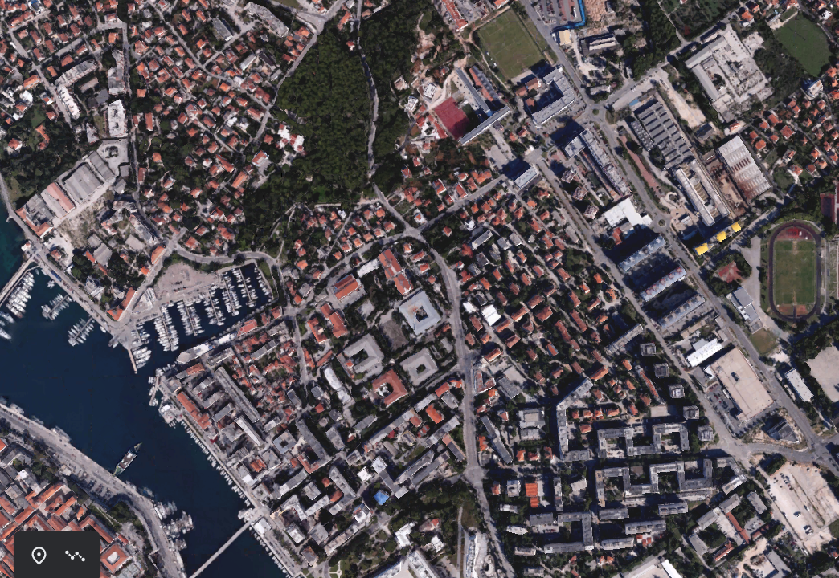
Google Earth

Slide 4
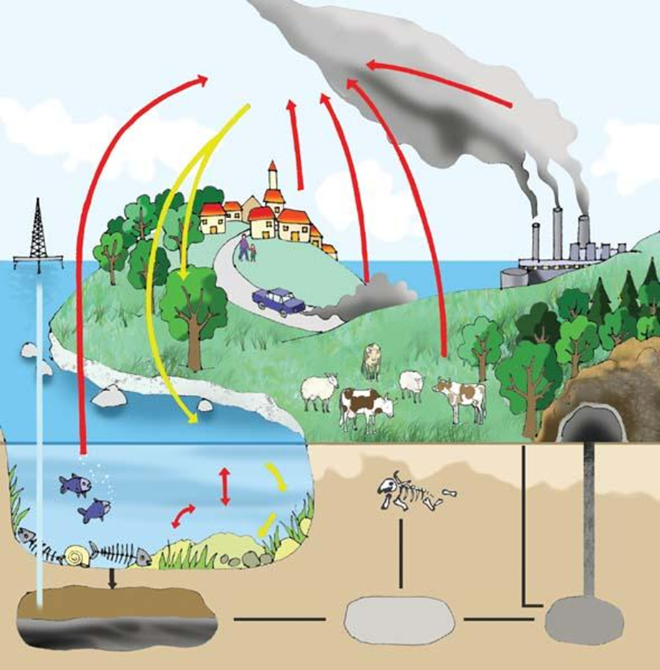
Legenda
CO₂ - disanje biljaka, životinja, ljudi, razgradnja i ispušni plinovi
O₂ - fotosinteza biljaka i algi

Slide 5
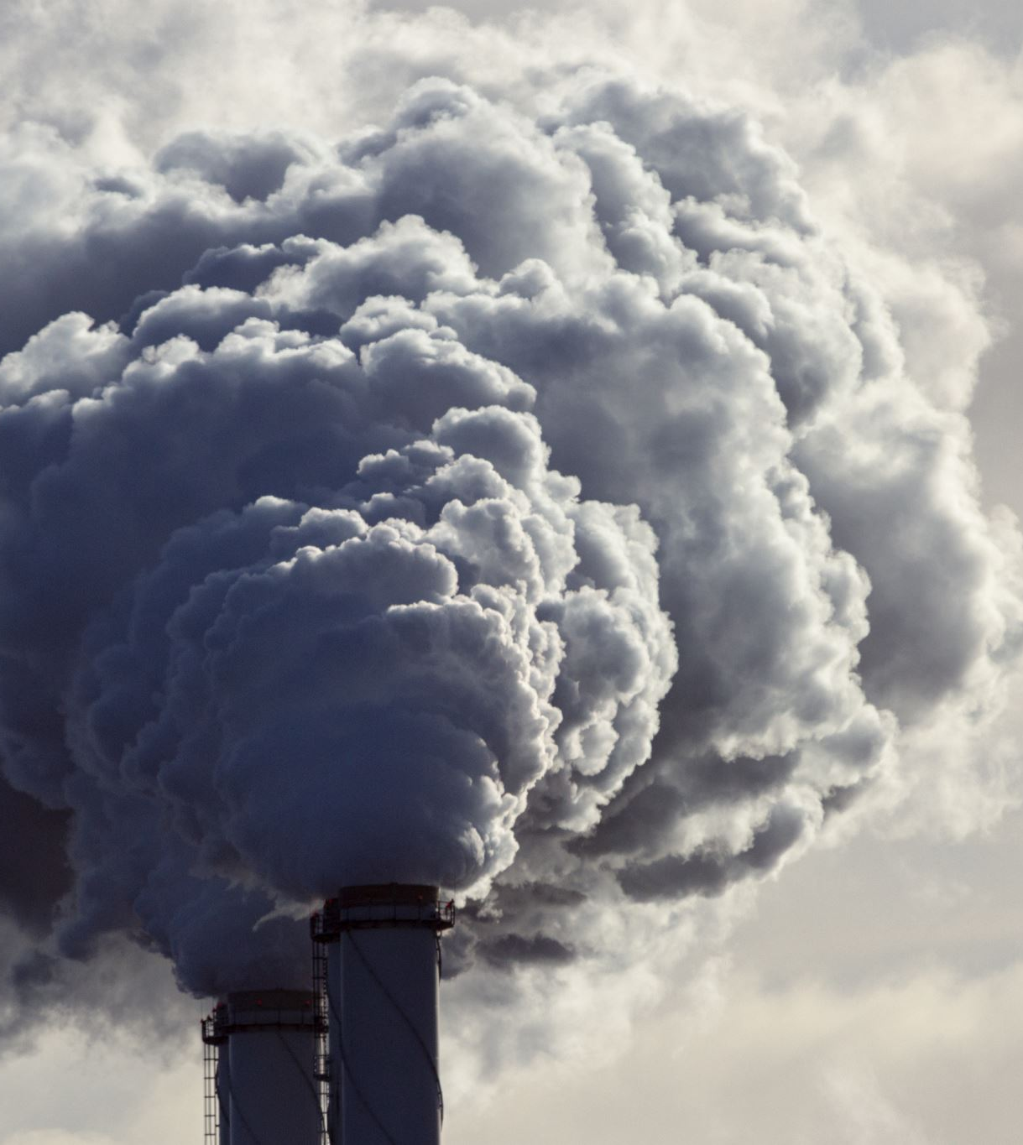
Greenhouse effect We researched
Greenhouse effect
The amount of carbon monoxide in the atmosphere increases sharply after the industrial revolution mainly due to the excessive combustion of fossil fuels.
Gas lets solar energy through the atmosphere to the Earth’s surface but makes it difficult for heat energy to escape from the atmosphere and causes it to return to Earth.
Gases with such a property are called greenhouse gases, and the phenomenon of heat retention is called the greenhouse effect.

Slide 6
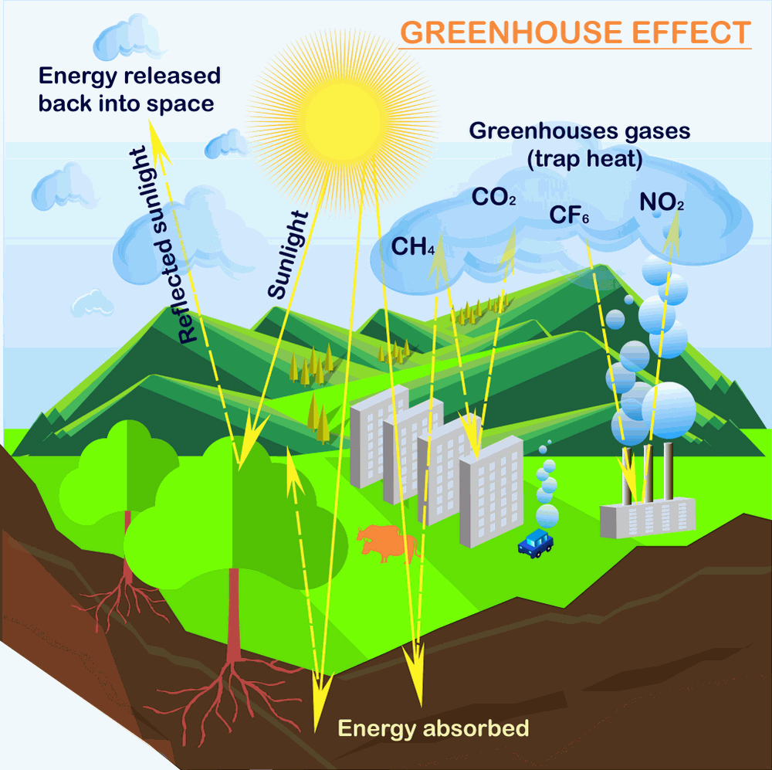
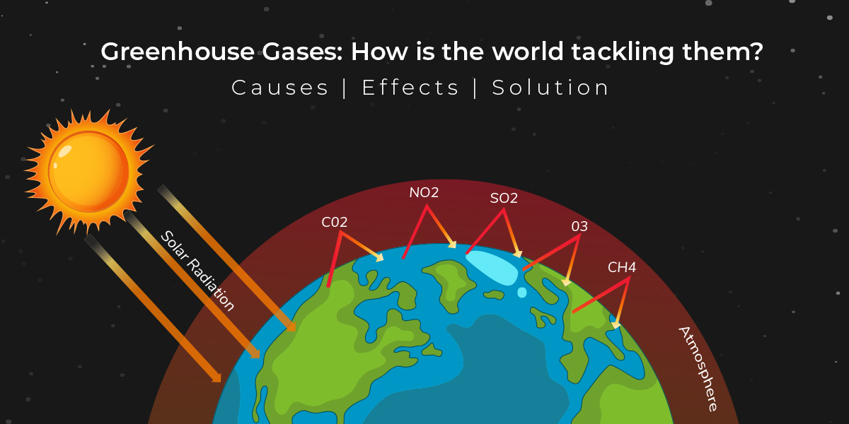

Slide 7
We studied
Link:
https://svs.gsfc.nasa.gov/10494
https://svs.gsfc.nasa.gov/12066
https://svs.gsfc.nasa.gov/12044

