Slide 1
OŠ Šime Budinića Zadar, Croatia
http://www.tree-guide.com/tree-age-calculator
Activity 3 –
First Leaves

Slide 2
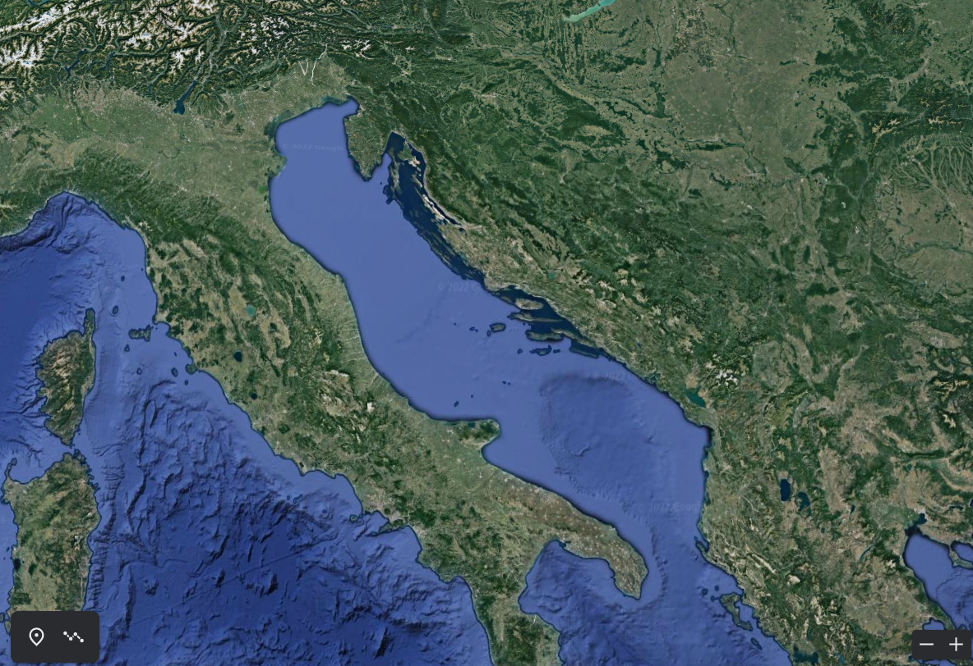
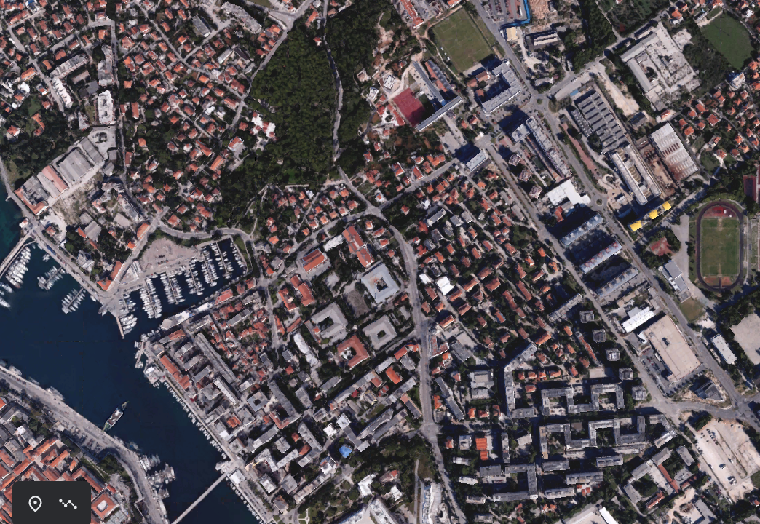
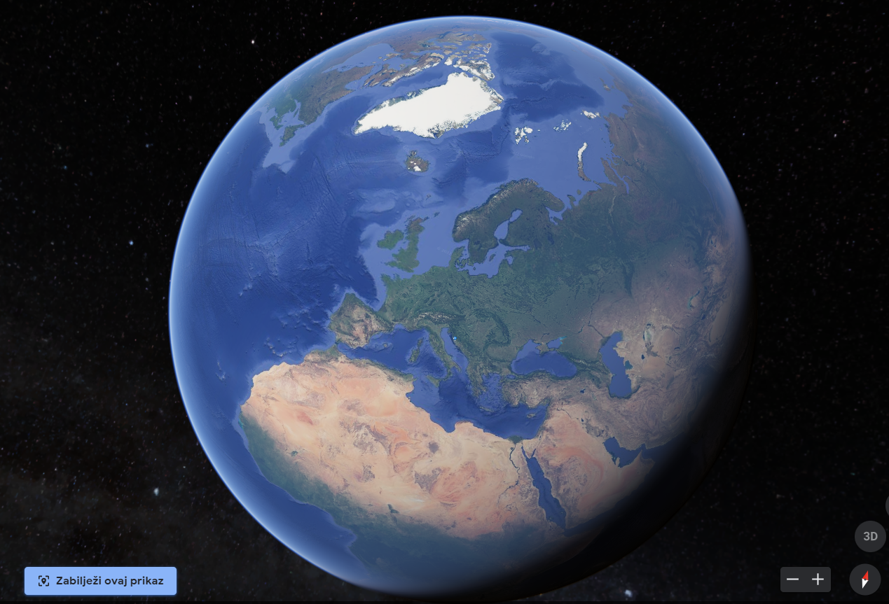
Google Earth

Slide 3
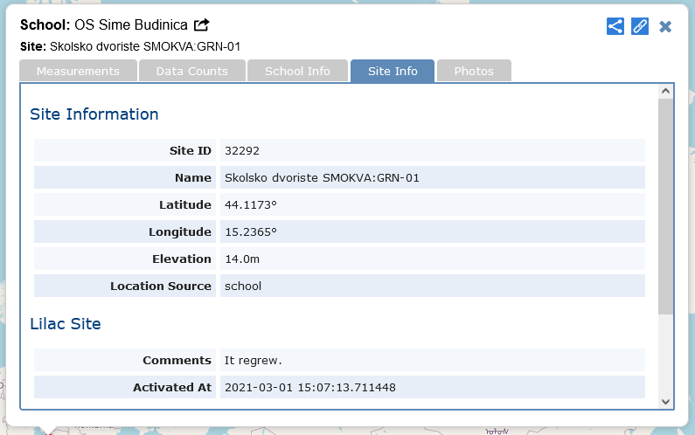
Site Name:
Školsko dvorište - SMOKVA 2: GRN – 01
GPS coordinates
N 44.1173
E 15.2365
Lilac tree
Latin name:
Lilac (Syringa vulgaris L.)

Slide 4
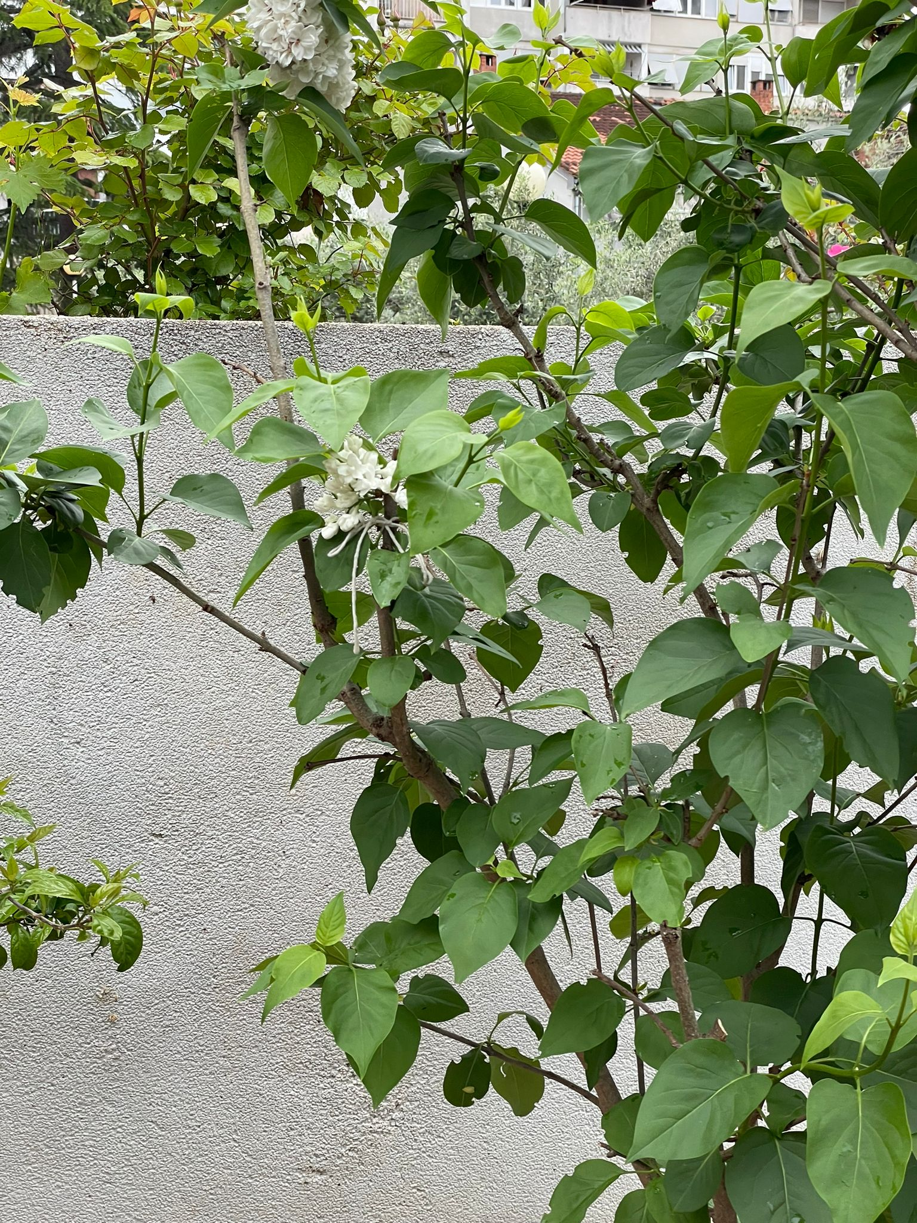
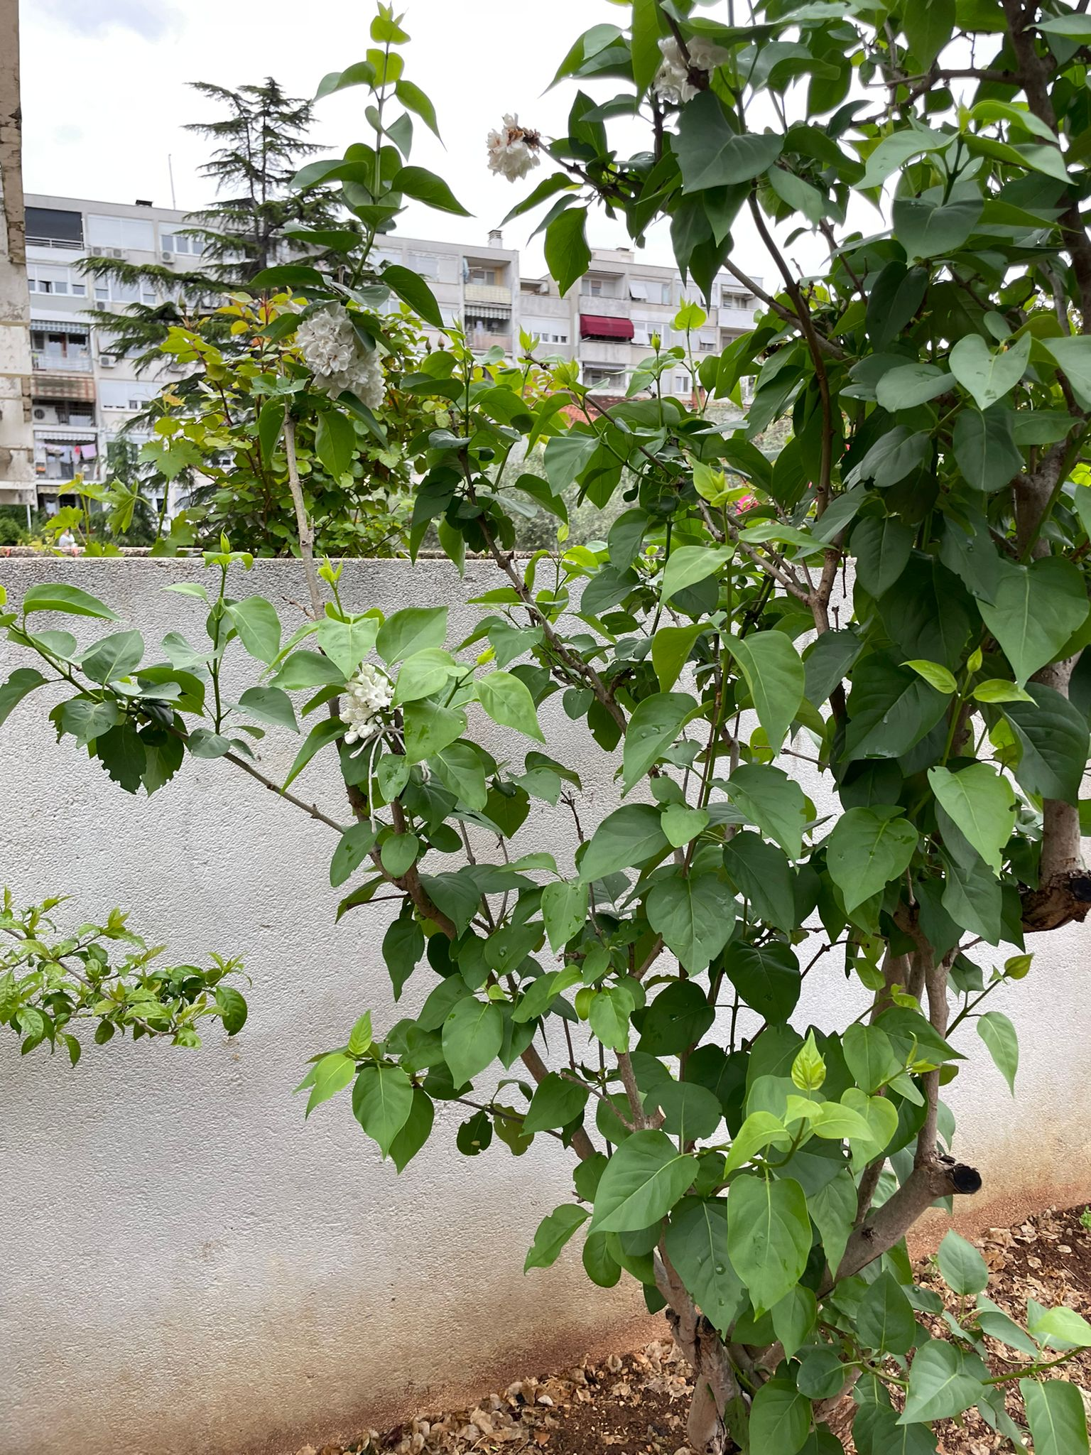
12.4.2023.

Slide 5
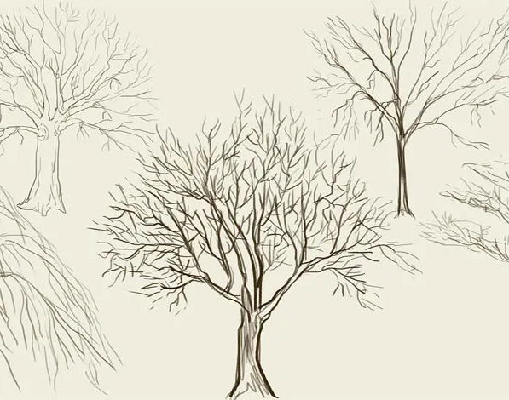
Carbon in my Tree

Slide 6
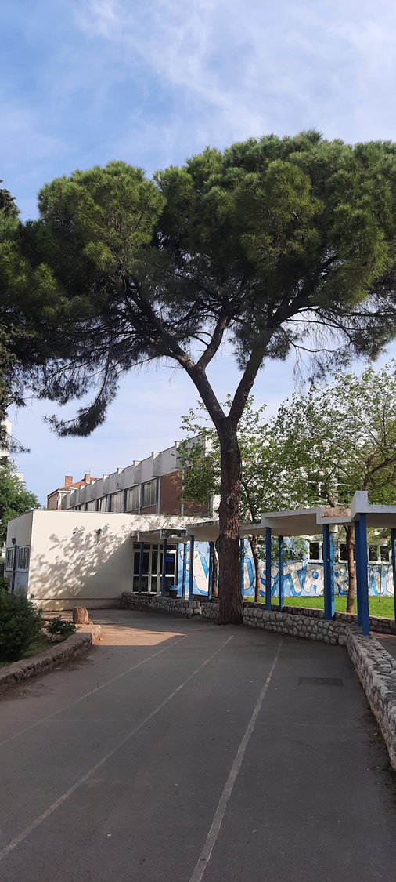
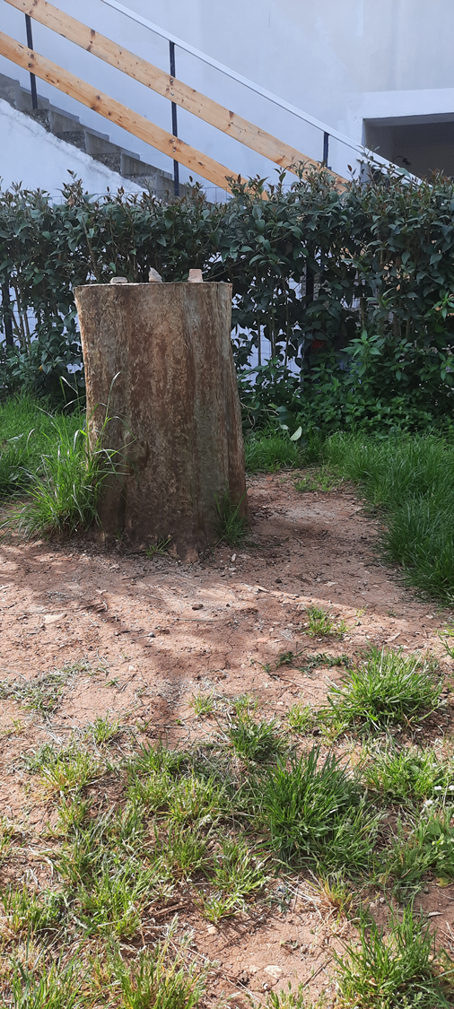
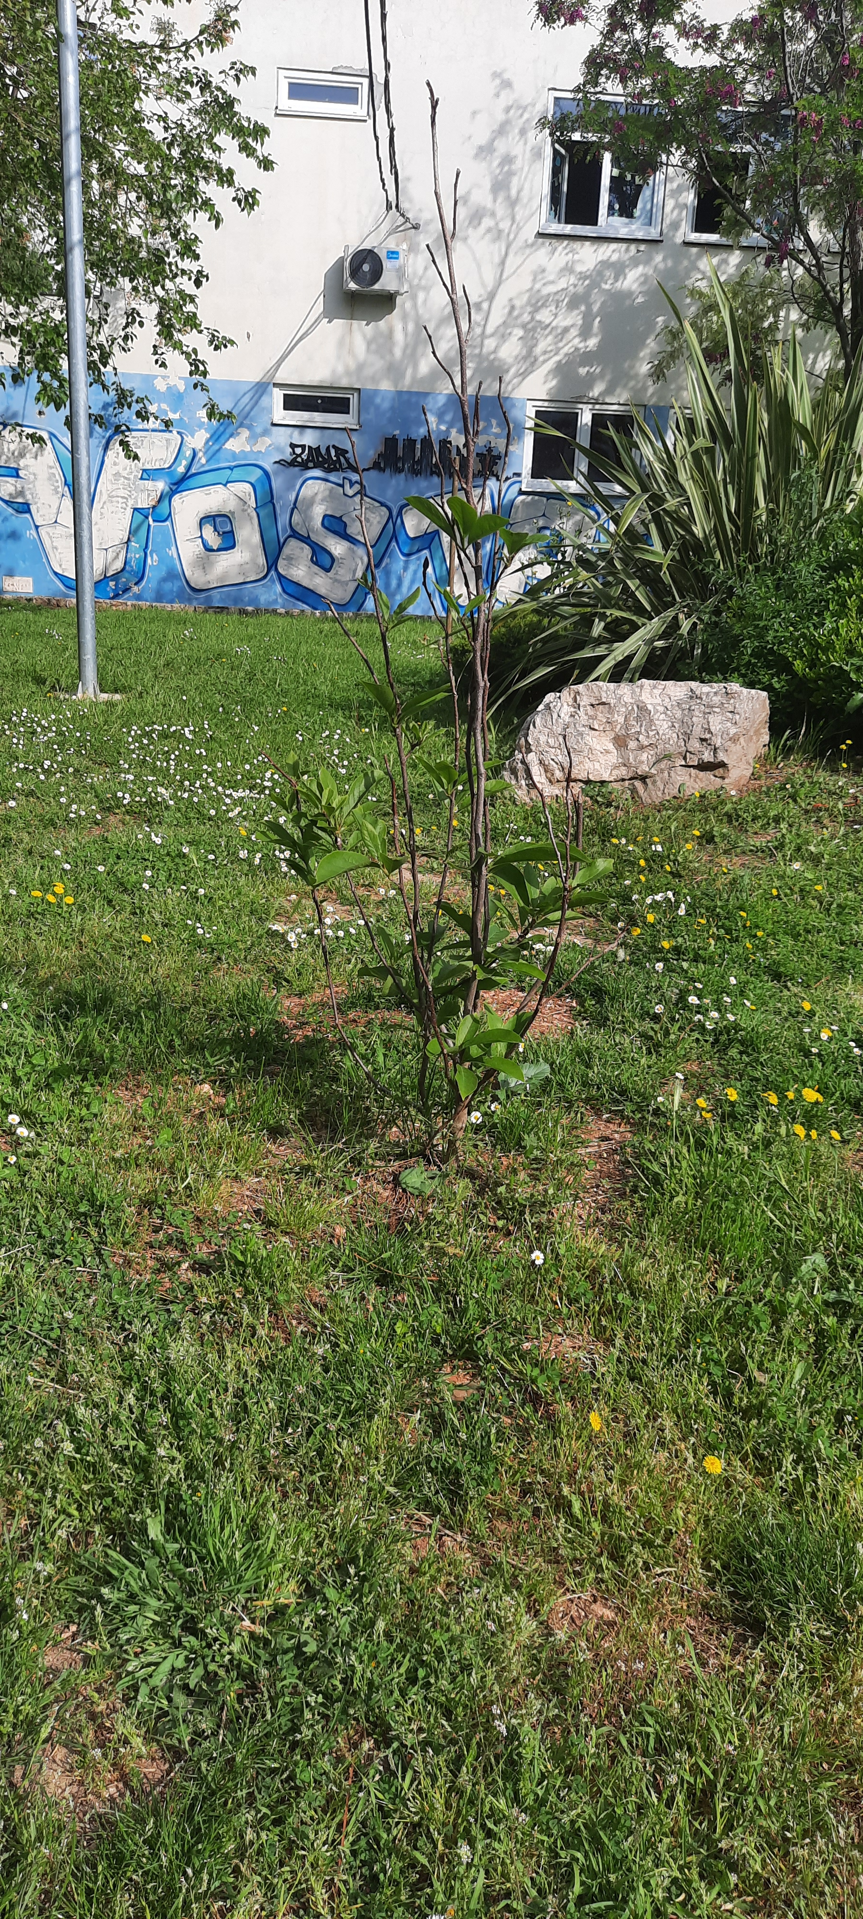
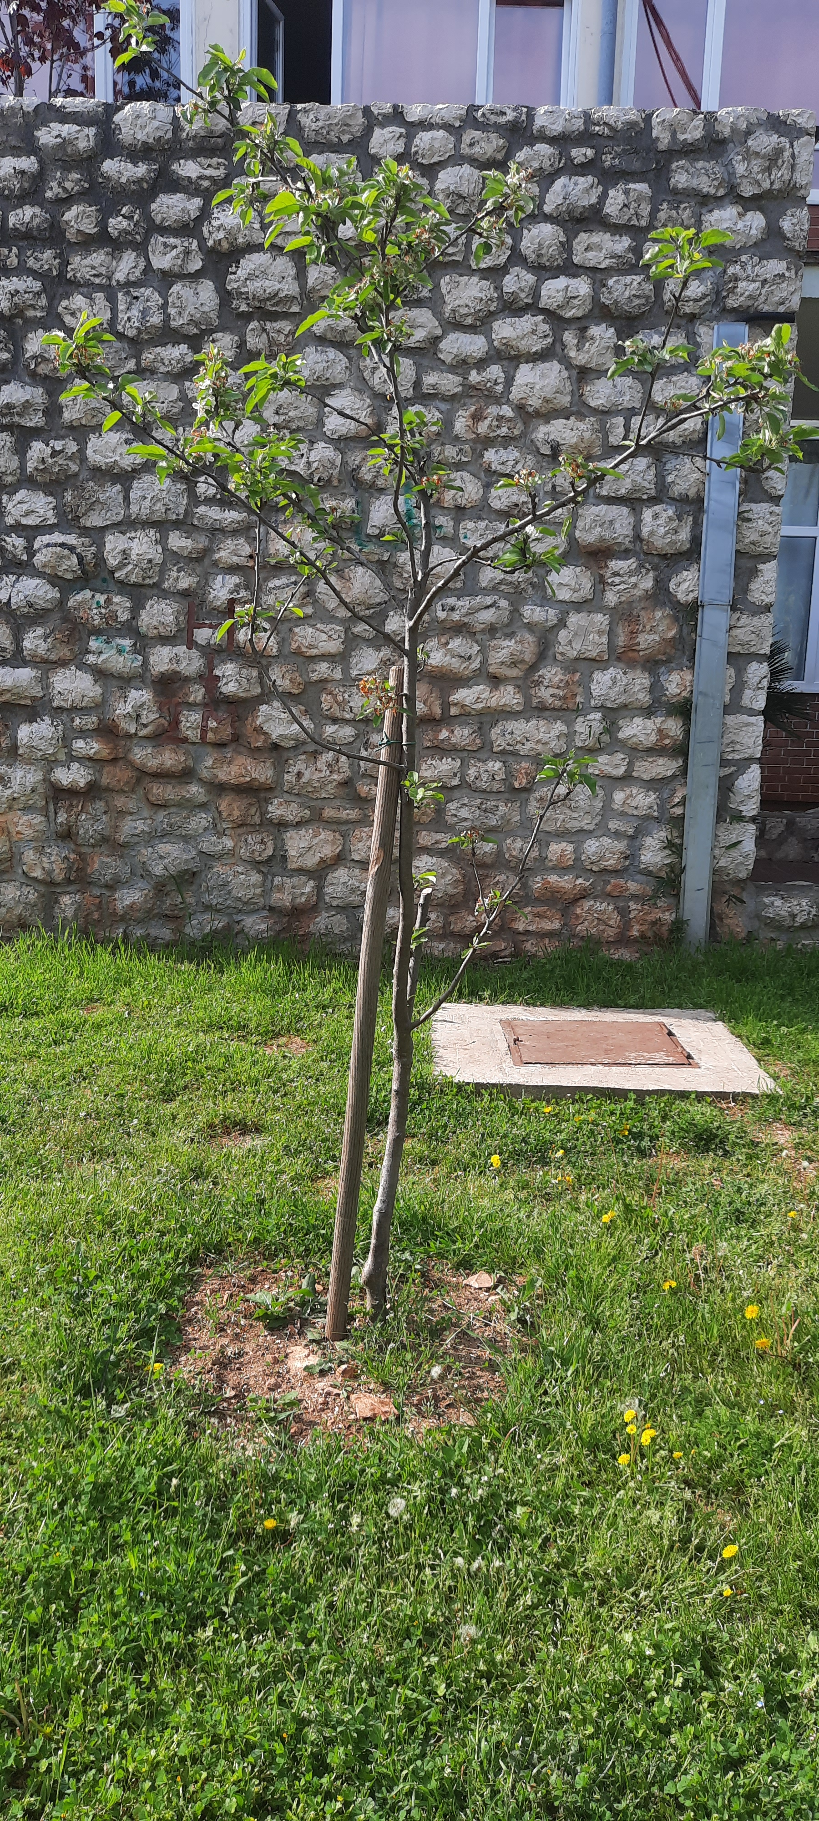
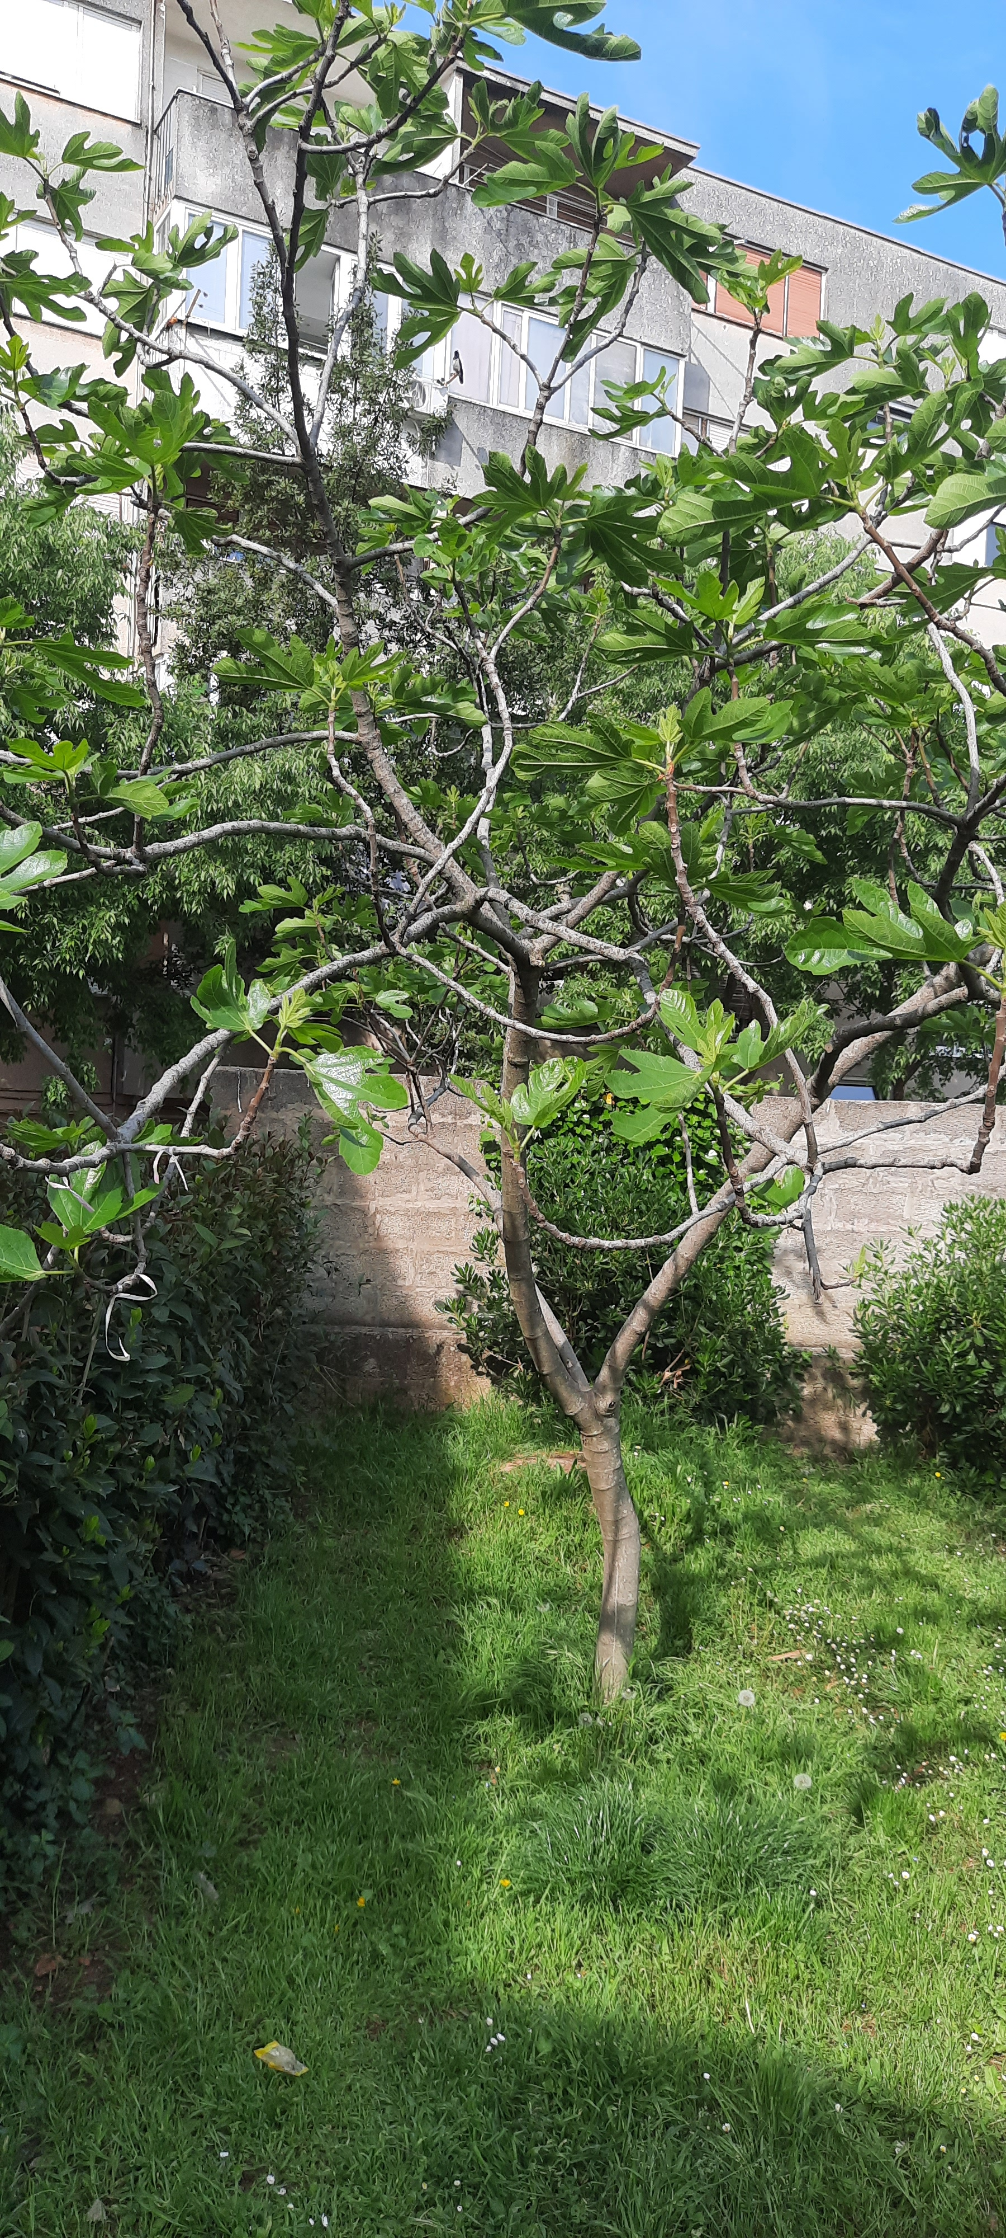
Trees in our school yard
1) young tree 2) mature tree 3)very old tree 4) dead tree

Slide 7
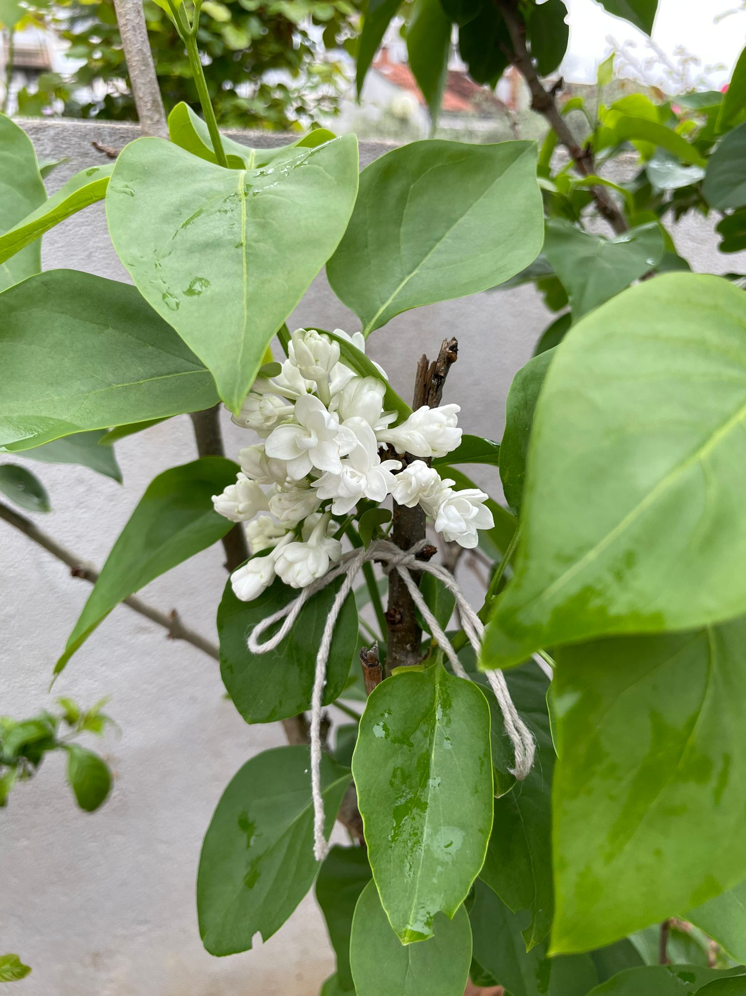
My tree is five years old.

