Slide 1
EUROPEAN PHENOLOGY CAMPAIGN
AUTUMN 2020 / ACTIVITY 3
ELEMENTARY SCHOOL RUGVICA, CROATIA

Slide 2
This year in september -the European Phenological Campaign
We measured the height of all the trees (using app Globe observer) and used the GrowApp app for all the trees.
7 to 13 observations, depending on whether the leaves have already fallen off the tree
We observe a change in leaf color at least twice a week or more often
We used GrowApp for every tree that we observed
COLLABORATION
Ivano-Frankivsk City Environmental Station – we compare birch, lime and cherry
The Ante Kuzmanić Medical School in Zadar - we compare the fig tree

Slide 3
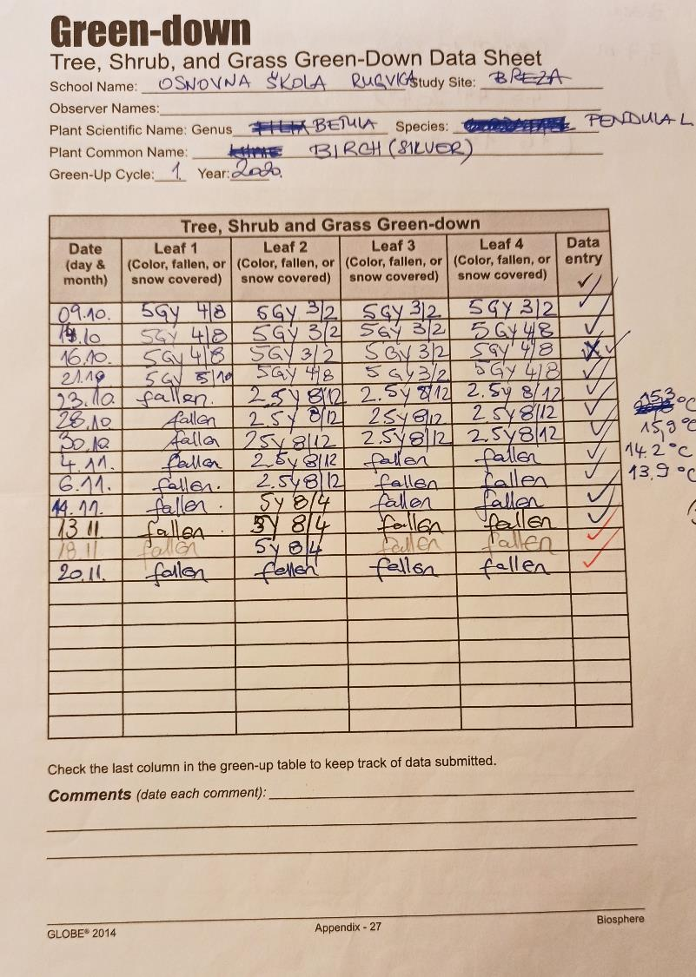
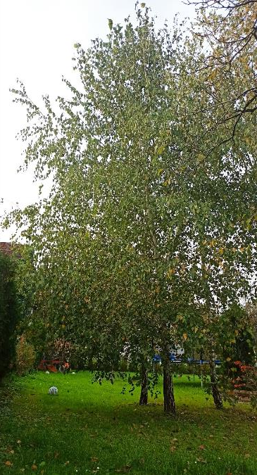
# BIRCH #BREZA
TREE HEIGHT: 7,7 m
LATITUDE: 45°44’20.4’’
LONGITUDE: 16°13’36.84’’

Slide 4
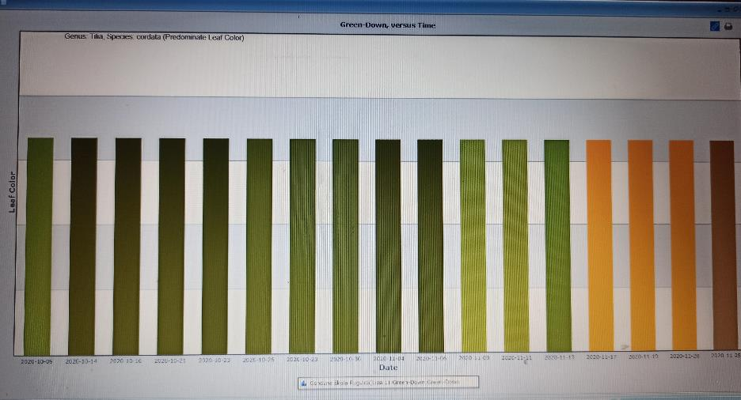
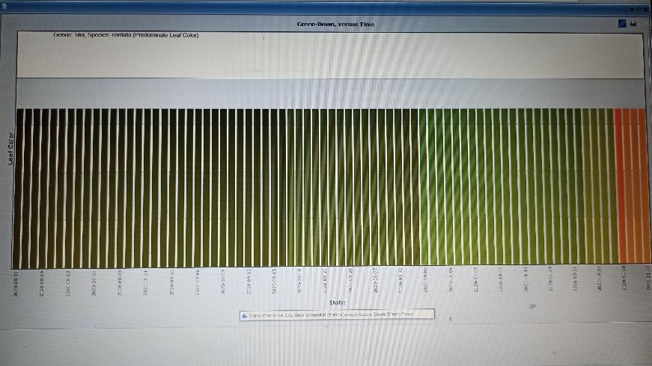
#TILIA #LIPA 1
TREE HEIGHT: 8.26 m
Latitude: 45°45’3.6’’
Longitude: 16°13’51.96’’
IVANO FRANKIVSK CITY ENVIRONMENTAL STATION, UKRAINA

Slide 5
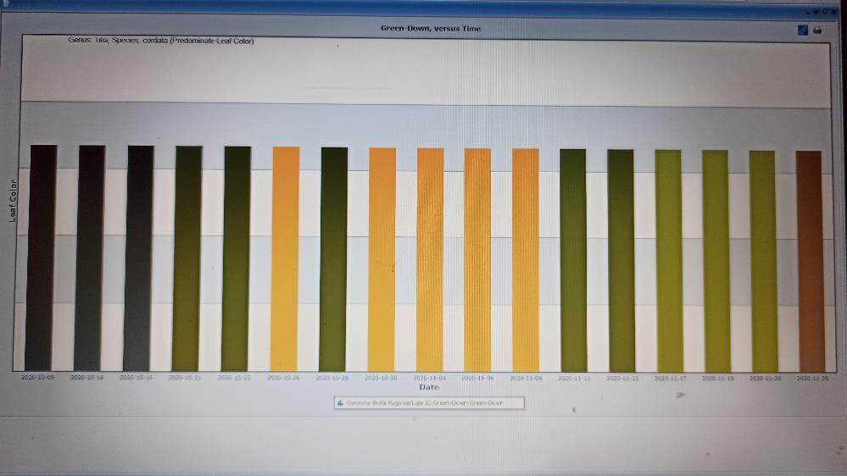
# TILIA #LIPA 2
TREE HEIGHT: 5,49 m
LATITUDE:
45°45’3.6’’
LONGITUDE:
16°13’53.4’’

Slide 6
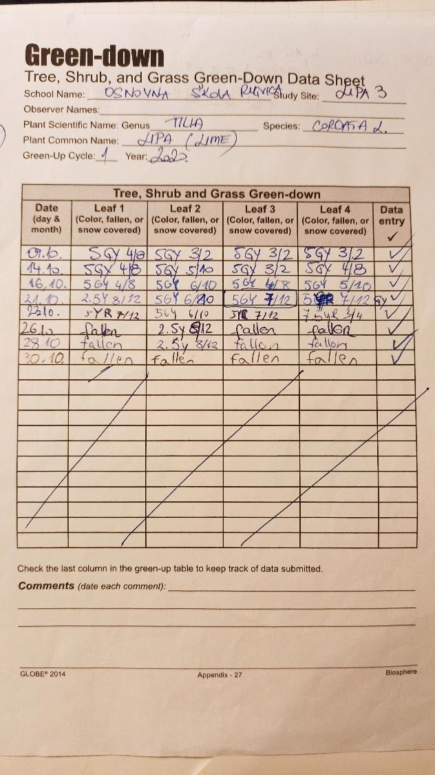
#TILIA #LIPA 3
TREE HEIGHT: 4,16m
LATITUDE:
45°45’5.76’’
LONGITUDE:
16°13’49.8’’

Slide 7
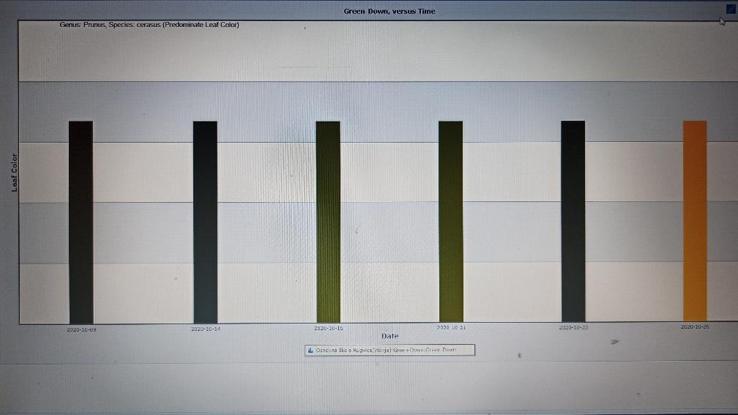
# PRUNUS #VIŠNJA
LATITUDE:
45°45’5.76’’
LONGITUDE:
16°13’52.32’’
TREE HEIGHT: 6,69 m

Slide 8
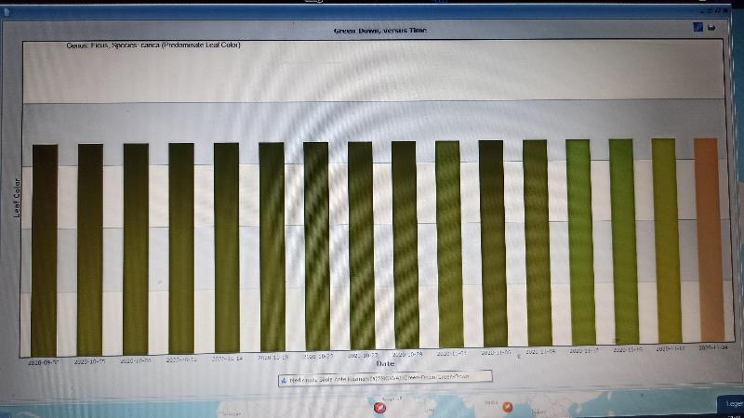
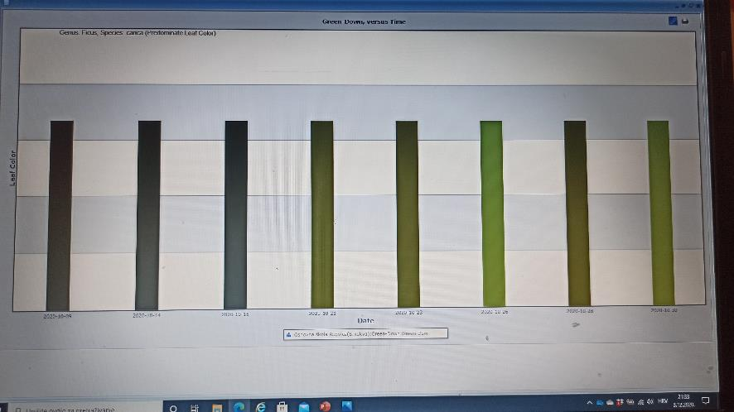
#FIG #SMOKVA
MEDICINSKA ŠKOLA ANTE KUZMANIĆA, ZADAR (CROATIA)
TREE HEIGHT: 3,26 m
LATITUDE: 45°45’6.12’’
LONGITUDE: 16°13’51.6’’

