Slide 1

The GLOBE Program
EUROPEAN
PHENOLOGY
CAMPAIGN
AUTUMN 2020 – ACTIVITY 3

Slide 2

Secondary Medical school Ante Kuzmanić Zadar, Croatia
Latitude: 44.1138
Longitude: 15.2372
Elevation: 8m
Notes:
<number>

Slide 3
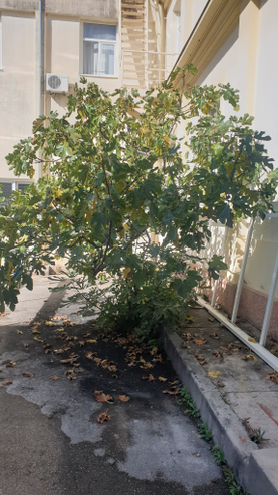
We observe a fig tree in our school yard
The height of our fig tree we measured using the app Globe observer
we observed it two times a week
we also used the GrowApp
-TREE HEIGHT: 4,69 m
Latitude: 44.1138
Longitude: 15.2373
Elevation: 8m
#FIG #SMOKVA

Slide 4
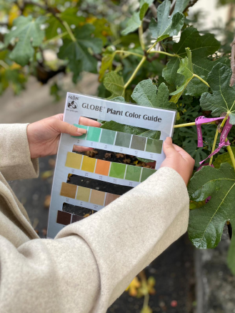
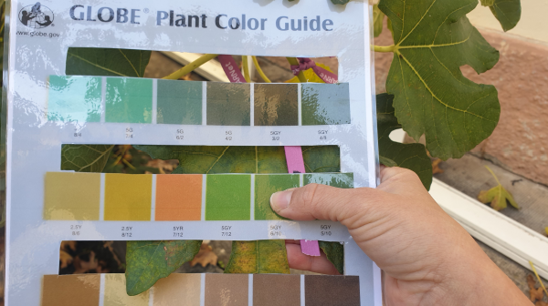
COLLABORATION:
Elementary school Rugvica, Croatia

Slide 5
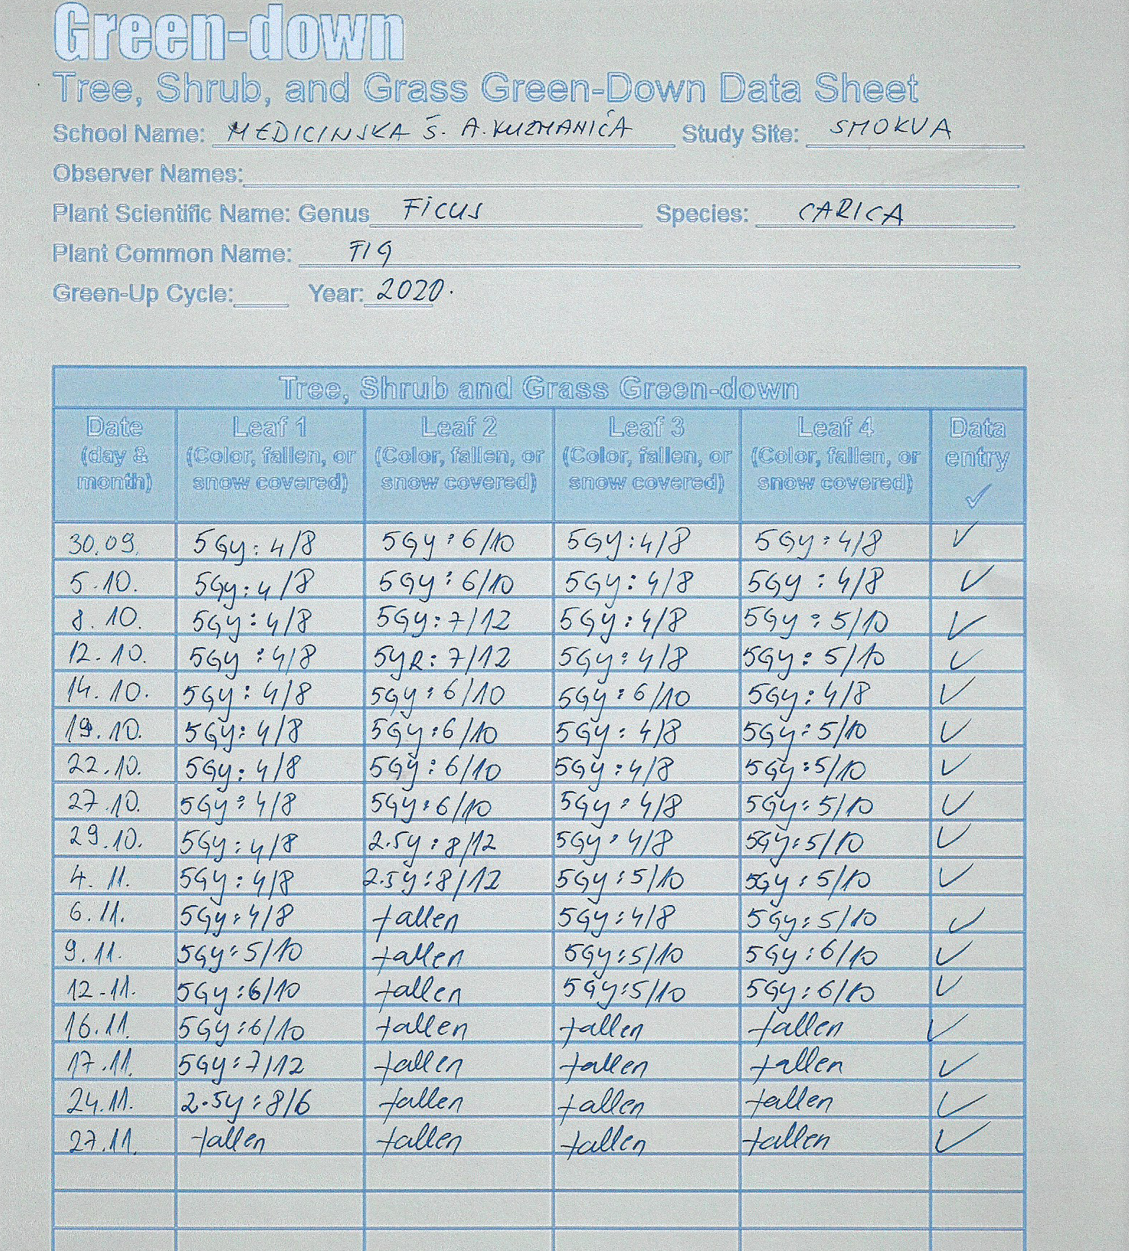
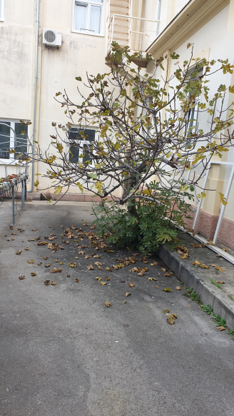
#FIG #SMOKVA

Slide 6
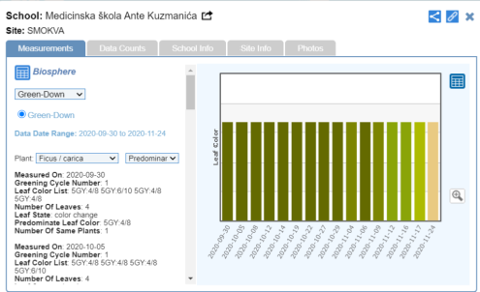
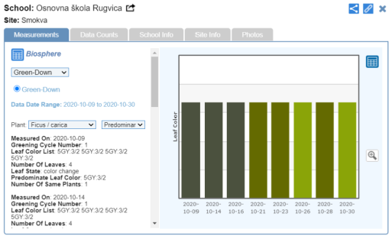
Secondary Medical school Ante Kuzmanić Zadar
Elementary school Rugvica, Croatia

