Slide 1
Hi
Students from Elementary school Štefcova

Slide 2
Introduction
Hi, welcome to Elementary school Štefcova
Our school is located in Hradec Králové
At our school there are school 720 students
Our teacher is named Sylva Balcarová
And our director is named Eduard Hlávka

Slide 3
What are we doing?
We are doing European Phenology Campaign
We are working on observation of buds of hazel, lime, beech
And in competition of the most beautiful birdhouses and insect houses

Slide 4
About our hometown
Hradec Králové is located in the Czech Republic
There is White Tower, Cathedral of the Holy Spirit and Museum of East Bohemia

Slide 5
Our PROJECTS
Garden bomb
Phenology
Grow app
School model
School competition in building birdhouses
Posters of trees

Slide 6
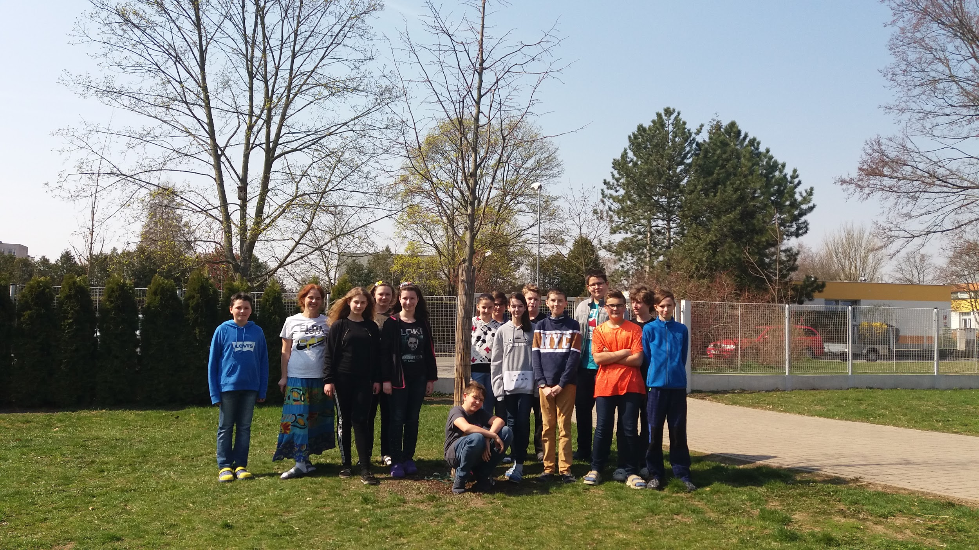
Our common photo

Slide 7
Thanks for watching

