Slide 1
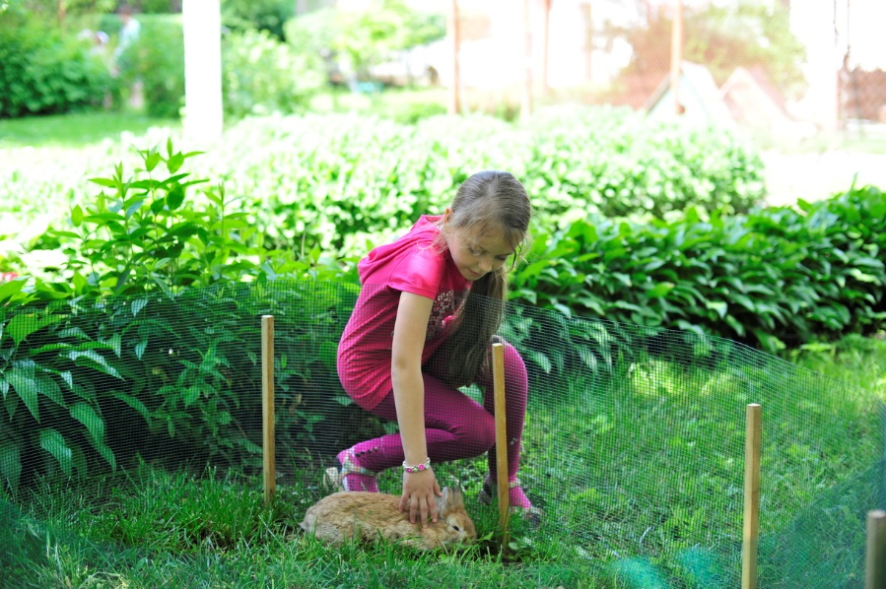

Slide 2
Hello. My name is Tetiana Cheban. I am a teacher at the Chernivtsi regional and nature center for youth, Ukraine. I explore with my students phonological features birch in our region.

Slide 3
My students are 12-15 years old.

Slide 4
There are my students.

Slide 5
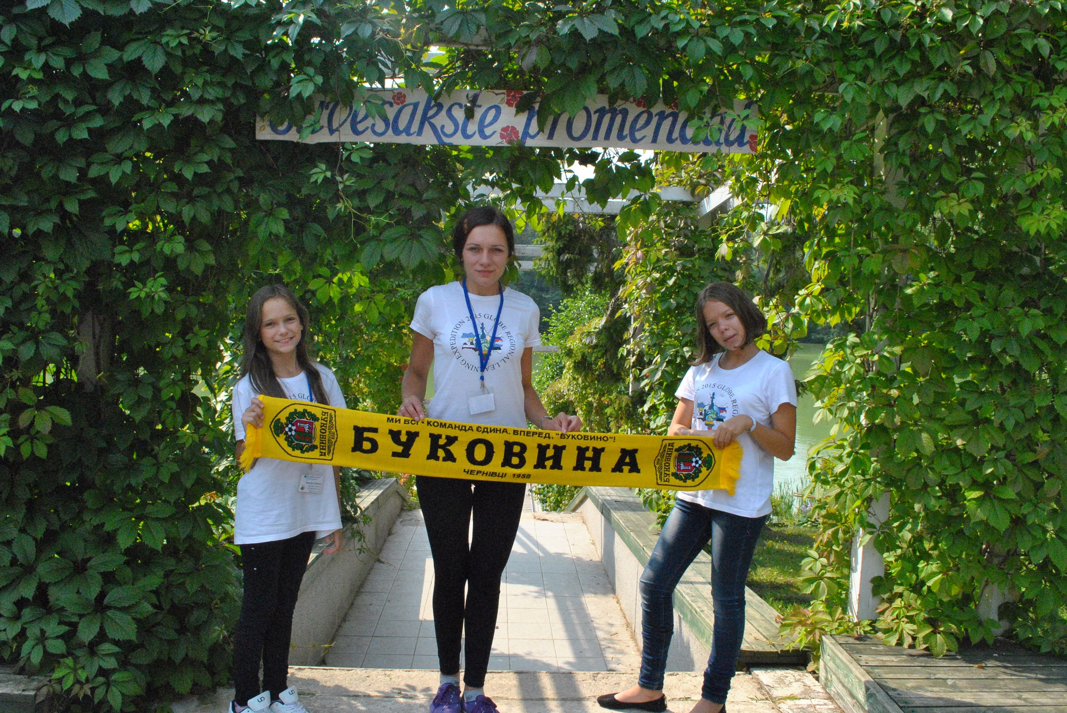

Slide 6
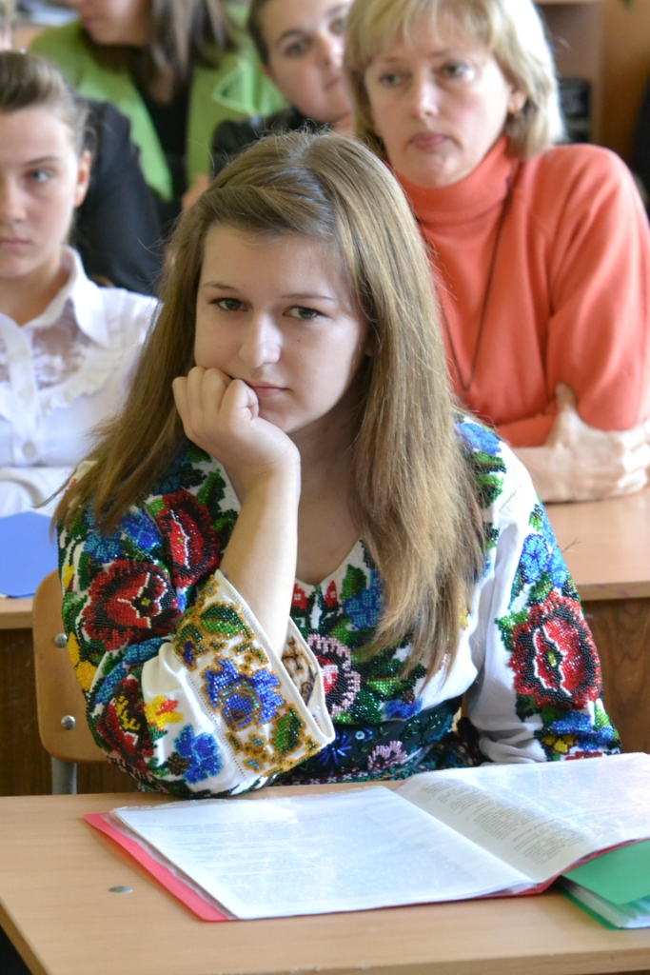

Slide 7
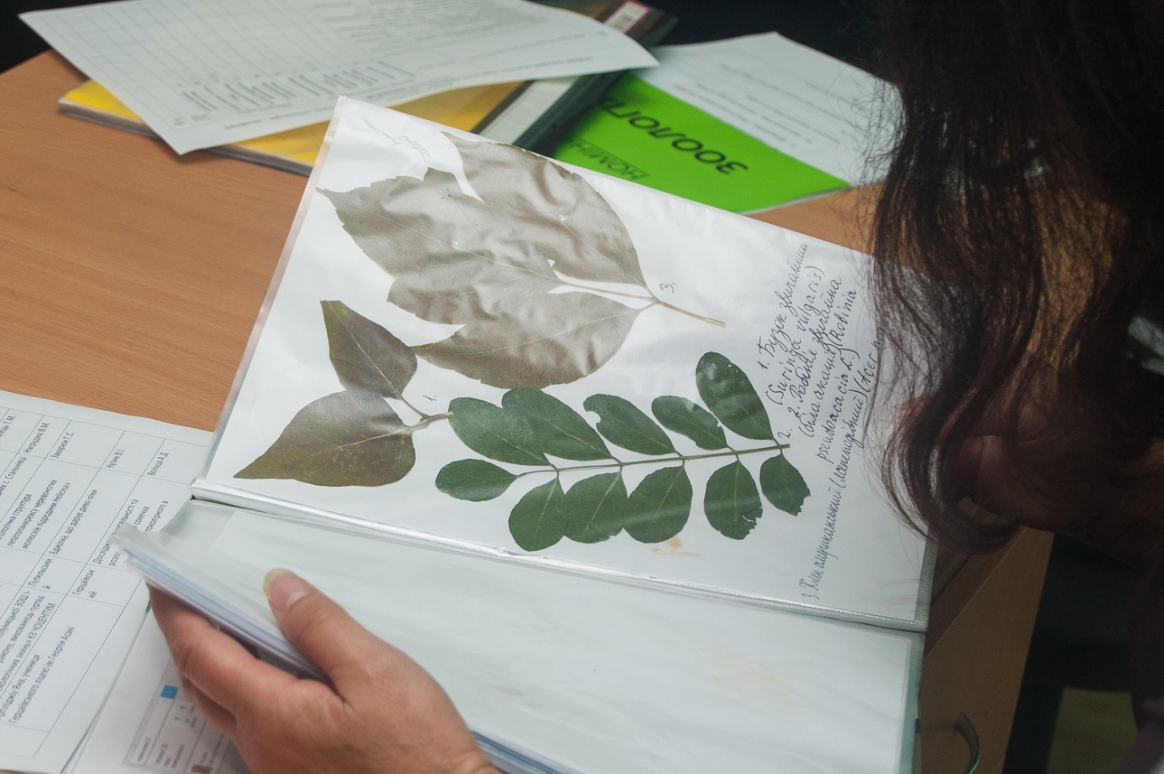
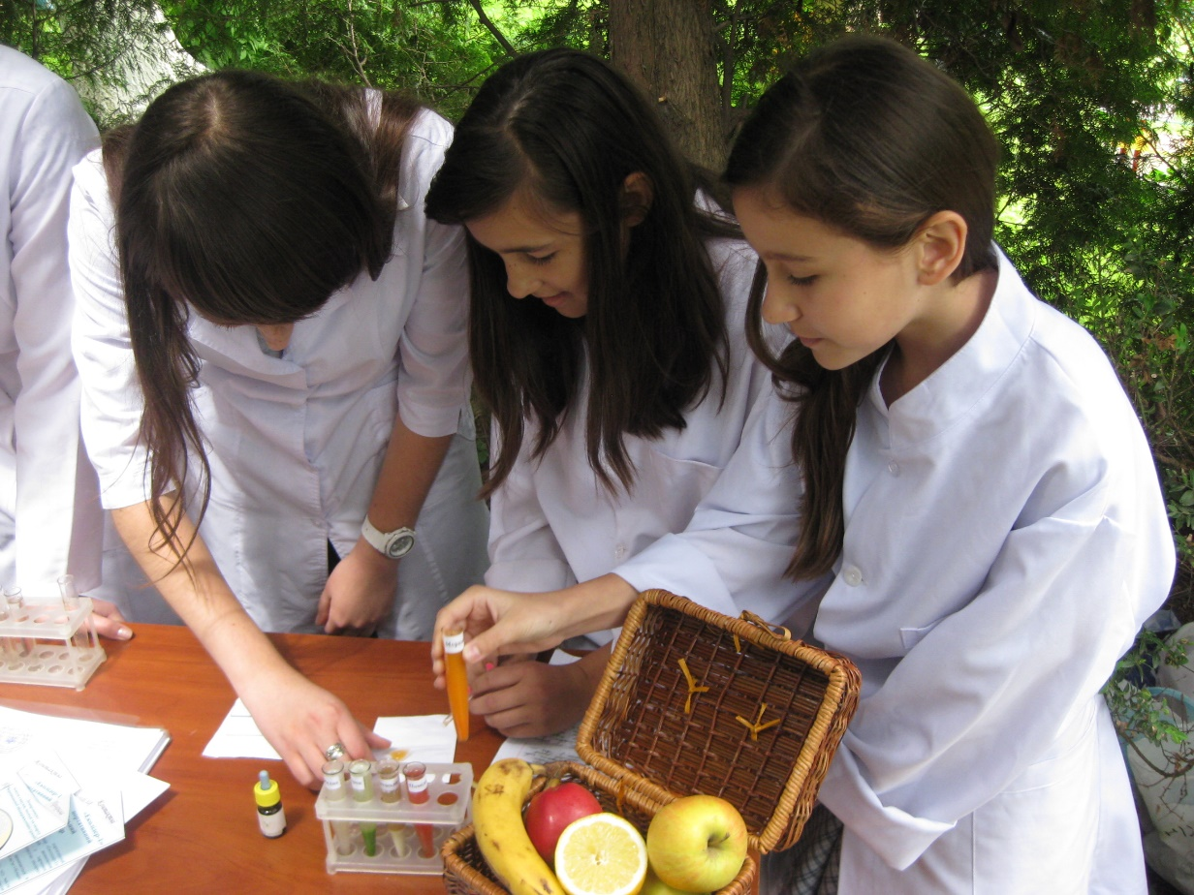

Slide 8
