Slide 1
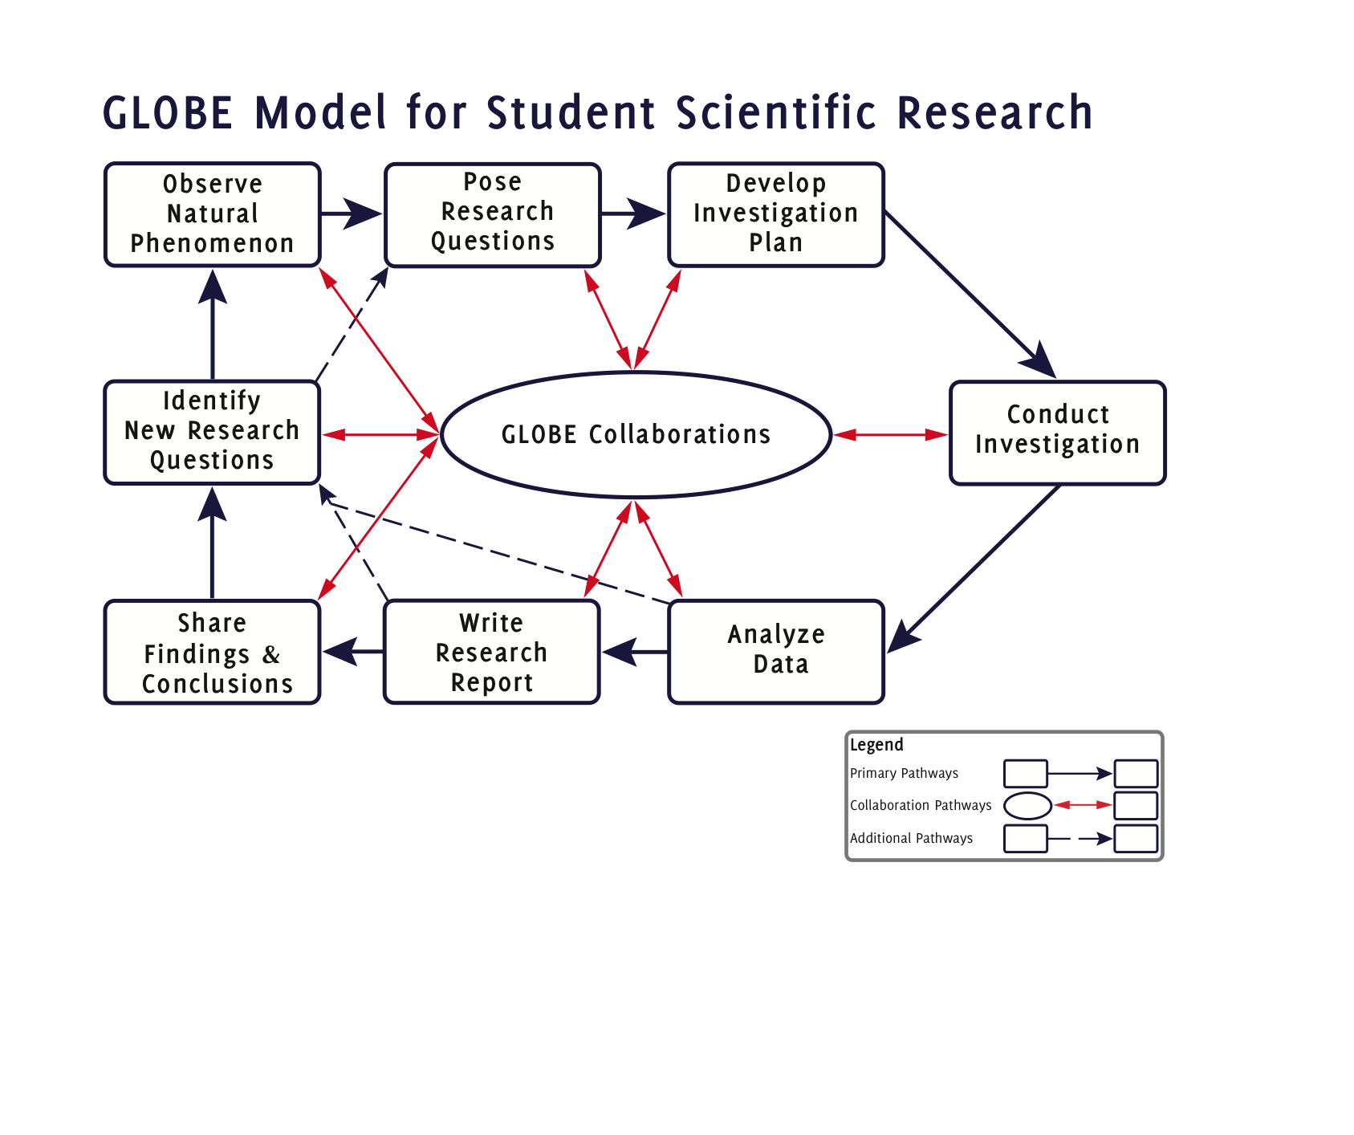
Notes:
File Name: GMSSR Core Final 01202011

Slide 2

Notes:
File Name: GMSSR Expanded Final 01202011.eps

Slide 3
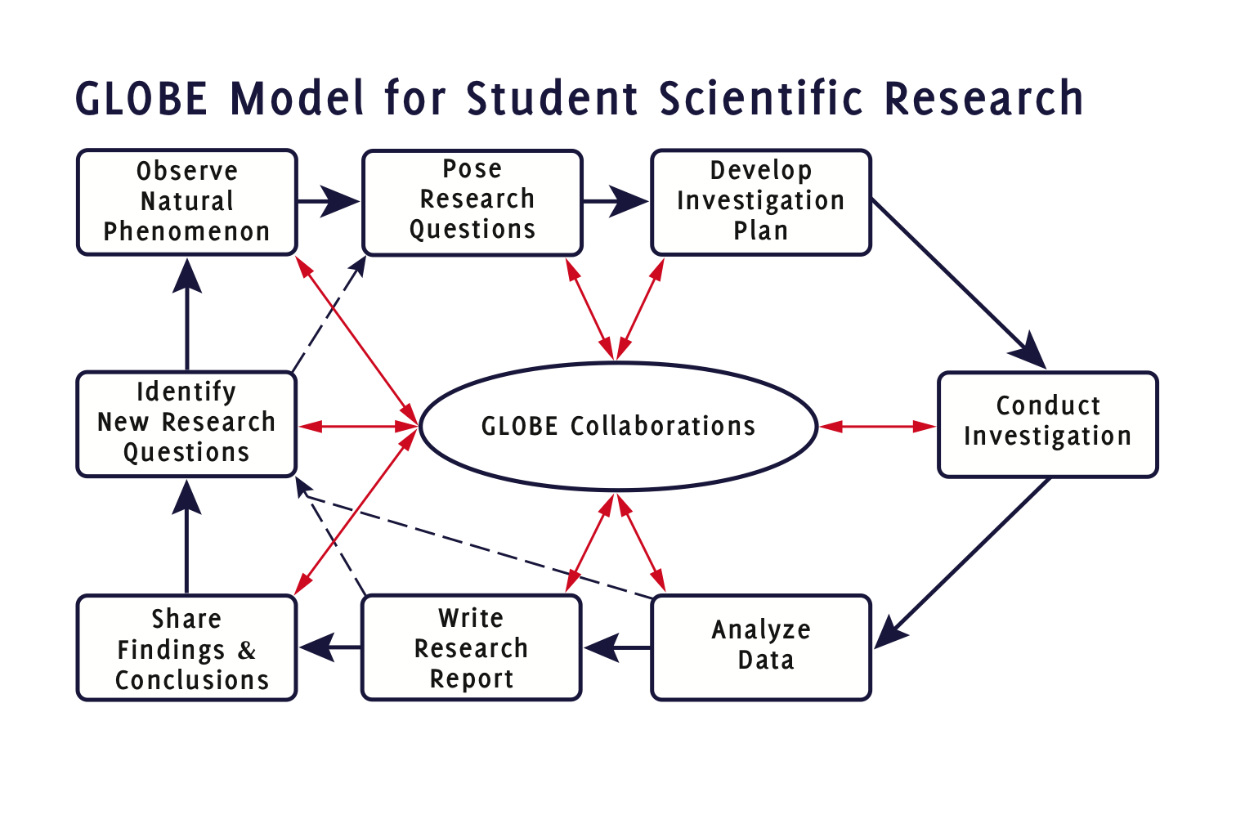
Notes:
File Name: GMSSR Icon Final 01202011.eps

Slide 4
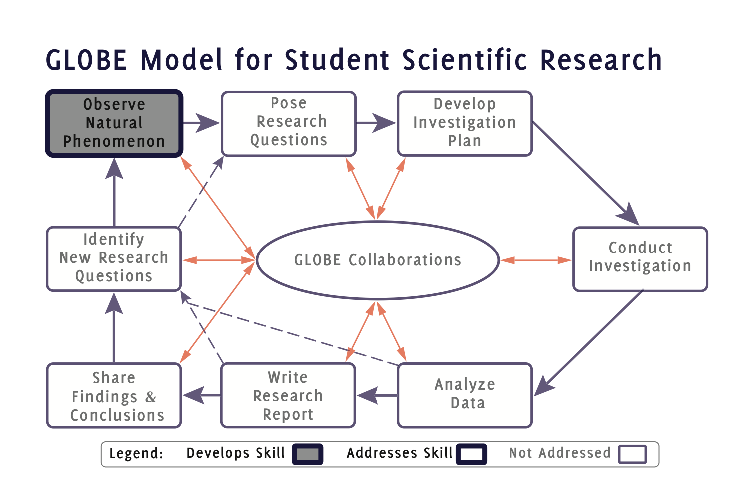
Notes:
GMSSR Icon 1.eps

Slide 5
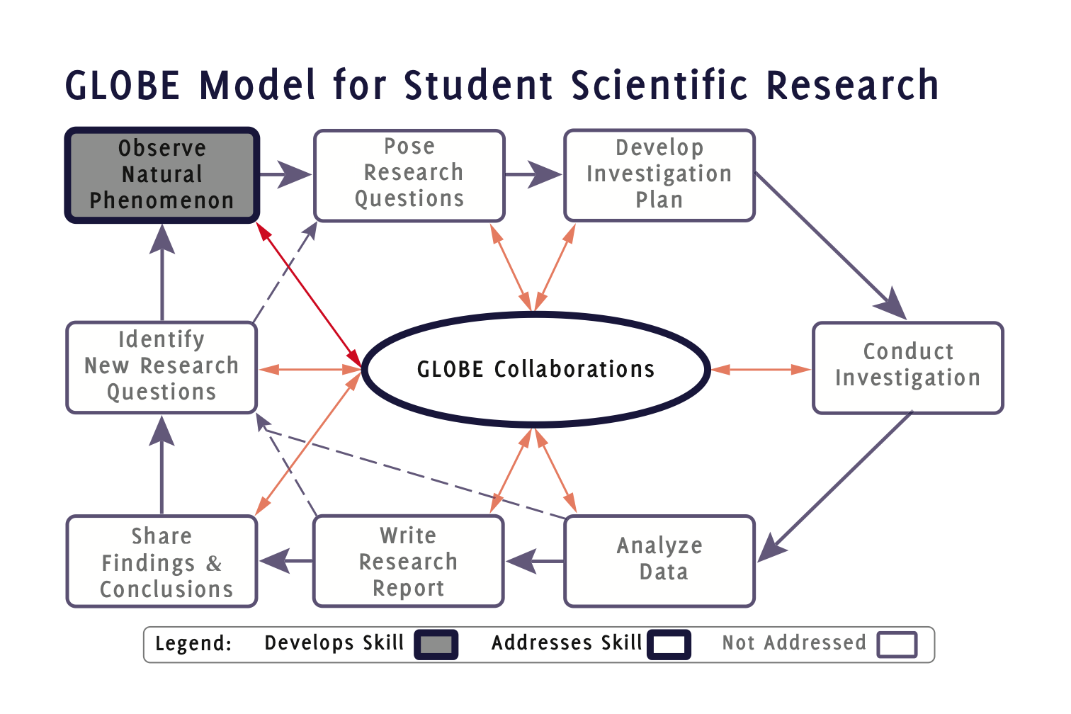
Notes:
GMSSR Icon 1C.eps

Slide 6
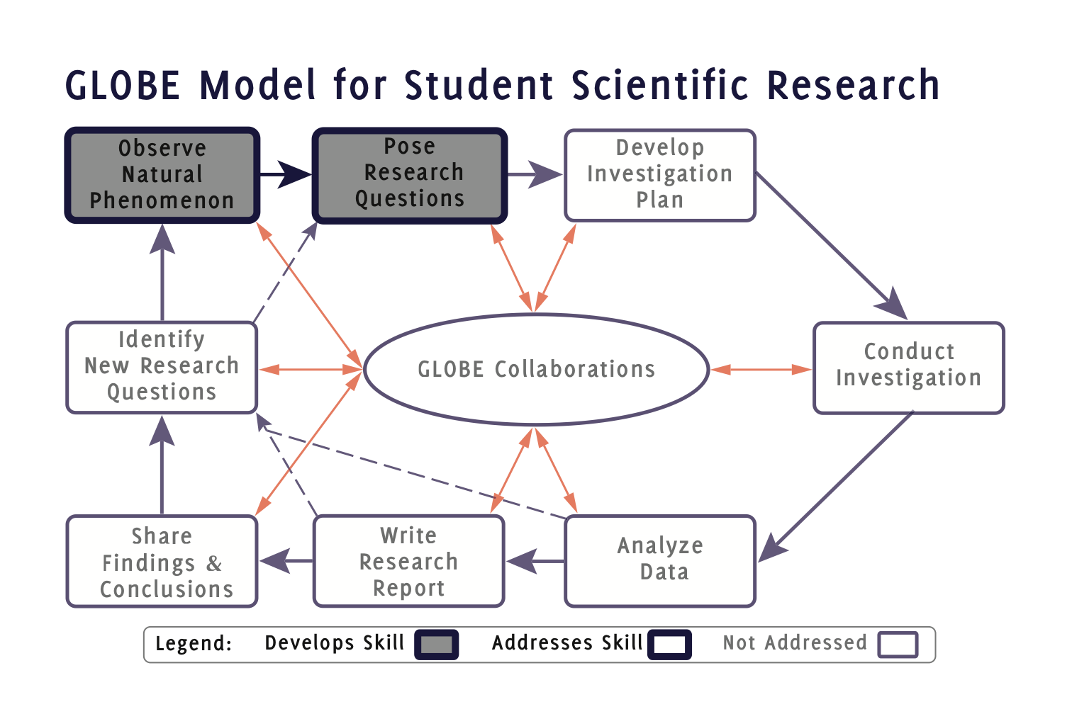
Notes:
GMSSR Icon 1-(2).eps

Slide 7
Notes:
GMSSR Icon 1-2.eps

Slide 8
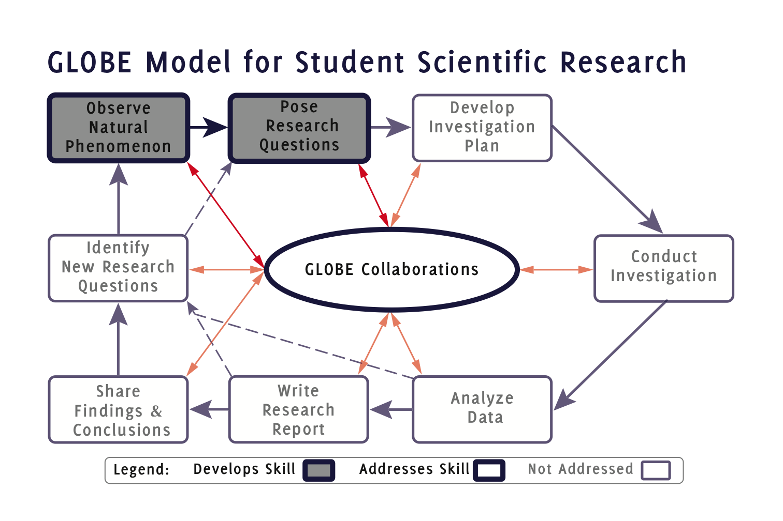
Notes:
GMSSR Icon 1C-2C.eps

Slide 9
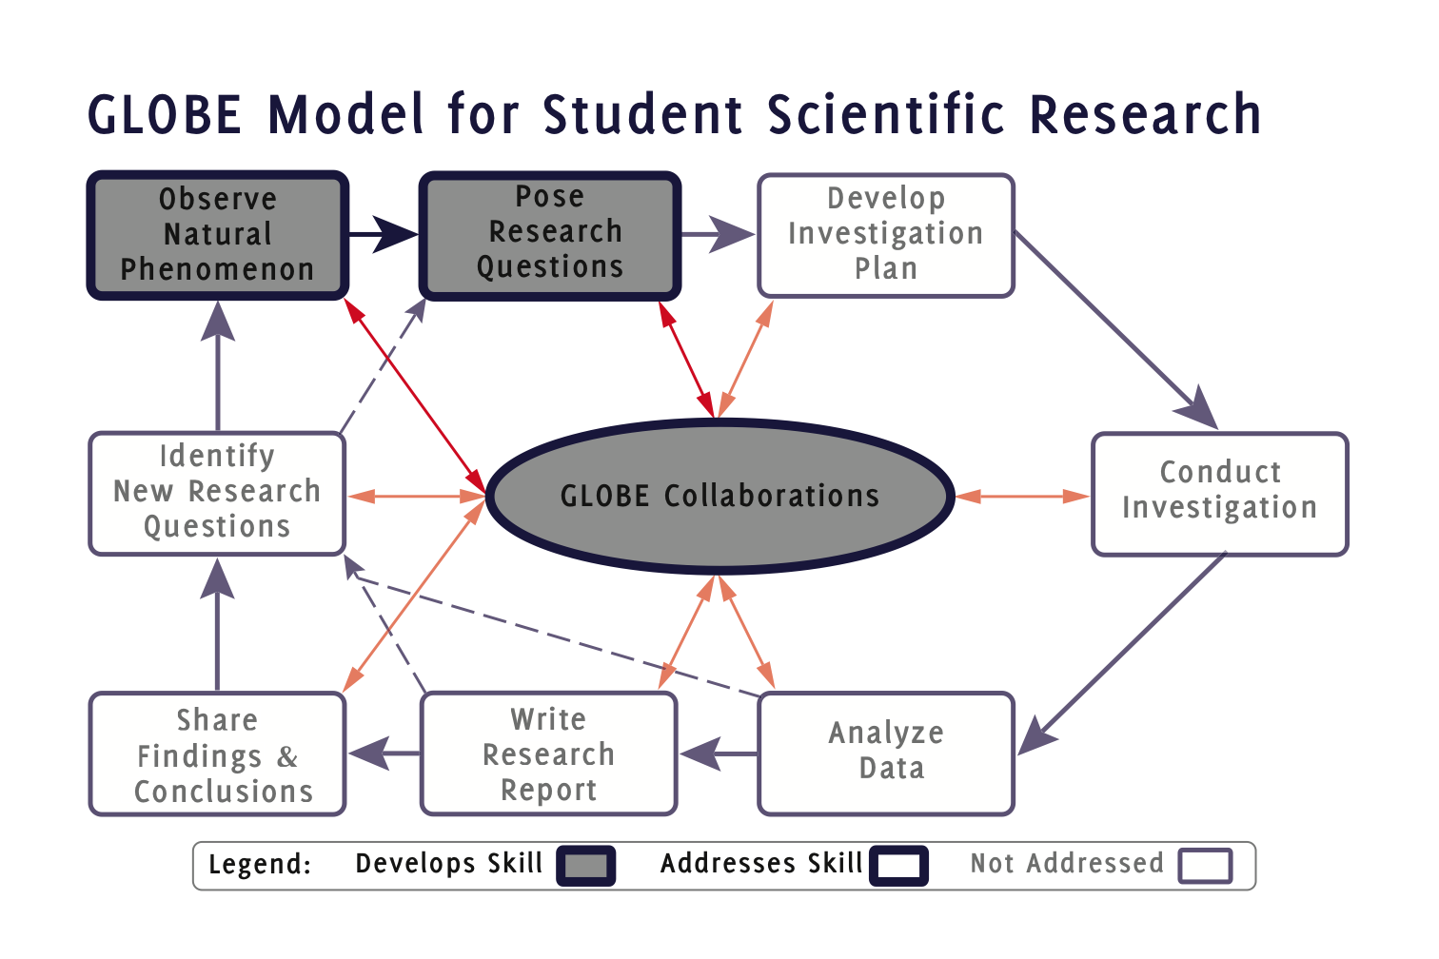
Notes:
GMSSR Icon 1-2-C.eps

Slide 10
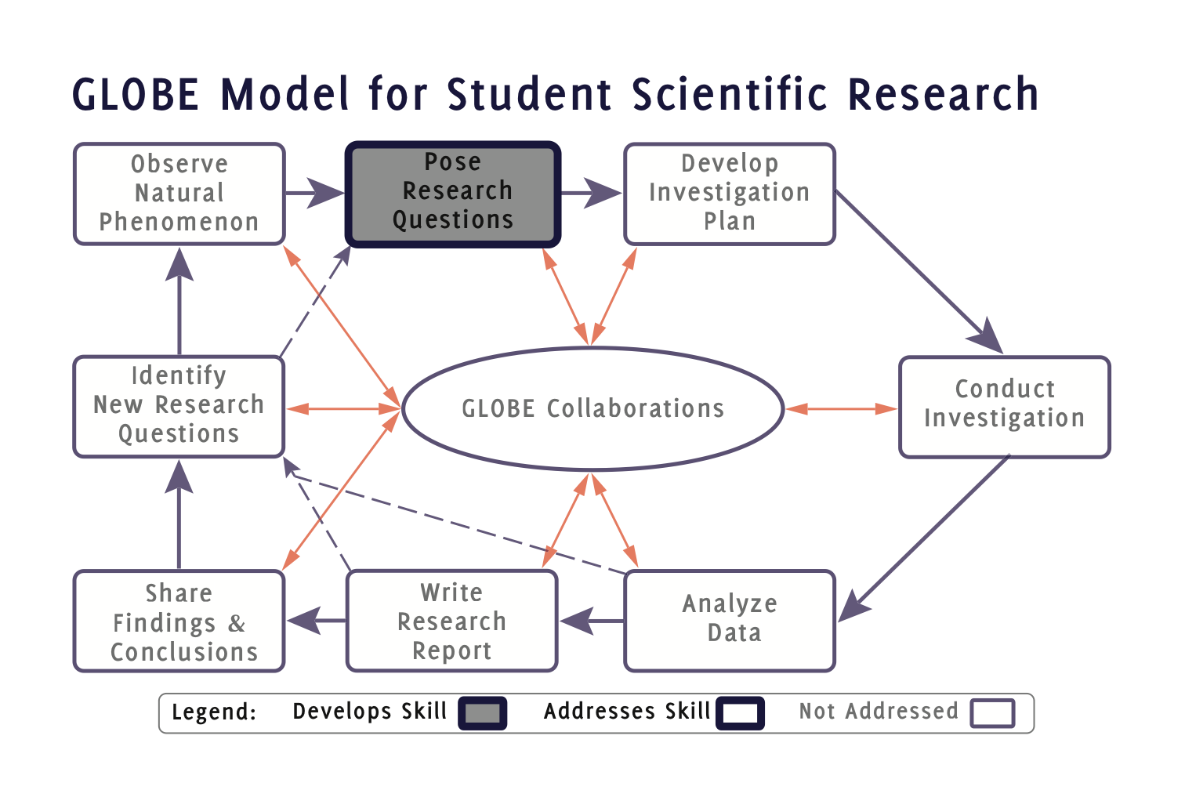
Notes:
GMSSR Icon 2.eps

Slide 11
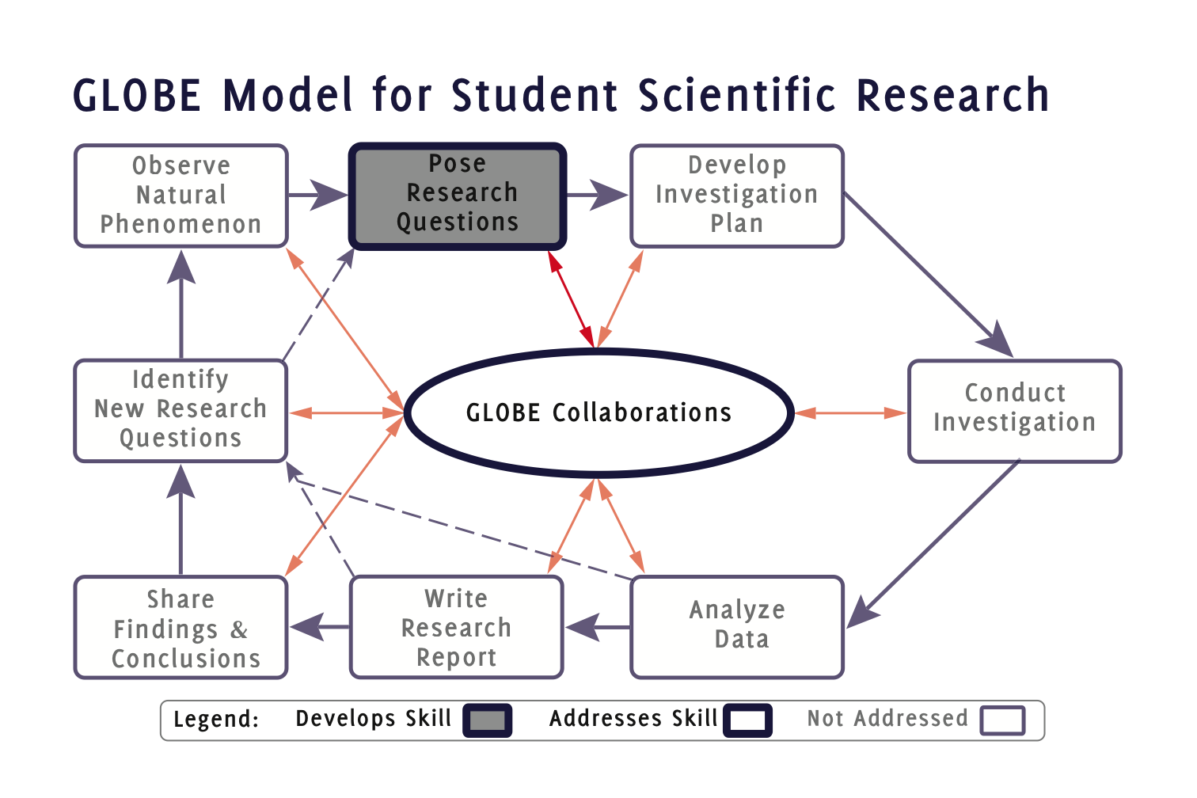
Notes:
GMSSR Icon 2C.eps

Slide 12
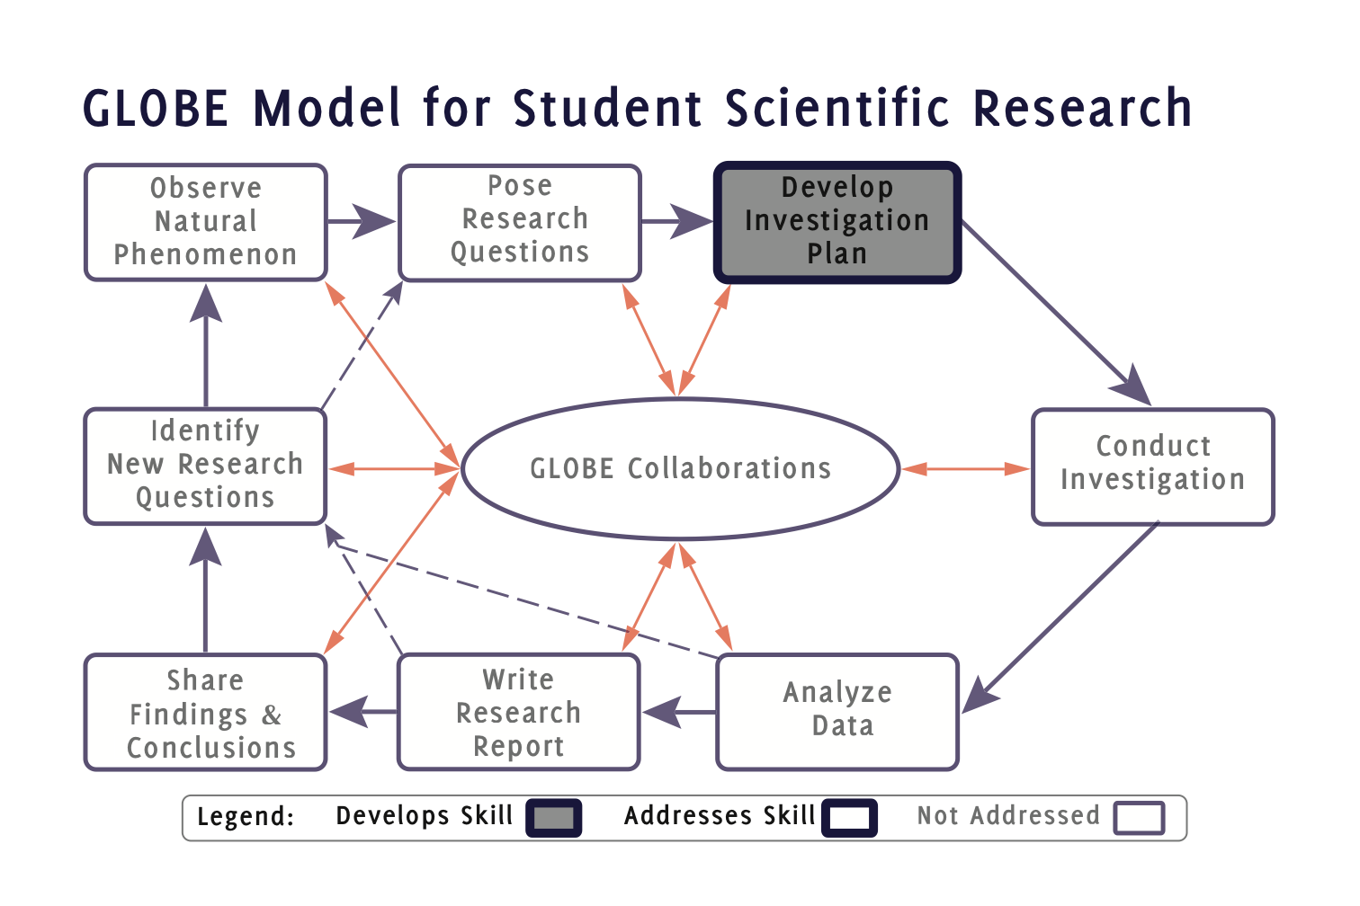
Notes:
GMSSR Icon 3.eps

Slide 13
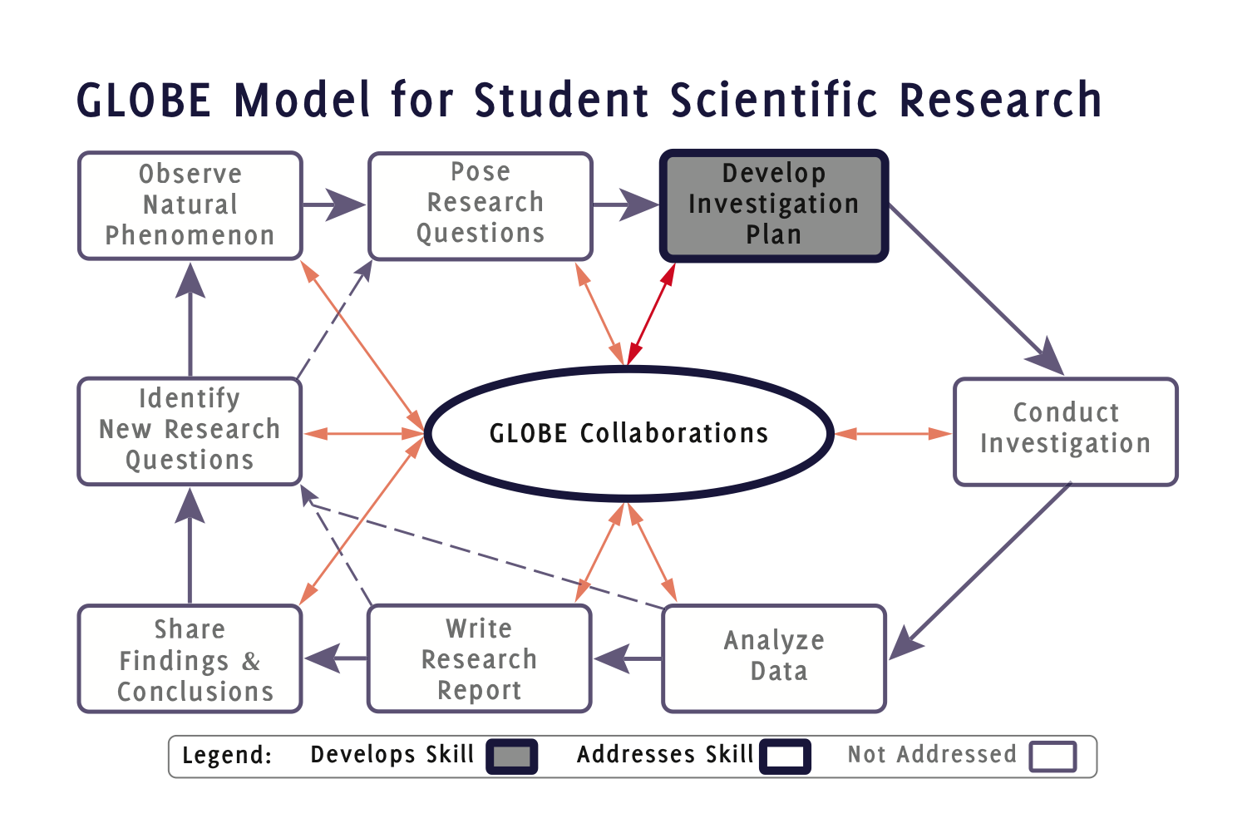
Notes:
GMSSR Icon 3C.eps

Slide 14
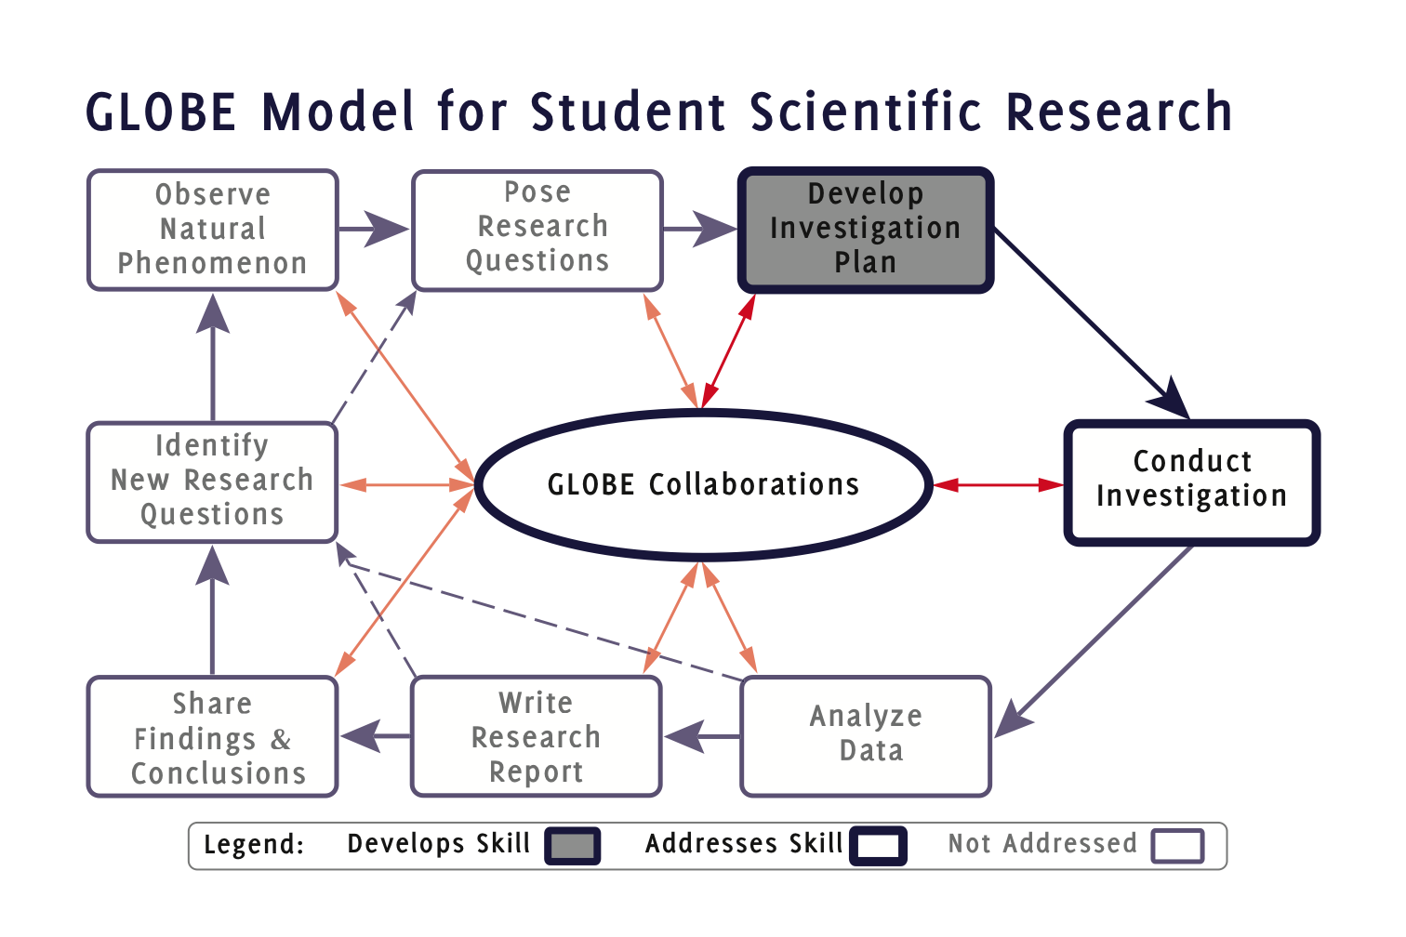
Notes:
GMSSR Icon 3C-(4)C.eps

Slide 15
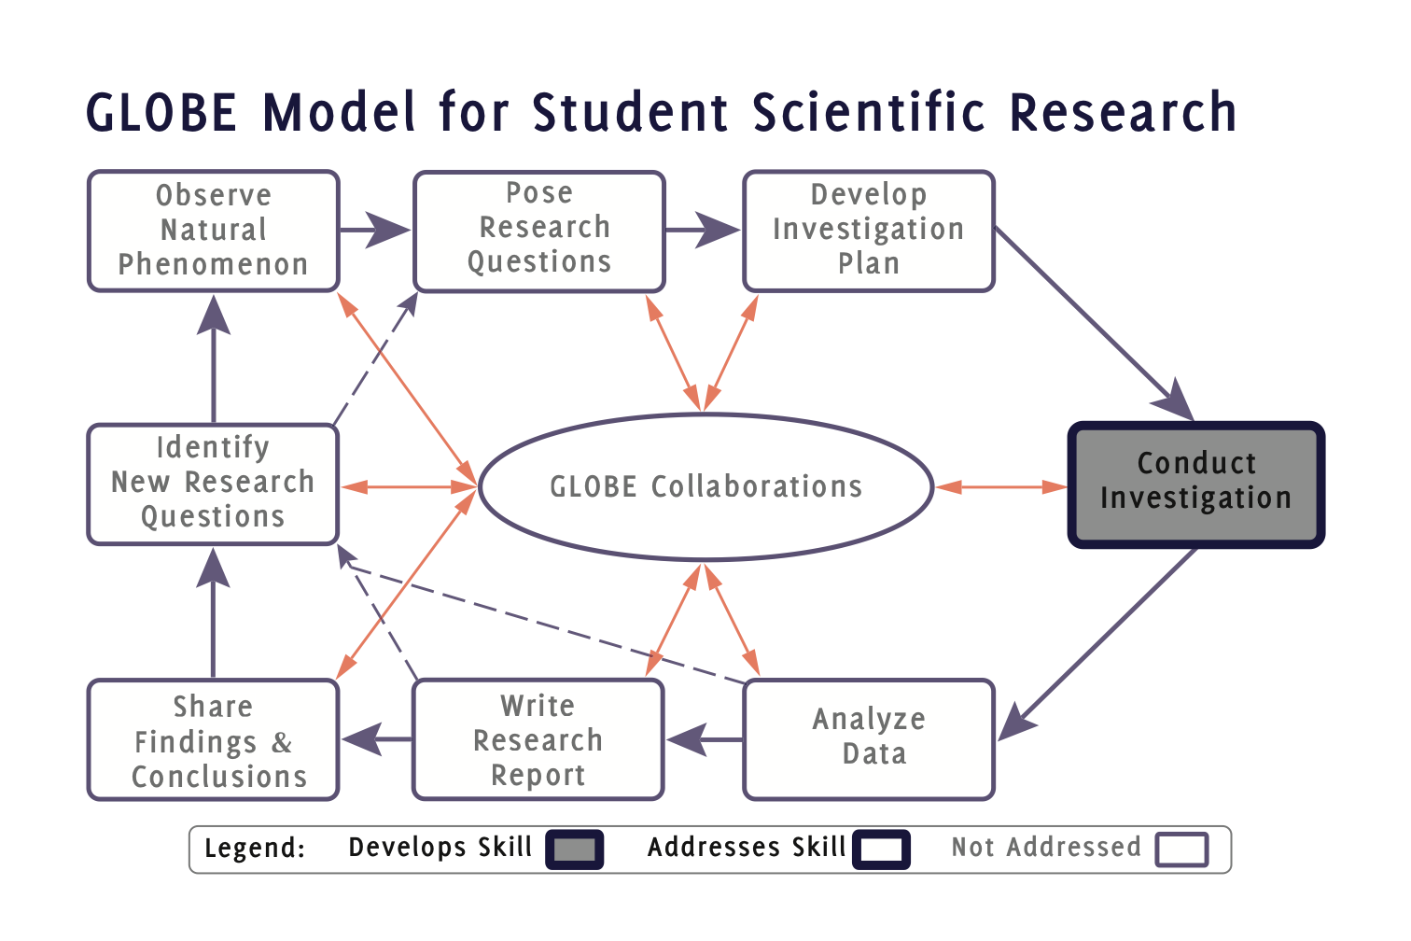
Notes:
GMSSR Icon 4.eps

Slide 16
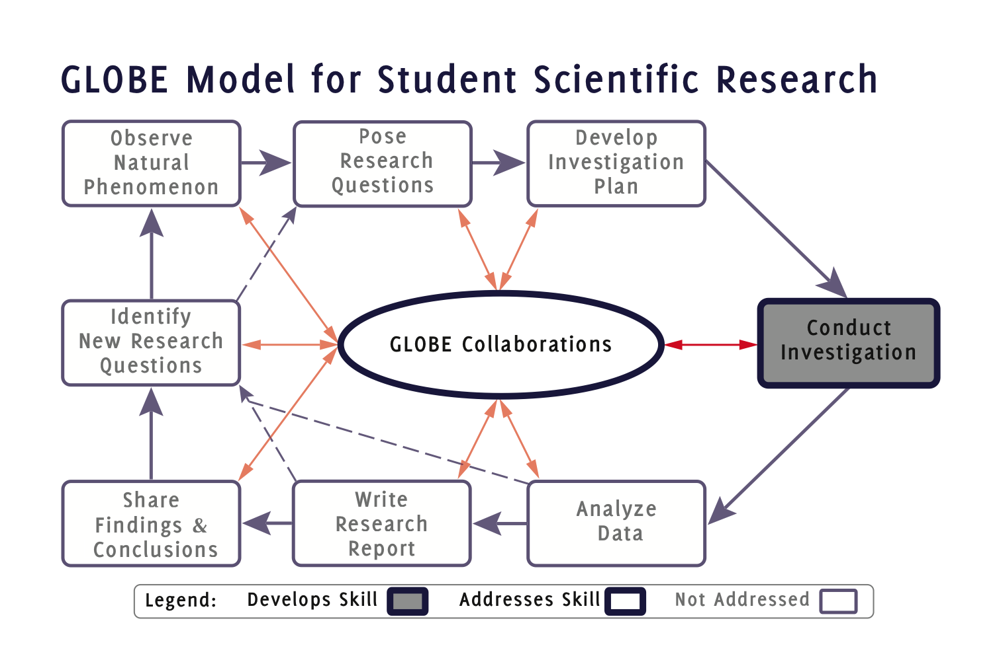
Notes:
GMSSR Icon 4C.eps

Slide 17
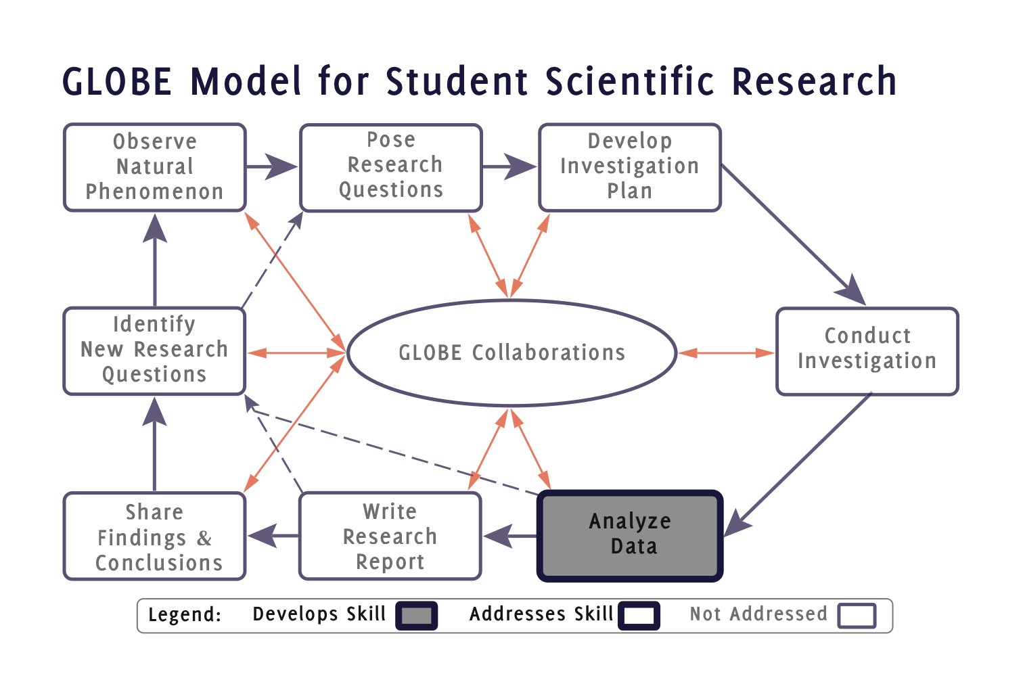
Notes:
GMSSR Icon 5.eps

Slide 18
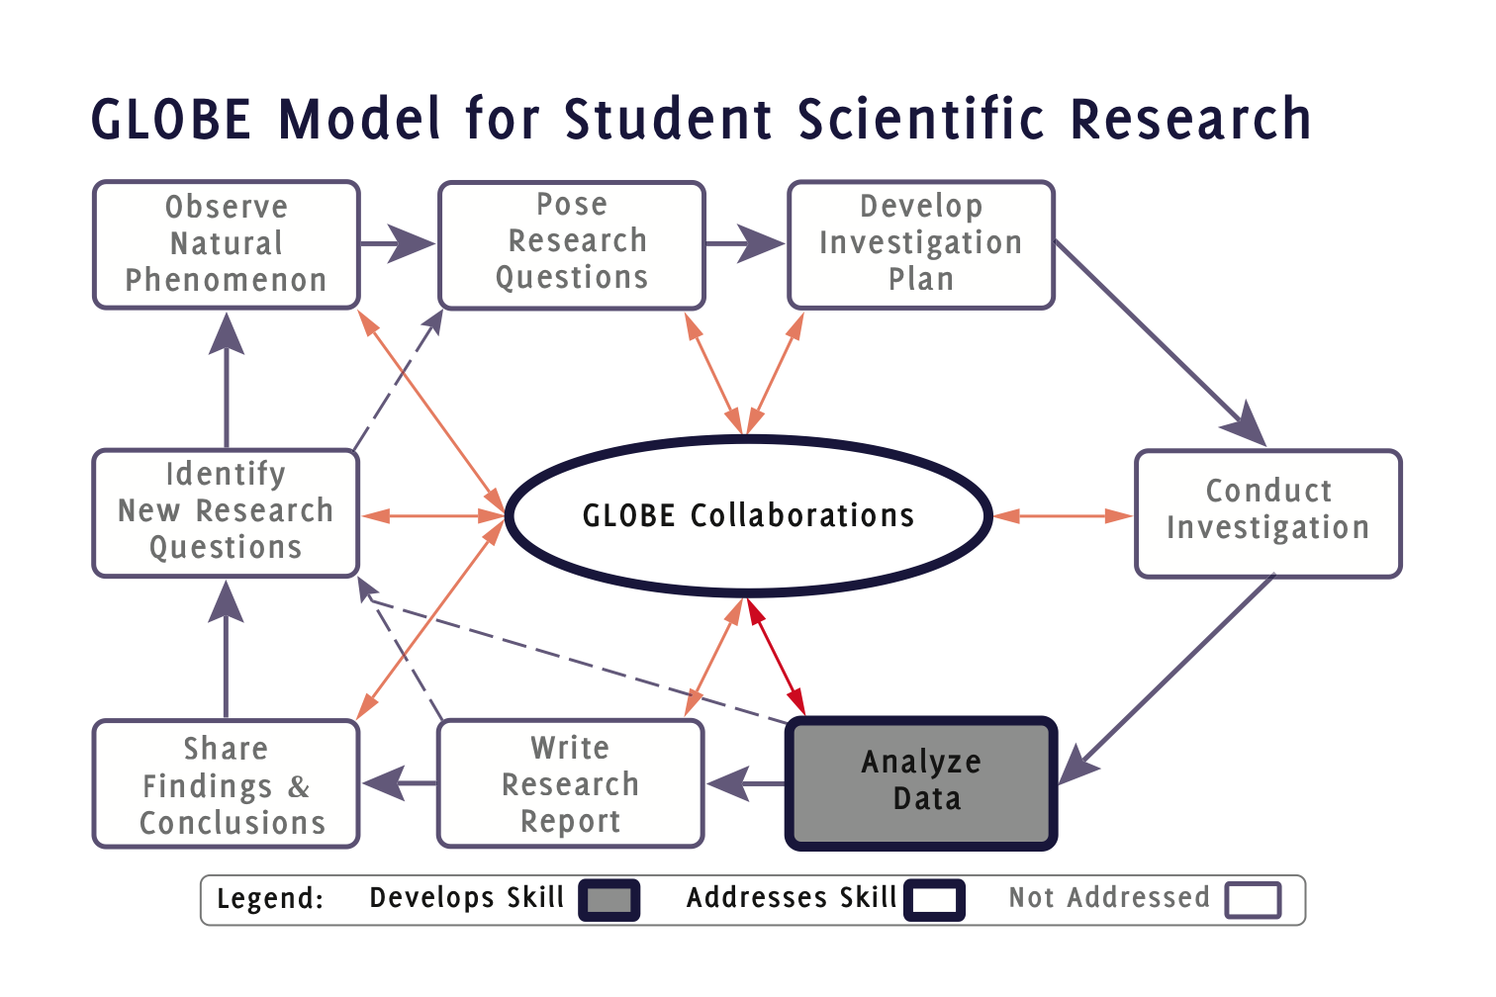
Notes:
GMSSR Icon 5C.eps

Slide 19
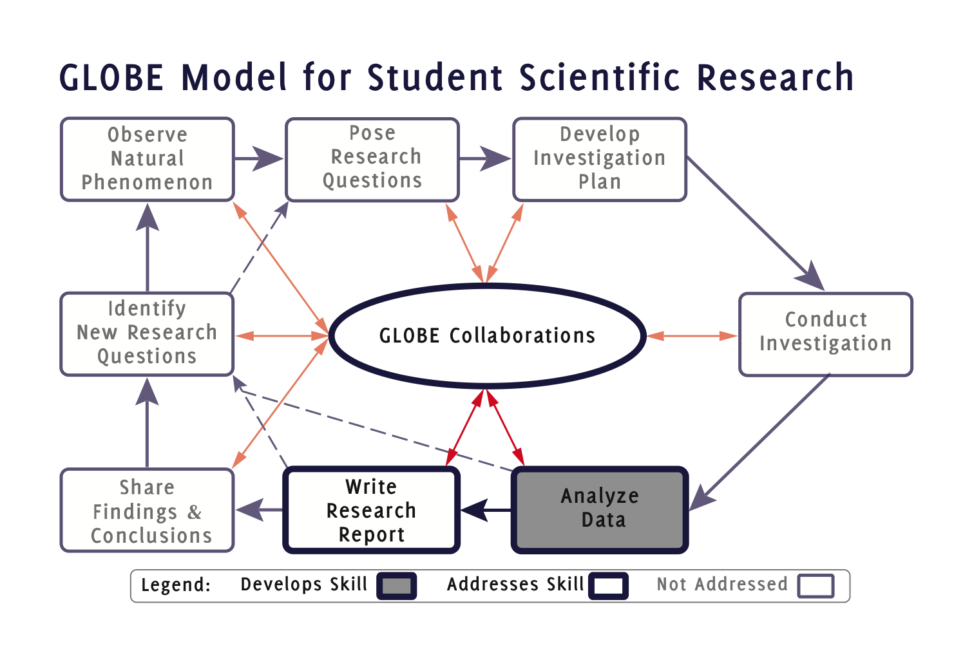
Notes:
GMSSR Icon 5C-(6)C.eps

Slide 20
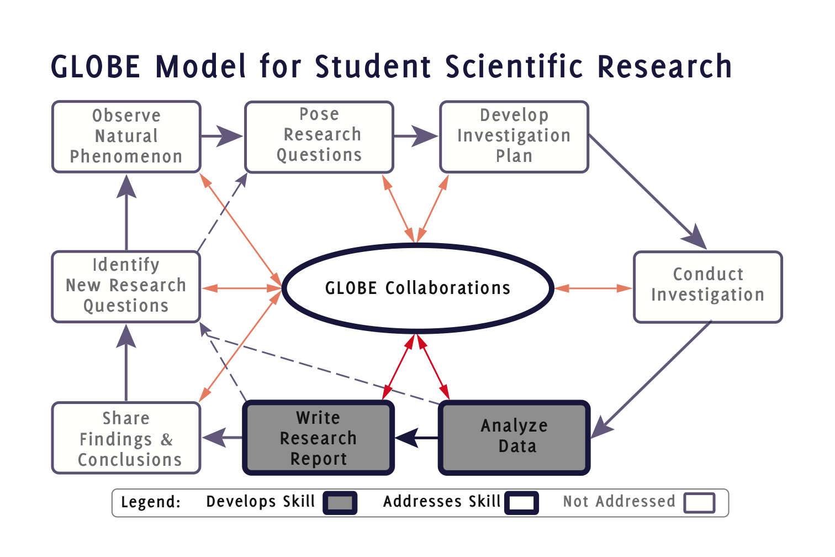
Notes:
GMSSR Icon 5C-6C.eps

Slide 21
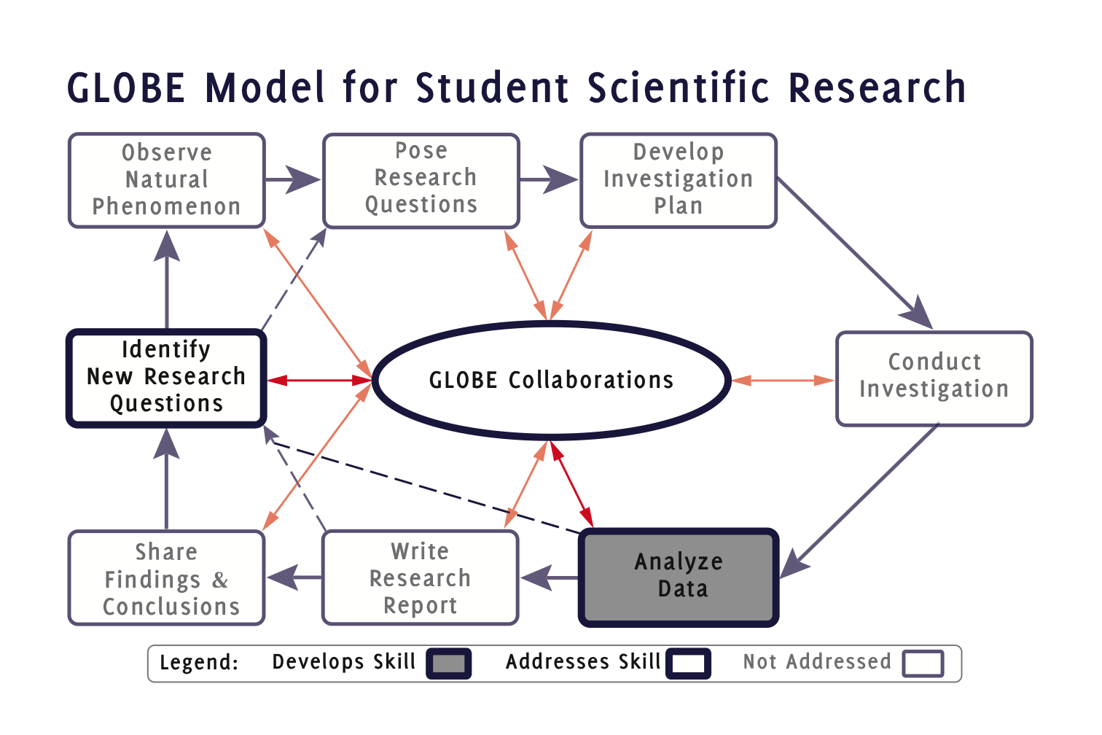
Notes:
GMSSR Icon 5C-(8)C.eps

Slide 22
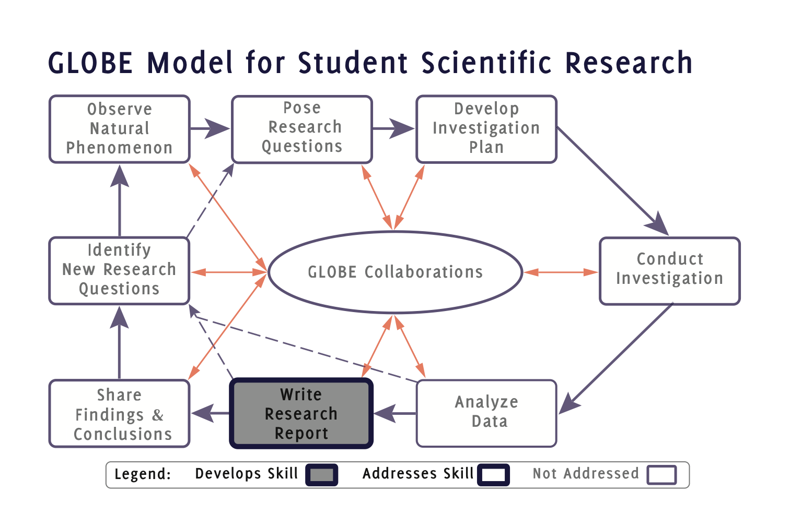
Notes:
GMSSR Icon 6.eps

Slide 23
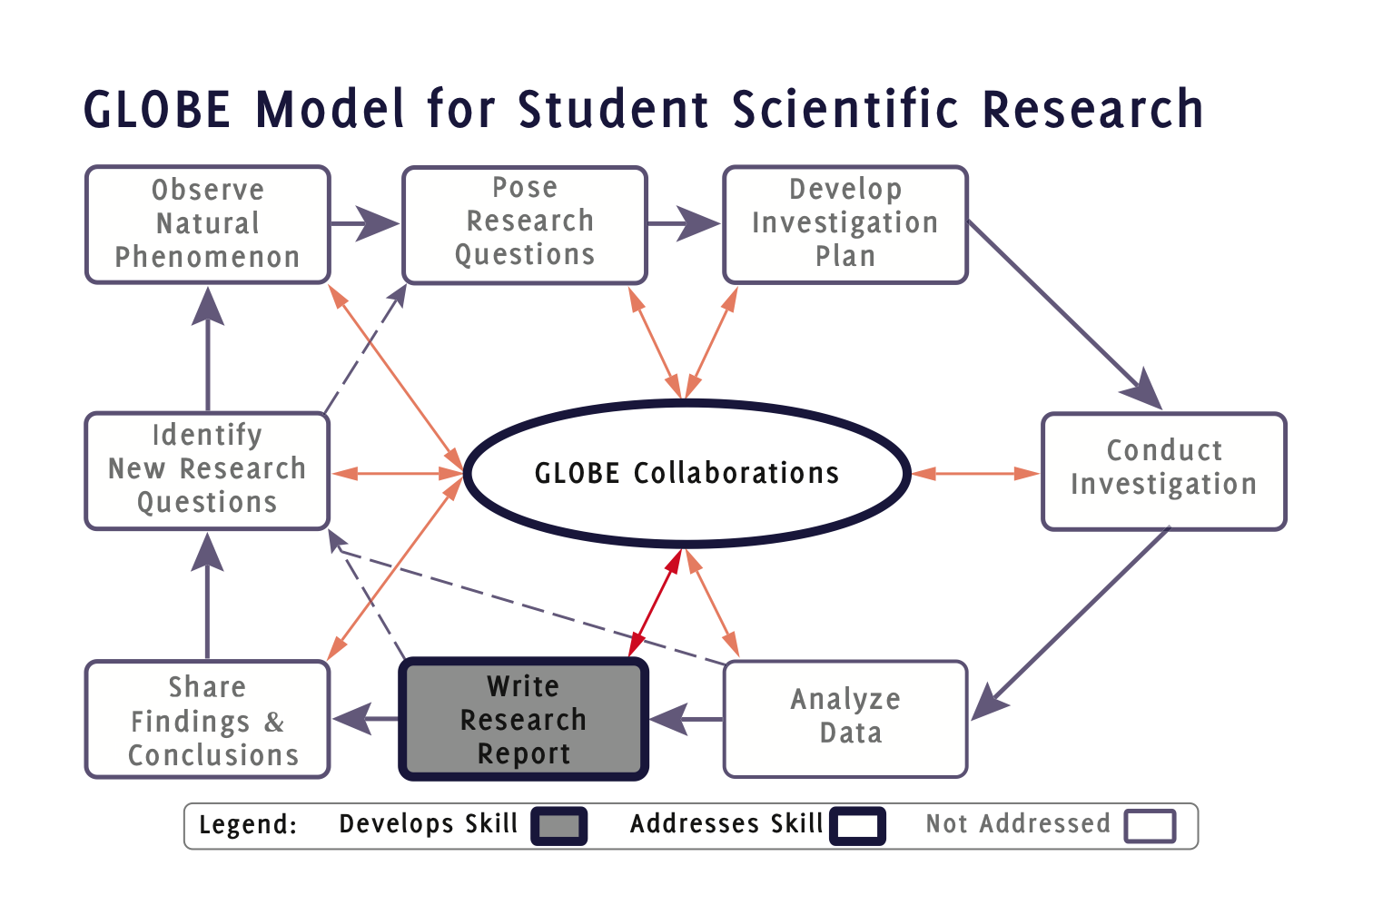
Notes:
GMSSR Icon 6C.eps

Slide 24
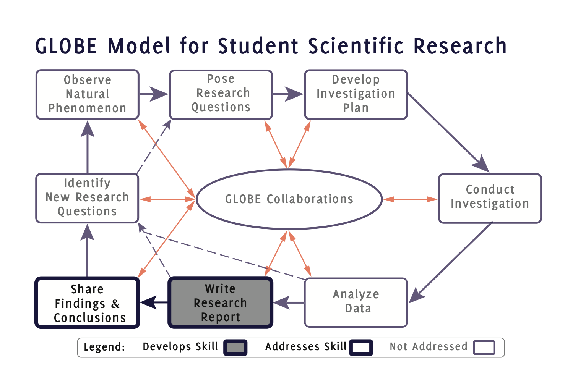
Notes:
GMSSR Icon 6-(7).eps

Slide 25
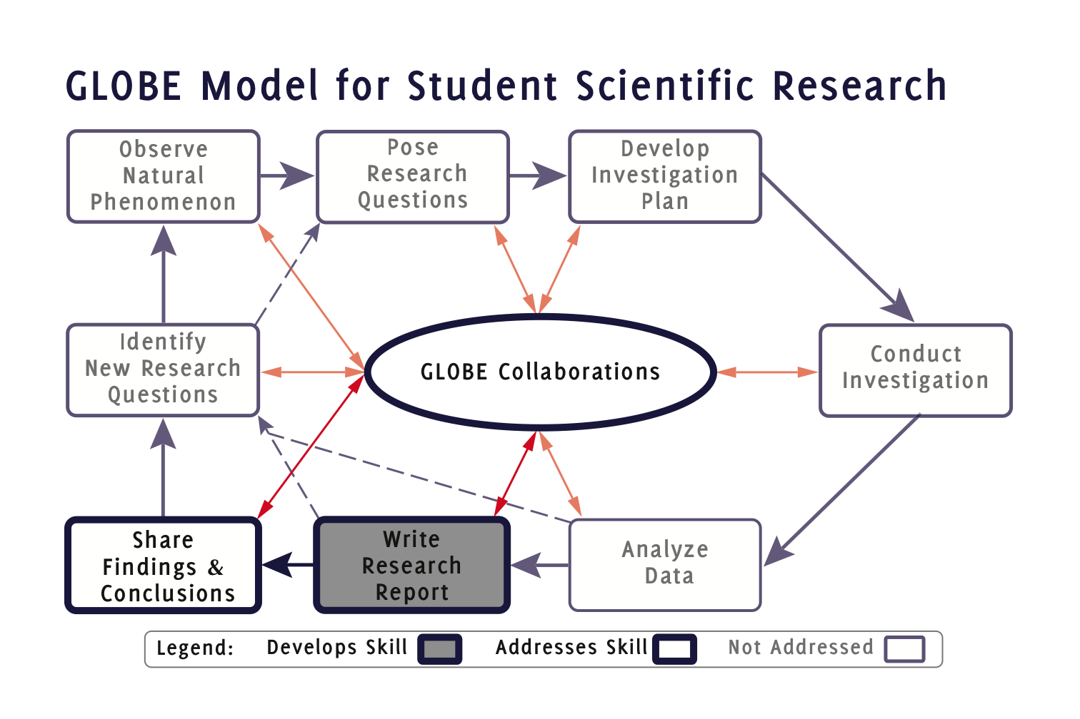
Notes:
GMSSR Icon 6C-(7)C.eps

Slide 26
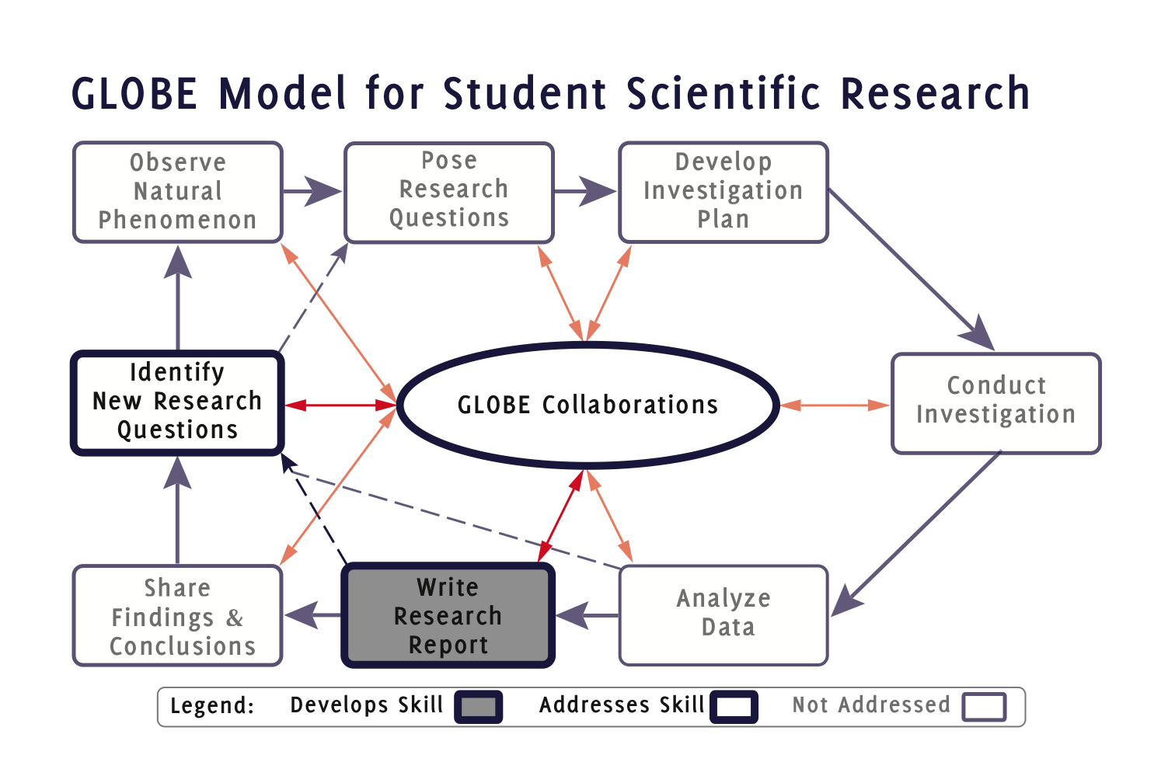
Notes:
GMSSR Icon 6C-(8)C.eps

Slide 27
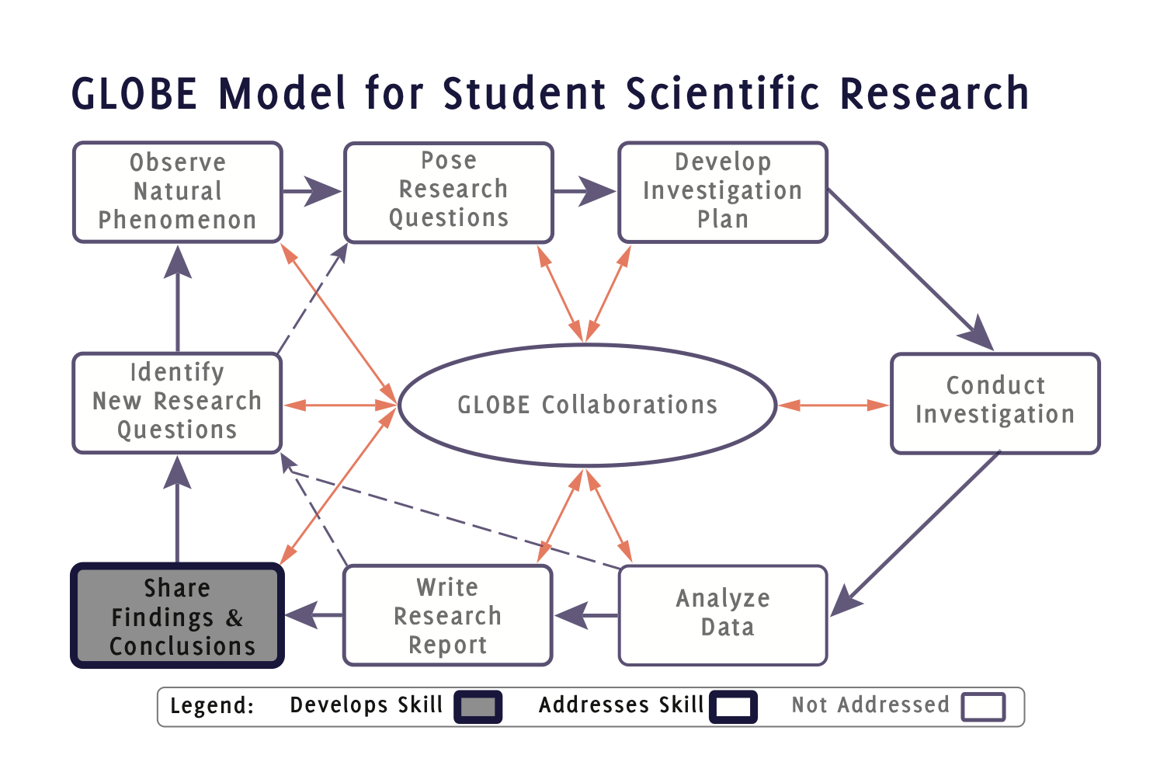
Notes:
GMSSR Icon 7.eps

Slide 28
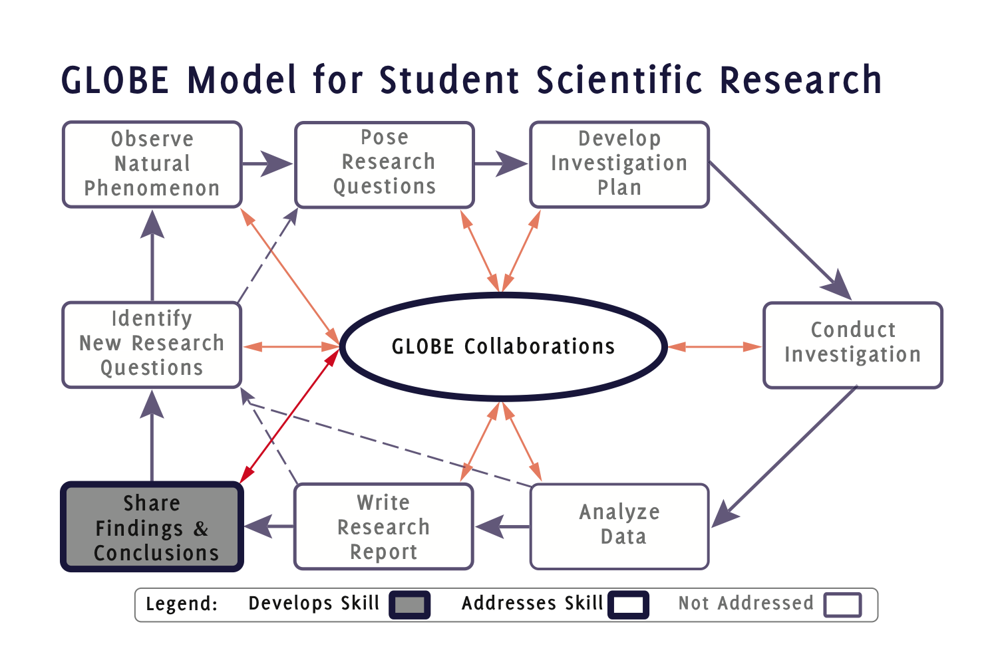
Notes:
GMSSR Icon 7C.eps

Slide 29
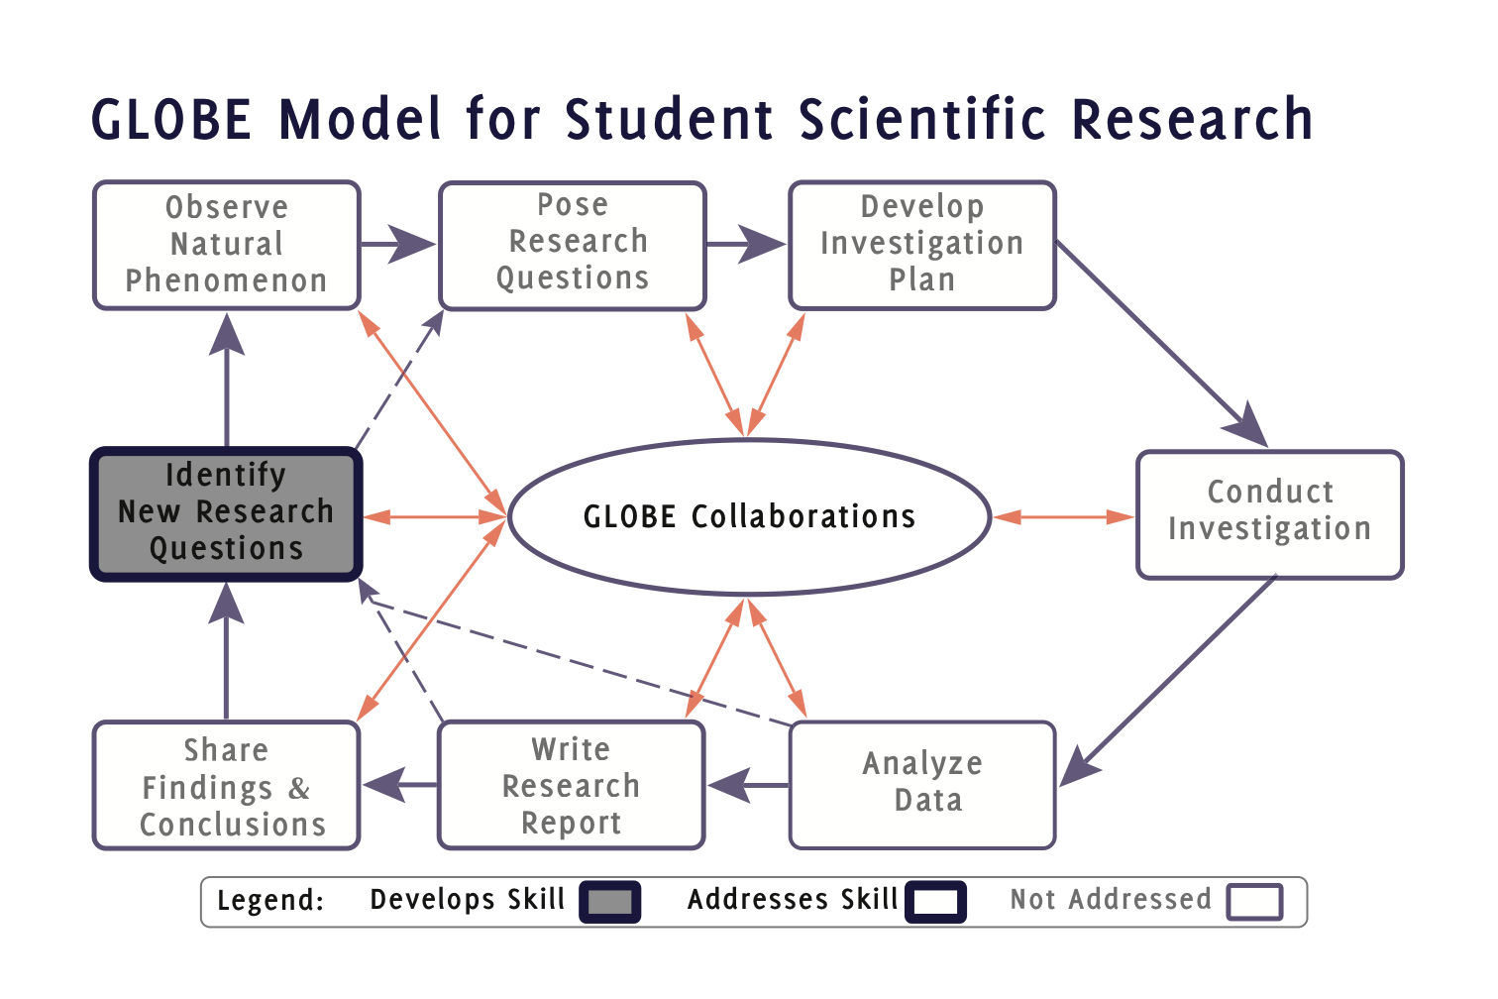
Notes:
GMSSR Icon 8.eps

Slide 30
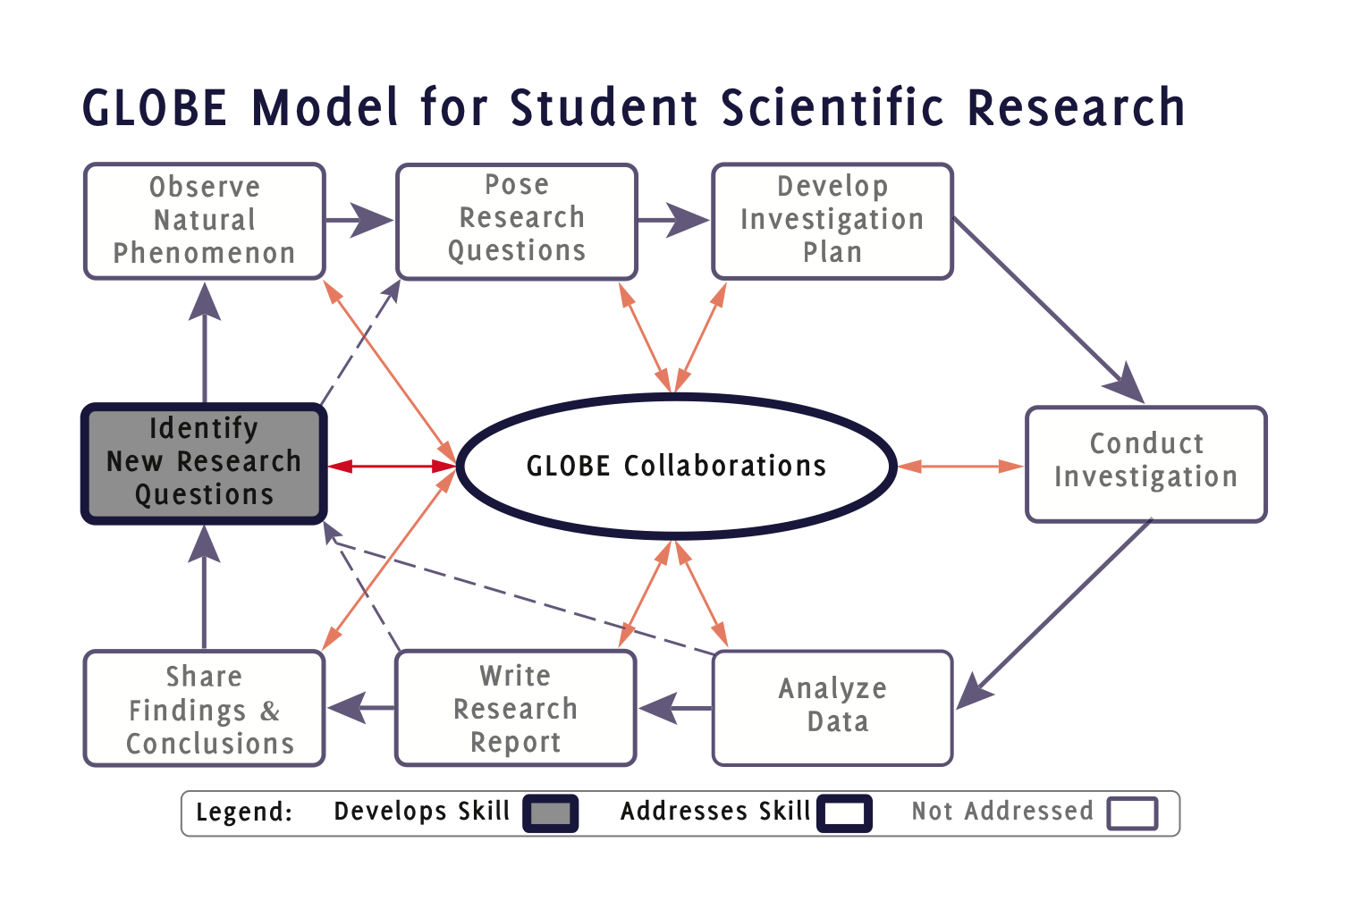
Notes:
GMSSR Icon 8C.eps

Slide 31
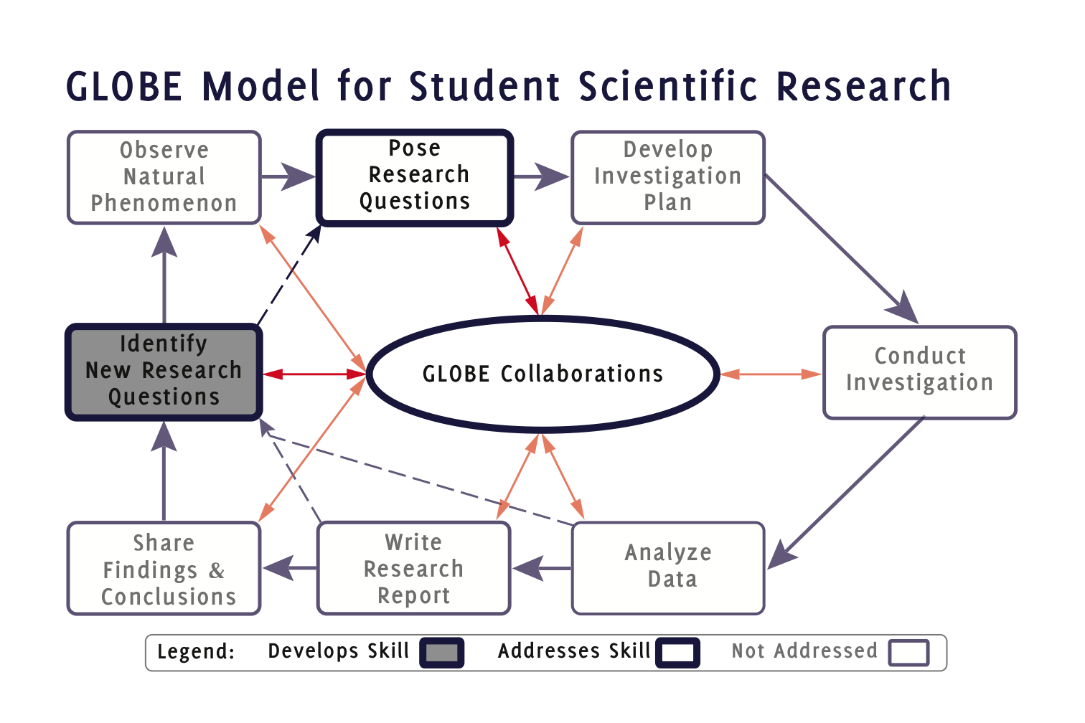
Notes:
GMSSR Icon 8C-(2)C.eps

Slide 32
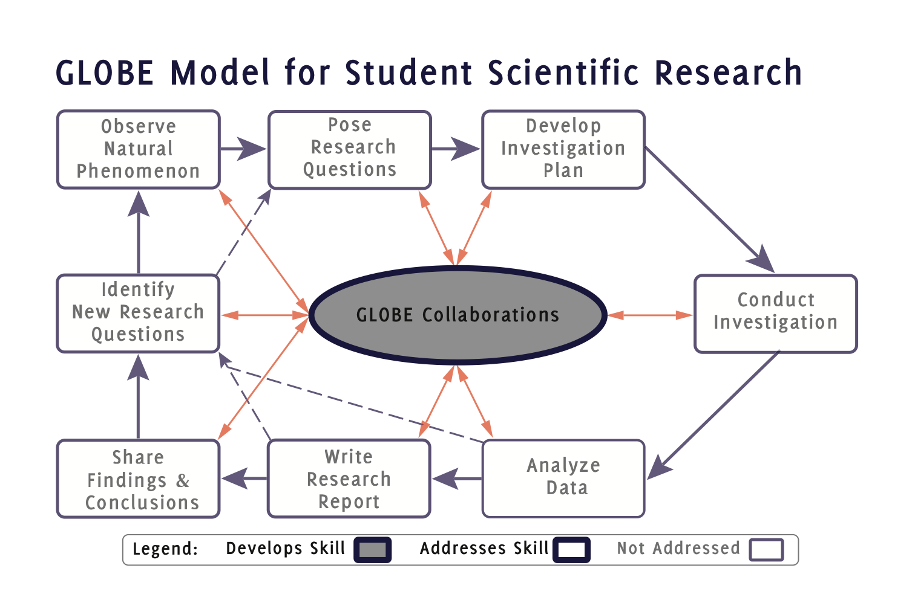
Notes:
GMSSR Icon C.eps

