Slide 1
The GLOBE Program
Guide to creating your
GISN video and profile www.globe.gov

Slide 2
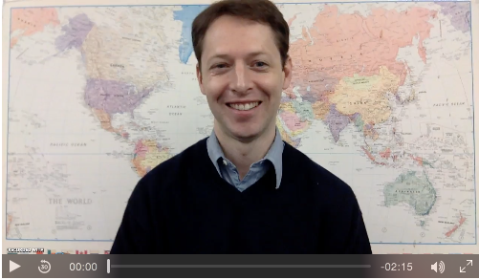
Guide to creating your GISN connection video
We invite you, as a member of the GLOBE International Scientists’ Network (GISN), to create a 2 minute (or shorter) video clip to introduce you and your science to GLOBE students and teachers.
The following slides provides a few tips and ideas.
See Peder Nelson’s video here:
http://www.globe.gov/web/peder.nelson/

Slide 3
1. Know your Audience
Your audience is GLOBE students and teachers
Keep your audience in mind when discussing science concepts and vocabulary

Slide 4
2. Considerations for writing your video script
Include a guiding question as a hook for the students and include relevant connections to the student’s life (school, neighborhood, town, park, etc.). For example, “Have you ever wondered what the land cover was like before your school was built?”
Transition from the guiding question to your personal “spark of curiosity” that guided you to study (or pursue your personal STEM path). “I was interested in how our land was changing, so I got involved in remote sensing and Landsat images.”
Describe yourself: your background, your education background, your current role, a short elevator pitch (two sentences or less) about what you research
How can GLOBE students help you in your research? For example, how can doing the GLOBE Land Cover protocol and uploading their data help YOU with your personal research, help contribute to our overall science understanding, and help GLOBE students around the world have a better understanding of changes over time?
Additional things to consider including:
  What inspires you about this work?
  How does your research help make a better world?
  How are YOU part of a bigger community, and how can the students feel like they are part of that community of building knowledge and understanding?
How can students contact you? Include your contact information at the end of your video and include it in your profile. Invite students to ask you questions.

Slide 5
Additional Tips
Type up your script
You might want to hide the camera of yourself as you speak – watching yourself on the video as you speak can be a distraction!
We recommend using Screencast-o-matic, a free video recording service online
Upload your video to your GLOBE profile page (instructions coming up!)

Slide 6
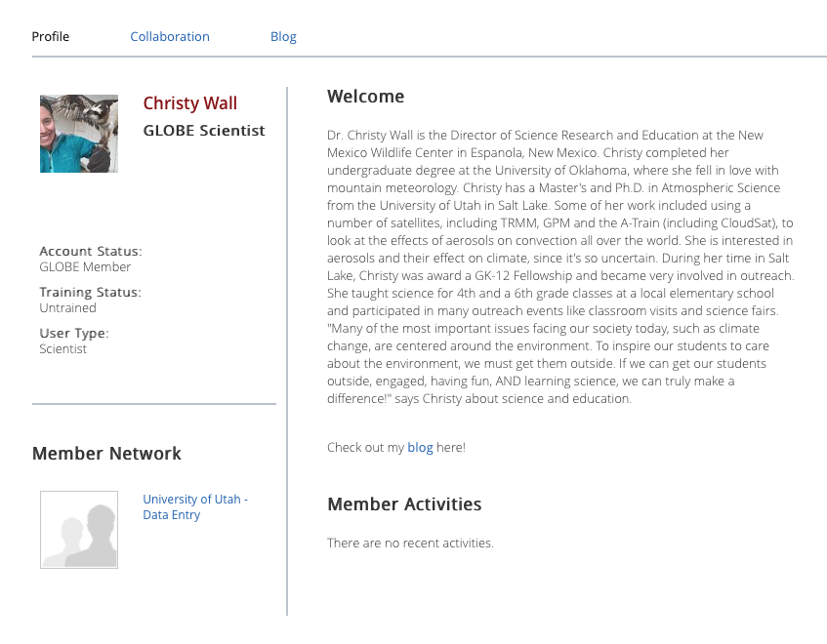
Creating your GISN profile
Now that you have created your GISN video, it’s time to polish up your GISN profile page!
The next few slides will walk you through the process.
http://www.globe.gov/web/christy.wall/home

Slide 7
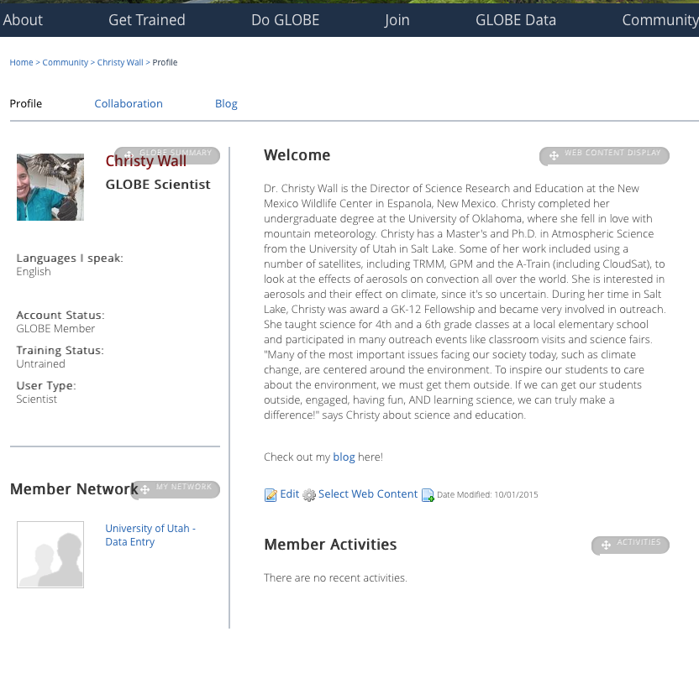
Updating your GLOBE Profile
Log into your GLOBE account
Click “Edit”

Slide 8
Considerations for your GISN profile
Include:
Photo
Current title
Academic background
GLOBE investigation areas and protocols
What are you curious about? (Research questions, things that interest you, etc.)
How can GLOBE students help you do your research?
Something interesting about you (What languages do you speak, extracurricular interests and activities?)
Your connection to GLOBE: Why do you love GLOBE? What types of questions can GLOBE students ask you? What kind of GLOBE collaboration are you looking for?
Sample Profile:
http://www.globe.gov/web/christy.wall/

Slide 9
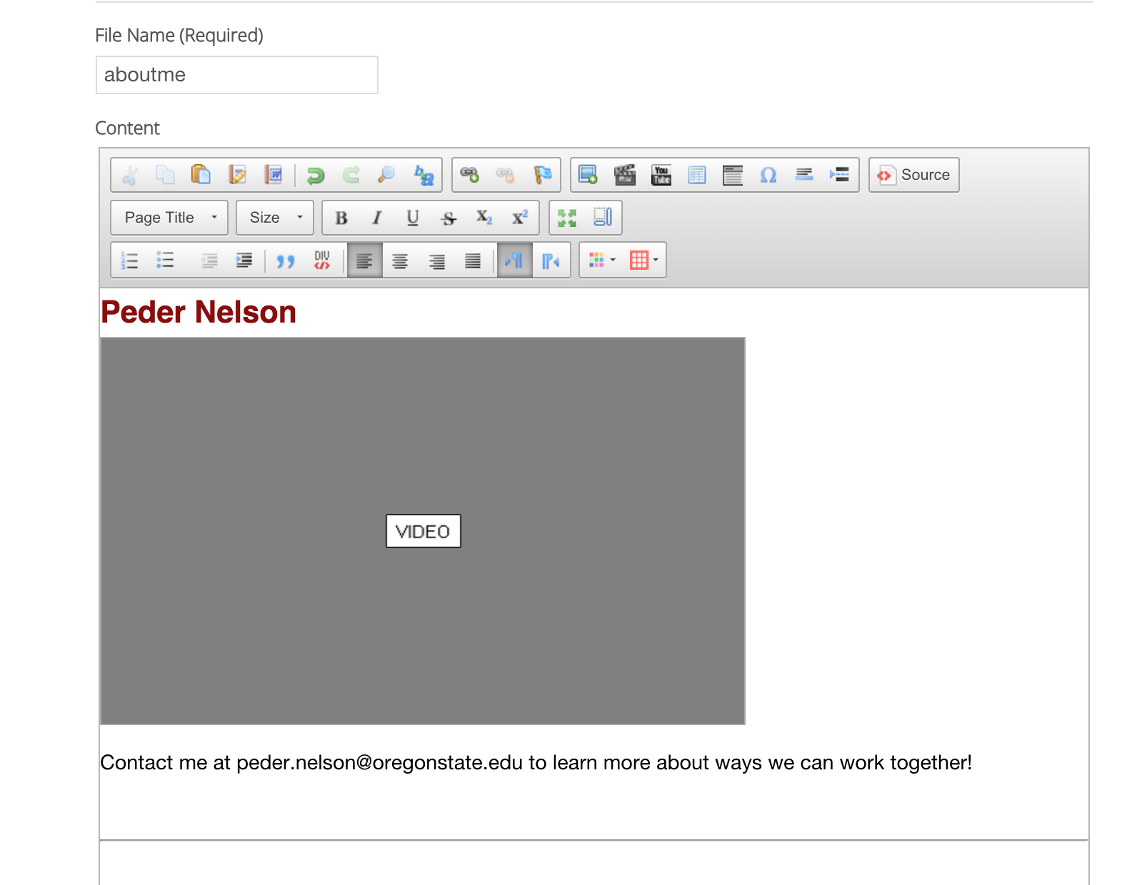
Including a Video
Click the “video” icon

Slide 10
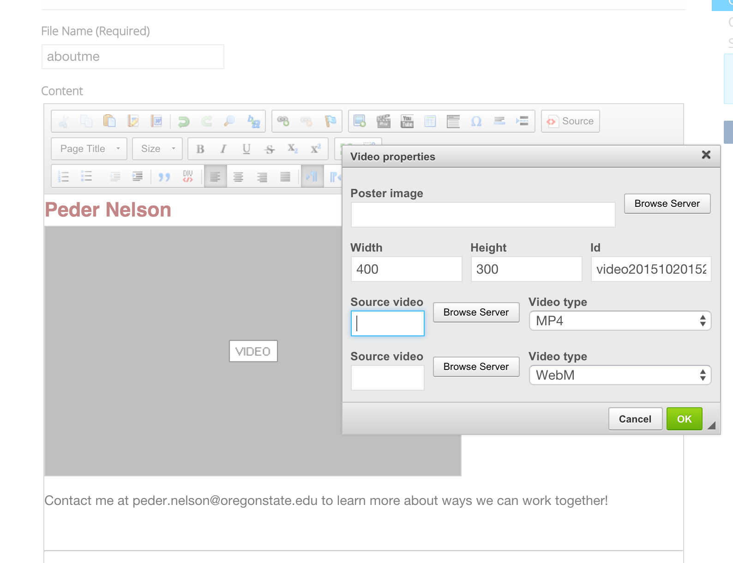
Including a Video
Select “Browse Server” to select a video. Make sure to pick the right video type.

Slide 11
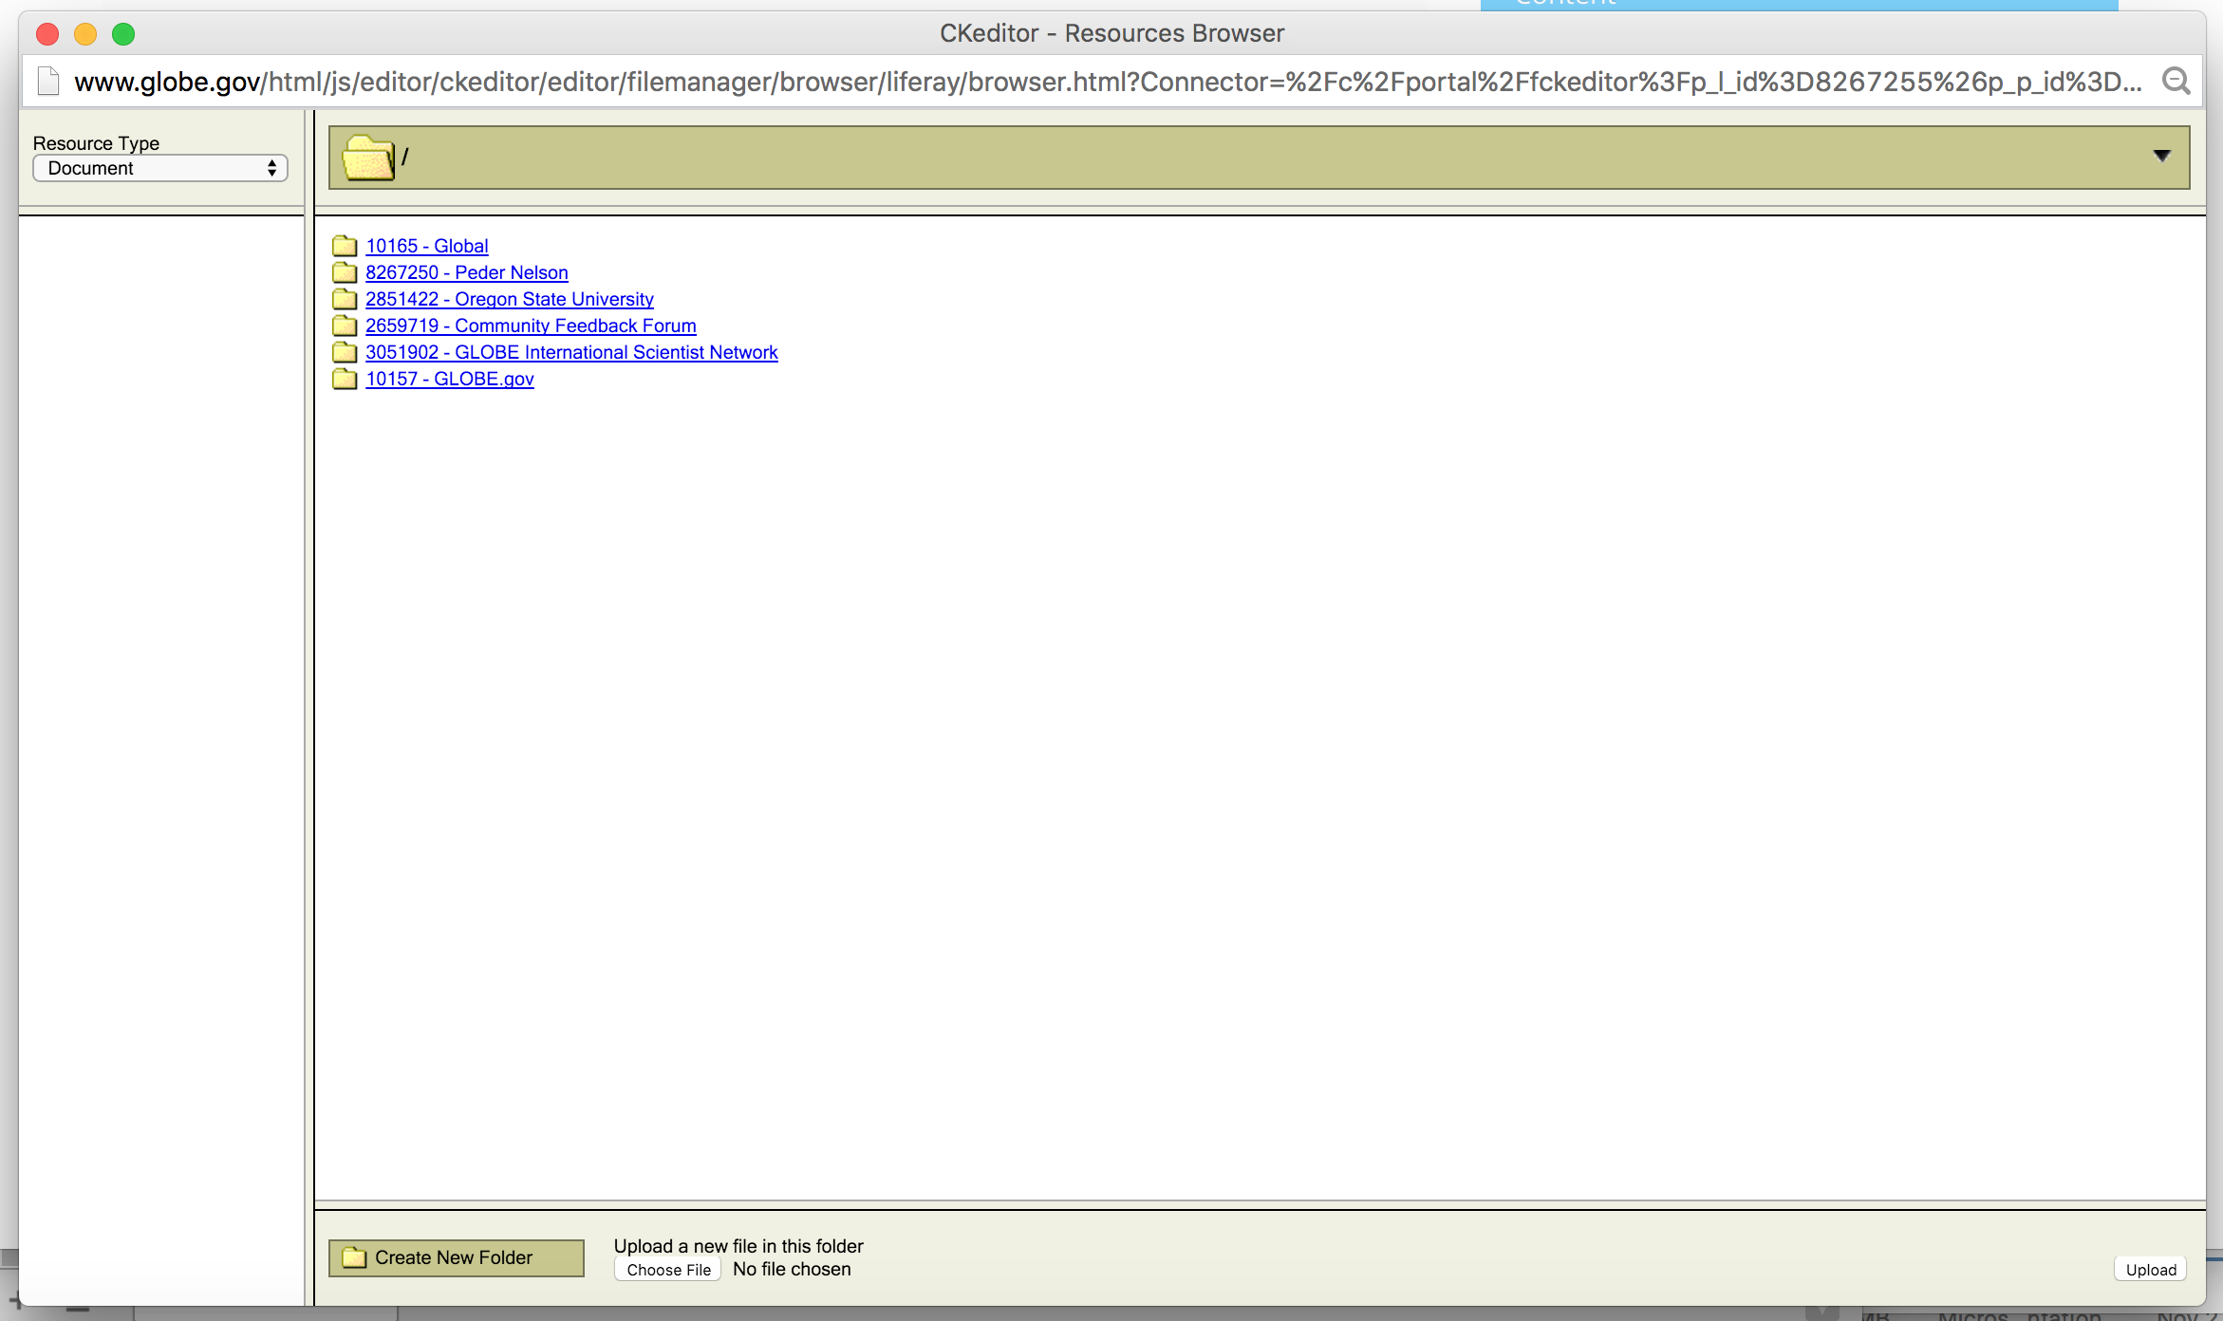
Including a Video
Step 1: Select the folder with your name.
Step 3: Select “Upload”
Step 2: Choose your video from your computer.

Slide 12
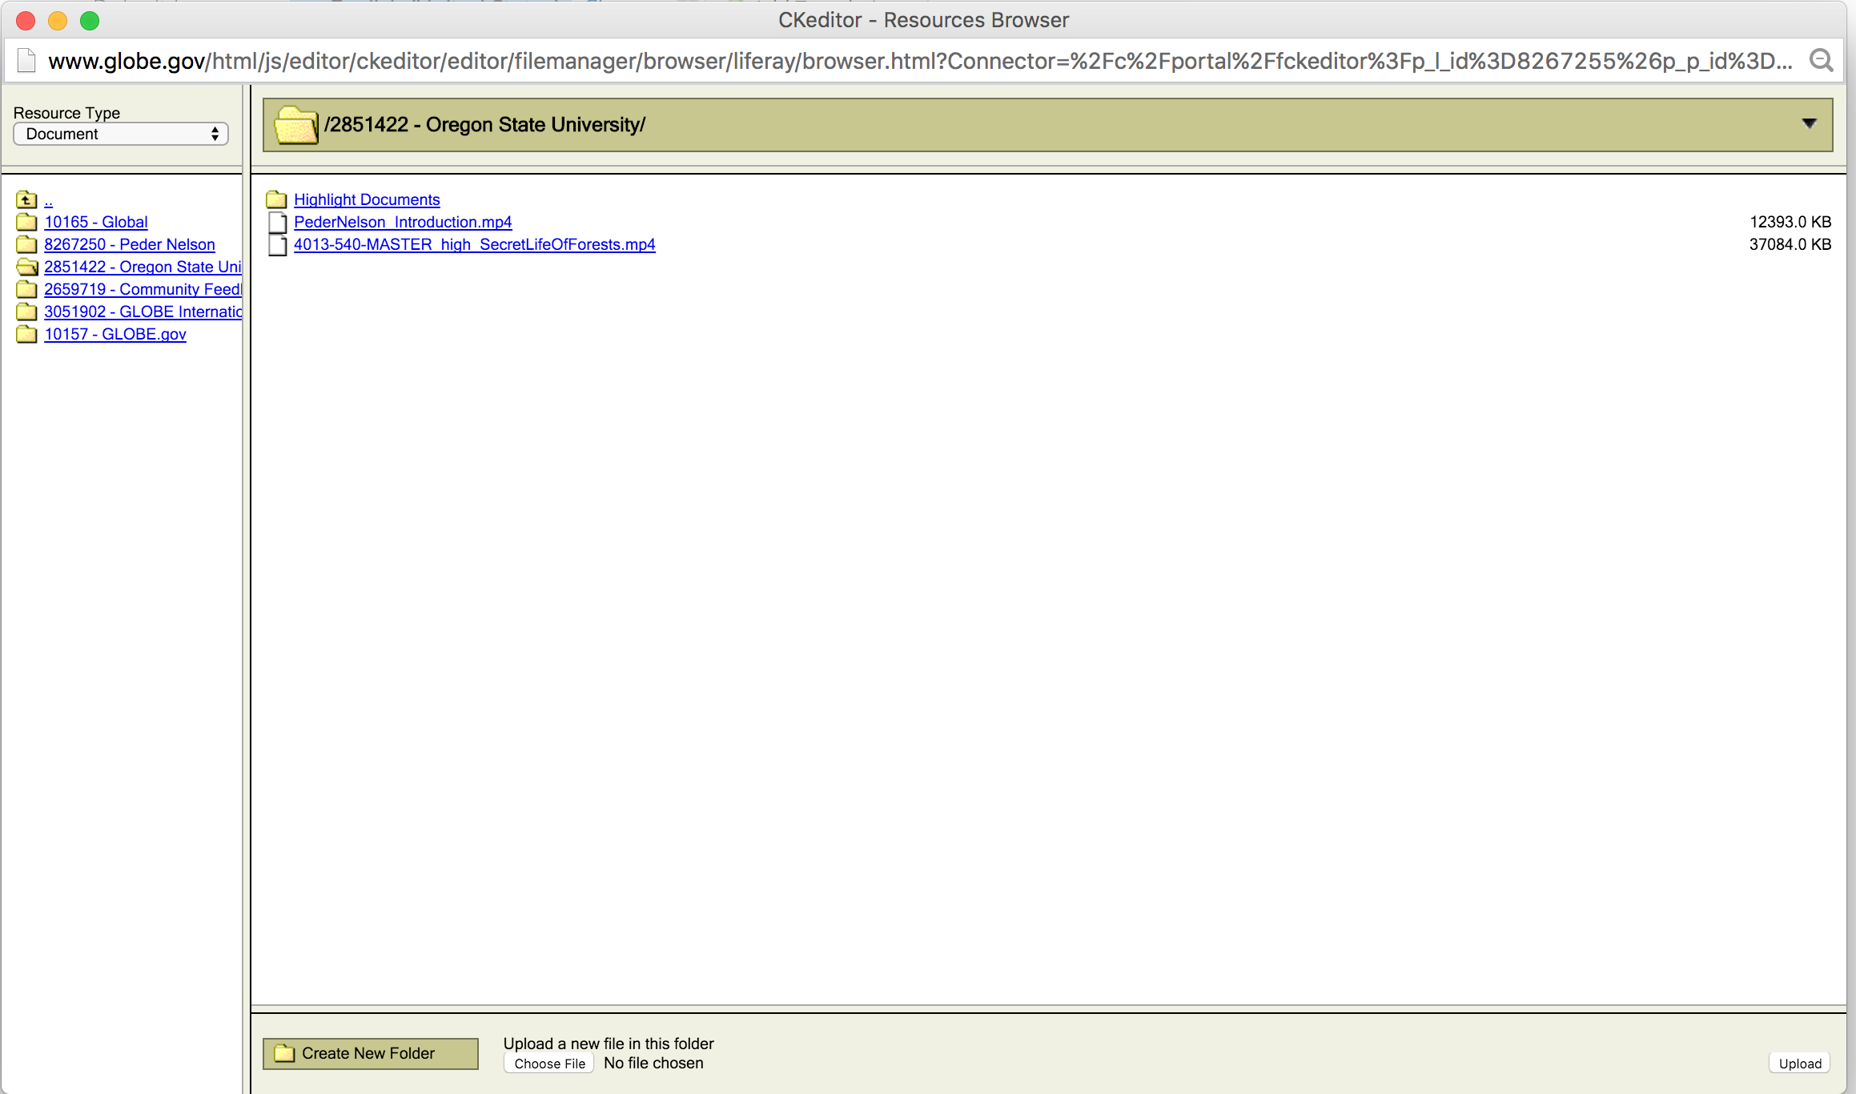
Including a Video
Once your video is uploaded, click on it.

Slide 13
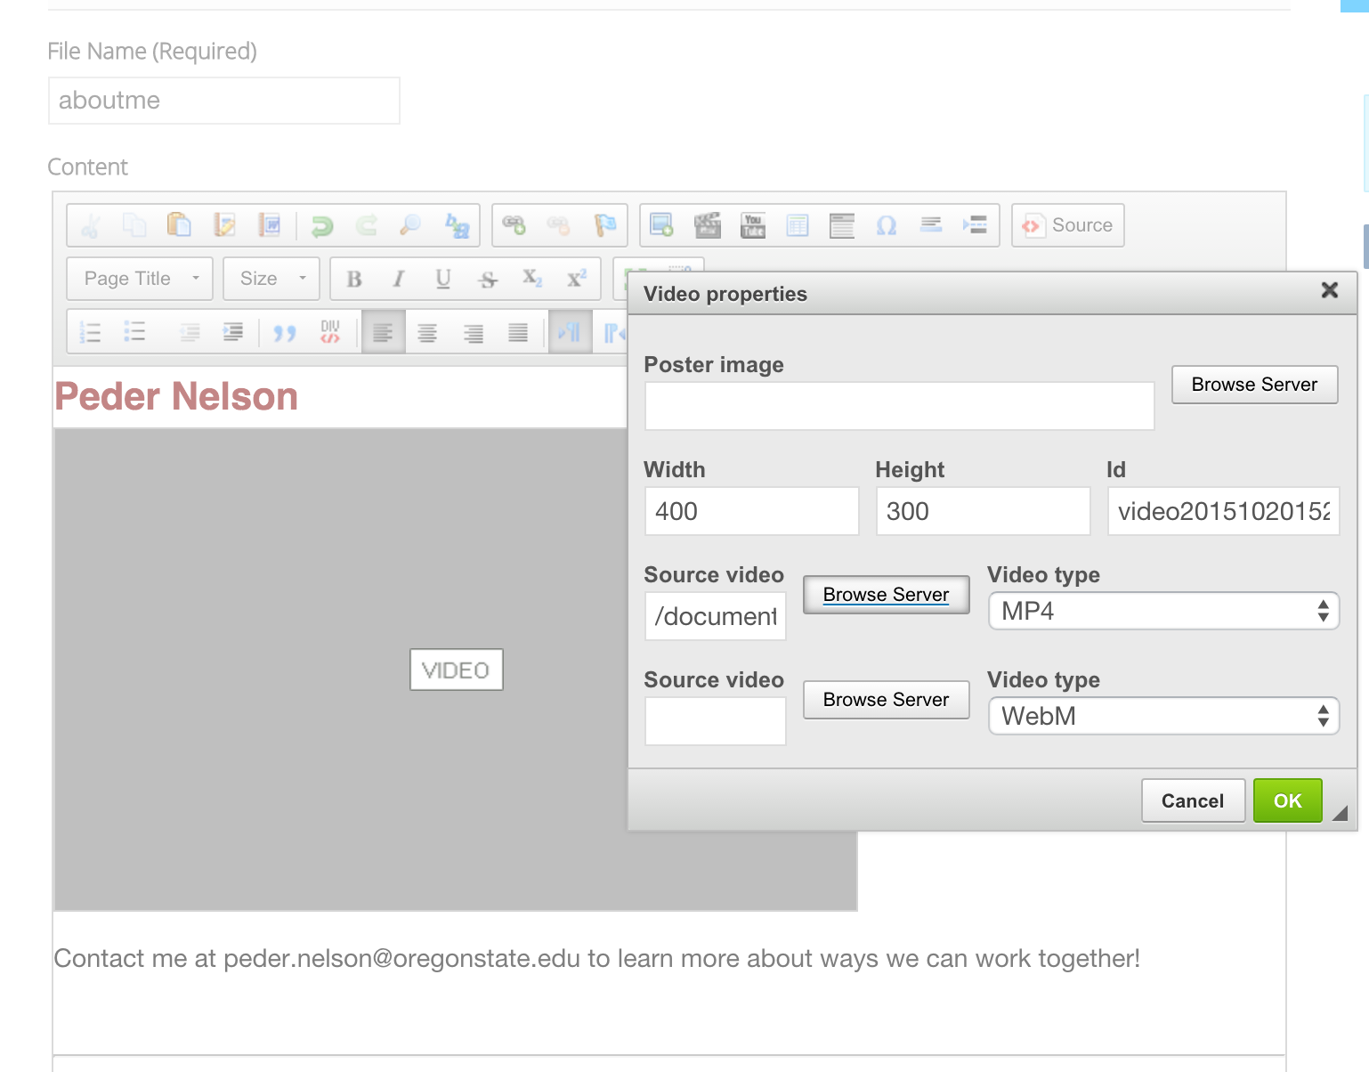
Including a Video
Hit “OK” and the video will appear in your profile as a gray box.

Slide 14
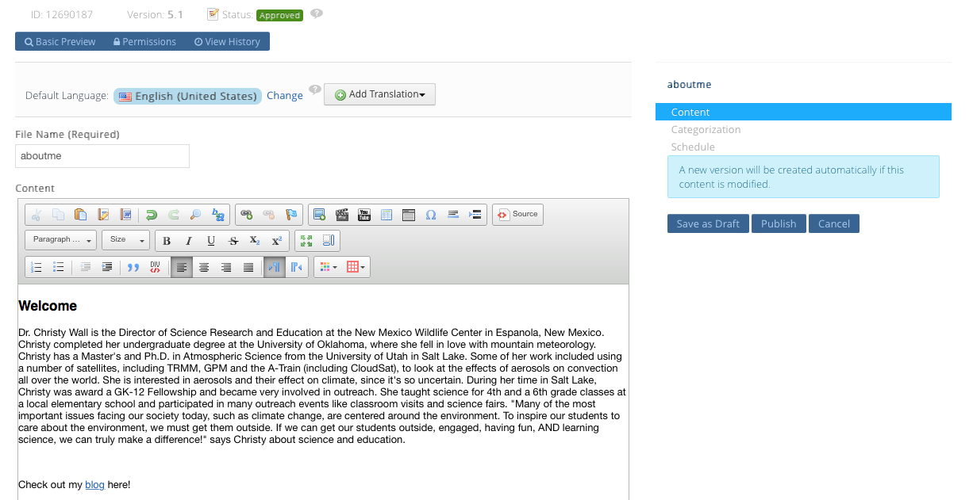
Updating your GLOBE Profile
Type your content, click “Publish”

Slide 15
Important Notes for Videos
Videos can have a max width of 320 pixels. If your video is wider than that, it will cover up other parts of your profile screen. You can change the size by double-clicking on your video in the edit screen and adjusting the width or by setting the width when you upload the video.
Make sure to upload only .mp4 or WebM files. Other file types will not work.
If your video is not playing on Firefox, watch this video to help make your video playable: https://www.youtube.com/watch?v=q263-oFMV58
Need help? Contact help@globe.gov

Slide 16
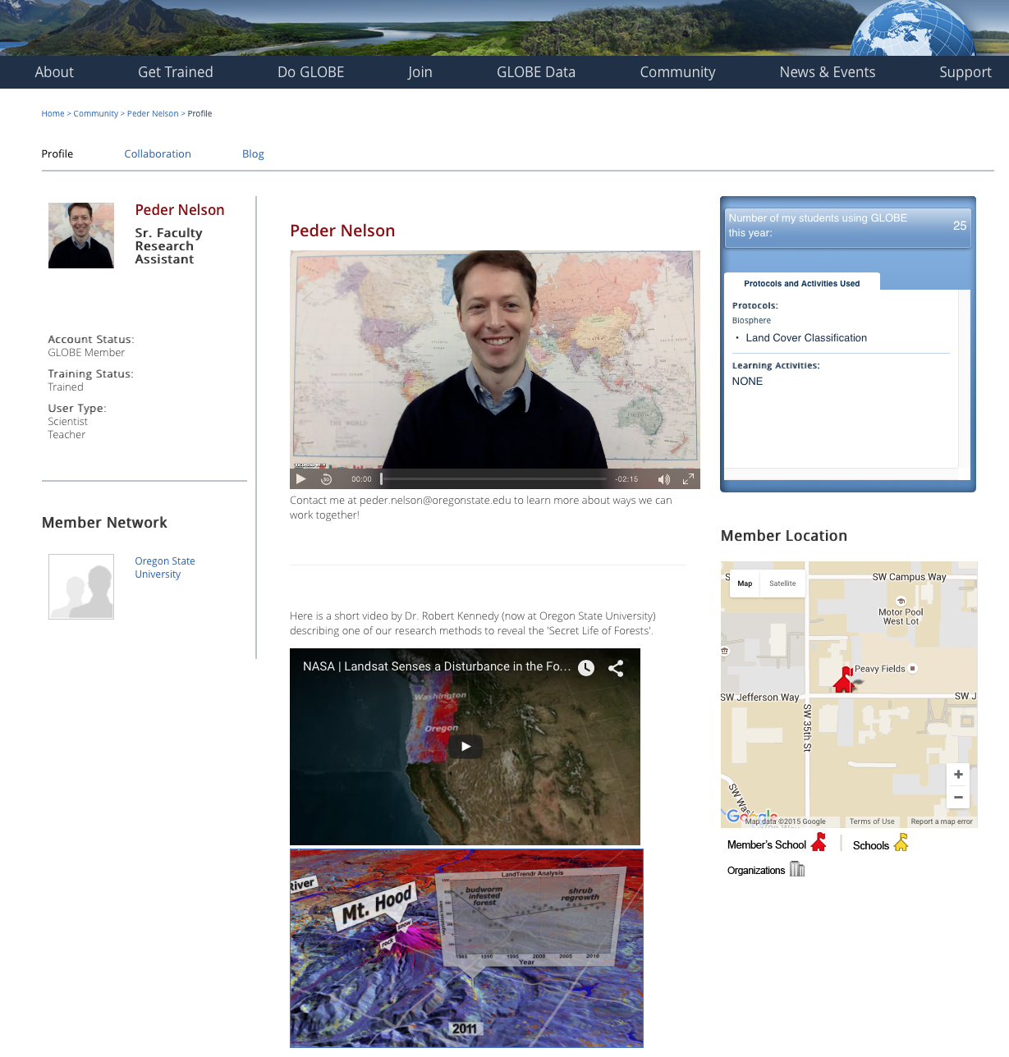
3. Include accompanying resources on your GLOBE profile page:
Other items to include:
  Links to relevant educational resources
  Links to GLOBE protocols
  Link to your profile video on YouTube
  Other videos
  Educational activities

Slide 17
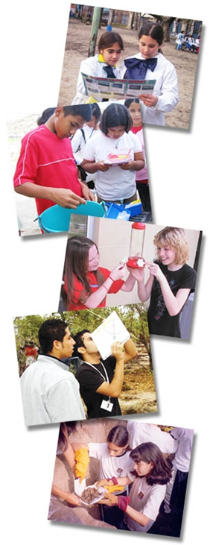
www.globe.gov help@globe.gov

