Slide 1
GLOBE Presentation Template
Use this template to help you create your Symposium Presentation and outline your Project Research Paper
BLUE slides are formatting info, GREEN Slides are task instructions
Adapted by K. Johnson (Boston University GLOBE Mission Earth 2019)
From Globe Professional Development Webinar February 11, 2016
Dr. Elizabeth Burakowski
National Center for Atmospheric Research Boulder, CO

Slide 3
Poster Formatting Tips
Use Sans-serif fonts: ^{e.g.} Arial, Gill Sans, Avenir, Helvetica, Calibri, Canandra, Corbel, Nunito
Title: 80 or larger
Headings: 40-60
Body text: 36 or larger

Slide 4
Instructions:
The remaining slides are in pairs:
One slide with the section heading and instructions on what to include
The next slide with just the section heading for you to add YOUR project content

Slide 5
Title
Less than 15 words
Catchy, not jargony. Think HEADLINE!
Captures your main question or main finding
Example: Common Clouds in Southeast Michigan

Slide 6
Short Title (less than 15 words)
Class Name or Room Number
Teacher’s name (if not above)
School Name
School Logo

Slide 7
Abstract
Less than 200 words
Describes:
The problem or phenomenon that inspired your project
The questions asked
The objectives of your project
Your methods (briefly)
Your results (briefly)
Your Conclusions
Your recommendations, your suggestions for future work/explorations
List of 3-5 KEY WORDS at end that emphasize key ideas in the paper

Slide 8
Abstract
The problem or phenomenon that inspired your project

Slide 9
Abstract
The questions asked

Slide 10
Abstract
The objectives of your project

Slide 11
Abstract
Your methods (briefly)
Your results (briefly)

Slide 12
Abstract
Your Conclusions
Your recommendations/ideas for future explorations

Slide 13
Research Question(s)
Original (something YOU worked to develop)
Must be possible to answer through scientific research
Example: Using high quality climate data, how have snowfall, snow cover, and temperature in Boston, MA changed over the past 40 years?

Slide 14
Research Questions

Slide 15
Introduction & Hypothesis
Introduction:
Describes:
Problem
Importance
Community/Societal Relevance
A couple of sentences about each of these.
Hypothesis:
Measurable
Proposes a possible explanation
Example: We expect that high-quality climate records will demonstrate consistent warming trends in Boston, MA
One or two sentences.

Slide 16
Introduction

Slide 17
Hypothesis

Slide 18
Methods and Data
Describe:
How your data relates to your research question(s)
If relevant, describe your study site(s). If possible include a map and description of site such as climatic characteristics and basic aspects of land cover
Sources of data (for example: websites, direct measurements, databanks like Weatherlink)
Dates of collection
Variables (for example: temperature, snowfall)
Where and how data was collected
Data analysis methods (what math did you use to analyze the data?)

Slide 19
Methods and Data
Map of Study Site(s)

Slide 20
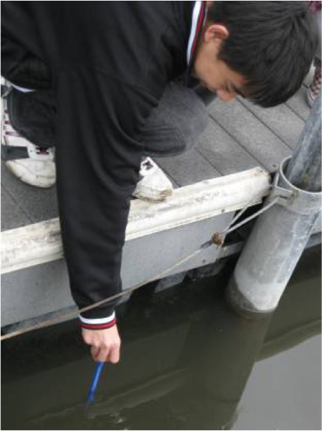
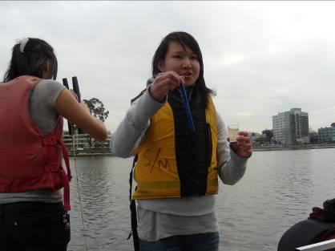
Methods and Data
You can include Field Photos (requires release forms)

Slide 21
Methods and Data

Slide 22
Results
Include:
What answers your results provide for your research question(s)
Graphs/Charts (to guide audience toward your conclusions)
Clearly labeled axes
Easy to interpret
Key (if more than one type of data is represented on the same graph)
Figure Label telling audience what the graph is showing
*Before using tables, ask: would a graph or chart show this better?

Slide 23
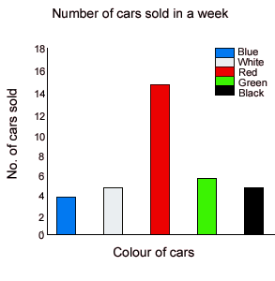
Results
Figure 1: Include a caption that tells the reviewer what is shown in this figure.
Figure 2: Include a caption that tells the reviewer what is shown in this figure.

Slide 24
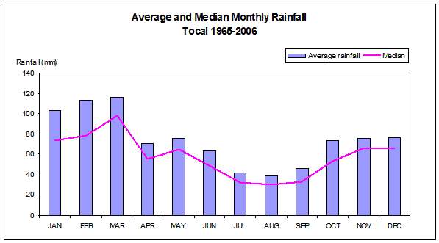
Results Examples
Graphs:
Figure 1: Average amount of rain that fell each month of the year in Tocal, New South Wales. Averages were calculated from monthly data recorded from 1965 and 2006.

Slide 25
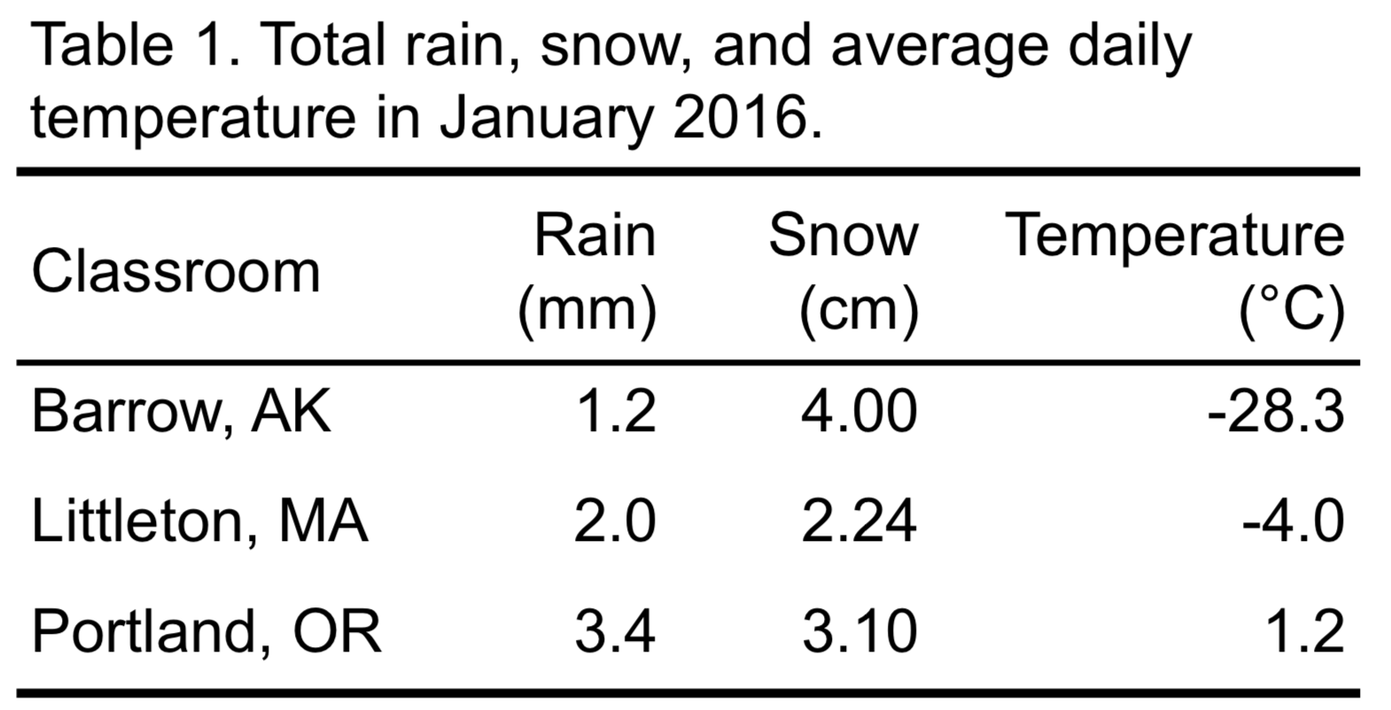
Results Examples
Tables:

Slide 26
Results

Slide 27
Conclusions and Future Work
What are your conclusions?
How are your conclusions supported by your data?
Put findings in context:
explain why they are important or relevant
Describe next steps (for example, conservation efforts, clean up efforts, specific ideas for further research)
Describe the impact of working with a GLOBE project mentor

Slide 28
Conclusions and Future Work

Slide 29
References
List all sources used in research. Websites should include date accessed.
GLOBE sources AND non-GLOBE sources
Cite all images used in the paper or presentation
Provide link to the source (^{e.g.} https://www.globe.gov/)

Slide 30
References

Slide 31
Which GLOBE Badges (For IVSS) do you feel you qualify for?: For full information, click here
Be a Collaborator All team members are listed including students from the same school or schools from around the world... Be a Data Scientist The report includes in-depth analysis of students’ own data as well as other data sources from other databases... Be an Engineer The report uses student-generated sources of evidence to describe an engineering problem... Make an Impact The report clearly describes how a local issue led to the research questions or makes connections between local and global impacts... | Be a STEM Professional The report clearly describes collaboration with a STEM professional that enhanced the research methods, contributed to improved precision, and supported more sophisticated analyses and interpretations of results. Be a STEM Storyteller The report describes or shows how the students shared the story of their research in a creative way...

Slide 32
Badges

